Slide 2
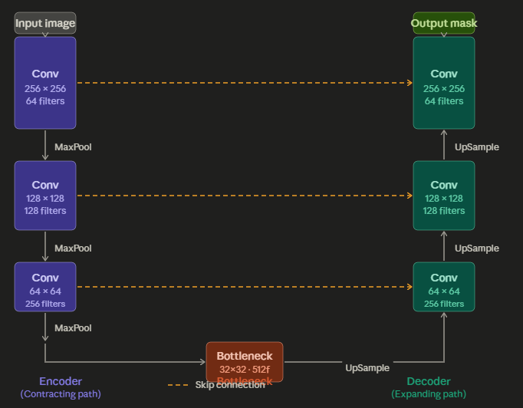
The left side compresses the image (like zooming out to see the big picture), and
the right side expands it back (zooming in to make precise decisions).
The magic is the skip connections — shortcuts that pass detail from the left side directly to the right side.

Slide 3
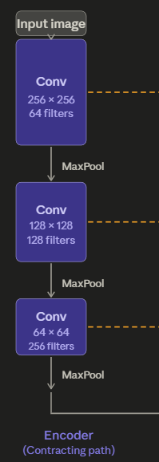
The encoder (left) — "What is this?“
The encoder is like squinting at the image. At each step it applies convolutions (small filters that detect edges, textures, patterns) and then a MaxPool operation that halves the image size.
So, a 256×256 image becomes 128×128, then 64×64, and so on.
As the image shrinks, the number of filters grows — it's trading spatial detail for richer, abstract understanding.
By the bottom it knows what objects are present, but has lost track of exactly where each pixel belongs.

Slide 4
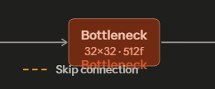
The bottleneck (bottom) — the "thinking" layer
This is the most compressed representation of the image.
The network has the most contextual understanding here, but the resolution is smallest.

Slide 5
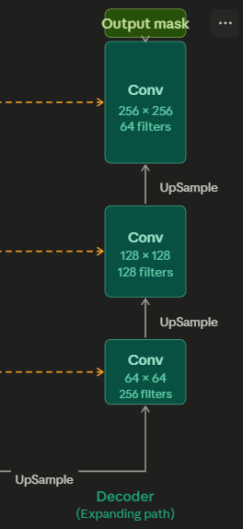
The decoder (right) — "Where exactly?“
The decoder does the reverse.
It upsamples (zooms back in) step by step, recovering the original resolution.
At each step it refines its pixel-level predictions.
But zooming back in is lossy — detail was lost on the way down.

Slide 6
Skip connections (orange dashed lines) — the clever part
This is what makes U-Net special.
At each level, the encoder sends a copy of its feature map directly to the matching decoder level. This means the decoder gets both: the high-level context from the bottleneck and the fine-grained detail from the same resolution in the encoder. Without skip connections, the decoder would have to guess where boundaries are.
With them, it already knows.

Slide 7
The output
After decoding, a final 1×1 convolution maps each pixel to a class label — for example: 0 = background, 1 = cell. The result is a segmentation mask the same size as the input image.
Why is U-Net so popular?
It works remarkably well with small datasets (sometimes just 30–50 images). This is crucial in medical imaging where labeled data is scarce and expensive.

Slide 8
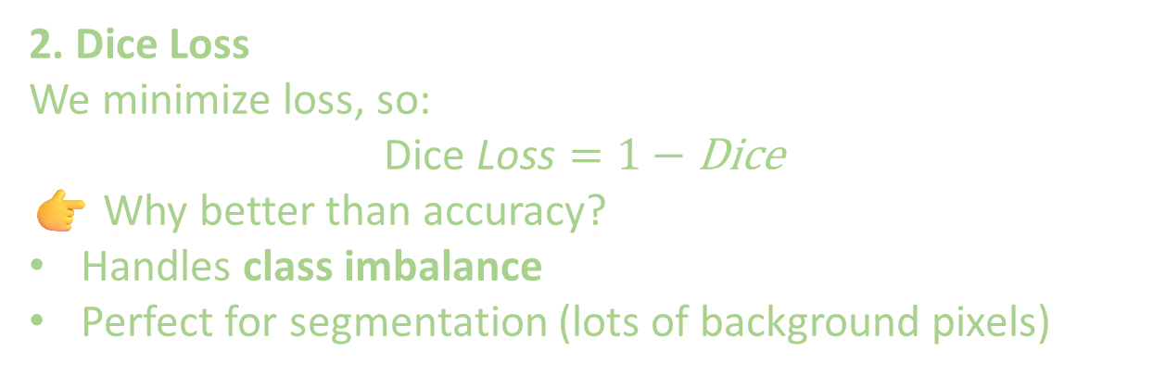
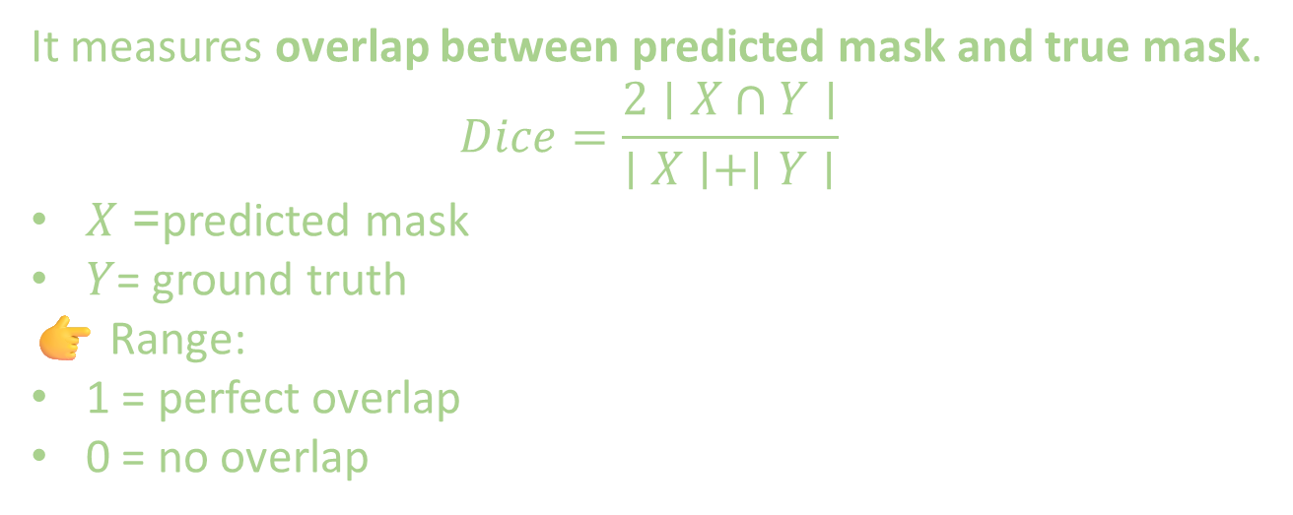
U-NET uses dice coefficient as a measure of loss funciton
1. What is Dice Coefficient
It measures overlap between predicted mask and true mask.
$$Dice=\frac{2∣X∩Y∣}{∣X∣+∣Y∣}$$
$X$= predicted mask
$Y$= ground truth
👉 Range:
1 = perfect overlap
0 = no overlap
2. Dice Loss
We minimize loss, so:
$$\text{Dice} \text{Loss}=1−\text{Dice}$$
👉 Why better than accuracy?
Handles class imbalance
Perfect for segmentation (lots of background pixels)

Slide 9
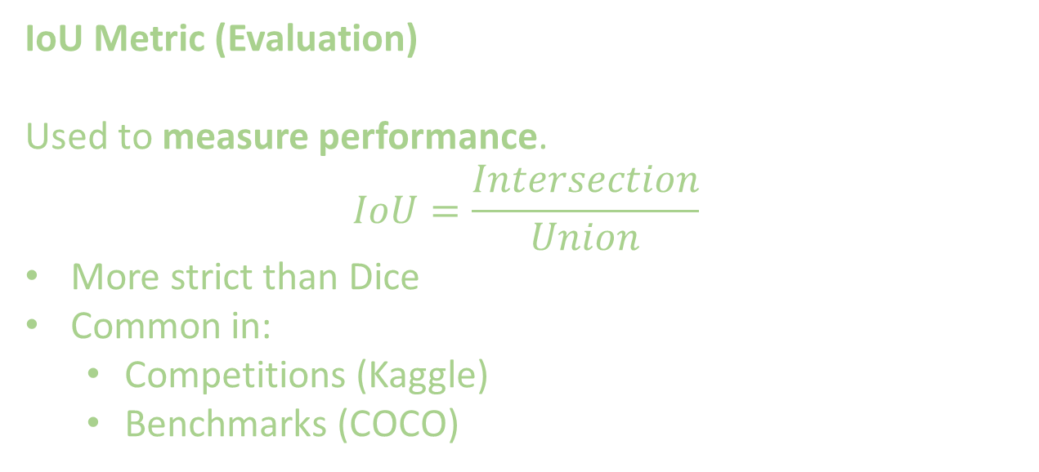
IoU Metric (Evaluation)
Used to measure performance.
$$IoU=\frac{Intersection}{Union}$$
More strict than Dice
Common in:
Competitions (Kaggle)
Benchmarks (COCO)

Slide 10
Dice Loss is used for training because it’s differentiable and handles imbalance well
IoU is used for evaluation because it is stricter and better reflects segmentation quality.

