Slide 1
Variance And Standard Deviation
Problem: Can you tell which of the following data has more spread ?
1, 1, 0, 0, 5, 9, 9, 10, 10, 5
4, 3, 5, 6, 7, 3, 5, 6, 4, 5
5, 5, 5, 5, 5, 5, 5, 5, 5, 5

Slide 2
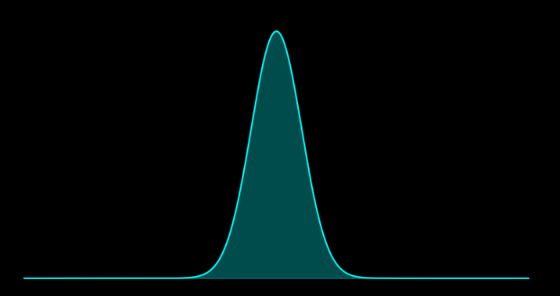
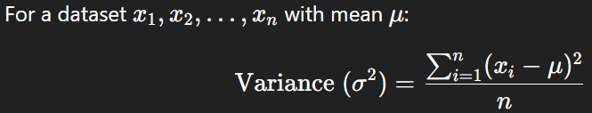
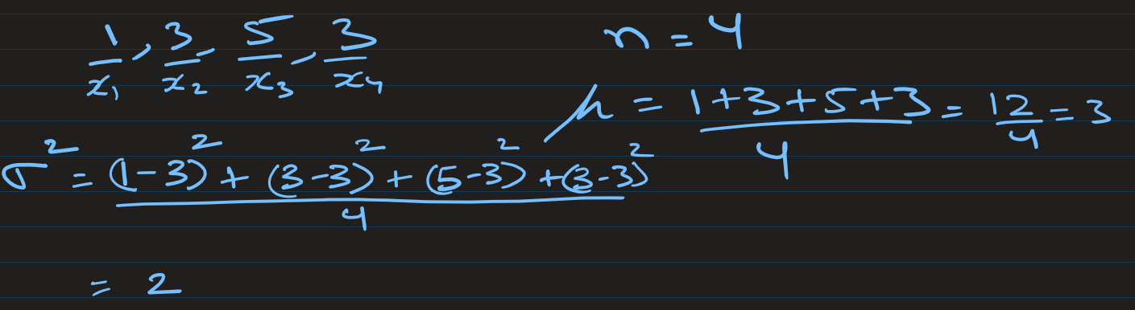
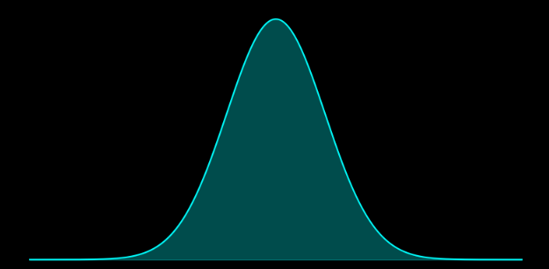
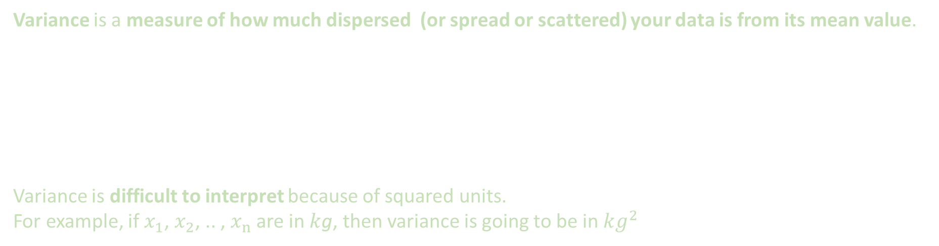
Variance and Standard deviation of population
Variance is a measure of how much dispersed (or spread or scattered) your data is from its mean value.
Variance is difficult to interpret because of squared units.
For example, if $x_{1}$, $x_{2}$, .. , $x_{n}$ are in $k$g, then variance is going to be in $kg^{2}$
Low variance
High variance

Slide 3
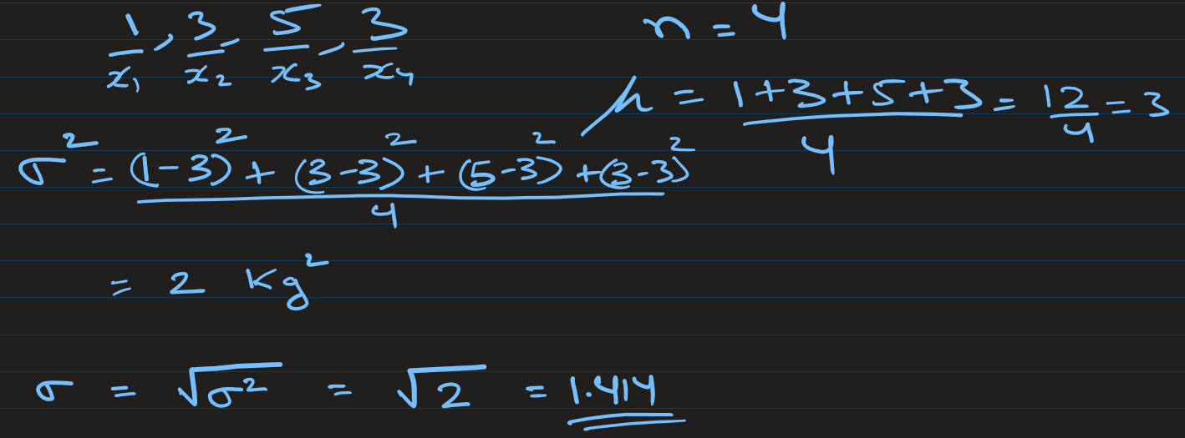
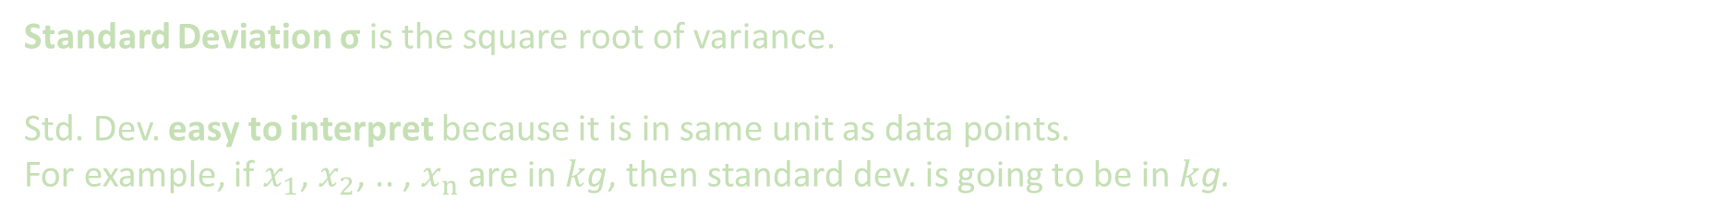
Variance and Standard deviation of population
Standard Deviation σ is the square root of variance.
Std. Dev. easy to interpret because it is in same unit as data points.
For example, if $x_{1}$, $x_{2}$, .. , $x_{n}$ are in $k$g, then standard dev. is going to be in $k$g.
Low standard deviation
High standard deviation

Slide 4
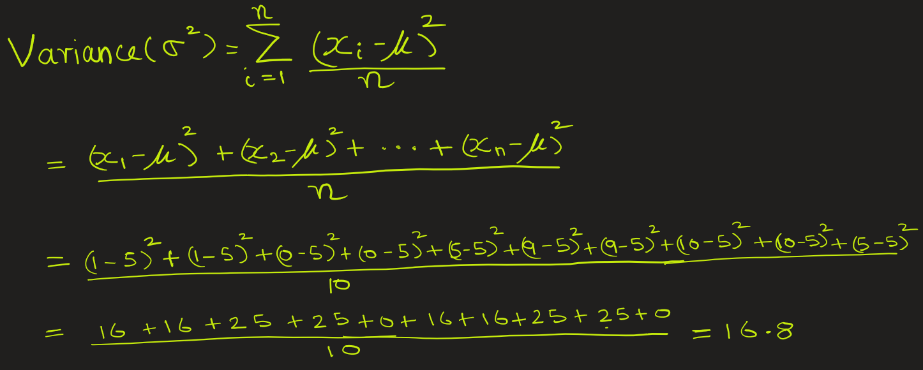
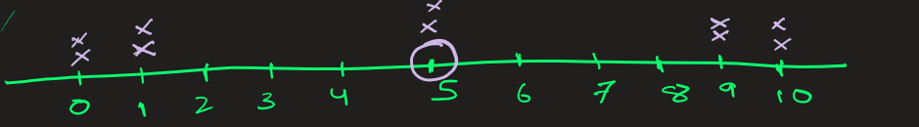

Example1: Large spread around mean
Suppose monthly income of population in a city is 1, 1, 0, 0, 5, 9, 9, 10, 10, 5.
Calculate the variance and standard deviation for this population.
Ans: Here size n = 10, and mean = (1 + 1 + 0 + 0 + 5 + 9 + 9 + 10 + 10 + 5)/ 10 = 5 .
Standard deviation σ = $\sqrt{16.8}$ = 4.1
There is some dispersion / spread in data

Slide 5
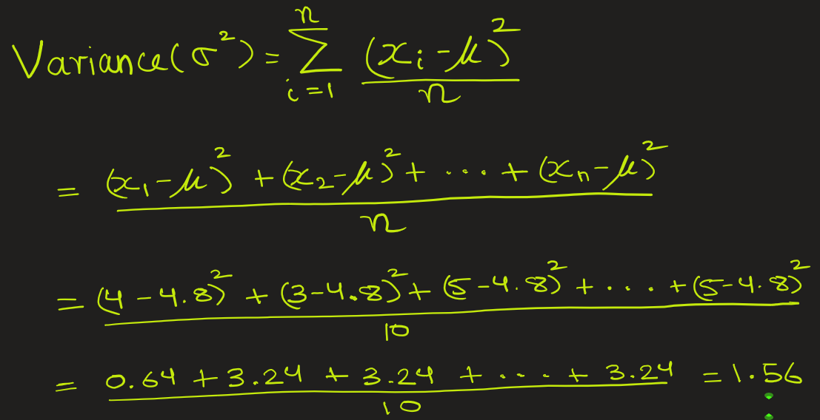
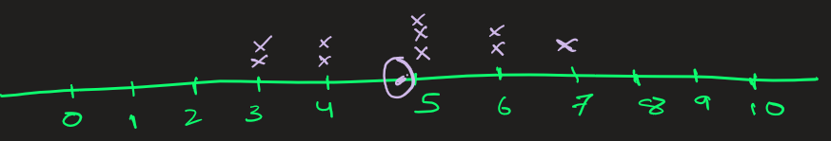

Example2: Few spread around mean
Consider the package weights (in kilograms) produced on a production line: 4, 3, 5, 6, 7, 3, 5, 6, 4, 5. Calculate the variance and standard deviation for this population.
Ans: Here size n = 10, and mean = (4 + 3 + 5 + 6 + 7 + 3 + 5 + 6 + 4 + 5)/ 10 = 4.8
Standard deviation σ = $\sqrt{1.56}$ = 1.3 Kg
Here data is less dispersed.
Variance in data went down

Slide 6
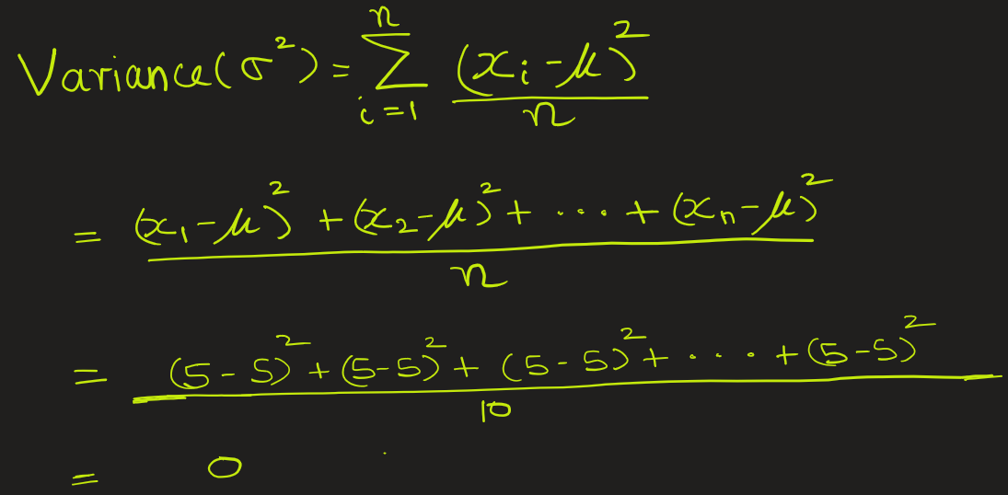
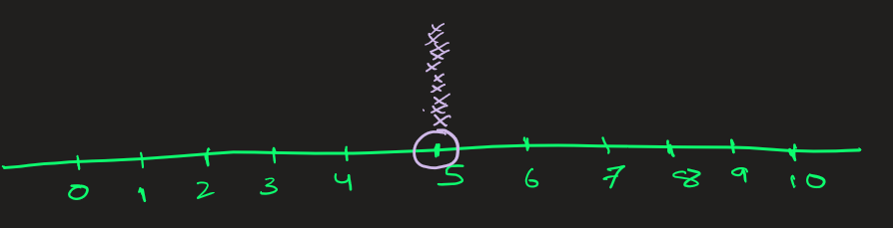

Example3: Time intervals (in seconds) between each operation in an assembly line (high precision)
Consider the time intervals (in seconds) between operations on an assembly line for all 10 machines: 5, 5, 5, 5, 5, 5, 5, 5, 5, 5. Calculate the variance and standard deviation for this population.
Ans: Here size n = 10, and mean = (5 + 5 + 5 + … + 5)/ 10 = 5
Standard deviation σ = $\sqrt{0}$ = 0 seconds
The data has no dispersion.
Zero variance in data.

Slide 7
Conclusion:
If data points are far from the mean -> Variance is large. Data is more dispersed or more spread
If all data points are close to the mean -> Variance is small. Data is less dispersed or less spread
Case A: 1, 1, 0, 0, 5, 9, 9, 10, 10, 5
variance = 16.8
Case B: 4, 3, 5, 6, 7, 3, 5, 6, 4, 5
variance = 1.56
Case C: 5, 5, 5, 5, 5, 5, 5, 5, 5, 5
variance = 0

Slide 8
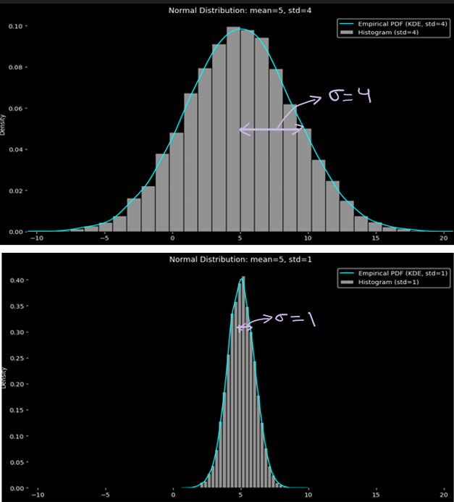
How standard deviation controls dispersion/spread of distribution curve:
1) Following is 100 samples taken from population with 1050 data points with high std dev. (This could be temperature.)
6.987, 4.447, 7.591, 11.092, 4.063, 4.063, 11.317, 8.070, 3.122, 7.170, 3.146, 3.137, 5.968, -2.653, -1.900, 2.751, 0.949, 6.257, 1.368, -0.649, 10.863, 4.097, 5.270, -0.699, 2.822, 5.444, 0.396, 6.503, 2.597, 3.833, 2.593, 12.409, 4.946, 0.769, 8.290, 0.117, 5.835, -2.839, -0.313, 5.787, 7.954, 5.685, 4.537, 3.796, -0.914, 2.121, 3.157, 9.228, 6.374, -2.052, 6.296, 3.460, 2.292, 7.447, 9.124, 8.725, 1.643, 3.763, 6.325, 8.902, 3.083, 4.257, 0.575, 0.215, 8.250, 10.425, 4.712, 9.014, 6.447, 2.420, 6.446, 11.152, 4.857, 11.259, -5.479, 8.288, 5.348, 3.804, 5.367, -2.950, 4.121, 6.428, 10.912, 2.927, 1.766, 2.993, 8.662, 6.315, 2.881, 7.053, 5.388, 8.875, 2.192, 3.689, 3.432, -0.854, 6.184, 6.044, 5.020, 4.062
Sample mean: 5, Sample std dev: 4

Slide 9
How standard deviation controls dispersion/spread of distribution curve:
2) Following is 100 samples taken from population with 1050 data points with low std dev
4.322, 4.695, 4.403, 5.110, 6.197, 4.229, 6.001, 4.218, 4.152, 5.819, 5.922, 5.851, 3.684, 4.534, 5.823, 5.042, 3.926, 5.458, 4.285, 6.795, 6.545, 5.604, 6.361, 5.065, 5.765, 6.478, 5.245, 4.745, 3.295, 4.917, 5.823, 5.946, 5.504, 4.459, 3.023, 4.505, 4.696, 4.687, 5.619, 6.986, 5.124, 4.783, 4.741, 5.124, 4.172, 5.120, 5.451, 5.210, 5.458, 5.434, 3.228, 5.637, 4.329, 3.904, 3.896, 5.434, 4.777, 3.318, 5.478, 3.560, 5.140, 5.238, 5.886, 6.782, 3.635, 4.948, 4.724, 5.434, 5.216, 4.647, 4.559, 3.884, 5.988, 5.459, 5.918, 4.690, 4.343, 3.922, 5.359, 3.960, 6.849, 3.692, 5.274, 6.567, 5.599, 5.176, 4.032, 3.618, 5.770, 6.506, 4.561, 3.861, 2.542, 4.019, 4.886, 6.599, 5.673, 5.305, 4.600, 4.417
Sample mean: 5, Sample std dev: 1

Slide 10
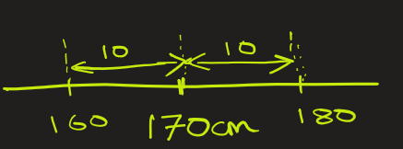
Why the 2 measure: variance and std. dev.?
Variance is the average squared deviation from the mean. So, if your data is in, say, cm, then variance is in square cm (cm²). Squared units aren’t directly interpretable: nobody says “the spread of your height is 100 cm²”.
By taking the square root as in standard deviation, you bring the units back to the original scale: cm -> cm
If the mean height is 170 cm and variance is 100 cm², then standard deviation would 10 cm: that is , you can say “Most data is within 10 cm above or below the mean.”

Slide 11
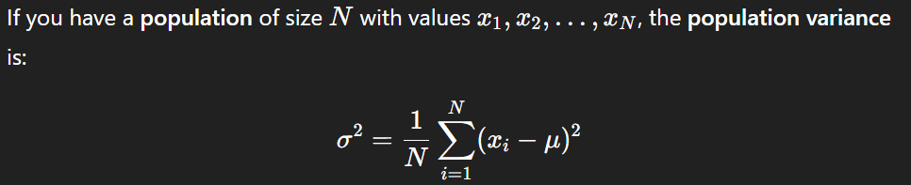
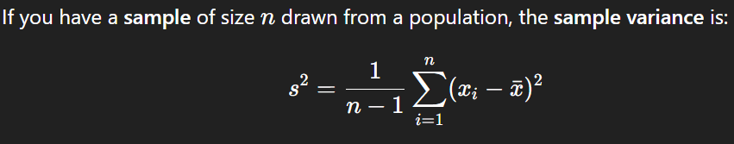
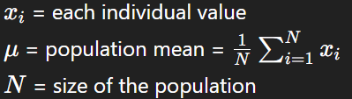
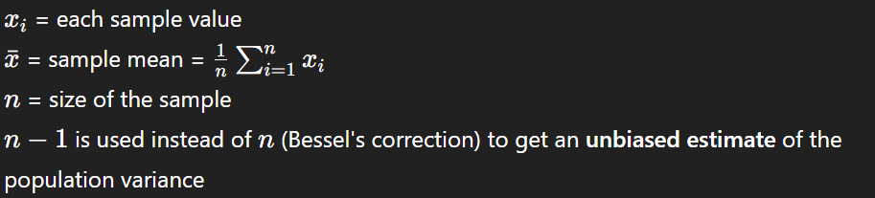
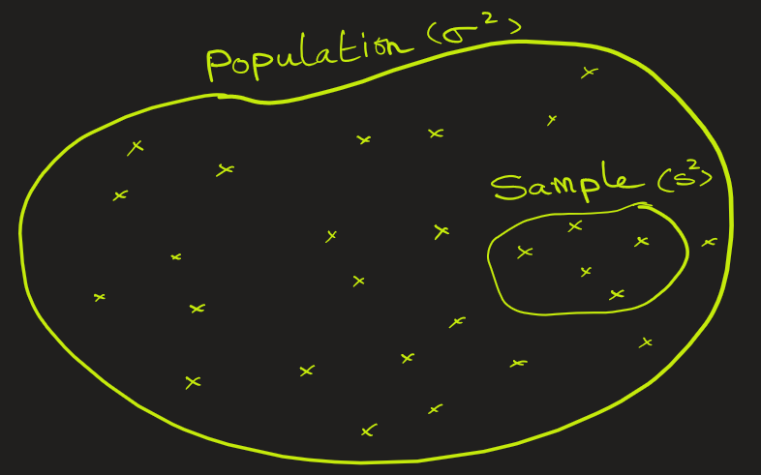
Population variance versus Sample variance
For population variance, divide by n
For sample variance, divide by n-1
For large n, the result is almost same

Slide 12
How to decide which variance to use: population or sample?
If you are analyzing all the data from the group you're interested in, then use population.
If you are analyzing a subset (a sample) of the full group and trying to generalize, then use sample.
Situation | Population or Sample? | Formula to Use
You recorded heights of all 100 students in a school | Population | Divide by n
You took a random sample of 10 students to estimate the average height in the school | Sample | Divide by n - 1
You analyzed every product made in a factory on one day | Population | Divide by n
You tested 20 random products to estimate quality | Sample | Divide by n - 1

Slide 13
EXTRA

