Slide 1
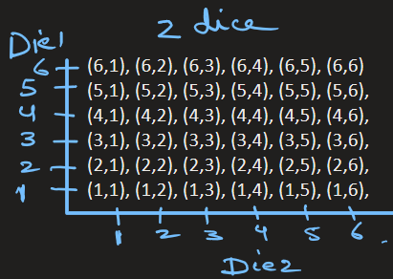
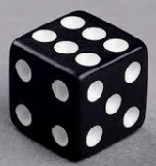
Addition Rule
Problem: Suppose we roll a pair of dice.
What is the probability that either first number is even or second number is odd?

Slide 2
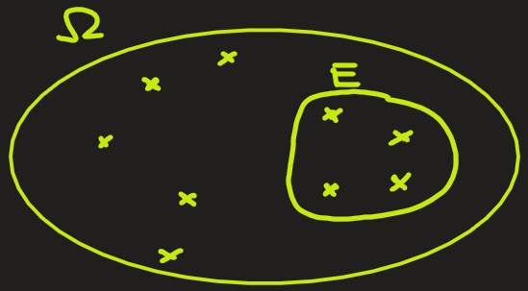
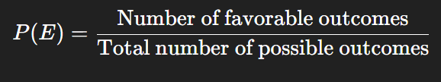


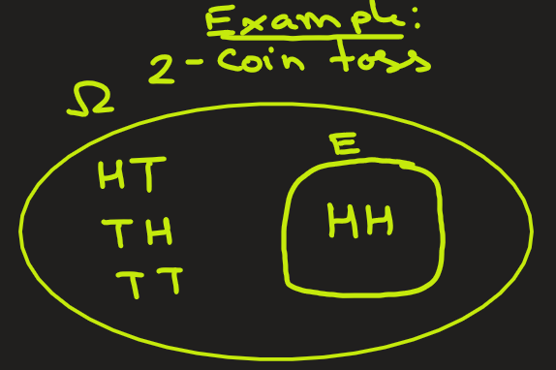

Probability: Definition (Review)
Probability of an event E:
Or,
Here,
$∣E∣$ = number (size) of elements in event $E$,
$∣Ω∣$= total number (size) of elements in sample space
Example: In 2-coin toss, what is the probability of getting both heads?
Ans: Here sample space is Ω = {HH, HT, TH, TT}. Size is |Ω| = 4
The event E is both toss are heads: E = {HH}. Size is |E| = 1
P(E) = 1/4.
coin1
coin2

Slide 3
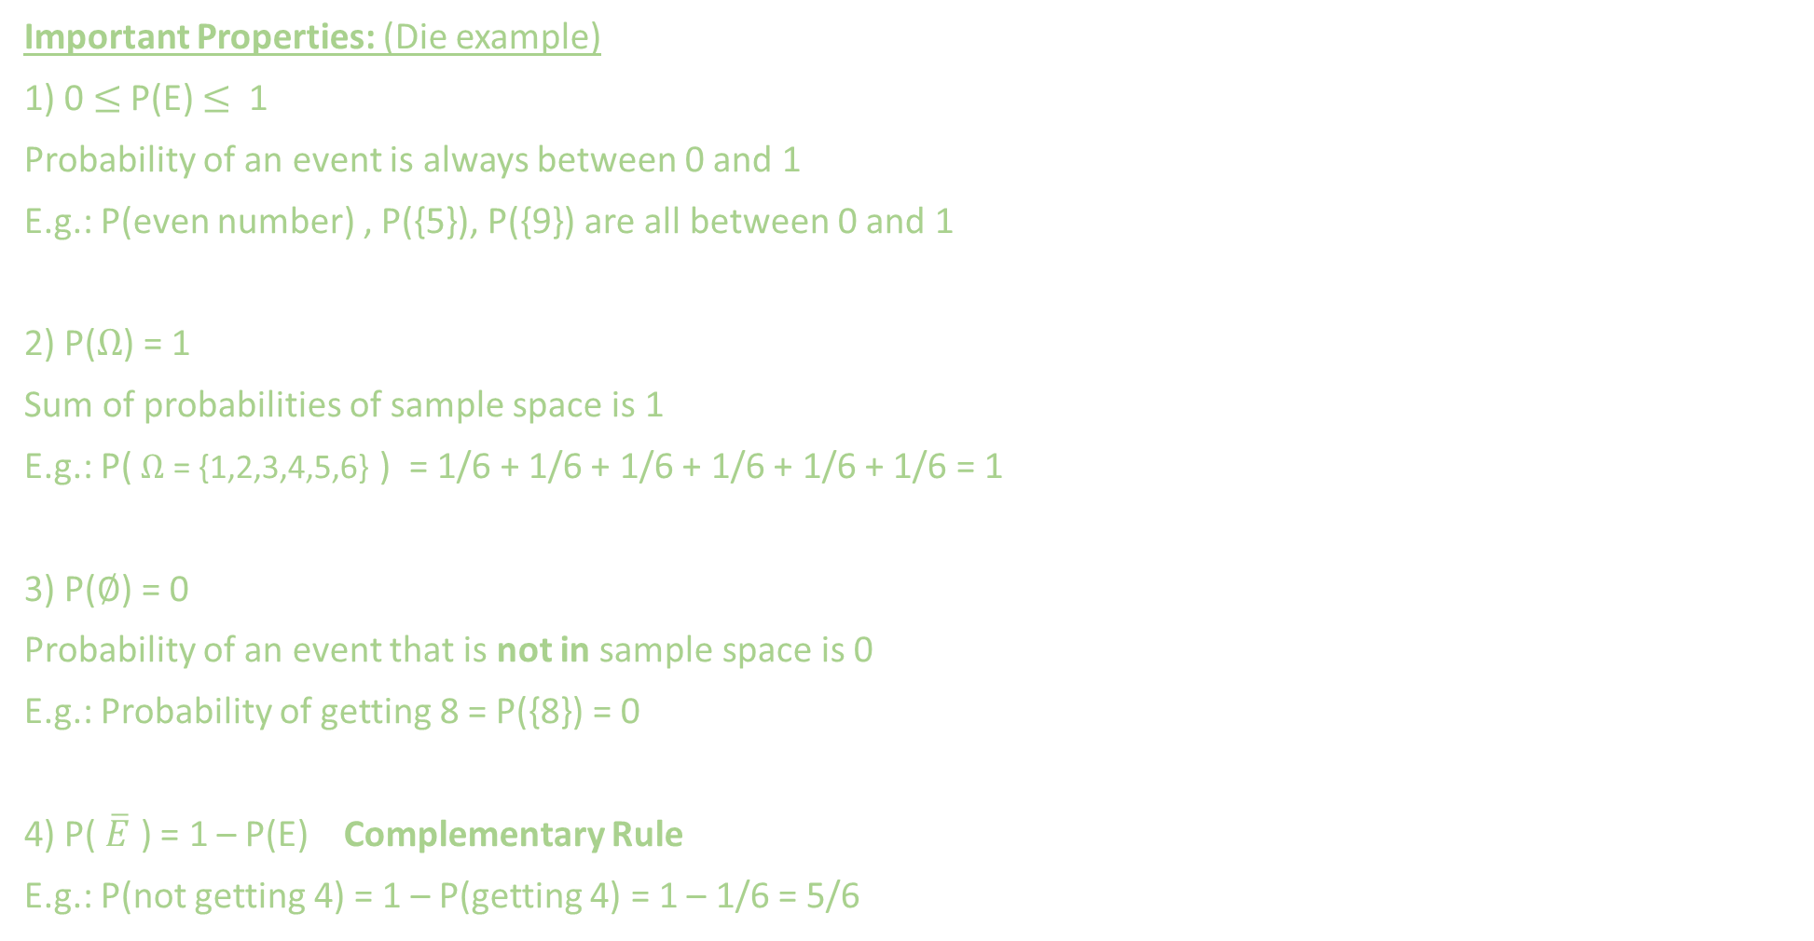
Probability
Important Properties: (Die example)
1) 0 $≤$ P(E) $≤$ 1
Probability of an event is always between 0 and 1
E.g.: P(even number) , P({5}), P({9}) are all between 0 and 1
2) P($Ω$) = 1
Sum of probabilities of sample space is 1
E.g.: P( $Ω$ = {1,2,3,4,5,6} ) = 1/6 + 1/6 + 1/6 + 1/6 + 1/6 + 1/6 = 1
3) P($∅$) = 0
Probability of an event that is not in sample space is 0
E.g.: Probability of getting 8 = P({8}) = 0
4) P( $\overline{E}$ ) = 1 – P(E) Complementary Rule
E.g.: P(not getting 4) = 1 – P(getting 4) = 1 – 1/6 = 5/6

Slide 4
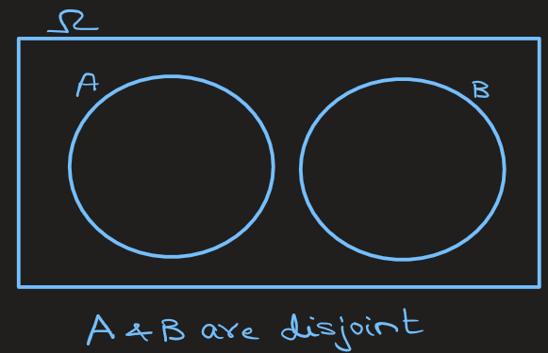
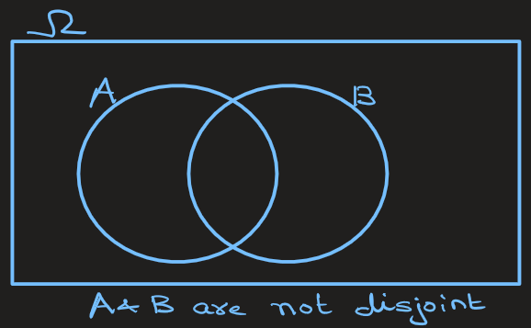
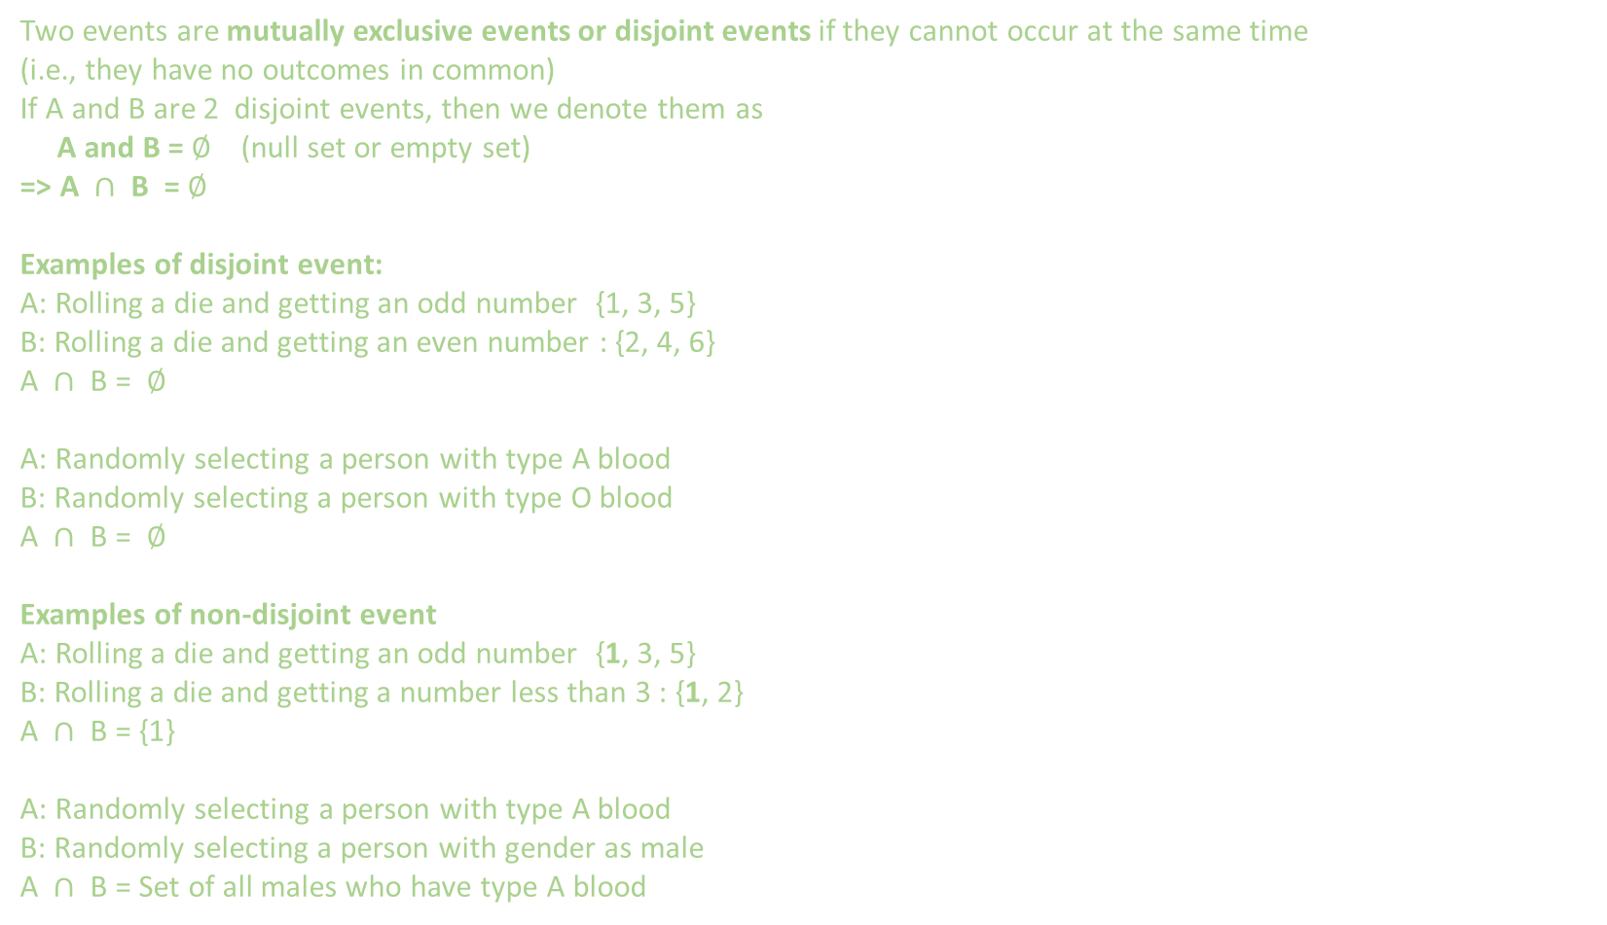
Addition Rule: Disjoint Events
Two events are mutually exclusive events or disjoint events if they cannot occur at the same time
(i.e., they have no outcomes in common)
If A and B are 2 disjoint events, then we denote them as
A and B = $∅$ (null set or empty set)
=> A $∩$ B = $∅$
Examples of disjoint event:
A: Rolling a die and getting an odd number {1, 3, 5}
B: Rolling a die and getting an even number : {2, 4, 6}
A $∩$ B = $∅$
A: Randomly selecting a person with type A blood
B: Randomly selecting a person with type O blood
A $∩$ B = $∅$
Examples of non-disjoint event
A: Rolling a die and getting an odd number {1, 3, 5}
B: Rolling a die and getting a number less than 3 : {1, 2}
A $∩$ B = {1}
A: Randomly selecting a person with type A blood
B: Randomly selecting a person with gender as male
A $∩$ B = Set of all males who have type A blood
Venn Diagram

Slide 5
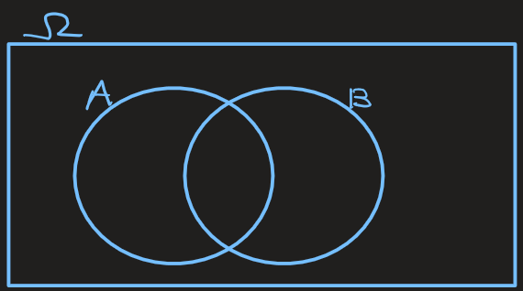
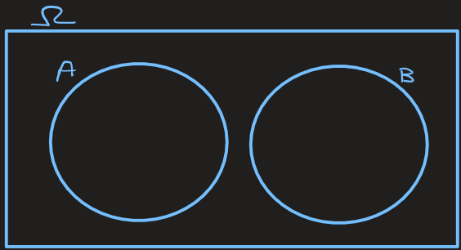
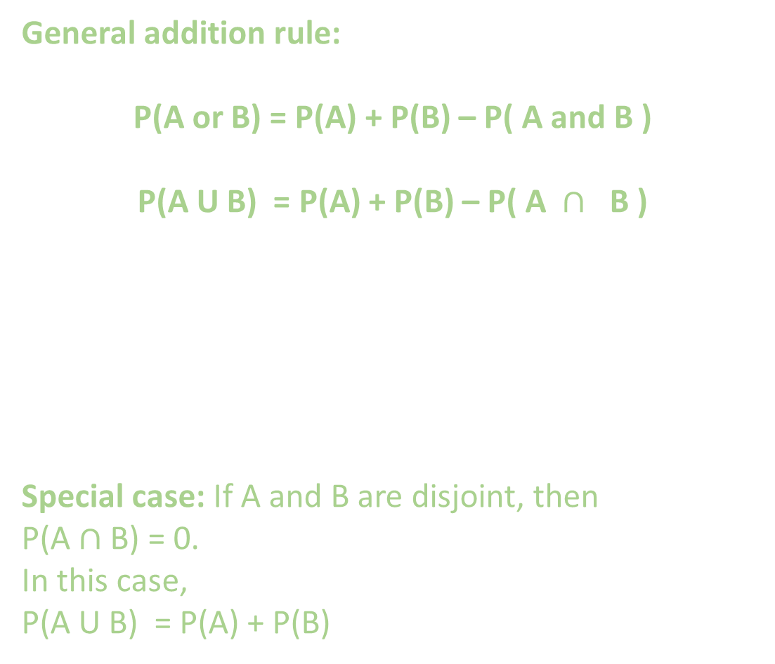
Addition Rule
General addition rule:
P(A or B) = P(A) + P(B) – P( A and B )
P(A U B) = P(A) + P(B) – P( A $∩$ B )
Special case: If A and B are disjoint, then
P(A $∩$ B) = 0.
In this case,
P(A U B) = P(A) + P(B)

Slide 6
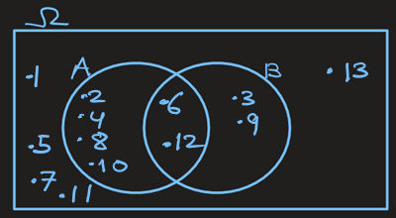
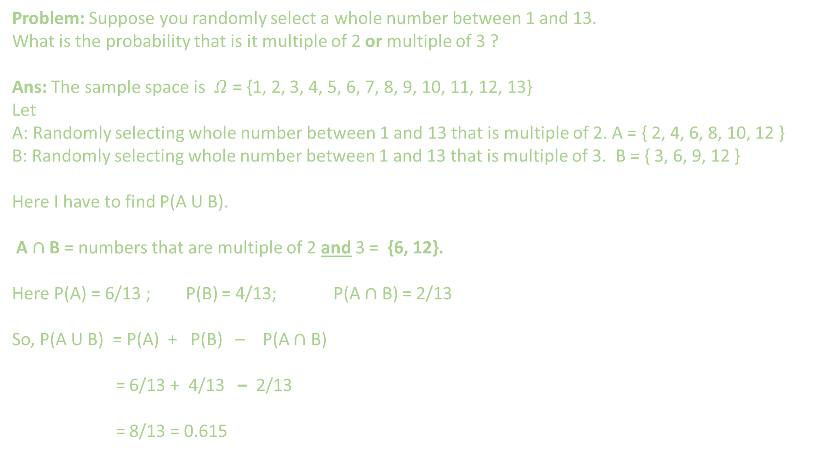

Addition Rule
P(A U B) = P(A) + P(B) – P( A $∩$ B )
Problem: Suppose you randomly select a whole number between 1 and 13.
What is the probability that is it multiple of 2 or multiple of 3 ?
Ans: The sample space is $Ω$ = {1, 2, 3, 4, 5, 6, 7, 8, 9, 10, 11, 12, 13}
Let
A: Randomly selecting whole number between 1 and 13 that is multiple of 2. A = { 2, 4, 6, 8, 10, 12 }
B: Randomly selecting whole number between 1 and 13 that is multiple of 3. B = { 3, 6, 9, 12 }
Here I have to find P(A U B).
A $∩$ B = numbers that are multiple of 2 and 3 = {6, 12}.
Here P(A) = 6/13 ; P(B) = 4/13; P(A $∩$ B) = 2/13
So, P(A U B) = P(A) + P(B) – P(A $∩$ B)
= 6/13 + 4/13 – 2/13
= 8/13 = 0.615

Slide 7
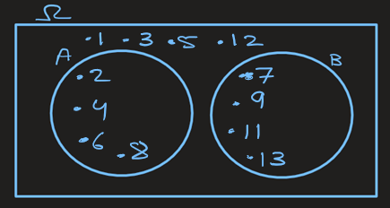
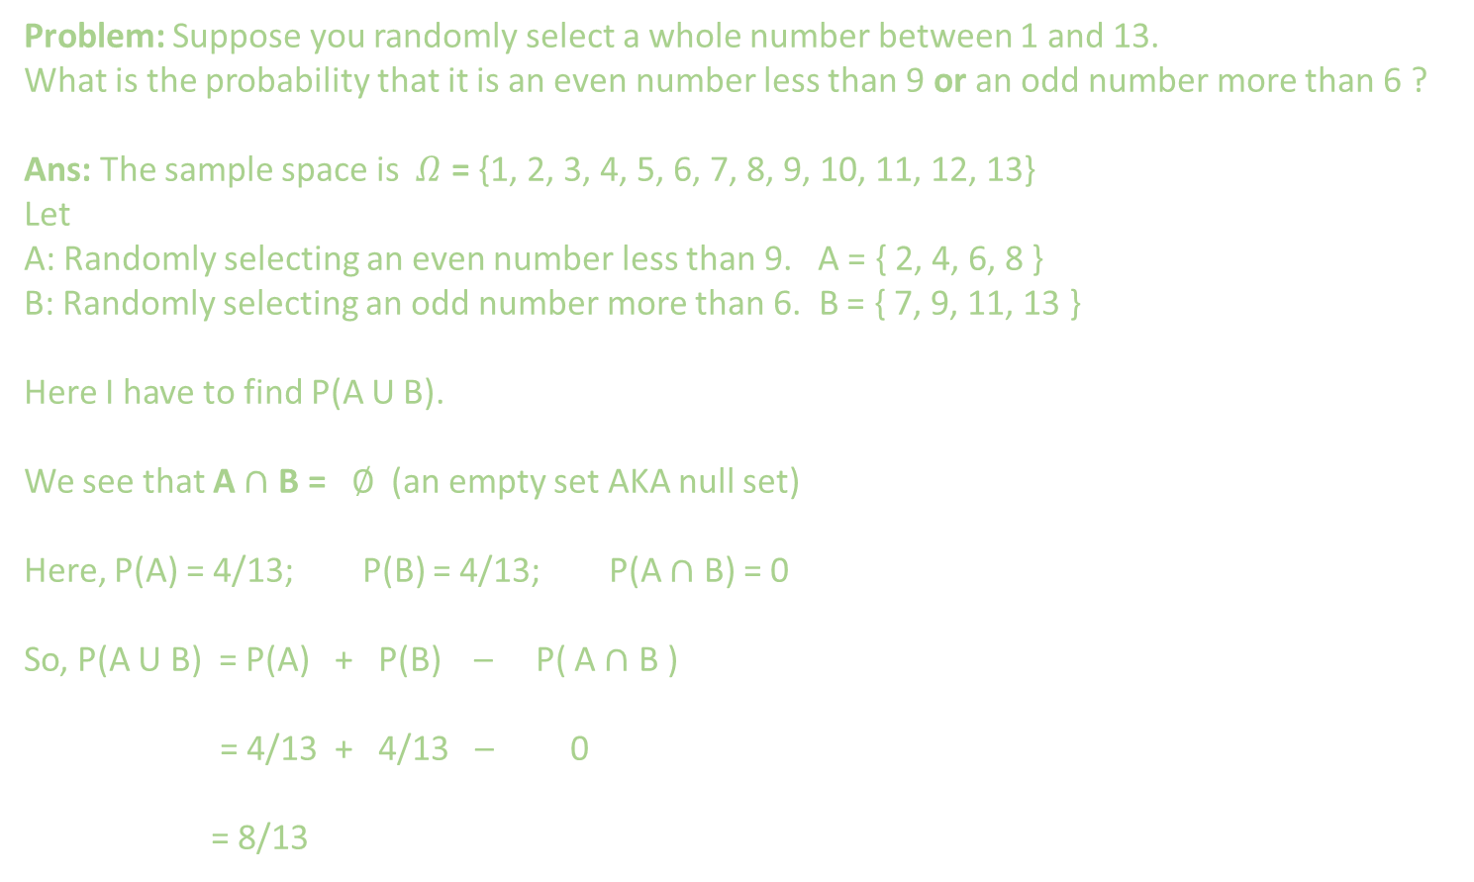
Addition Rule
P(A U B) = P(A) + P(B) – P( A $∩$ B )
Problem: Suppose you randomly select a whole number between 1 and 13.
What is the probability that it is an even number less than 9 or an odd number more than 6 ?
Ans: The sample space is $Ω$ = {1, 2, 3, 4, 5, 6, 7, 8, 9, 10, 11, 12, 13}
Let
A: Randomly selecting an even number less than 9. A = { 2, 4, 6, 8 }
B: Randomly selecting an odd number more than 6. B = { 7, 9, 11, 13 }
Here I have to find P(A U B).
We see that A $∩$ B = $∅$ (an empty set AKA null set)
Here, P(A) = 4/13; P(B) = 4/13; P(A $∩$ B) = 0
So, P(A U B) = P(A) + P(B) – P( A $∩$ B )
= 4/13 + 4/13 – 0
= 8/13

Slide 8
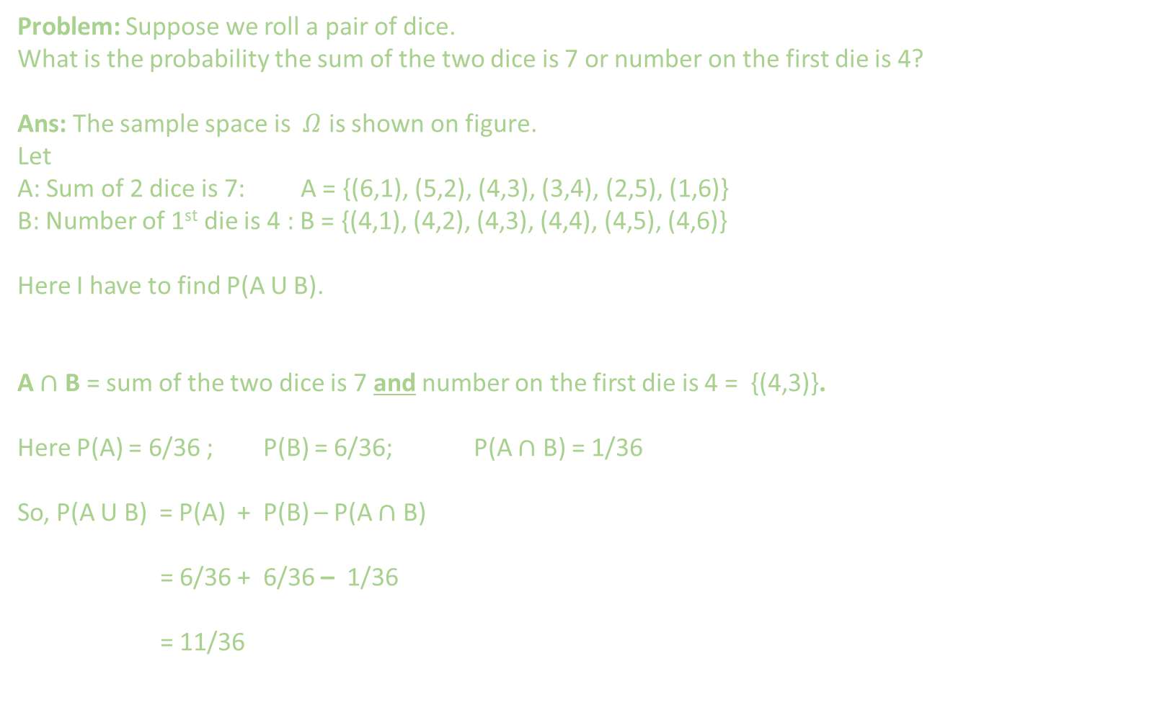
Addition Rule
P(A U B) = P(A) + P(B) – P( A $∩$ B )
Problem: Suppose we roll a pair of dice.
What is the probability the sum of the two dice is 7 or number on the first die is 4?
Ans: The sample space is $Ω$ is shown on figure.
Let
A: Sum of 2 dice is 7: A = {(6,1), (5,2), (4,3), (3,4), (2,5), (1,6)}
B: Number of 1st die is 4 : B = {(4,1), (4,2), (4,3), (4,4), (4,5), (4,6)}
Here I have to find P(A U B).
A $∩$ B = sum of the two dice is 7 and number on the first die is 4 = {(4,3)}.
Here P(A) = 6/36 ; P(B) = 6/36; P(A $∩$ B) = 1/36
So, P(A U B) = P(A) + P(B) – P(A $∩$ B)
= 6/36 + 6/36 – 1/36
= 11/36

Slide 9
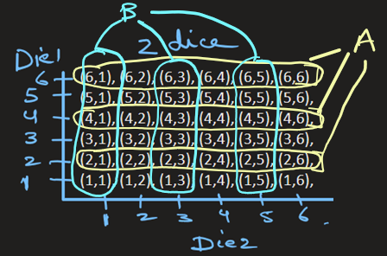
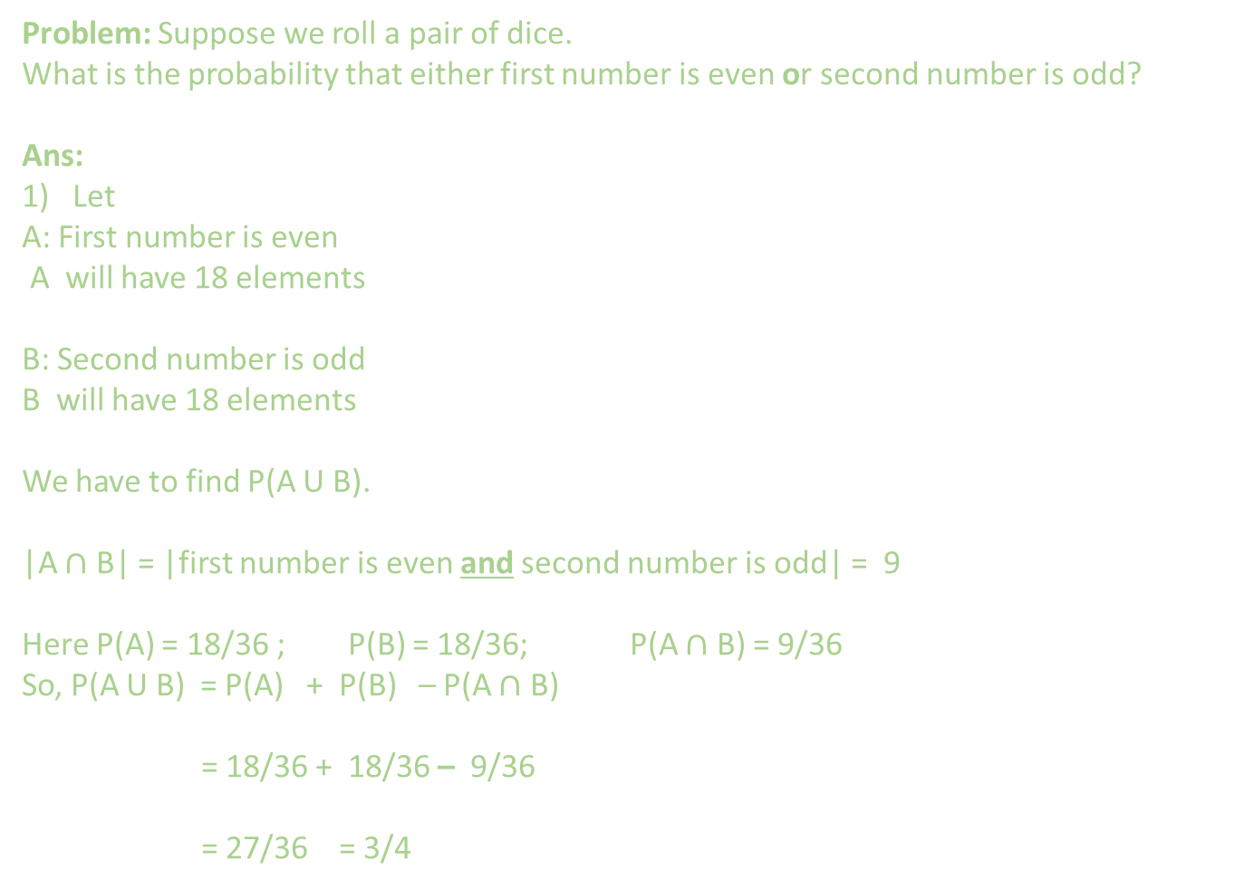
Addition Rule
P(A U B) = P(A) + P(B) – P( A $∩$ B )
Problem: Suppose we roll a pair of dice.
What is the probability that either first number is even or second number is odd?
Ans:
Let
A: First number is even
A will have 18 elements
B: Second number is odd
B will have 18 elements
We have to find P(A U B).
|A $∩$ B| = |first number is even and second number is odd| = 9
Here P(A) = 18/36 ; P(B) = 18/36; P(A $∩$ B) = 9/36
So, P(A U B) = P(A) + P(B) – P(A $∩$ B)
= 18/36 + 18/36 – 9/36
= 27/36 = 3/4

Slide 10
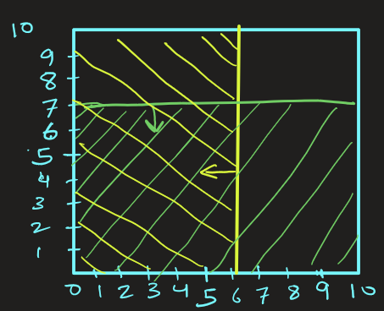
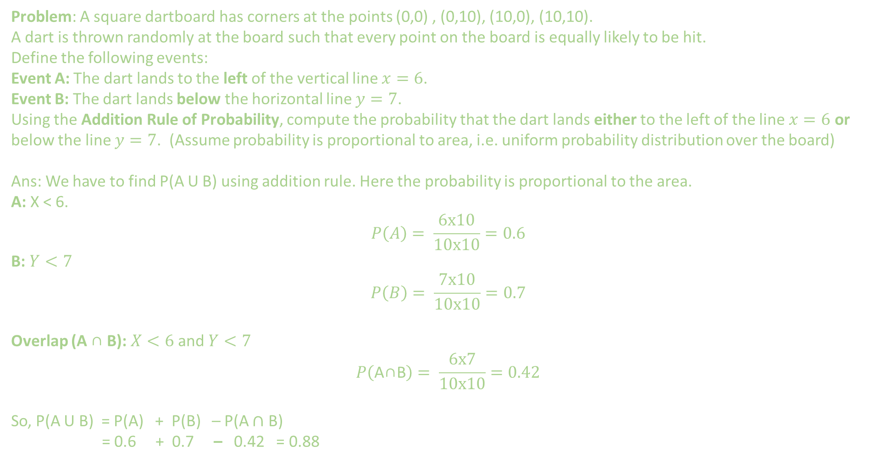
Addition Rule
P(A U B) = P(A) + P(B) – P( A $∩$ B )
Problem: A square dartboard has corners at the points (0,0) , (0,10), (10,0), (10,10). A dart is thrown randomly at the board such that every point on the board is equally likely to be hit.
Define the following events:
Event A: The dart lands to the left of the vertical line $x=6$.
Event B: The dart lands below the horizontal line $y=7$.
Using the Addition Rule of Probability, compute the probability that the dart lands either to the left of the line $x=6$ or below the line $y=7$. (Assume probability is proportional to area, i.e. uniform probability distribution over the board)
Ans: We have to find P(A U B) using addition rule. Here the probability is proportional to the area.
A: X < 6.
$$P\left(A\right)= \frac{6x10}{10x10}=0.6$$
B: $Y<7$
$$P\left(B\right)= \frac{7x10}{10x10}=0.7$$
Overlap (A ∩ B): $X<6$ and $Y<7$
$$P\left(\text{A}\text{∩}\text{B}\right)= \frac{6x7}{10x10}=0.42$$
So, P(A U B) = P(A) + P(B) – P(A $∩$ B)
= 0.6 + 0.7 – 0.42 = 0.88

Slide 11
EXTRA
Extra questions.

Slide 12
Addition Rule
P(A U B) = P(A) + P(B) – P( A $∩$ B )
Problem Suppose you’re designing a fraud detection system for online transactions.
Based on past historical data of 10,000 transactions, we have following empirical results.
1000 transaction were large ( that is, > $5000)
500 transaction were from unusual locations
200 transactions were large AND from an unusual location
You receive some notification of some random transaction. What is the probability that transaction is either large OR from an unusual location?
Transaction_id | >5000 | From_unusual_location
1 | y | y
2 | y | n
3 | n | n
4 | y | n

Slide 13
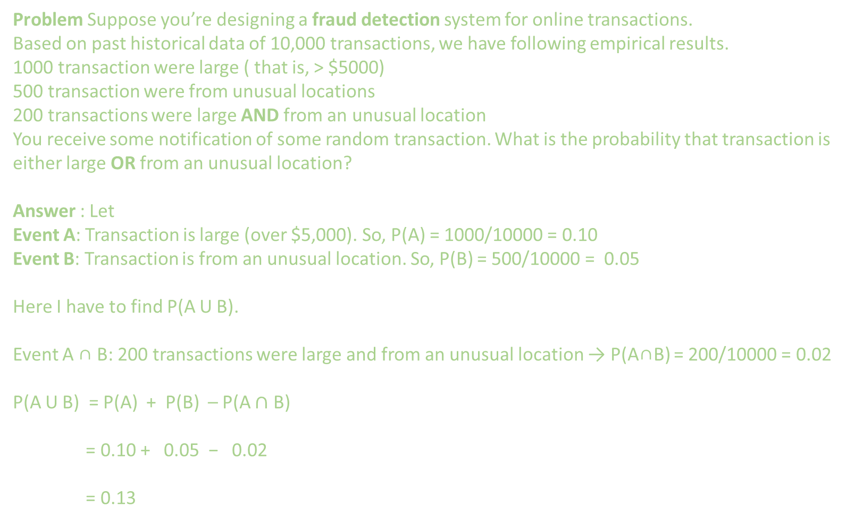
Addition Rule
P(A U B) = P(A) + P(B) – P( A $∩$ B )
Problem Suppose you’re designing a fraud detection system for online transactions.
Based on past historical data of 10,000 transactions, we have following empirical results.
1000 transaction were large ( that is, > $5000)
500 transaction were from unusual locations
200 transactions were large AND from an unusual location
You receive some notification of some random transaction. What is the probability that transaction is either large OR from an unusual location?
Answer : Let
Event A: Transaction is large (over $5,000). So, P(A) = 1000/10000 = 0.10
Event B: Transaction is from an unusual location. So, P(B) = 500/10000 = 0.05
Here I have to find P(A U B).
Event A ∩ B: 200 transactions were large and from an unusual location → P(A∩B) = 200/10000 = 0.02
P(A U B) = P(A) + P(B) – P(A $∩$ B)
= 0.10 + 0.05 − 0.02
= 0.13

Slide 14
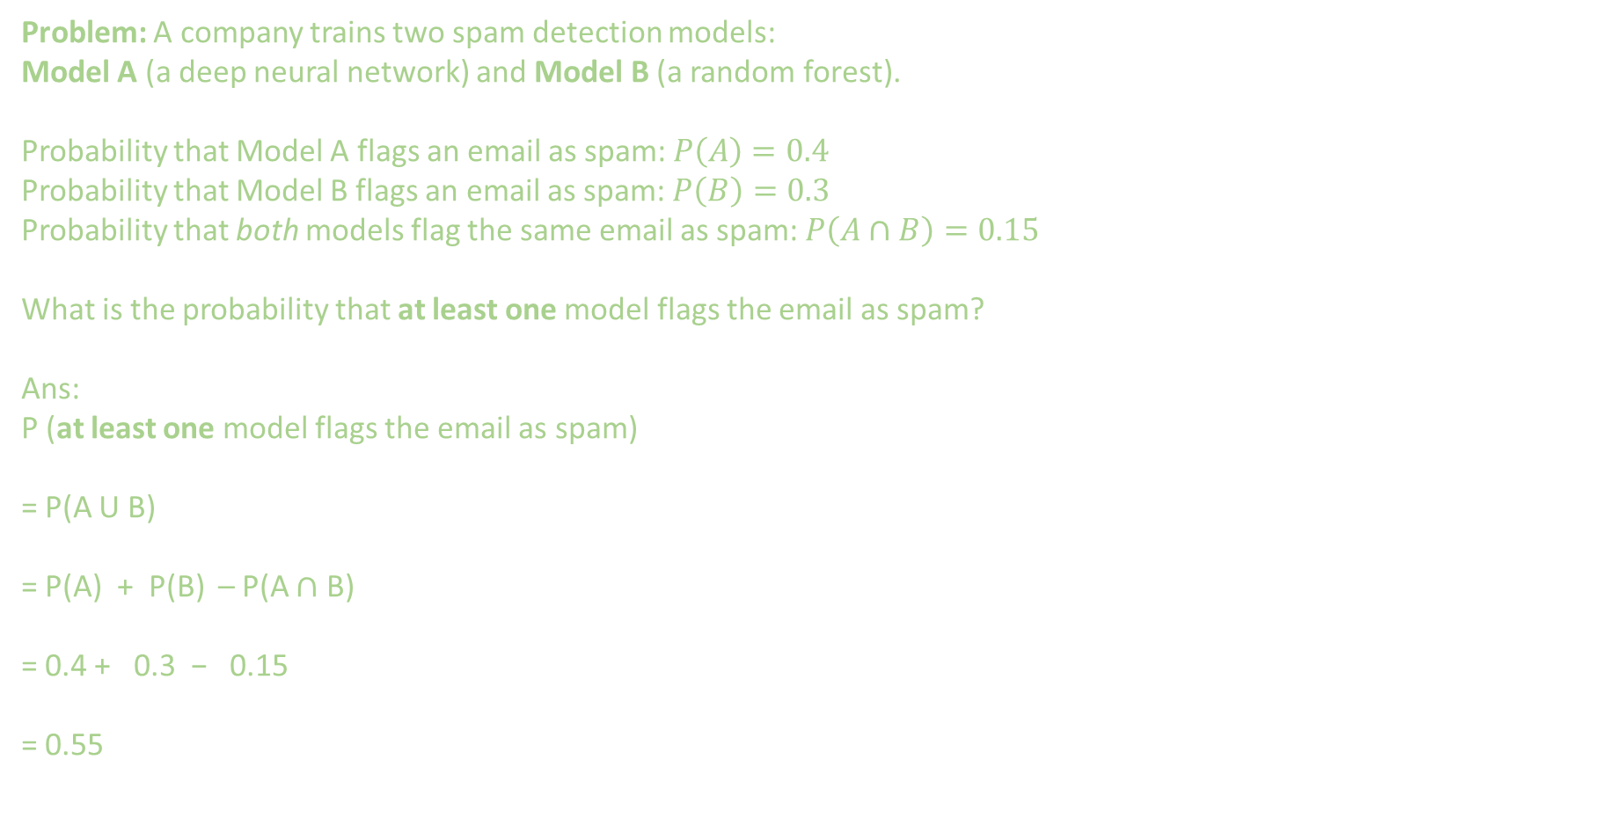
Addition Rule
P(A U B) = P(A) + P(B) – P( A $∩$ B )
Problem: A company trains two spam detection models:
Model A (a deep neural network) and Model B (a random forest).
Probability that Model A flags an email as spam: $P\left(A\right)=0.4$
Probability that Model B flags an email as spam: $P\left(B\right)=0.3$
Probability that both models flag the same email as spam: $P\left(A∩B\right)=0.15$
What is the probability that at least one model flags the email as spam?
Ans:
P (at least one model flags the email as spam)
= P(A U B)
= P(A) + P(B) – P(A $∩$ B)
= 0.4 + 0.3 − 0.15
= 0.55

Slide 15
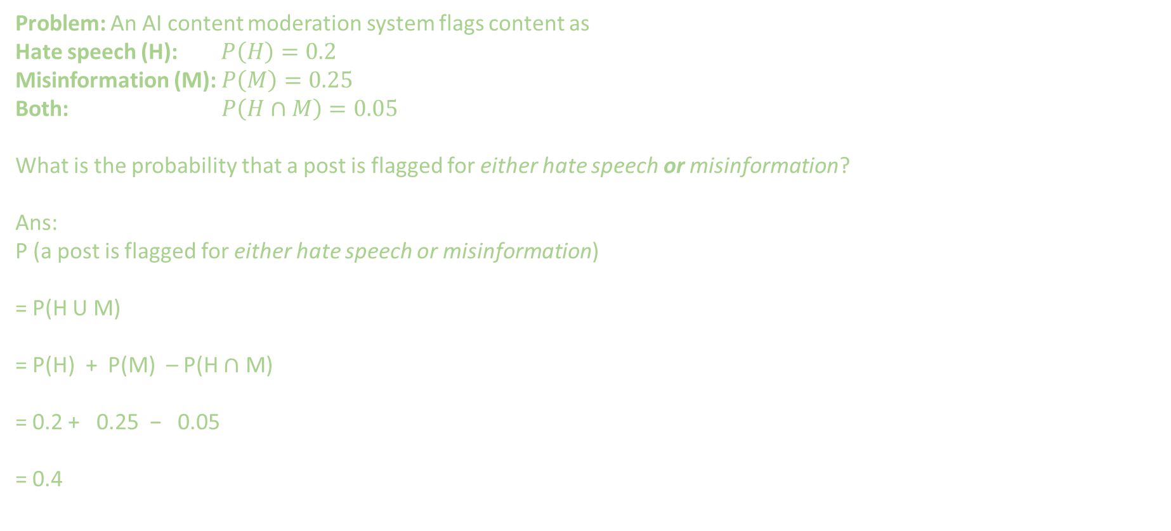
Addition Rule
P(A U B) = P(A) + P(B) – P( A $∩$ B )
Problem: An AI content moderation system flags content as
Hate speech (H): $P\left(H\right)=0.2$
Misinformation (M): $P\left(M\right)=0.25$
Both: $P\left(H∩M\right)=0.05$
What is the probability that a post is flagged for either hate speech or misinformation?
Ans: P (a post is flagged for either hate speech or misinformation)
= P(H U M)
= P(H) + P(M) – P(H $∩$ M)
= 0.2 + 0.25 − 0.05
= 0.4

Slide 16
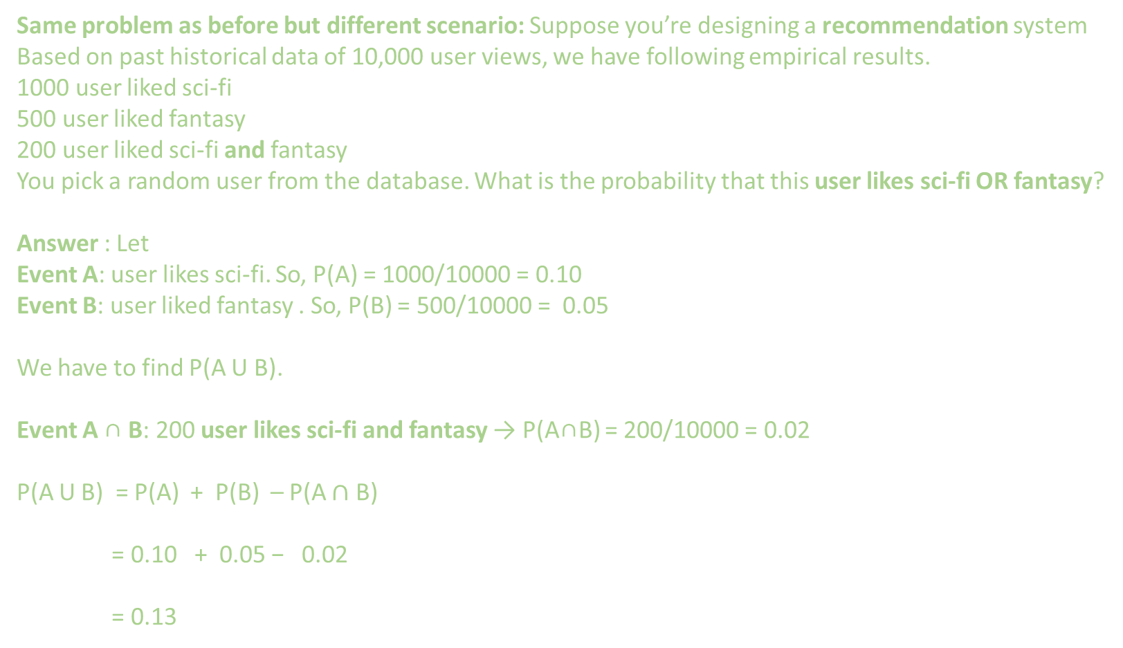
Addition Rule
P(A U B) = P(A) + P(B) – P( A $∩$ B )
Same problem as before but different scenario: Suppose you’re designing a recommendation system
Based on past historical data of 10,000 user views, we have following empirical results.
1000 user liked sci-fi
500 user liked fantasy
200 user liked sci-fi and fantasy
You pick a random user from the database. What is the probability that this user likes sci-fi OR fantasy?
Answer : Let
Event A: user likes sci-fi. So, P(A) = 1000/10000 = 0.10
Event B: user liked fantasy . So, P(B) = 500/10000 = 0.05
We have to find P(A U B).
Event A ∩ B: 200 user likes sci-fi and fantasy → P(A∩B) = 200/10000 = 0.02
P(A U B) = P(A) + P(B) – P(A $∩$ B)
= 0.10 + 0.05 − 0.02
= 0.13

Slide 17
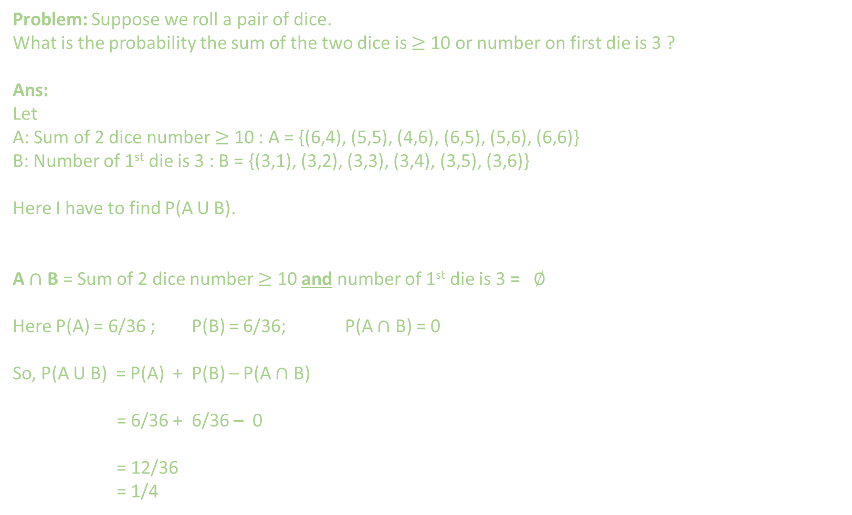
Addition Rule
P(A U B) = P(A) + P(B) – P( A $∩$ B )
Problem: Suppose we roll a pair of dice.
What is the probability the sum of the two dice is $≥$ 10 or number on first die is 3 ?
Ans:
Let
A: Sum of 2 dice number $≥$ 10 : A = {(6,4), (5,5), (4,6), (6,5), (5,6), (6,6)}
B: Number of 1st die is 3 : B = {(3,1), (3,2), (3,3), (3,4), (3,5), (3,6)}
Here I have to find P(A U B).
A $∩$ B = Sum of 2 dice number $≥$ 10 and number of 1st die is 3 = $∅$
Here P(A) = 6/36 ; P(B) = 6/36; P(A $∩$ B) = 0
So, P(A U B) = P(A) + P(B) – P(A $∩$ B)
= 6/36 + 6/36 – 0
= 12/36
= 1/4

Slide 18
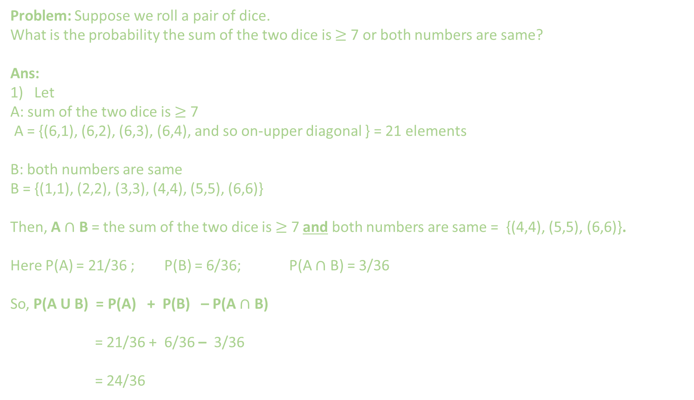
Addition Rule
P(A U B) = P(A) + P(B) – P( A $∩$ B )
Problem: Suppose we roll a pair of dice.
What is the probability the sum of the two dice is $≥$ 7 or both numbers are same?
Ans:
Let
A: sum of the two dice is $≥$ 7
A = {(6,1), (6,2), (6,3), (6,4), and so on-upper diagonal } = 21 elements
B: both numbers are same
B = {(1,1), (2,2), (3,3), (4,4), (5,5), (6,6)}
Then, A $∩$ B = the sum of the two dice is $≥$ 7 and both numbers are same = {(4,4), (5,5), (6,6)}.
Here P(A) = 21/36 ; P(B) = 6/36; P(A $∩$ B) = 3/36
So, P(A U B) = P(A) + P(B) – P(A $∩$ B)
= 21/36 + 6/36 – 3/36
= 24/36

