Slide 1

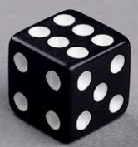
Conditional Probability
Problem: You roll a standard six-sided die. Your outcome are
{1, 2, 3, 4, 5, 6}
1) what is the probability of rolling a 5?
2) what is the probability of rolling a 5, given that the result was a number greater than 3?
Are above answer same or different ?
If they are same, why ?
If they are different, why ?

Slide 2
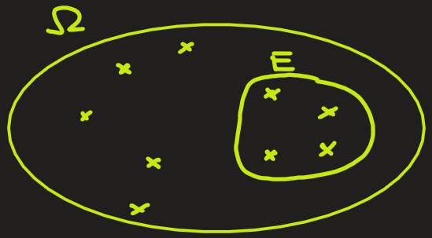
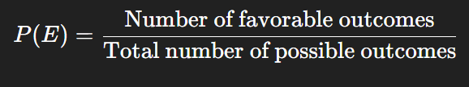


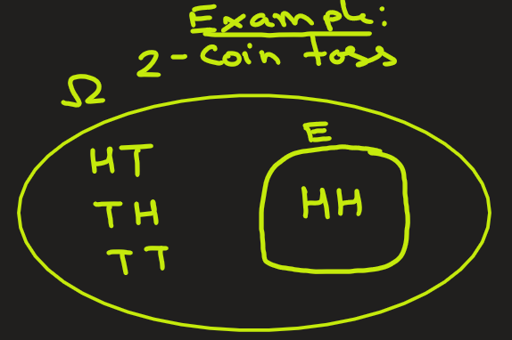

Probability: Definition (Review)
Probability of an event E:
Or,
Here,
$∣E∣$ = number (size) of elements in event $E$,
$∣Ω∣$= total number (size) of elements in sample space
Example: In 2-coin toss, what is the probability of getting both heads?
Ans: Here sample space is Ω = {HH, HT, TH, TT}. Size is |Ω| = 4
The event E is both toss are heads: E = {HH}. Size is |E| = 1
P(E) = 1/4.
coin1
coin2

Slide 3
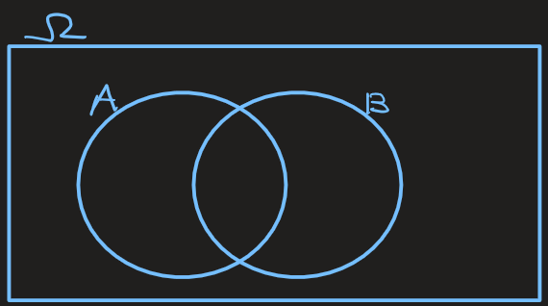
Conditional Probability,
The conditional probability of an event B, given that another event A has already occurred, is the probability that B happens under the condition that A is known to have occurred.
It is written as P(B∣A).
It is defined mathematically as:
where,
P(A∩B): Probability that both A and B occur together.
P(A): Probability that A occurs and it is P(A) > 0.
This formula tells us how to update our probability of B when we know A has happened.
Here A is also referred to as an evidence.
Another name for P(B) is the prior probability of B and P(B|A) is the posterior probability of B ( prior means before updating based on the evidence A, and posterior means after updating based on the evidence)

Slide 4
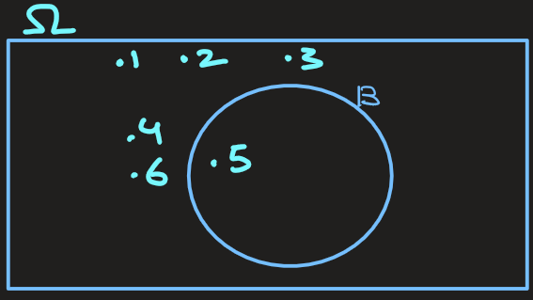
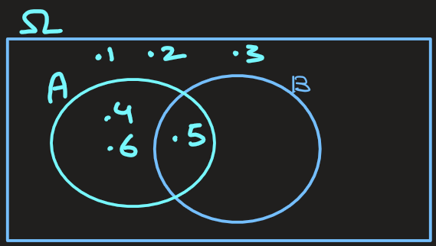
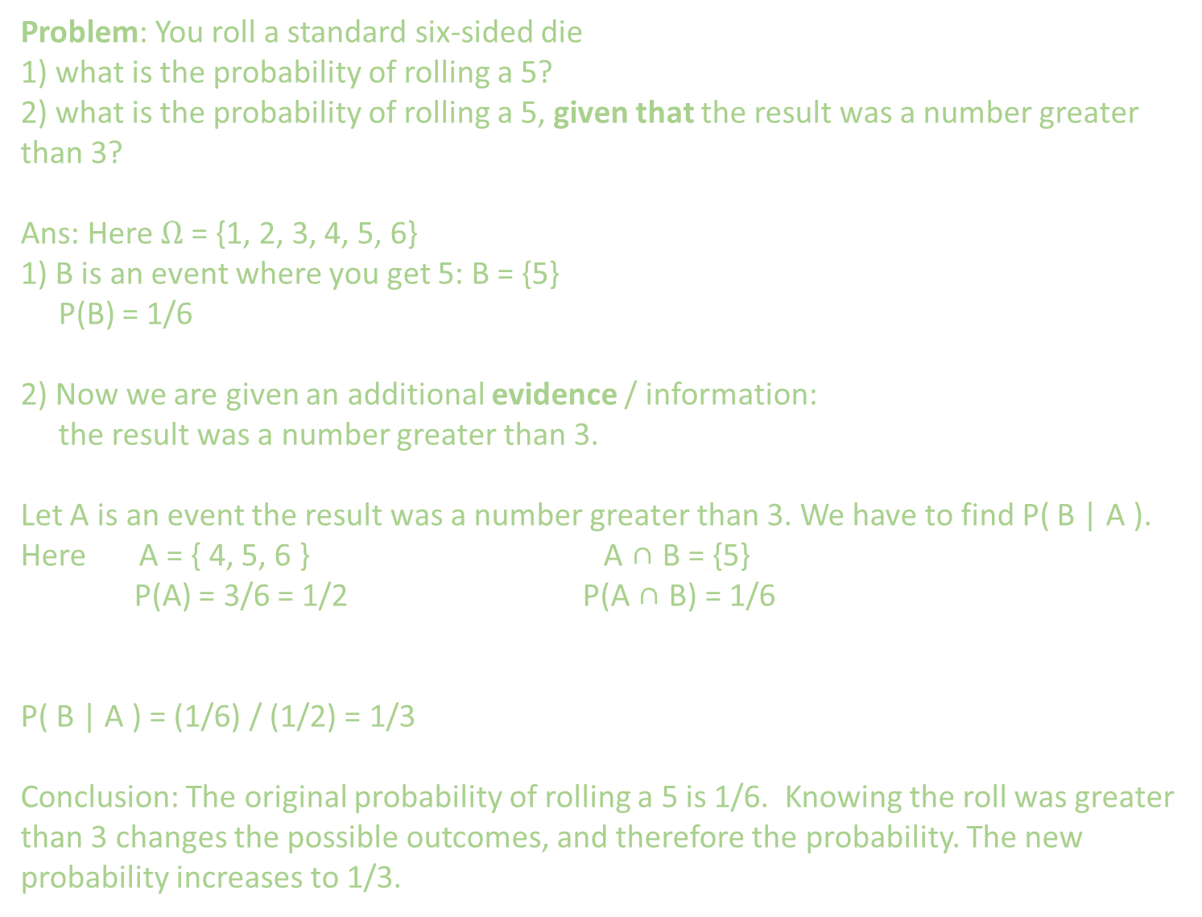
Problem: You roll a standard six-sided die
1) what is the probability of rolling a 5?
2) what is the probability of rolling a 5, given that the result was a number greater than 3?
Ans: Here $Ω$ = {1, 2, 3, 4, 5, 6}
1) B is an event where you get 5: B = {5}
P(B) = 1/6
2) Now we are given an additional evidence / information:
the result was a number greater than 3.
Let A is an event the result was a number greater than 3. We have to find P( B | A ).
Here A = { 4, 5, 6 } A ∩ B = {5}
P(A) = 3/6 = 1/2 P(A ∩ B) = 1/6
P( B | A ) = (1/6) / (1/2) = 1/3
Conclusion: The original probability of rolling a 5 is 1/6. Knowing the roll was greater than 3 changes the possible outcomes, and therefore the probability. The new probability increases to 1/3.

Slide 5
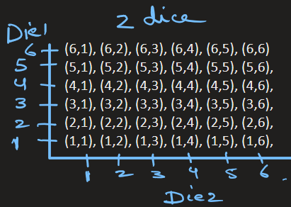
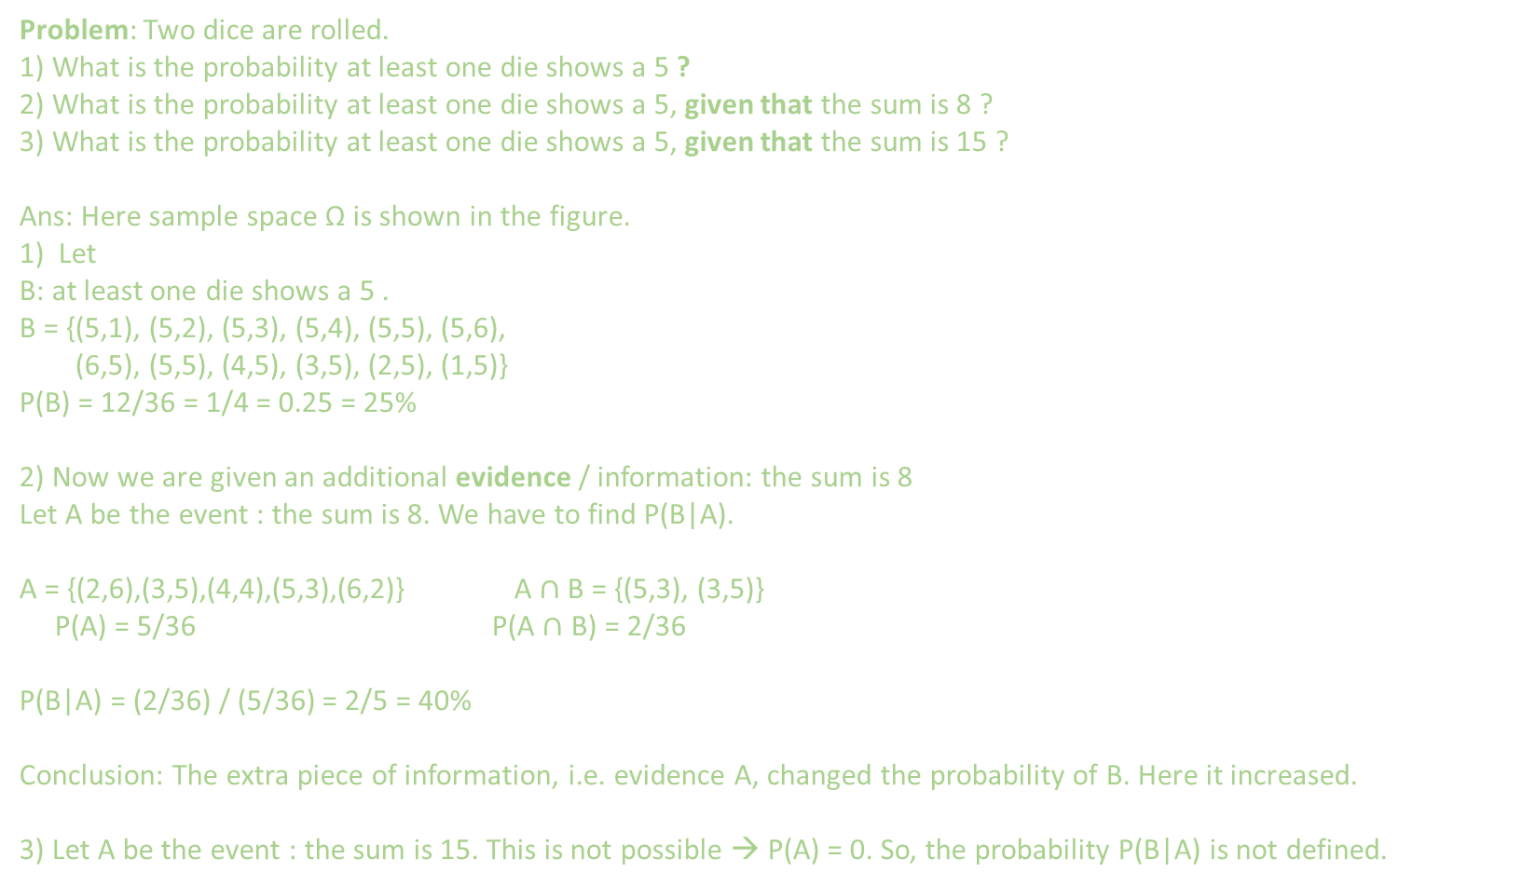
Conditional Probability
Problem: Two dice are rolled.
1) What is the probability at least one die shows a 5 ?
2) What is the probability at least one die shows a 5, given that the sum is 8 ?
3) What is the probability at least one die shows a 5, given that the sum is 15 ?
Ans: Here sample space Ω is shown in the figure.
1) Let
B: at least one die shows a 5 .
B = {(5,1), (5,2), (5,3), (5,4), (5,5), (5,6),
(6,5), (5,5), (4,5), (3,5), (2,5), (1,5)}
P(B) = 12/36 = 1/4 = 0.25 = 25%
2) Now we are given an additional evidence / information: the sum is 8
Let A be the event : the sum is 8. We have to find P(B|A).
A = {(2,6),(3,5),(4,4),(5,3),(6,2)} A $∩$ B = {(5,3), (3,5)}
P(A) = 5/36 P(A $∩$ B) = 2/36
P(B|A) = (2/36) / (5/36) = 2/5 = 40%
Conclusion: The extra piece of information, i.e. evidence A, changed the probability of B. Here it increased.
3) Let A be the event : the sum is 15. This is not possible → P(A) = 0. So, the probability P(B|A) is not defined.

Slide 6
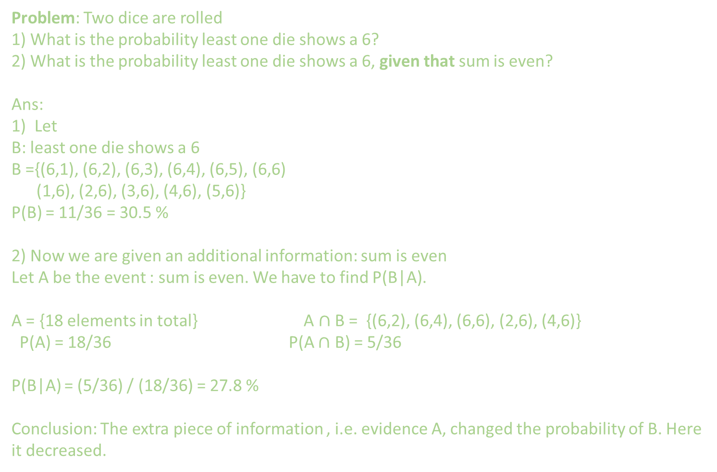
Conditional Probability
Problem: Two dice are rolled
1) What is the probability least one die shows a 6?
2) What is the probability least one die shows a 6, given that sum is even?
Ans:
1) Let
B: least one die shows a 6
B ={(6,1), (6,2), (6,3), (6,4), (6,5), (6,6)
(1,6), (2,6), (3,6), (4,6), (5,6)}
P(B) = 11/36 = 30.5 %
2) Now we are given an additional information: sum is even
Let A be the event : sum is even. We have to find P(B|A).
A = {18 elements in total} A $∩$ B = {(6,2), (6,4), (6,6), (2,6), (4,6)}
P(A) = 18/36 P(A $∩$ B) = 5/36
P(B|A) = (5/36) / (18/36) = 27.8 %
Conclusion: The extra piece of information , i.e. evidence A, changed the probability of B. Here it decreased.

Slide 7
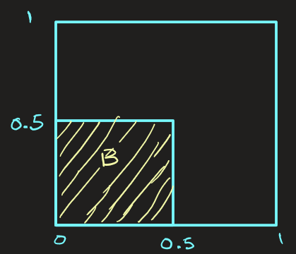
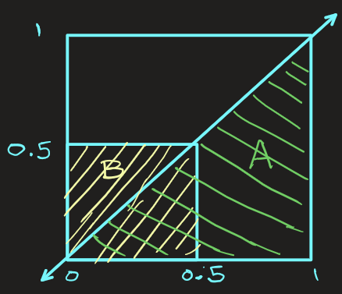
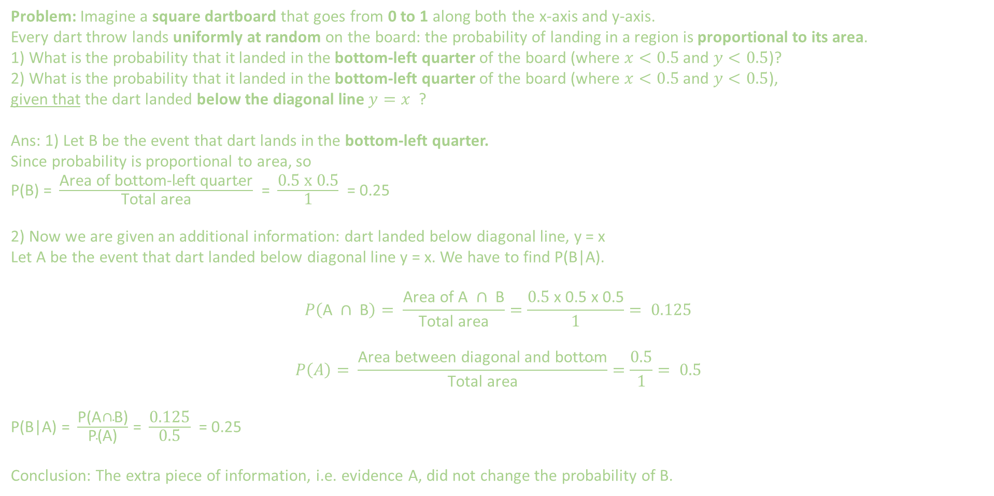
Conditional Probability
Problem: Imagine a square dartboard that goes from 0 to 1 along both the x-axis and y-axis.
Every dart throw lands uniformly at random on the board: the probability of landing in a region is proportional to its area.
1) What is the probability that it landed in the bottom-left quarter of the board (where $x<0.5$ and $y<0.5$)?
2) What is the probability that it landed in the bottom-left quarter of the board (where $x<0.5$ and $y<0.5$),
given that the dart landed below the diagonal line $y=x$ ?
Ans: 1) Let B be the event that dart lands in the bottom-left quarter.
Since probability is proportional to area, so
P(B) = $\frac{\text{Area} \text{of} \text{bottom}\text{−}\text{left} \text{quarter}}{\text{Total} \text{area}}$ = $\frac{\text{0.5 }\text{x} \text{0.5}}{\text{1}}$ = 0.25
2) Now we are given an additional information: dart landed below diagonal line, y = x
Let A be the event that dart landed below diagonal line y = x. We have to find P(B|A).
$$P\left(\text{A} ∩ \text{B}\right)= \frac{\text{Area} \text{of} \text{A} ∩ \text{B}}{\text{Total} \text{area}}=\frac{\text{0}\text{.}\text{5} \text{x} \text{0}\text{.}\text{5 }\text{x} \text{0}\text{.}\text{5}}{\text{1}}= 0.125$$
$$P\left(A\right)= \frac{\text{Area} \text{between} \text{diagonal} \text{and} \text{bottom}}{\text{Total} \text{area}}=\frac{\text{0}\text{.}\text{5}}{\text{1}}= 0.5$$
P(B|A) = $\frac{\text{P}\text{(}\text{A}\text{∩}\text{B}\text{)}}{\text{P}\text{(}\text{A}\text{)}}$ = $\frac{\text{0.125}}{\text{0.5}}$ = 0.25
Conclusion: The extra piece of information, i.e. evidence A, did not change the probability of B.

Slide 8
EXTRA
Extra problems

Slide 9
Conditional Probability
Problem: Conditional Probability in a Markov (2-gram) Language Model
Suppose you are developing a Markov-based language model for predicting the next word in a sentence.
You have following corpus:
The big dog barked loudly.
The big cat chased the mouse.
A big dog ran across the yard.
The small dog slept peacefully.
The tree sailed across the river.
The big tree was by the river.
The dog looked at the tree.
A small tree carried a big dog.
The small dog was barking at big tree.
The big tree had juicy fruits.
What is the probability that next word is “dog”, given that previous word is “big” ?, i.e. P(“big dog”) = ?
What is the probability that next word is “tree”, given that previous word is “big” ?, i.e. P(“big tree”) = ?
Side Note: These types of problems are solved by AI in sentence completion → “big ?”

Slide 10
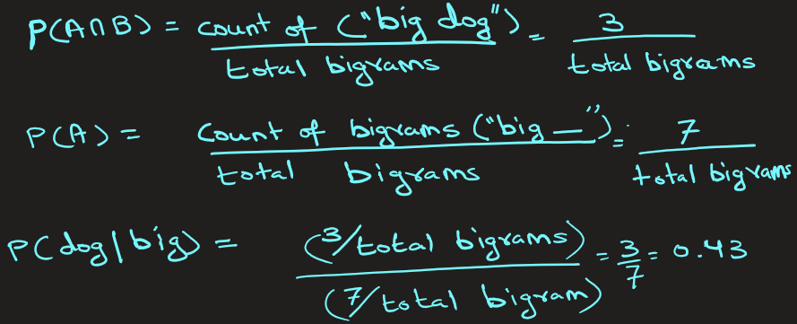
Conditional Probability
Ans:
1)Let
Event B: The next word is “dog.”
Event A: The previous word is “big.”
We have to find P(B|A), i.e. P(“big dog”).
Total bigrams starting with “big” → 7
{ big dog, big cat, big dog, big boat, big dog, big boat, big house }
Count of (“big dog”) = 3
In a first-order Markov model, the probability of one word depends only on the previous word. Hence, the model estimates:

Slide 11
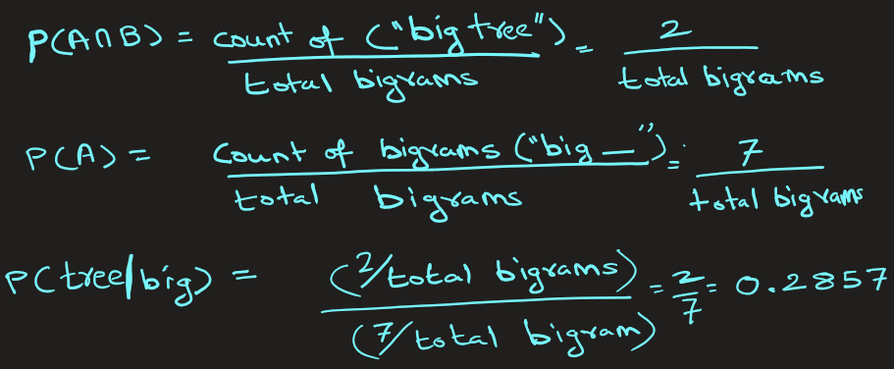
Conditional Probability
Ans:
2) Let
Event B: The next word is “tree.”
Event A: The previous word is “big.”
We have to find P(B|A), i.e. P(“big tree”).
Total bigrams starting with “big” → 7
{ big dog, big cat, big dog, big tree, big dog, big tree, big house }
Count of (“big tree”) = 2
In a first-order Markov model, the probability of one word depends only on the previous word. Hence, the model estimates:
Conclusion:
P(dog|big) = 0.43 , P(tree|big) = 0.2857
The next word should be dog because of higher probability

Slide 12
Conditional Probability
Problem: Medical Diagnosis (Bayesian Networks)
Suppose you’re building a disease prediction model.
Based on past data we have,
0.95% of the population both have the disease and test positive
5% of all tested people test positive
If a patient tests positive, what is the chance they really have the disease ?
Ans: Let
B: Patient has the disease
A: Patient has a positive test result
P(A∩B) = 0.0095 (0.95% of the population both have the disease and test positive)
P(A)=0.05 (5% of all tested people test positive)
Then,
P(B∣A) = P(A∩B) / P(A) = 0.0095 / 0.05 = 0.19
So, if a patient tests positive, there’s a 19% chance they really have the disease.
This is the Bayesian update idea in medical AI.

Slide 13


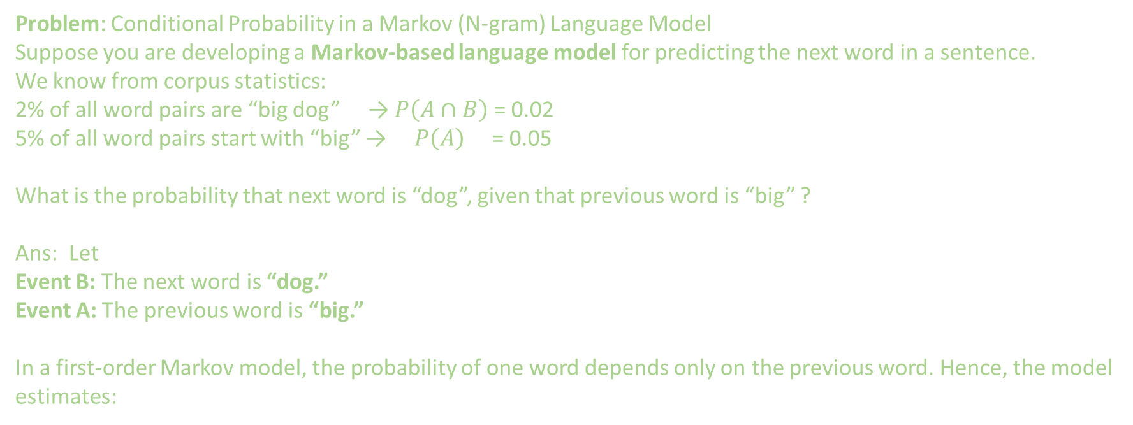
Conditional Probability
Problem: Conditional Probability in a Markov (N-gram) Language Model
Suppose you are developing a Markov-based language model for predicting the next word in a sentence.
We know from corpus statistics:
2% of all word pairs are “big dog” → $P\left(A∩B\right)$ = 0.02
5% of all word pairs start with “big” → $P\left(A\right)$ = 0.05
What is the probability that next word is “dog”, given that previous word is “big” ?
Ans: Let
Event B: The next word is “dog.”
Event A: The previous word is “big.”
In a first-order Markov model, the probability of one word depends only on the previous word. Hence, the model estimates:
There is a 40% probability that the word “dog” follows “big.” It predicts probability for all words that follows big, and then it assigns the word that has highest probability.

Slide 14
Application of probability in AI ML (p1)
Probability in Clustering — Gaussian Mixture Models (GMM)
Example: When clustering customers, a GMM says:
Each cluster is a probability distribution (usually Gaussian).
Each point belongs to each cluster with some probability.
So, customer A might belong:
70% to Cluster 1 (young students)
30% to Cluster 2 (young professionals)
Unlike K-Means, GMM gives soft assignments.

Slide 15
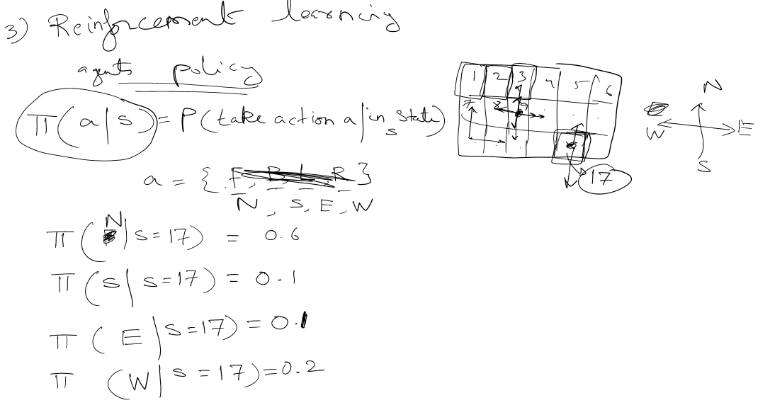
Application of probability in AI ML (p2)
In RL, like training robots, the agent's policy is
PI(a|s) = Prob(take action a | in state s)
The policy samples actions probabilistically- helping agents to explore

