Slide 1
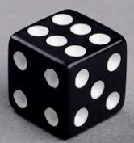
Multiplication Rule
Problem: You roll a die. Let’s define two events :
A: “The number is even.” → {2, 4, 6}
B: “The number is greater than 3.” → {4, 5, 6}
Are these independent ?
In other words, are they related ?

Slide 2
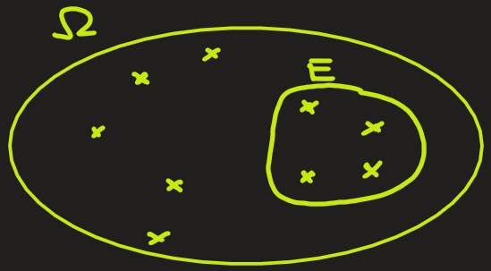
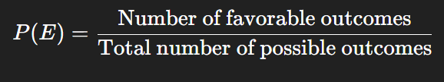


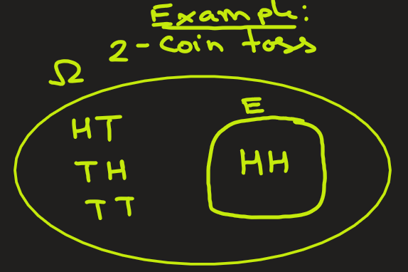

Probability: Definition (Review)
Probability of an event E:
Or,
Here,
$∣E∣$ = number (size) of elements in event $E$,
$∣Ω∣$ = total number (size) of elements in sample space
Example: In 2-coin toss, what is the probability of getting both heads?
Ans: Here sample space is Ω = {HH, HT, TH, TT}. Size of $Ω$ is $∣Ω∣$= 4
The event E is both toss are heads: E = {HH}. Size of E is |E|= 1
P(E) = 1/4.
coin1
coin2

Slide 3
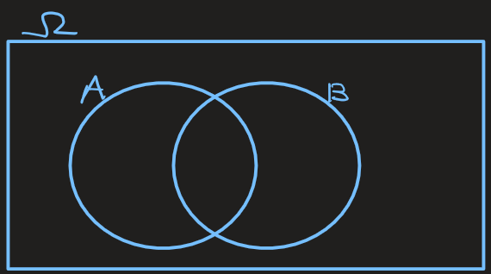
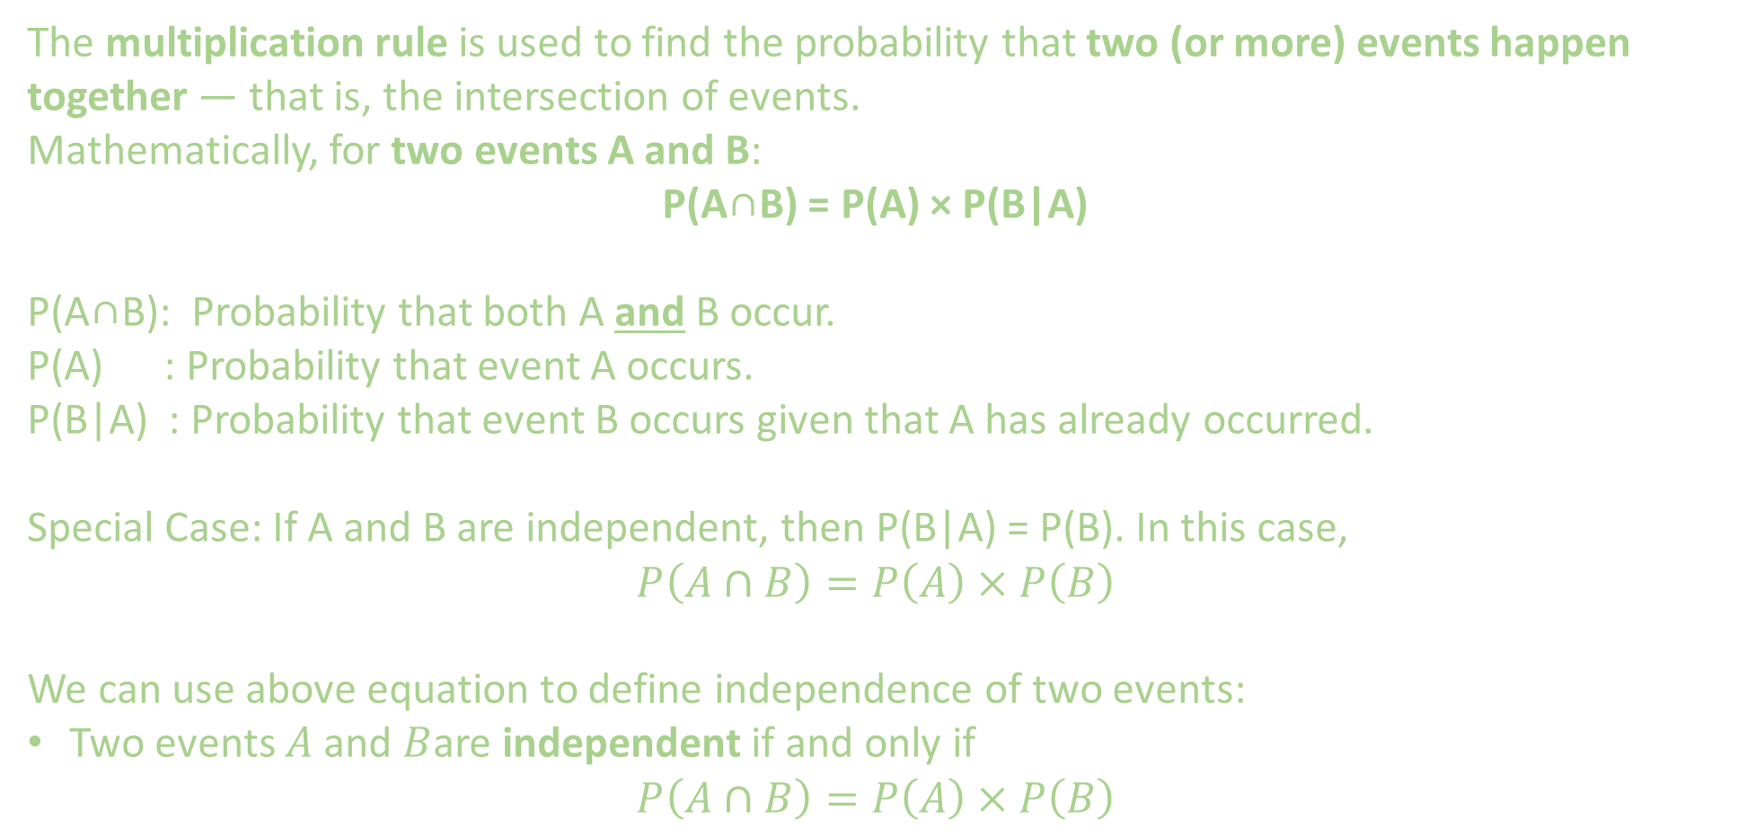
Multiplication Rule
P(A∩B) = P(A) × P(B|A)
The multiplication rule is used to find the probability that two (or more) events happen together — that is, the intersection of events.
Mathematically, for two events A and B:
P(A∩B) = P(A) × P(B|A)
P(A∩B): Probability that both A and B occur.
P(A) : Probability that event A occurs.
P(B|A) : Probability that event B occurs given that A has already occurred.
Special Case: If A and B are independent, then P(B|A) = P(B). In this case,
$$P\left(A∩B\right)=P\left(A\right)×P\left(B\right)$$
We can use above equation to define independence of two events:
Two events $A$ and $B$are independent if and only if
$$P\left(A∩B\right)=P\left(A\right)×P\left(B\right)$$

Slide 4
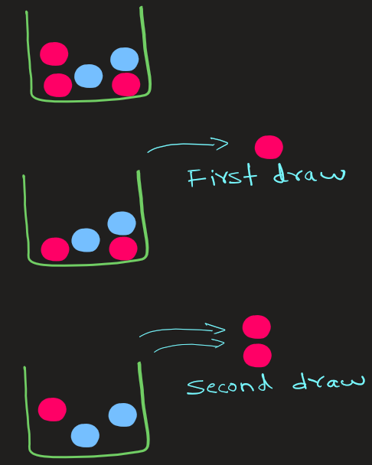
Multiplication Rule
P(A∩B) = P(A) × P(B|A)
Problem: A box contains 5 balls — 3 red and 2 blue.
Two balls are drawn one after another without replacement.
What is the probability that both balls are red ?

Slide 5
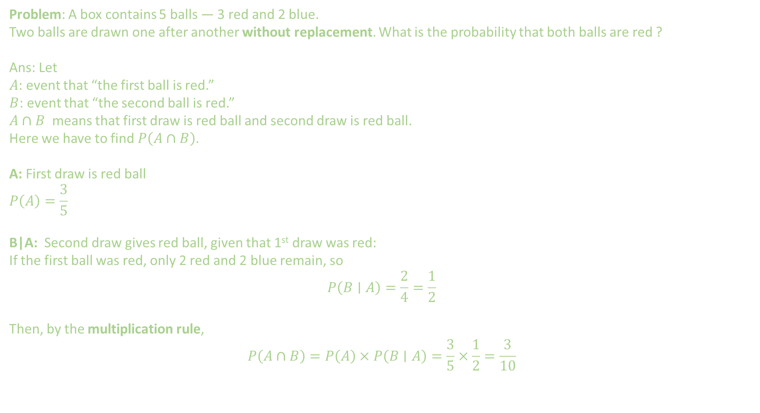
Multiplication Rule
P(A∩B) = P(A) × P(B|A)
Problem: A box contains 5 balls — 3 red and 2 blue. Two balls are drawn one after another without replacement. What is the probability that both balls are red ?
Ans: Let
$A$: event that “the first ball is red.”
$B$: event that “the second ball is red.”
$A∩B$ means that first draw is red ball and second draw is red ball.
Here we have to find $P\left(A∩B\right)$.
A: First draw is red ball
$$P\left(A\right)=\frac{3}{5}$$
B|A: Second draw gives red ball, given that 1st draw was red:
If the first ball was red, only 2 red and 2 blue remain, so
$$P\left(B∣A\right)=\frac{2}{4}=\frac{1}{2}$$
Then, by the multiplication rule,
$$P\left(A∩B\right)=P\left(A\right)×P\left(B∣A\right)=\frac{3}{5}×\frac{1}{2}=\frac{3}{10}$$

Slide 6
Multiplication Rule
P(A∩B) = P(A) × P(B|A)
Problem: Suppose you roll two fair dice.
What is the probability that the first die shows a 3 and the second die shows an even number.
3 Even

Slide 7
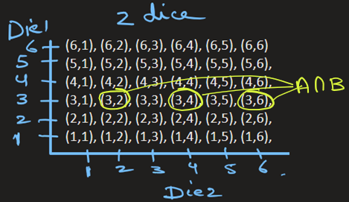
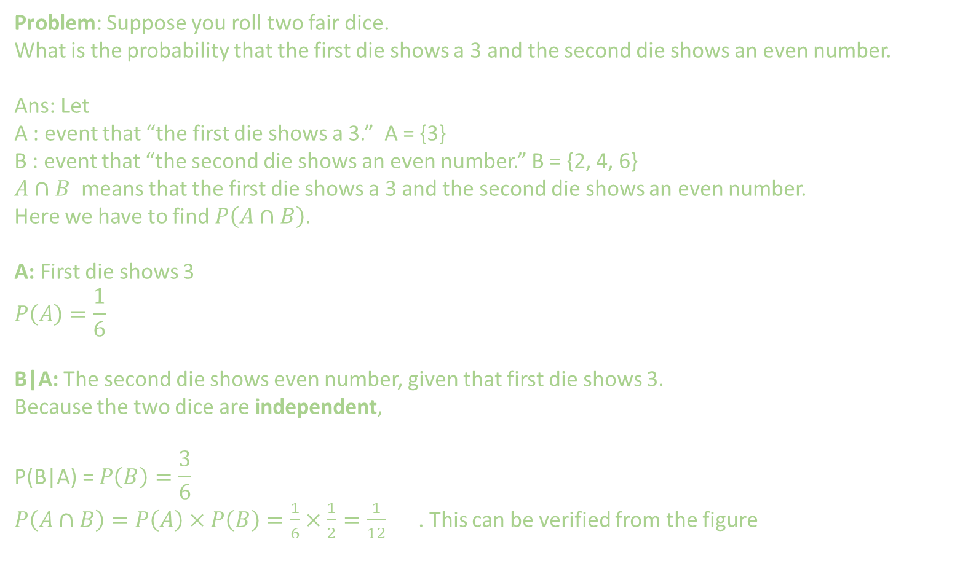
Multiplication Rule
P(A∩B) = P(A) × P(B|A)
Problem: Suppose you roll two fair dice.
What is the probability that the first die shows a 3 and the second die shows an even number.
Ans: Let
A : event that “the first die shows a 3.” A = {3}
B : event that “the second die shows an even number.” B = {2, 4, 6}
$A∩B$ means that the first die shows a 3 and the second die shows an even number.
Here we have to find $P\left(A∩B\right)$.
A: First die shows 3
$$P\left(A\right)=\frac{1}{6}$$
B|A: The second die shows even number, given that first die shows 3.
Because the two dice are independent,
$$\text{P}\text{(}\text{B}\text{|}\text{A}\text{) = }P\left(B\right)=\frac{3}{6}$$
$P\left(A∩B\right)=P\left(A\right)×P\left(B\right)=\frac{1}{6}×\frac{1}{2}=\frac{1}{12}$ . This can be verified from the figure
3 Even

Slide 8
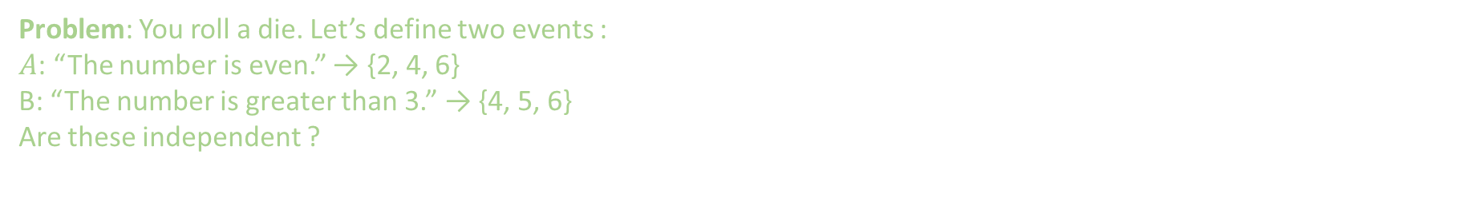
Multiplication Rule
P(A∩B) = P(A) × P(B|A)
Problem: You roll a die. Let’s define two events :
$A$: “The number is even.” → {2, 4, 6}
B: “The number is greater than 3.” → {4, 5, 6}
Are these independent ?

Slide 9
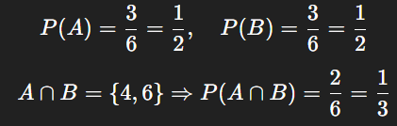
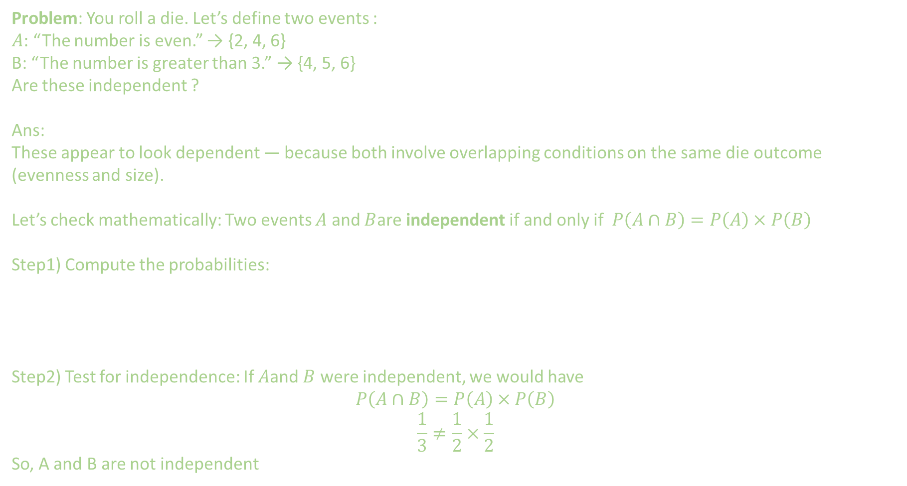
Multiplication Rule
P(A∩B) = P(A) × P(B|A)
Problem: You roll a die. Let’s define two events :
$A$: “The number is even.” → {2, 4, 6}
B: “The number is greater than 3.” → {4, 5, 6}
Are these independent ?
Ans:
These appear to look dependent — because both involve overlapping conditions on the same die outcome (evenness and size).
Let’s check mathematically: Two events $A$ and $B$are independent if and only if $P\left(A∩B\right)=P\left(A\right)×P\left(B\right)$
Step1) Compute the probabilities:
Step2) Test for independence: If $A$and $B$ were independent, we would have
$$P\left(A∩B\right)=P\left(A\right)×P\left(B\right)$$
$$\frac{1}{3}≠\frac{1}{2}×\frac{1}{2}$$
So, A and B are not independent

Slide 10
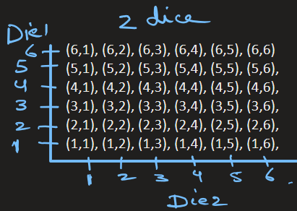
Multiplication Rule
P(A∩B) = P(A) × P(B|A)
Problem: You roll a pair of dice. What is the probability that the sum of two dice is greater than 8 and the
first die shows a 5 ?

Slide 11
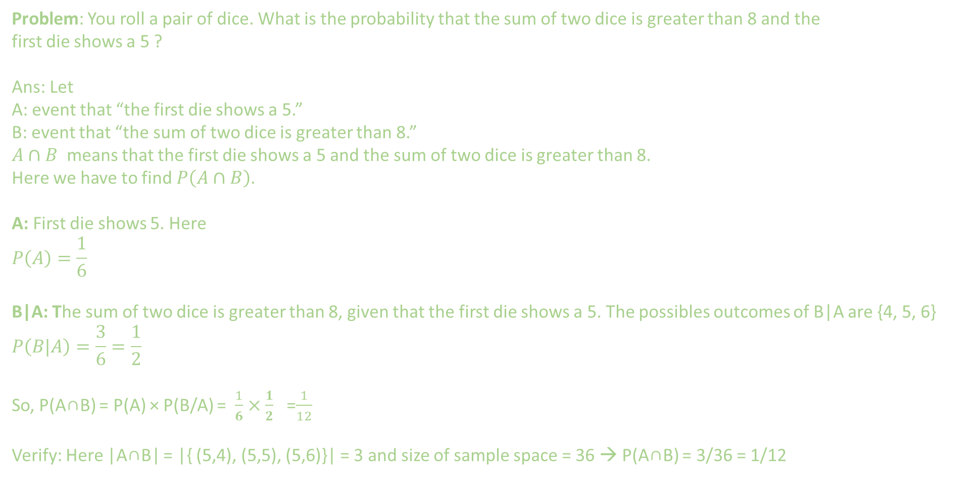
Multiplication Rule
P(A∩B) = P(A) × P(B|A)
Problem: You roll a pair of dice. What is the probability that the sum of two dice is greater than 8 and the
first die shows a 5 ?
Ans: Let
A: event that “the first die shows a 5.”
B: event that “the sum of two dice is greater than 8.”
$A∩B$ means that the first die shows a 5 and the sum of two dice is greater than 8.
Here we have to find $P\left(A∩B\right)$.
A: First die shows 5. Here
$$P\left(A\right)=\frac{1}{6}$$
B|A: The sum of two dice is greater than 8, given that the first die shows a 5. The possibles outcomes of B|A are {4, 5, 6}
$$P\left(B|A\right)=\frac{3}{6}=\frac{1}{2}$$
So, P(A∩B) = P(A) × P(B/A) = $\frac{1}{6}×\frac{1}{2}$ =$\frac{1}{12}$
Verify: Here |A∩B| = |{ (5,4), (5,5), (5,6)}| = 3 and size of sample space = 36 → P(A∩B) = 3/36 = 1/12

Slide 12
Multiplication Rule
P(A∩B) = P(A) × P(B|A)
Problem: Suppose an AI spam filter classifies emails.
Based on past data we know that
30% of all emails contain 'discount'
80% of emails containing 'discount' are spam
How many emails contain the word “discount” and are spam.

Slide 13
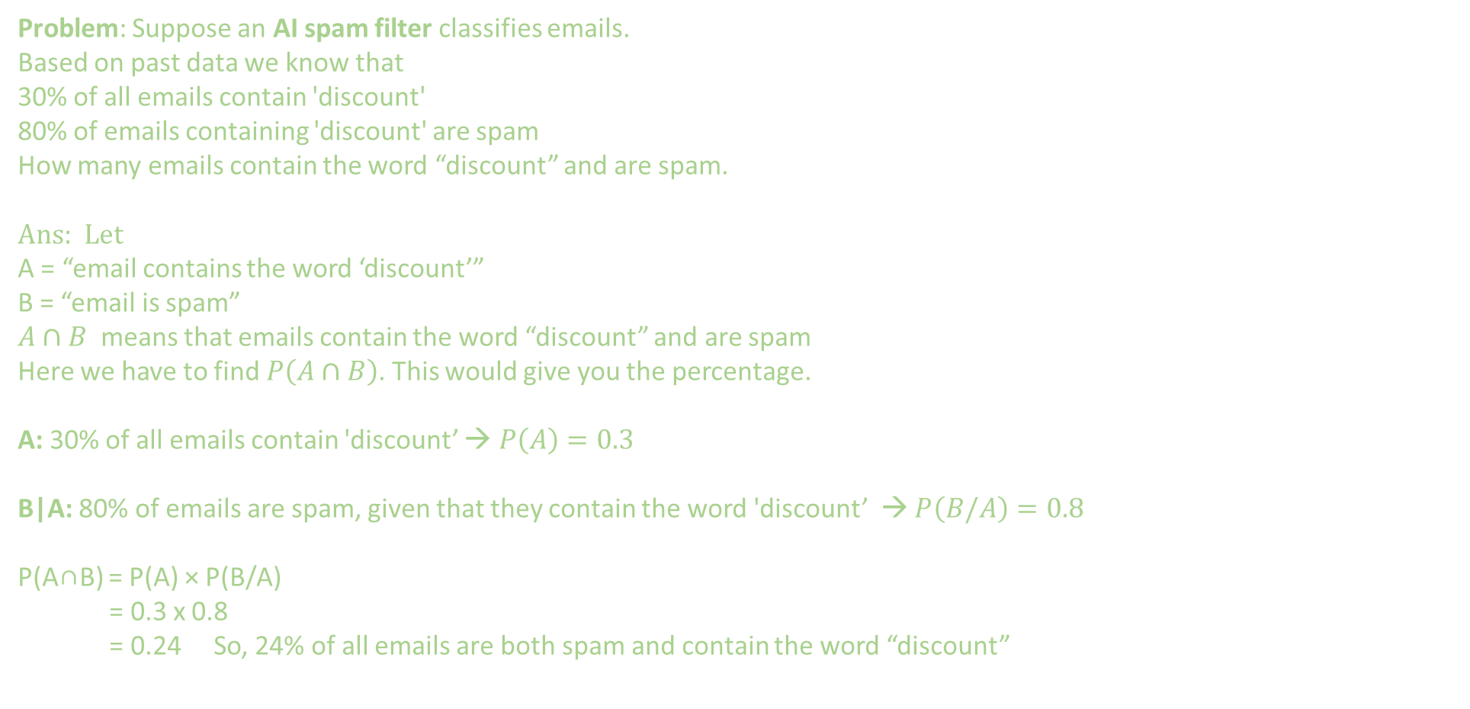
Multiplication Rule
P(A∩B) = P(A) × P(B|A)
Problem: Suppose an AI spam filter classifies emails.
Based on past data we know that
30% of all emails contain 'discount'
80% of emails containing 'discount' are spam
How many emails contain the word “discount” and are spam.
Ans: Let
A = “email contains the word ‘discount’”
B = “email is spam”
$A∩B$ means that emails contain the word “discount” and are spam
Here we have to find $P\left(A∩B\right)$. This would give you the percentage.
A: 30% of all emails contain 'discount’ → $P\left(A\right)=0.3$
B|A: 80% of emails are spam, given that they contain the word 'discount’ → $P\left(B/A\right)=0.8$
P(A∩B) = P(A) × P(B/A)
= 0.3 x 0.8
= 0.24 So, 24% of all emails are both spam and contain the word “discount”

Slide 14
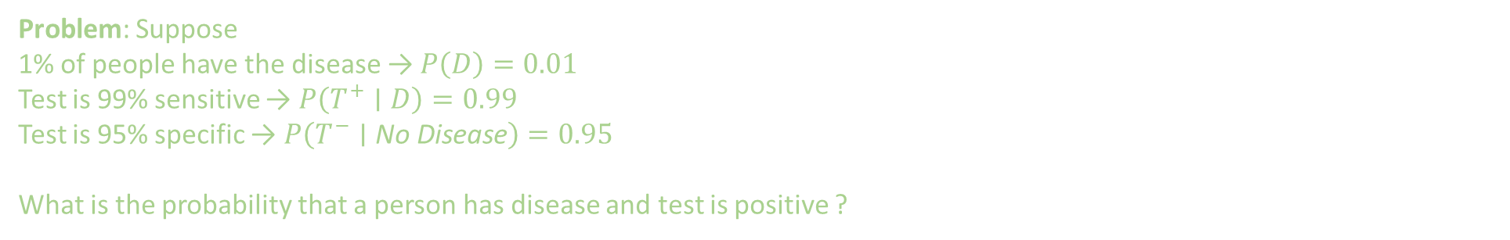
Multiplication Rule
P(A∩B) = P(A) × P(B|A)
Problem: Suppose
1% of people have the disease → $P\left(D\right)=0.01$
Test is 99% sensitive → $P\left(T^{+}∣D\right)=0.99$
Test is 95% specific → $P\left(T^{−}∣\text{No} \text{Disease}\right)=0.95$
What is the probability that a person has disease and test is positive ?

Slide 15
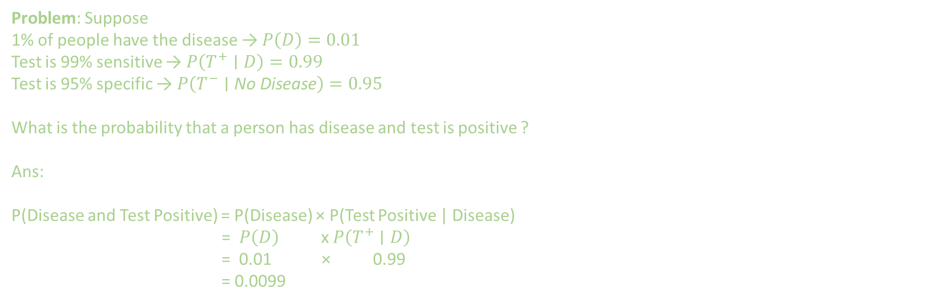
Multiplication Rule
P(A∩B) = P(A) × P(B|A)
Problem: Suppose
1% of people have the disease → $P\left(D\right)=0.01$
Test is 99% sensitive → $P\left(T^{+}∣D\right)=0.99$
Test is 95% specific → $P\left(T^{−}∣\text{No} \text{Disease}\right)=0.95$
What is the probability that a person has disease and test is positive ?
Ans:
P(Disease and Test Positive) = P(Disease) × P(Test Positive | Disease)
= $P\left(D\right)$ x $P\left(T^{+}∣D\right)$
= 0.01 × 0.99
= 0.0099

Slide 16
EXTRA
P(A∩B) = P(A) × P(B|A)
Extra problems

Slide 17
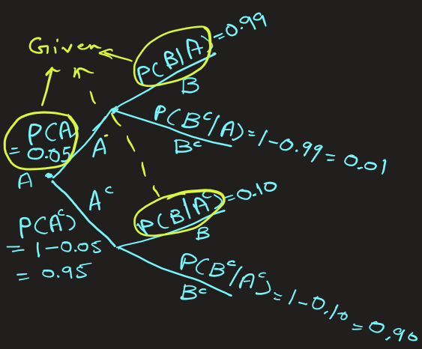
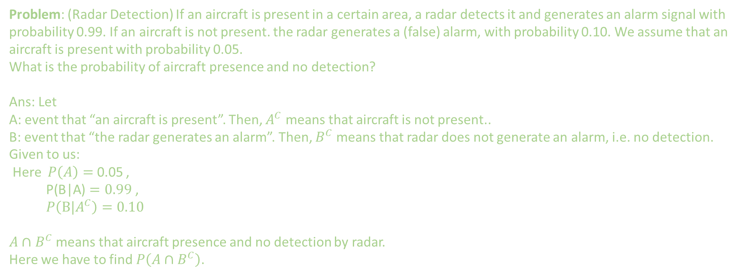
Multiplication Rule
P(A∩B) = P(A) × P(B|A)
Problem: (Radar Detection) If an aircraft is present in a certain area, a radar detects it and generates an alarm signal with probability 0.99. If an aircraft is not present. the radar generates a (false) alarm, with probability 0.10. We assume that an aircraft is present with probability 0.05.
What is the probability of aircraft presence and no detection?
Ans: Let
A: event that “an aircraft is present”. Then, $A^{C}$ means that aircraft is not present..
B: event that “the radar generates an alarm”. Then, $B^{C}$ means that radar does not generate an alarm, i.e. no detection.
Given to us:
Here $P\left(A\right)=$ 0.05 ,
$\text{P}\text{(}\text{B}\text{|}\text{A}\text{)}=0.99$ ,
$P\left(B|A^{C}\right)=0.10$
$A∩$ $B^{C}$ means that aircraft presence and no detection by radar.
Here we have to find $P\left(A∩B^{C}\right)$.

Slide 18
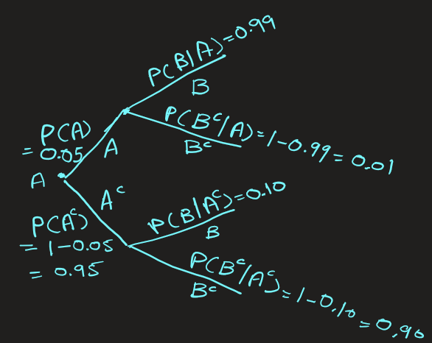
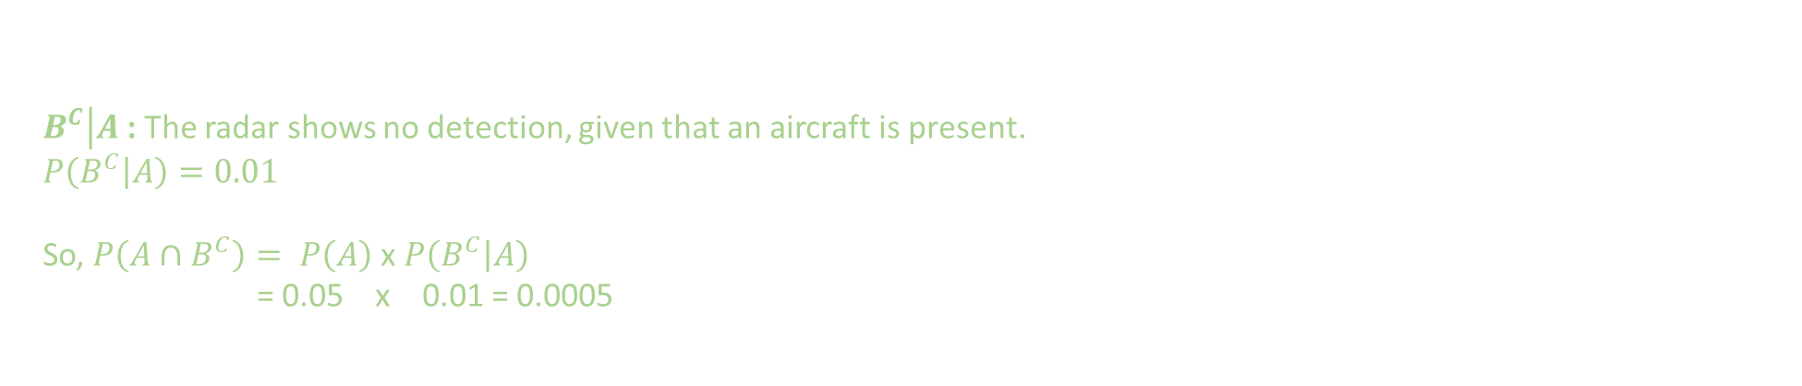
Multiplication Rule
P(A∩B) = P(A) × P(B|A)
$\left.B^{C}\right|A$ : The radar shows no detection, given that an aircraft is present.
$$P\left(\left.B^{C}\right|A\right)=0.01$$
So, $P\left(A∩B^{C}\right)= P\left(A\right)$x $P\left(\left.B^{C}\right|A\right)$
= 0.05 x 0.01 = 0.0005

Slide 19
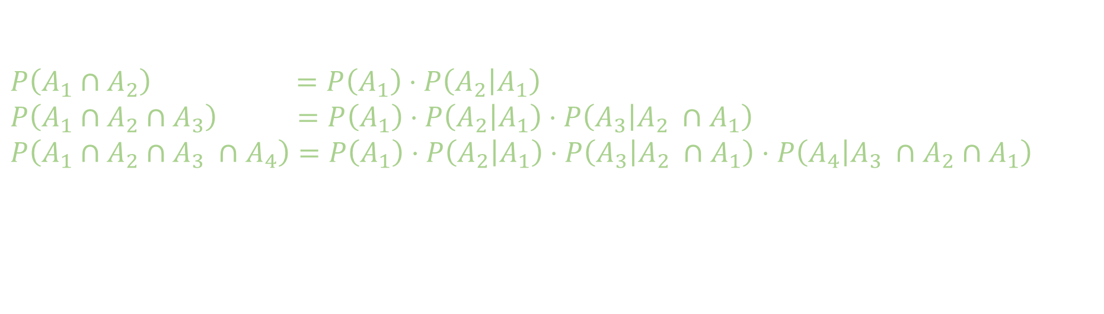
Multiplication Rule: Generalization
P(A∩B) = P(A) × P(B|A)
$$P\left(A_{1}∩A_{2}\right) =P\left(A_{1}\right)⋅P\left(\left.A_{2}\right|A_{1}\right)$$
$P\left(A_{1}∩A_{2}∩A_{3}\right) =P\left(A_{1}\right)⋅P\left(\left.A_{2}\right|A_{1}\right)$ $⋅P\left(\left.A_{3}\right|A_{2} ∩A_{1}\right)$
$P\left(A_{1}∩A_{2}∩A_{3} ∩A_{4}\right)=P\left(A_{1}\right)⋅P\left(\left.A_{2}\right|A_{1}\right)$ $⋅P\left(\left.A_{3}\right|A_{2} ∩A_{1}\right)$ $⋅$ $P\left(\left.A_{4}\right|A_{3} ∩A_{2}∩A_{1}\right)$

