Slide 1
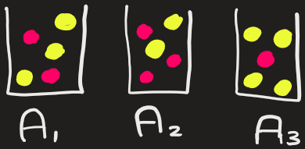
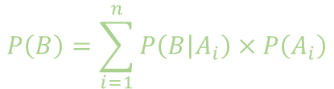
Law Of Total Probability
$$P\left(B\right)=\sum_{i=1}^{n}{P\left(\left.B\right|A_{i}\right)}×P\left(A_{i}\right)$$
Problem: Suppose we have following 3 bags containing red and yellow balls
Bag 1: 2 red balls and 3 yellow balls
Bag 2: 3 red balls and 2 yellow balls
Bag 3: 1 red balls and 4 yellow balls
If a ball is randomly selected from a random bag, what is the probability that the ball is red ?

Slide 2
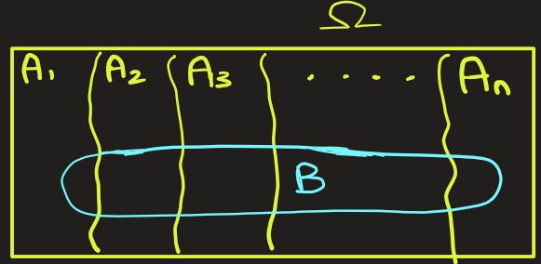
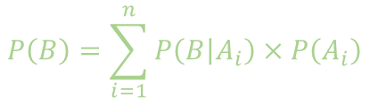
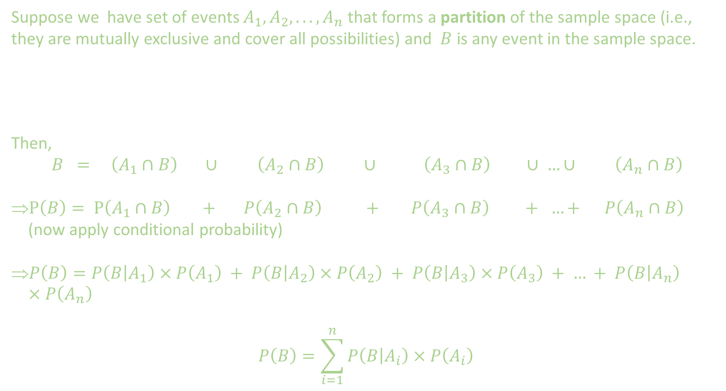
$$P\left(B\right)=\sum_{i=1}^{n}{P\left(\left.B\right|A_{i}\right)}×P\left(A_{i}\right)$$
Suppose we have set of events $A_{1},A_{2},...,A_{n}$ that forms a partition of the sample space (i.e., they are mutually exclusive and cover all possibilities) and $B$ is any event in the sample space.
Then,
$B = \left(A_{1}∩B\right) ∪ \left(A_{2}∩B\right) ∪ \left(A_{3}∩B\right) ∪ …∪ \left(A_{n}∩B\right)$
$P\left(B\right)= P\left(A_{1}∩B\right) + P\left(A_{2}∩B\right) + P\left(A_{3}∩B\right) + …+ P\left(A_{n}∩B\right)$ (now apply conditional probability)
$P\left(B\right)=P\left(\left.B\right|A_{1}\right)×P\left(A_{1}\right) + P\left(\left.B\right|A_{2}\right)×P\left(A_{2}\right) + P\left(\left.B\right|A_{3}\right)×P\left(A_{3}\right) + … + P\left(\left.B\right|A_{n}\right)×P\left(A_{n}\right)$
$$P\left(B\right)=\sum_{i=1}^{n}{P\left(\left.B\right|A_{i}\right)}×P\left(A_{i}\right)$$

Slide 3
$$P\left(B\right)=\sum_{i=1}^{n}{P\left(\left.B\right|A_{i}\right)}×P\left(A_{i}\right)$$
Why do we need Law of Total Probability ?
Answer: Because sometimes we are given conditional probability, P(B|A), and P(A), and we have to find P(B).

Slide 4
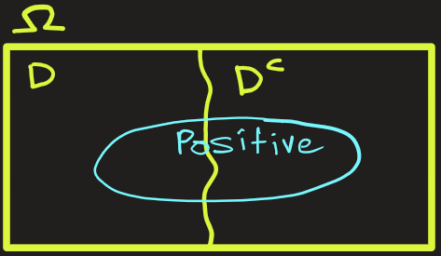
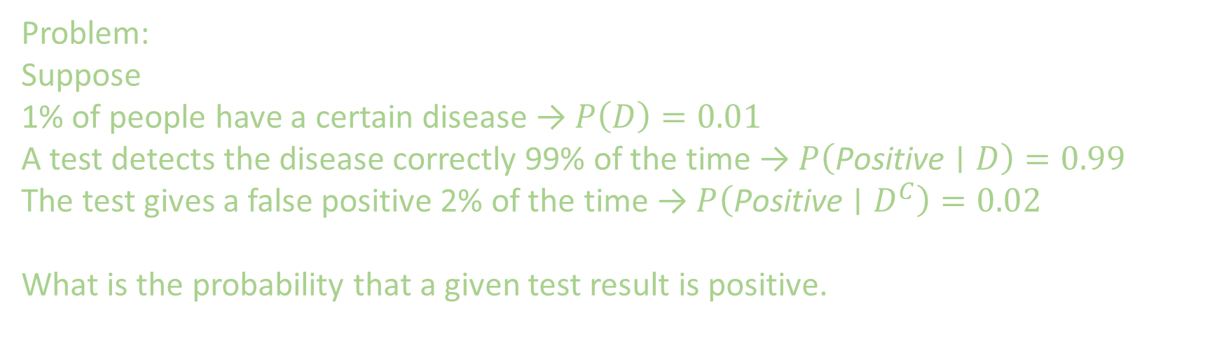
Law Of Total Probability
$$P\left(B\right)=\sum_{i=1}^{n}{P\left(\left.B\right|A_{i}\right)}×P\left(A_{i}\right)$$
Problem:
Suppose
1% of people have a certain disease → $P\left(D\right)=0.01$
A test detects the disease correctly 99% of the time → $P\left(\text{Positive}∣D\right)=0.99$
The test gives a false positive 2% of the time → $P\left(\text{Positive}∣D^{C}\right)=0.02$
What is the probability that a given test result is positive.

Slide 5
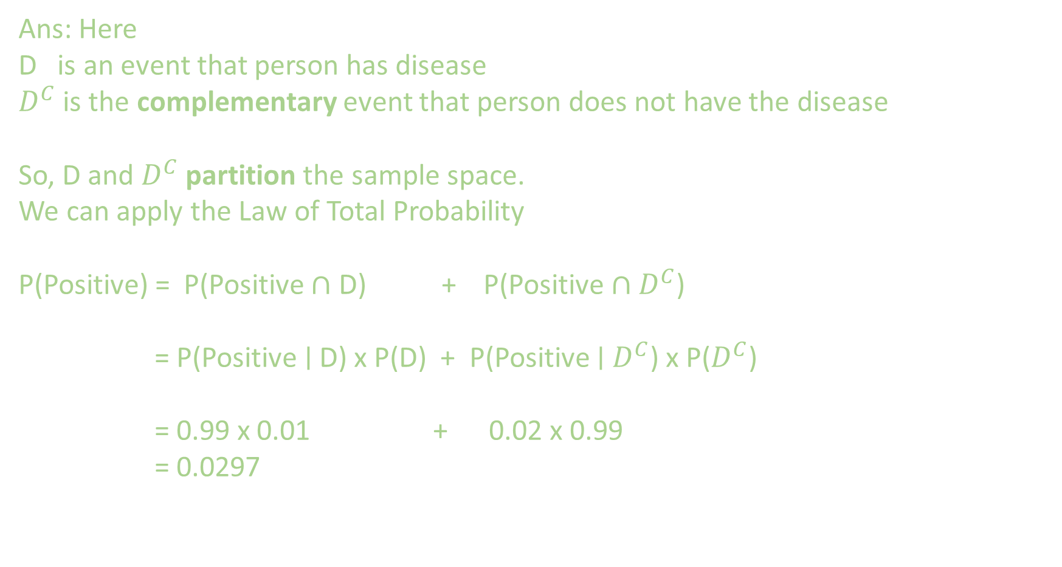
$$P\left(B\right)=\sum_{i=1}^{n}{P\left(\left.B\right|A_{i}\right)}×P\left(A_{i}\right)$$
Ans: Here
D is an event that person has disease
$D^{C}$ is the complementary event that person does not have the disease
So, D and $D^{C}$ partition the sample space.
We can apply the Law of Total Probability
P(Positive) = P(Positive $∩$ D) + P(Positive $∩$ $D^{C}$)
= P(Positive ∣ D) x P(D) + P(Positive ∣ $D^{C}$) x P($D^{C}$)
= 0.99 x 0.01 + 0.02 x 0.99
= 0.0297

Slide 6
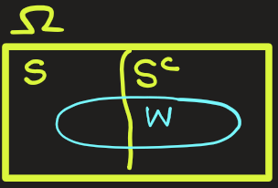
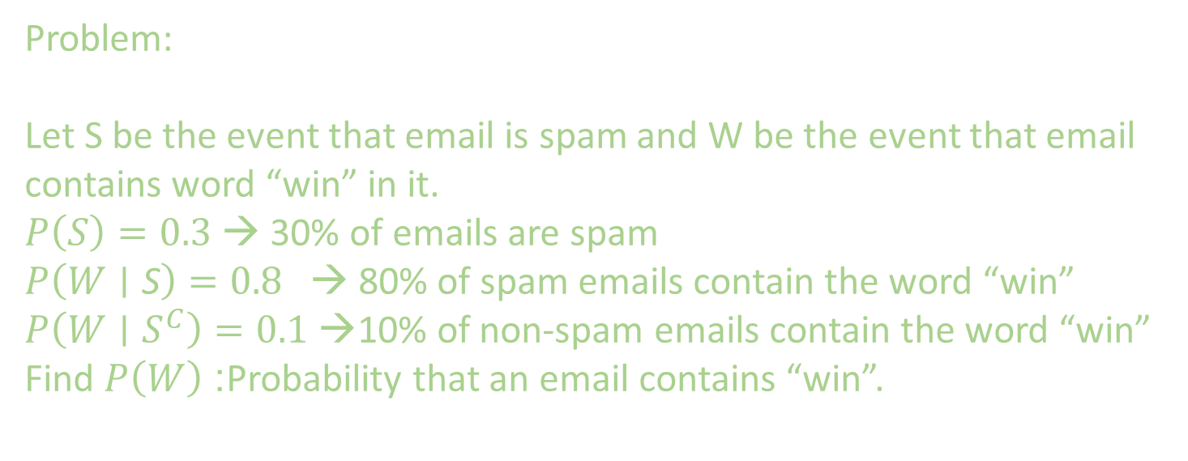
Law Of Total Probability
$$P\left(B\right)=\sum_{i=1}^{n}{P\left(\left.B\right|A_{i}\right)}×P\left(A_{i}\right)$$
Problem:
Let S be the event that email is spam and W be the event that email contains word “win” in it.
$P\left(S\right)=0.3$ → 30% of emails are spam
$P\left(W∣\text{S}\right)=0.8$ → 80% of spam emails contain the word “win”
$P\left(W∣S^{C}\right)=0.1$ →10% of non-spam emails contain the word “win”
Find $P\left(W\right)$: Probability that an email contains “win”.

Slide 7
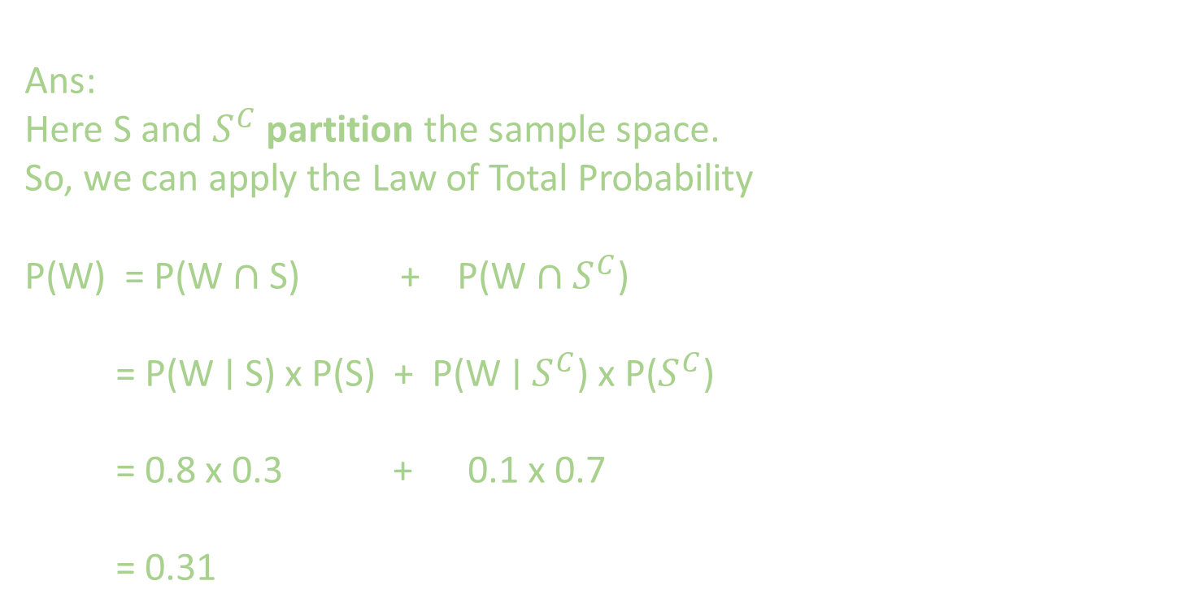
Law Of Total Probability
$$P\left(B\right)=\sum_{i=1}^{n}{P\left(\left.B\right|A_{i}\right)}×P\left(A_{i}\right)$$
Ans:
Here S and $S^{C}$ partition the sample space.
So, we can apply the Law of Total Probability
P(W) = P(W $∩$ S) + P(W $∩$ $S^{C}$)
= P(W ∣ S) x P(S) + P(W ∣ $S^{C}$) x P($S^{C}$)
= 0.8 x 0.3 + 0.1 x 0.7
= 0.31

Slide 8
Law Of Total Probability
$$P\left(B\right)=\sum_{i=1}^{n}{P\left(\left.B\right|A_{i}\right)}×P\left(A_{i}\right)$$
Problem: Suppose we have following 3 bags containing red and yellow balls
Bag 1: 2 red balls and 3 yellow balls
Bag 2: 3 red balls and 2 yellow balls
Bag 3: 1 red balls and 4 yellow balls
If a ball is randomly selected from a random bag, what is the probability that the ball is red ?

Slide 9
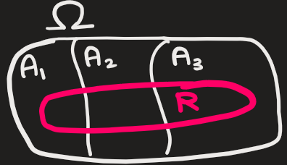
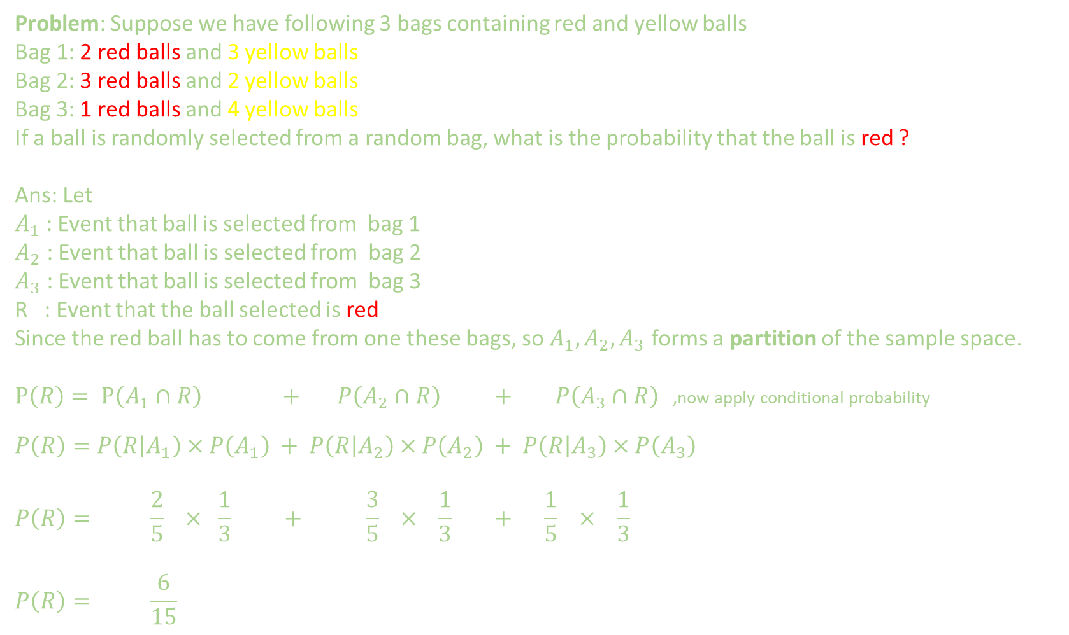
Law Of Total Probability
$$P\left(B\right)=\sum_{i=1}^{n}{P\left(\left.B\right|A_{i}\right)}×P\left(A_{i}\right)$$
Problem: Suppose we have following 3 bags containing red and yellow balls
Bag 1: 2 red balls and 3 yellow balls
Bag 2: 3 red balls and 2 yellow balls
Bag 3: 1 red balls and 4 yellow balls
If a ball is randomly selected from a random bag, what is the probability that the ball is red ?
Ans: Let
$A_{1}$ : Event that ball is selected from bag 1
$A_{2}$ : Event that ball is selected from bag 2
$A_{3}$ : Event that ball is selected from bag 3
R : Event that the ball selected is red
Since the red ball has to come from one these bags, so $A_{1},A_{2},A_{3}$ forms a partition of the sample space.
$P\left(R\right)= P\left(A_{1}∩R\right) + P\left(A_{2}∩R\right) + P\left(A_{3}∩R\right)$ ,now apply conditional probability
$$P\left(R\right)=P\left(\left.R\right|A_{1}\right)×P\left(A_{1}\right) + P\left(\left.R\right|A_{2}\right)×P\left(A_{2}\right) + P\left(\left.R\right|A_{3}\right)×P\left(A_{3}\right)$$
$$P\left(R\right)= \frac{2}{5} × \frac{1}{3} + \frac{3}{5} × \frac{1}{3} + \frac{1}{5} × \frac{1}{3}$$
$$P\left(R\right)= \frac{6}{15}$$

Slide 10
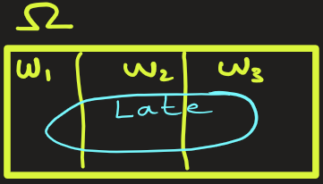
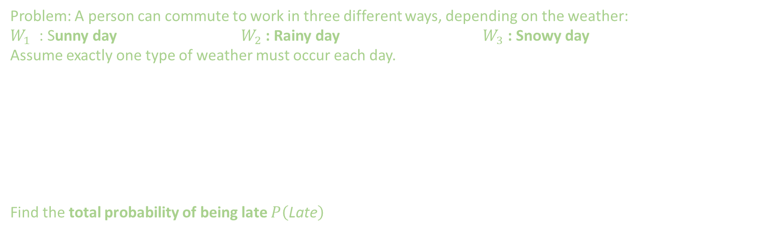
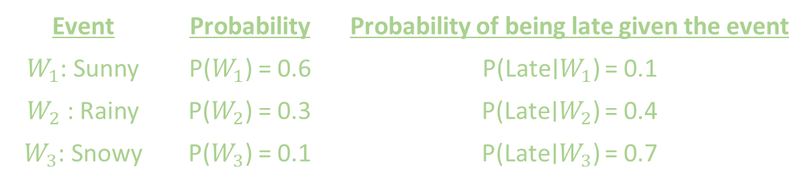
Law Of Total Probability
$$P\left(B\right)=\sum_{i=1}^{n}{P\left(\left.B\right|A_{i}\right)}×P\left(A_{i}\right)$$
Problem: A person can commute to work in three different ways, depending on the weather:
$W_{1}$ : Sunny day $W_{2}$ : Rainy day $W_{3}$ : Snowy day
Assume exactly one type of weather must occur each day.
Find the total probability of being late $P\left(\text{Late}\right)$
Event | Probability | Probability of being late given the event
$W_{1}$: Sunny | P($W_{1}$) = 0.6 | P(Late∣$W_{1}$​) = 0.1
$W_{2}$ : Rainy | P($W_{2}$) = 0.3 | P(Late∣$W_{2}$) = 0.4
$W_{3}$: Snowy | P($W_{3}$) = 0.1 | P(Late∣$W_{3}$) = 0.7

Slide 11
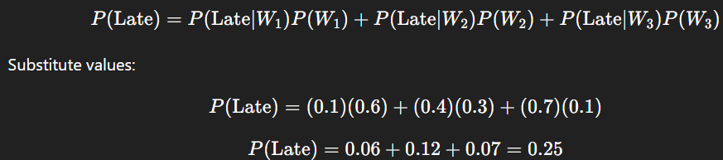

Law Of Total Probability
$$P\left(B\right)=\sum_{i=1}^{n}{P\left(\left.B\right|A_{i}\right)}×P\left(A_{i}\right)$$
Problem: A person can commute to work in three different ways, depending on the weather:
$W_{1}$ : Sunny day $W_{2}$ : Rainy day $W_{3}$ : Snowy day
Assume exactly one type of weather must occur each day.
Find the total probability of being late $P\left(\text{Late}\right)$
Ans: These three events $W_{1},W_{2},W_{3}$form a partition of the sample space because exactly one type of weather must occur each day. So, we can apply the Law of Total Probability
There’s a 25% chance the person will be late overall, considering all weather conditions.
Event | Probability | Probability of being late given the event
$W_{1}$: Sunny | P($W_{1}$) = 0.6 | P(Late∣$W_{1}$​) = 0.1
$W_{2}$ : Rainy | P($W_{2}$) = 0.3 | P(Late∣$W_{2}$) = 0.4
$W_{3}$: Snowy | P($W_{3}$) = 0.1 | P(Late∣$W_{3}$) = 0.7

Slide 12
Law Of Total Probability
$$P\left(B\right)=\sum_{i=1}^{n}{P\left(\left.B\right|A_{i}\right)}×P\left(A_{i}\right)$$
Problem: A person can commute to work in three different ways, depending on the weather:
$W_{1}$ : Sunny day $W_{2}$ : Rainy day $W_{3}$ : Snowy day
Assume exactly one type of weather must occur each day.
Find the total probability of being late $P\left(\text{Late}\right)$
Ans: These three events $W_{1},W_{2},W_{3}$form a partition of the sample space because exactly one type of weather must occur each day. So, we can apply the Law of Total Probability
There’s a 25% chance the person will be late overall, considering all weather conditions.
Event | Probability | Probability of being late given the event
$W_{1}$: Sunny | P($W_{1}$) = 0.6 | P(Late∣$W_{1}$​) = 0.1
$W_{2}$ : Rainy | P($W_{2}$) = 0.3 | P(Late∣$W_{2}$) = 0.4
$W_{3}$: Snowy | P($W_{3}$) = 0.1 | P(Late∣$W_{3}$) = 0.7

Slide 13
Law Of Total Probability
$$P\left(B\right)=\sum_{i=1}^{n}{P\left(\left.B\right|A_{i}\right)}×P\left(A_{i}\right)$$

Slide 14
Law Of Total Probability
Jlkdfds
Flsdf\p

Slide 15

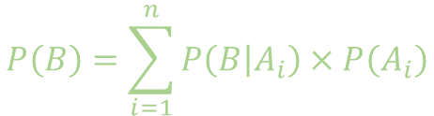
Extra
Jlkdfds
Flsdf\p
$$P\left(B\right)=\sum_{i=1}^{n}{P\left(\left.B\right|A_{i}\right)}×P\left(A_{i}\right)$$

