Slide 1
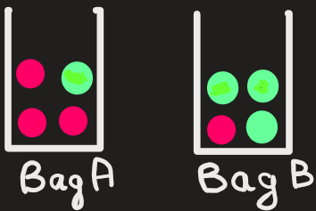



Bayes Theorem
$$P\left(\left.A\right|E\right)=\frac{P\left(A\right)×P\left(\left.E\right|A\right)}{P\left(E\right)}$$
Problem: Imagine you have two bags placed in front of you. Bag A has 3 red balls and 1 green ball. Bag B has 1 red ball and 3 green balls.
Now suppose someone randomly picks ball from one of the two bags, but he does not show you the color.
1) Can you tell the probability that the ball came from bag A?
Now he shows you the color: you are given additional information / evidence that the chosen ball is red, but you still don't know which bag it came from.
2) Now, can you tell the probability that the ball came from bag A, based on new evidence?
Is it same as before or does it change ?
And why?

Slide 2

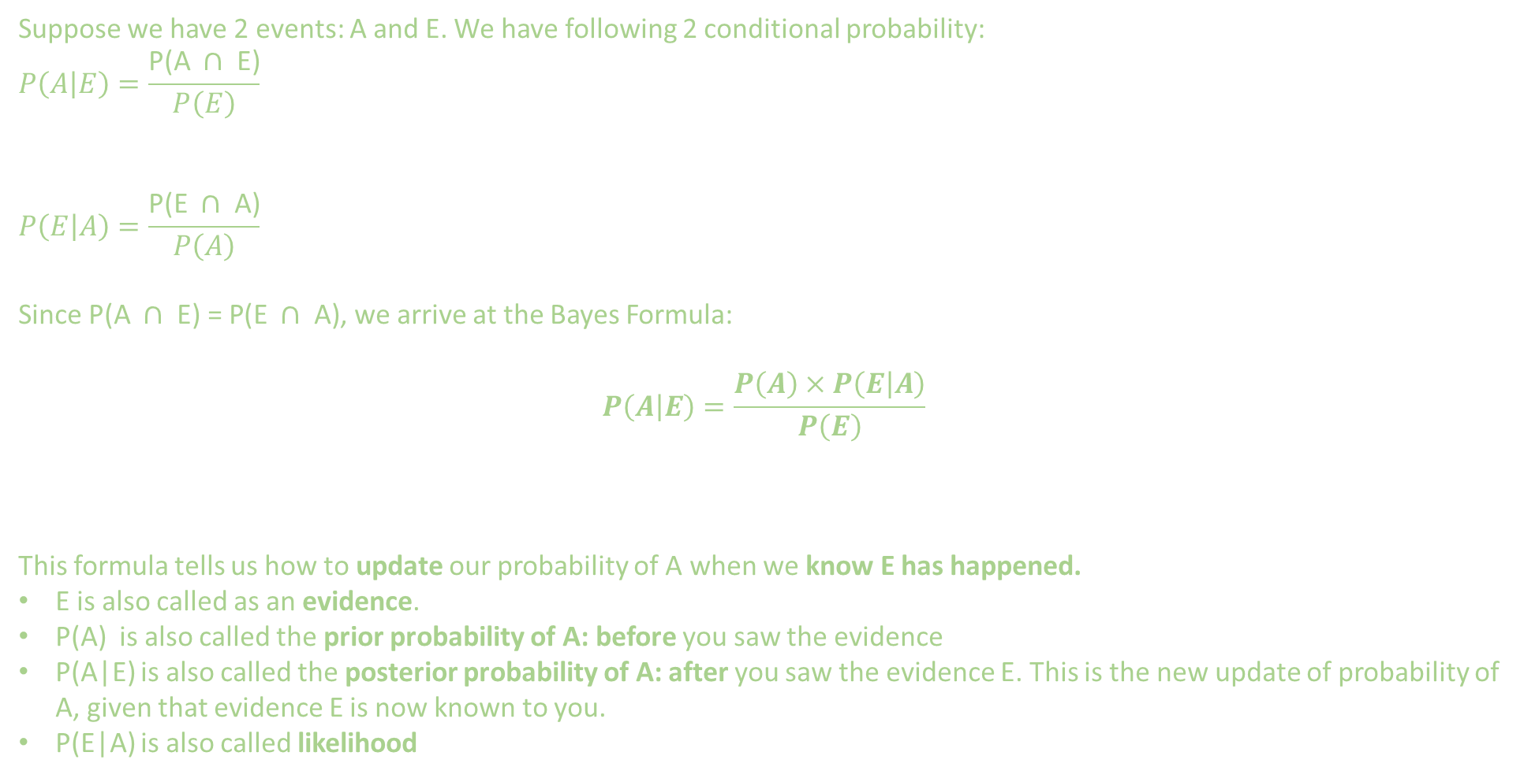
Bayes Theorem
$$P\left(\left.A\right|E\right)=\frac{P\left(A\right)×P\left(\left.E\right|A\right)}{P\left(E\right)}$$
Suppose we have 2 events: A and E. We have following 2 conditional probability:
$$P\left(\left.A\right|E\right)=\frac{\text{P}\text{(}\text{A} ∩ \text{E}\text{)}}{P\left(E\right)}$$
$$P\left(\left.E\right|A\right)=\frac{\text{P}\text{(}\text{E} ∩ \text{A}\text{)}}{P\left(A\right)}$$
Since $\text{P}\text{(}\text{A} ∩ \text{E}\text{) = }\text{P}\text{(}\text{E} ∩ \text{A}\text{)}$, we arrive at the Bayes Formula:
$$P\left(\left.A\right|E\right)=\frac{P\left(A\right)×P\left(\left.E\right|A\right)}{P\left(E\right)}$$
This formula tells us how to update our probability of A when we know E has happened.
E is also called as an evidence.
P(A) is also called the prior probability of A: before you saw the evidence
P(A|E) is also called the posterior probability of A: after you saw the evidence E. This is the new update of probability of A, given that evidence E is now known to you.​
P(E|A) is also called likelihood

Slide 3
Bayes Theorem
$$P\left(\left.A\right|E\right)=\frac{P\left(A\right)×P\left(\left.E\right|A\right)}{P\left(E\right)}$$
Problem: Bag A has 3 red balls and 1 green ball. Bag B has 1 red ball and 3 green balls. Now suppose someone randomly picks ball from one of the two bags, but he does not show you the color.
1) Can you tell the probability that the ball came from bag A?
Now he shows you the color: you are given additional information / evidence that the chosen ball is red, but you still don't know which bag it came from.
2) Now, can you tell the probability that the ball came from bag A, given the evidence?

Slide 4

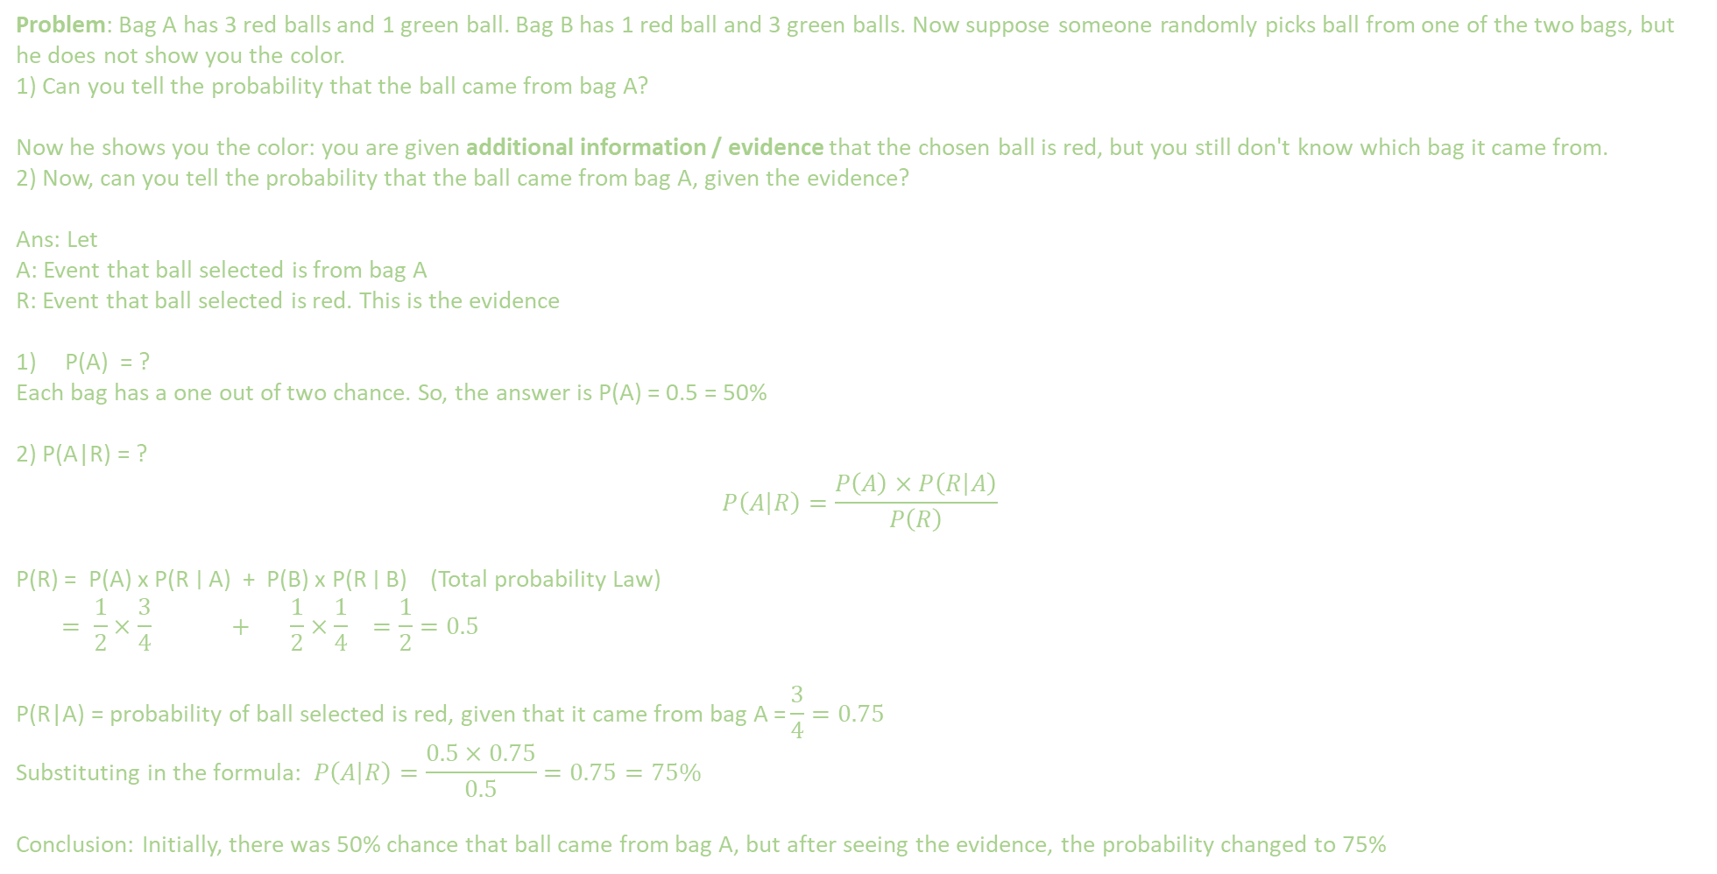
Bayes Theorem
$$P\left(\left.A\right|E\right)=\frac{P\left(A\right)×P\left(\left.E\right|A\right)}{P\left(E\right)}$$
Problem: Bag A has 3 red balls and 1 green ball. Bag B has 1 red ball and 3 green balls. Now suppose someone randomly picks ball from one of the two bags, but he does not show you the color.
1) Can you tell the probability that the ball came from bag A?
Now he shows you the color: you are given additional information / evidence that the chosen ball is red, but you still don't know which bag it came from.
2) Now, can you tell the probability that the ball came from bag A, given the evidence?
Ans: Let
A: Event that ball selected is from bag A
R: Event that ball selected is red. This is the evidence
P(A) = ?
Each bag has a one out of two chance. So, the answer is P(A) = 0.5 = 50%
2) P(A|R) = ?
$$P\left(\left.A\right|R\right)=\frac{P\left(A\right)×P\left(\left.R\right|A\right)}{P\left(R\right)}$$
P(R) = P(A) x P(R ∣ A) + P(B) x P(R ∣ B) (Total probability Law)
$$= \frac{1}{2}×\frac{3}{4} + \frac{1}{2}×\frac{1}{4} =\frac{1}{2}=0.5$$
$$\text{P}\text{(}\text{R}\text{|}\text{A}\text{) = }\text{probability} \text{of} \text{ball} \text{selected} \text{is} \text{red}\text{, }\text{given} \text{that} \text{it} \text{came} \text{from} \text{bag} \text{A}\text{ =}\frac{3}{4}=0.75$$
$$\text{Substituting} \text{in} \text{the} \text{formula}\text{: }P\left(\left.A\right|R\right)=\frac{0.5×0.75}{0.5}=0.75=75\%$$
Conclusion: Initially, there was 50% chance that ball came from bag A, but after seeing the evidence, the probability changed to 75%

Slide 5

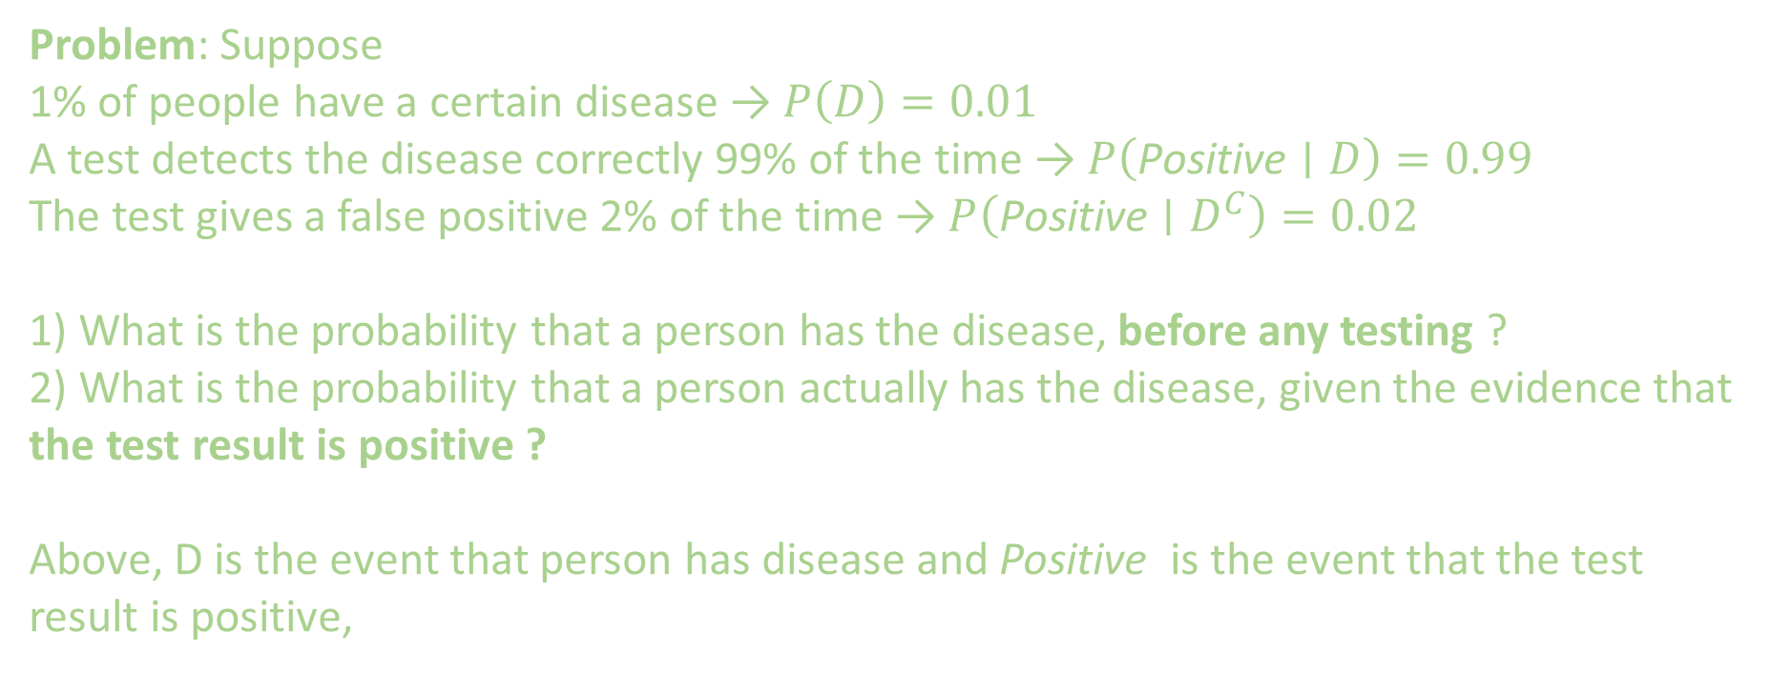
Bayes Theorem
$$P\left(\left.A\right|E\right)=\frac{P\left(A\right)×P\left(\left.E\right|A\right)}{P\left(E\right)}$$
Problem: Suppose
1% of people have a certain disease → $P\left(D\right)=0.01$
A test detects the disease correctly 99% of the time → $P\left(\text{Positive}∣D\right)=0.99$
The test gives a false positive 2% of the time → $P\left(\text{Positive}∣D^{C}\right)=0.02$
1) What is the probability that a person has the disease, before any testing ?
2) What is the probability that a person actually has the disease, given the evidence that the test result is positive ?
Above, D is the event that person has disease and Positive is the event that the test result is positive,

Slide 6
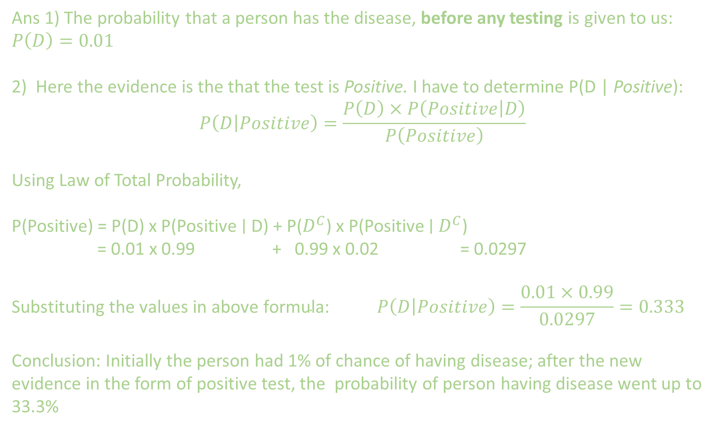
Ans 1) The probability that a person has the disease, before any testing is given to us: $P\left(D\right)=0.01$
2) Here the evidence is the that the test is Positive. I have to determine P(D | Positive):
$$P\left(\left.D\right|Positive\right)=\frac{P\left(D\right)×P\left(\left.Positive\right|D\right)}{P\left(Positive\right)}$$
Using Law of Total Probability,
P(Positive) = P(D) x P(Positive ∣ D) + P($D^{C}$) x P(Positive ∣ $D^{C}$)
= 0.01 x 0.99 + 0.99 x 0.02 = 0.0297
$$\text{Substituting} \text{the} \text{values} \text{in} \text{above} \text{formula}\text{: }P\left(\left.D\right|Positive\right)=\frac{0.01×0.99}{0.0297}=0.333$$
Conclusion: Initially the person had 1% of chance of having disease; after the new evidence in the form of positive test, the probability of person having disease went up to 33.3%

Slide 7
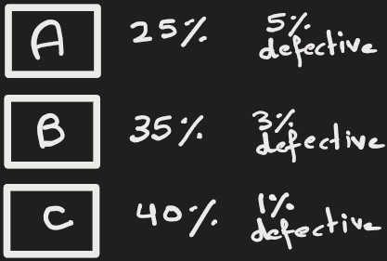

Bayes Theorem
$$P\left(\left.A\right|E\right)=\frac{P\left(A\right)×P\left(\left.E\right|A\right)}{P\left(E\right)}$$
Problem: Suppose machine A, B and C produces items and certain percentage of them are defective as shown in table below:
If you are given a defective item, then what is the probability that it came from machine C?
 | Production percentage | Defective percentage from each machine
Machine A | 25% | 5%
Machine B | 35% | 3%
Machine C | 40% | 1%

Slide 8
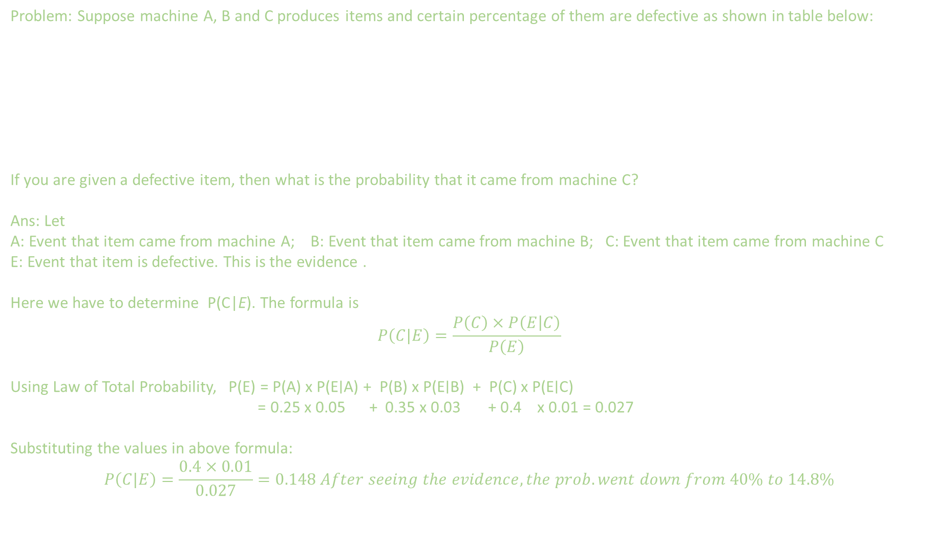
Bayes Theorem
$$P\left(\left.A\right|E\right)=\frac{P\left(A\right)×P\left(\left.E\right|A\right)}{P\left(E\right)}$$
Problem: Suppose machine A, B and C produces items and certain percentage of them are defective as shown in table below:
If you are given a defective item, then what is the probability that it came from machine C?
Ans: Let
A: Event that item came from machine A; B: Event that item came from machine B; C: Event that item came from machine C
E: Event that item is defective. This is the evidence .
Here we have to determine P(C|E). The formula is
$$P\left(C|E\right)=\frac{P\left(C\right)×P\left(\left.E\right|C\right)}{P\left(E\right)}$$
Using Law of Total Probability, P(E) = P(A) x P(E∣A) + P(B) x P(E∣B) + P(C) x P(E∣C)
= 0.25 x 0.05 + 0.35 x 0.03 + 0.4 x 0.01 = 0.027
Substituting the values in above formula:
$$P\left(C|E\right)=\frac{0.4×0.01}{0.027}=0.148 After seeing the evidence, the prob. went down from 40\% to 14.8\%$$
 | Production percentage | Defective percentage from each machine
Machine A | 25% | 5%
Machine B | 35% | 3%
Machine C | 40% | 1%

Slide 9
EXTRA
$$P\left(\left.A\right|E\right)=\frac{P\left(A\right)×P\left(\left.E\right|A\right)}{P\left(E\right)}$$
Extra problems

Slide 10
Bayes Theorem
$$P\left(\left.A\right|E\right)=\frac{P\left(A\right)×P\left(\left.E\right|A\right)}{P\left(E\right)}$$
Problem: Suppose machine A, B and C produces items and certain percentage of them are defective as shown in table below:
If you are given a defective item, then what is the probability that it came from machine C?
 | Production percentage | Defective percentage from each machine
Machine A | 25% | 5%
Machine B | 35% | 3%
Machine C | 40% | 1%

Slide 11
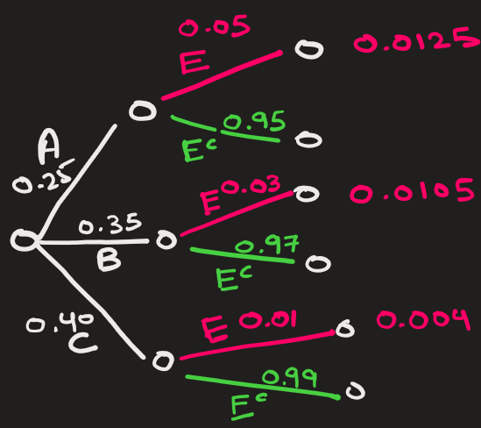
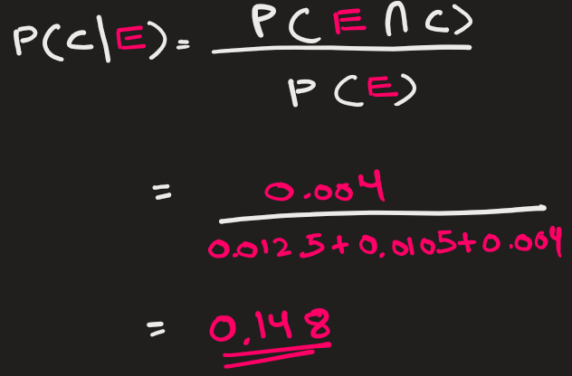
Bayes Theorem
$$P\left(\left.A\right|E\right)=\frac{P\left(A\right)×P\left(\left.E\right|A\right)}{P\left(E\right)}$$
Problem can be done using sequential tree.

Slide 12
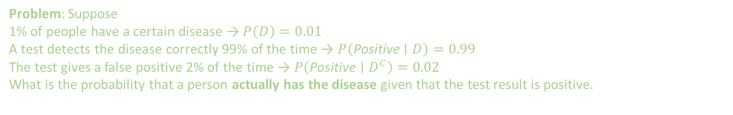
Bayes Theorem
$$P\left(\left.A\right|E\right)=\frac{P\left(A\right)×P\left(\left.E\right|A\right)}{P\left(E\right)}$$
Problem: Suppose
1% of people have a certain disease → $P\left(D\right)=0.01$
A test detects the disease correctly 99% of the time → $P\left(\text{Positive}∣D\right)=0.99$
The test gives a false positive 2% of the time → $P\left(\text{Positive}∣D^{C}\right)=0.02$
What is the probability that a person actually has the disease given that the test result is positive.

Slide 13
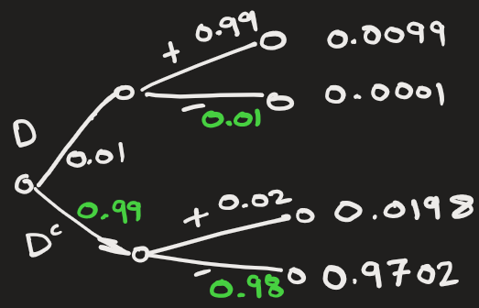
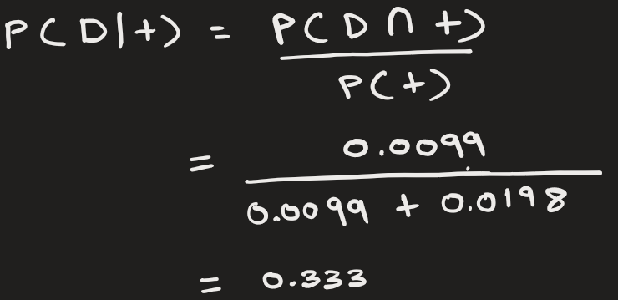
Bayes Theorem
$$P\left(\left.A\right|E\right)=\frac{P\left(A\right)×P\left(\left.E\right|A\right)}{P\left(E\right)}$$
Problem can be done using sequential tree.

Slide 14
Bayes Theorem
$$P\left(\left.A\right|E\right)=\frac{P\left(A\right)×P\left(\left.E\right|A\right)}{P\left(E\right)}$$
Problem: Bag A has 3 red balls and 1 green ball. Bag B has 1 red ball and 3 green balls. Now suppose someone randomly picks ball from one of the two bags, but he does not show you the color.
1) Can you tell the probability that the ball came from bag A?
Now he shows you the color: you are given additional information / evidence that the chosen ball is red, but you still don't know which bag it came from.
2) Now, can you tell the probability that the ball came from bag A, given the evidence?

Slide 15
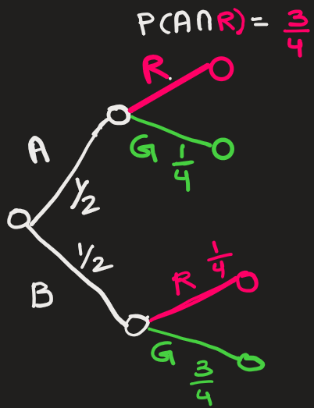
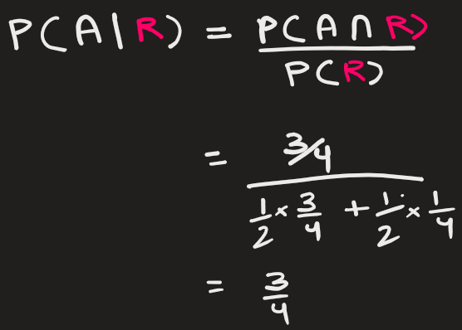
Bayes Theorem
$$P\left(\left.A\right|E\right)=\frac{P\left(A\right)×P\left(\left.E\right|A\right)}{P\left(E\right)}$$
Problem can also be done using sequential tree:

Slide 16

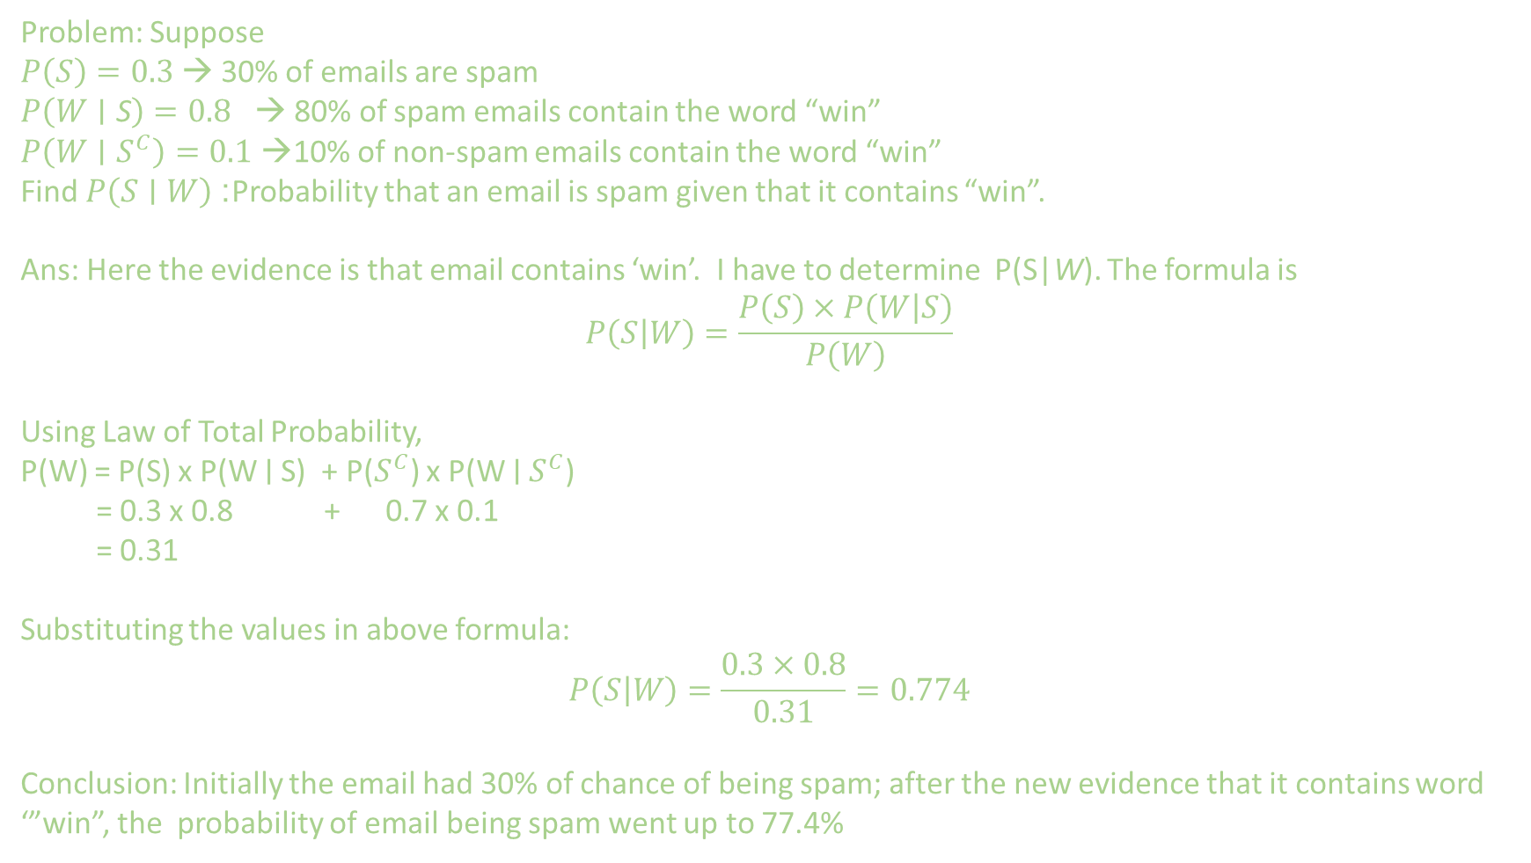
Bayes Theorem
$$P\left(\left.A\right|E\right)=\frac{P\left(A\right)×P\left(\left.E\right|A\right)}{P\left(E\right)}$$
Problem: Suppose
$P\left(S\right)=0.3$ → 30% of emails are spam
$P\left(W∣\text{S}\right)=0.8$ → 80% of spam emails contain the word “win”
$P\left(W∣S^{C}\right)=0.1$ →10% of non-spam emails contain the word “win”
Find $P\left(S∣W\right)$: Probability that an email is spam given that it contains “win”.
Ans: Here the evidence is that email contains ‘win’. I have to determine P(S|W). The formula is
$$P\left(\left.S\right|W\right)=\frac{P\left(S\right)×P\left(\left.W\right|S\right)}{P\left(W\right)}$$
Using Law of Total Probability,
P(W) = P(S) x P(W ∣ S) + P($S^{C}$) x P(W ∣ $S^{C}$)
= 0.3 x 0.8 + 0.7 x 0.1
= 0.31
Substituting the values in above formula:
$$P\left(\left.S\right|W\right)=\frac{0.3×0.8}{0.31}=0.774$$
Conclusion: Initially the email had 30% of chance of being spam; after the new evidence that it contains word ‘”win”, the probability of email being spam went up to 77.4%

