Slide 1

Binomial Distribution
The Binomial Distribution is a discrete probability distribution that describes the number of successes in a fixed number of independent experiments (trials) where each trial has only two possible outcomes.
These outcomes are usually called Success and Failure
Example:
You toss a coin 4 times and success is getting head.
Here each toss is independent experiment
You can get
0 success
1 success
2 success -->
3 success
4 success.

Slide 2
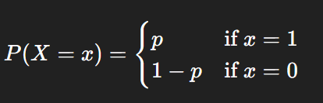
Binomial Distribution
Example:
You pick 4 random emails from inbox and success is getting spam.
Here picking each email is independent experiment
You can get
0 success -> no spam
1 success -> 1 spam
2 success -> 2 spam
3 success - >3 spam
4 success. - >4 spam
Spam
Spam
Spam
Non-Spam

Slide 3
Binomial Distribution
Example:
You pick 4 random items from an assembly line for inspection.
Success is getting defective piece.
Here picking item is an independent experiment
You can get
0 success -> no defect
1 success -> 1 defect
2 success -> 2 defect
3 success - >3 defect
4 success. - >4 defect
Non-Defect
Non-Defect
Non-Defect
Non-Defect
Defect
Non-Defect
Non-Defect
Non-Defect
Defect
Defect
Non-Defect
Non-Defect
Defect
Defect
Defect
Non-Defect

Slide 4
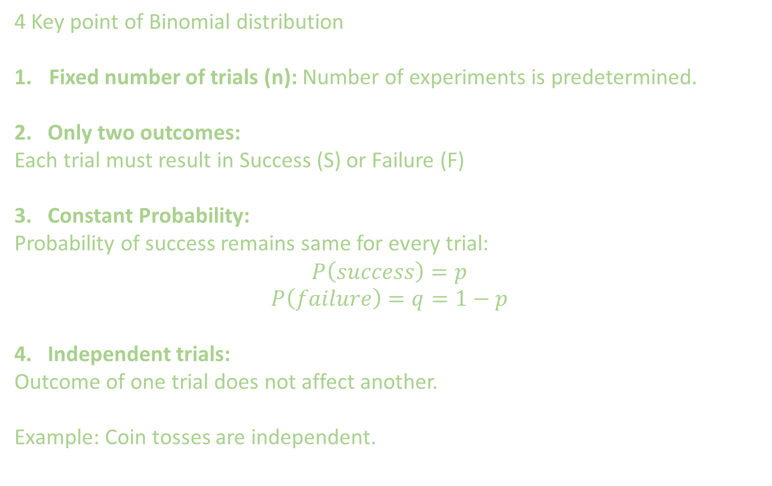
4 Key point of Binomial distribution
Fixed number of trials (n): Number of experiments is predetermined.
2. Only two outcomes:
Each trial must result in Success (S) or Failure (F)
3. Constant Probability:
Probability of success remains same for every trial:
$$P\left(success\right)=p$$
$$P\left(failure\right)=q=1−p$$
4. Independent trials:
Outcome of one trial does not affect another.
Example: Coin tosses are independent.

Slide 5

Random Variable
Let:
$$X=\text{Number} \text{of} \text{successes} \text{in} n \text{trials}$$
Then:
$$X∼Binomial(n,p)$$
Where,
$n$= number of trials
$p$= probability of success

Slide 6


Number of ways to choose k successes from n trials:
Example: You perform 4-coin toss experiment.
In how many ways can you have 2 heads ?
There are 6 ways of getting 2 H in 4-coin tosses:
HHTT, HTTH, HTHT, TTHH, THTH, THHT
Here Probability Mass Function (PMF) is given by
This is the probability of k successes

Slide 7
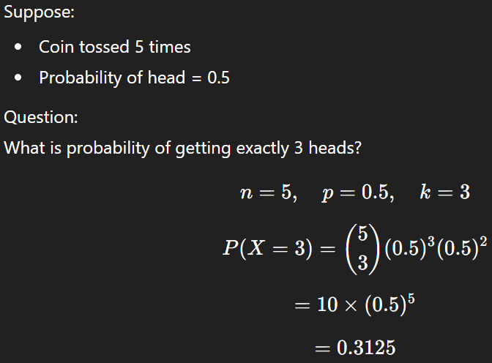

Slide 8
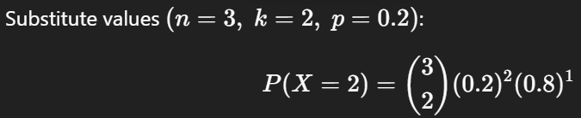

Example:
An assembly line produces machine parts. The probability that a part is defective is 0.2.
Three parts are selected randomly and independently.
What is the probability that exactly 2 parts are defective?
Solution:
Here we have 3 experiments: n=3
Success is getting a defective part. So, k=2

Slide 9
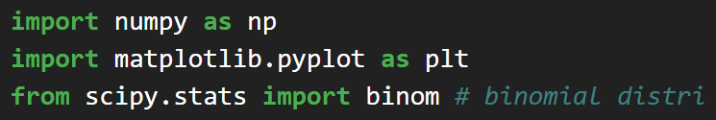
Code

Slide 10
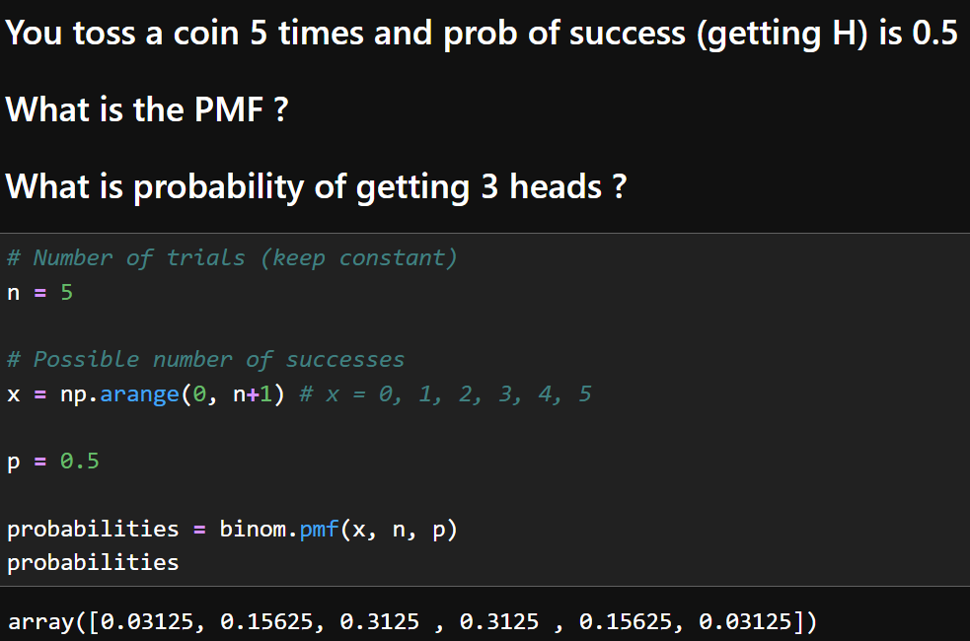
Code

Slide 11
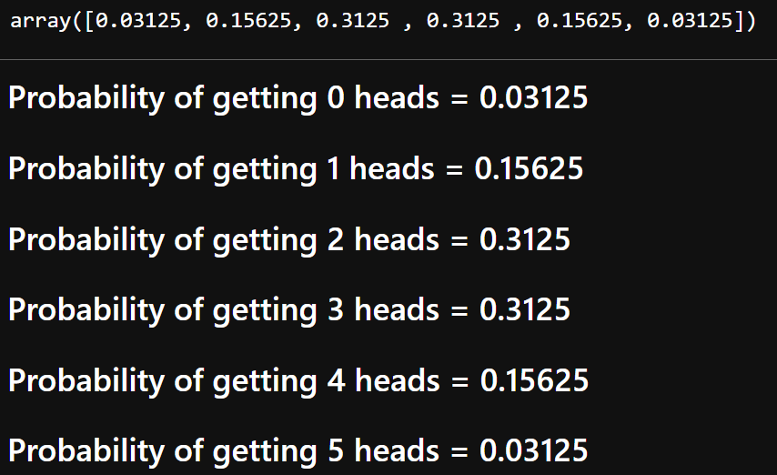
Code

Slide 12
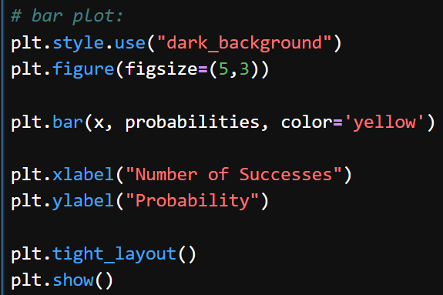
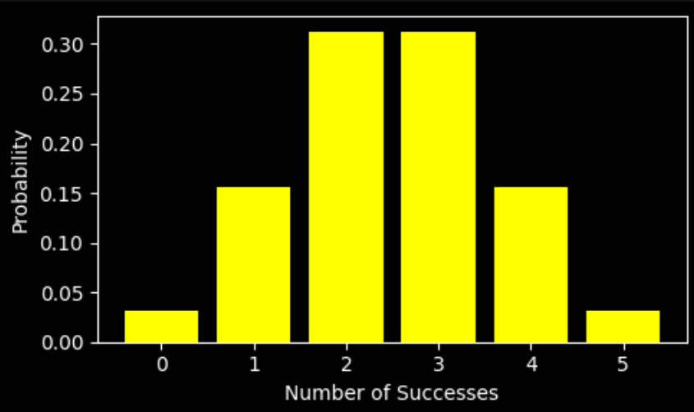
Code

Slide 13
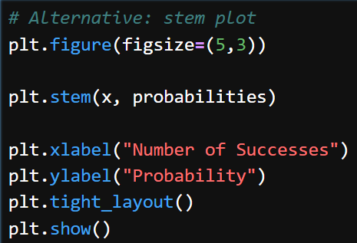
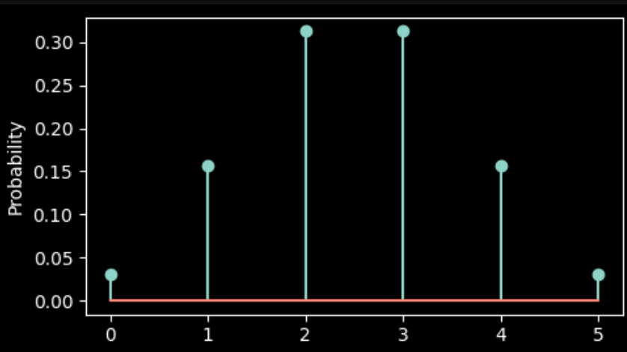
Code

Slide 14
Real-Life Applications
Binomial distribution is widely used in:
Machine Learning classification accuracy
Quality control testing
A/B testing
Medical trials

Slide 16
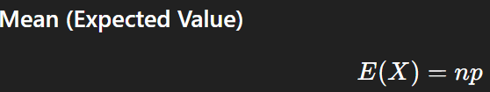
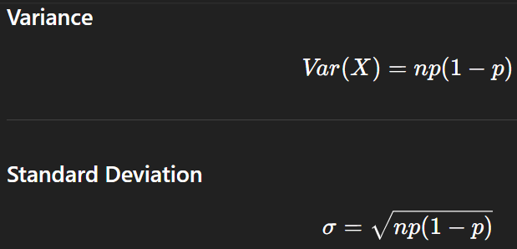

Slide 17
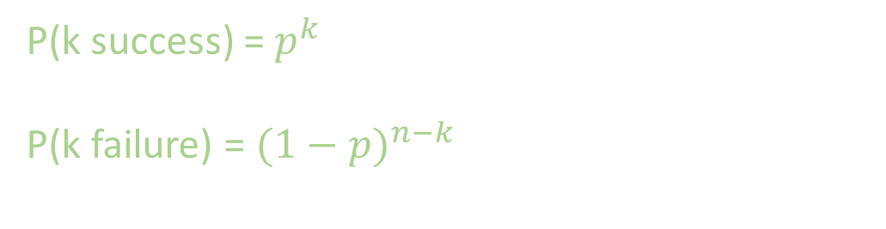
P(k success) = $p^{k}$
P(k failure) = ${(1−p)}^{n−k}$

