Slide 1
Null Hypothesis (H₀)
Alternate Hypothesis (H₁)

Slide 2
Need For Hypothesis Testing
1) A school claims that a new teaching method improves test scores.
2) A company claims their medicine decreases blood pressure.
How do we verify if this is true?

Slide 3
A statistical hypothesis is a conjecture/claim about a population parameter (e.g. mean, variance, std. dev., etc. ).
This conjecture may or may not be true.
Null hypothesis (H0):
There is no difference between a population parameter and the observed parameter.
That is, nothing is happening. Status quo.
Alternative hypothesis (H1):
There is a difference between population parameter and the observed parameter.
That is, something is happening.

Slide 4
Simple Example: Imagine you want to test if a new teaching method improves test scores.
Null hypothesis (H₀): The new teaching method has no effect on test scores.
( Students scores remained same as before. Nothing happened. No significant change)
Alternative hypothesis (H₁): The new teaching method has positive effect test scores.
( Students scores increased. Something happened. There was significant change)
Side Note:
The claim is generally the alternative hypothesis: This is what the researchers is trying to verify

Slide 5
Relationship Between H₀ and H₁
They are mutually exclusive -> Only one can be true
We assume H₀ is true initially
“We don’t prove H₁ directly. We try to reject H₀.”
Here we use statistics / data.
For example, when we are testing if a new teaching method improves test scores.
We start with assumption -> Null hypothesis (H₀) is true
The new teaching method has no effect on test scores.
We look at the data and then determine if null hypothesis should be rejected or not

Slide 6
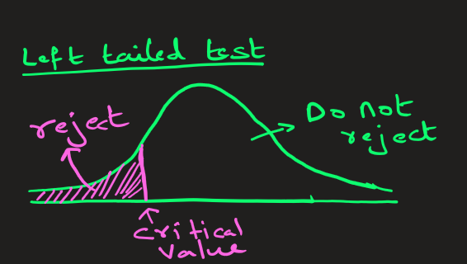
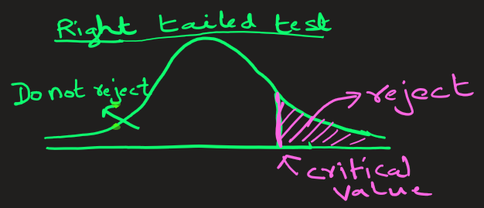
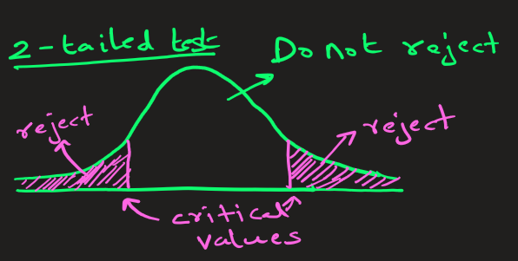
Decision Concept
We collect sample data → then decide:
Reject H₀
OR Fail to reject H₀
⚠️ Important:
We never say “accept H₀”
Only: “fail to reject”

Slide 7
Hypothesis problems fall under following 3 categories:
Left-tailed test:
H₁ : The new teaching method decreased the test scores.
Right-tailed test
H₁: The new teaching method increased the test scores.
2-tailed test
H₁: The new teaching method had no effect on the test scores.

Slide 8
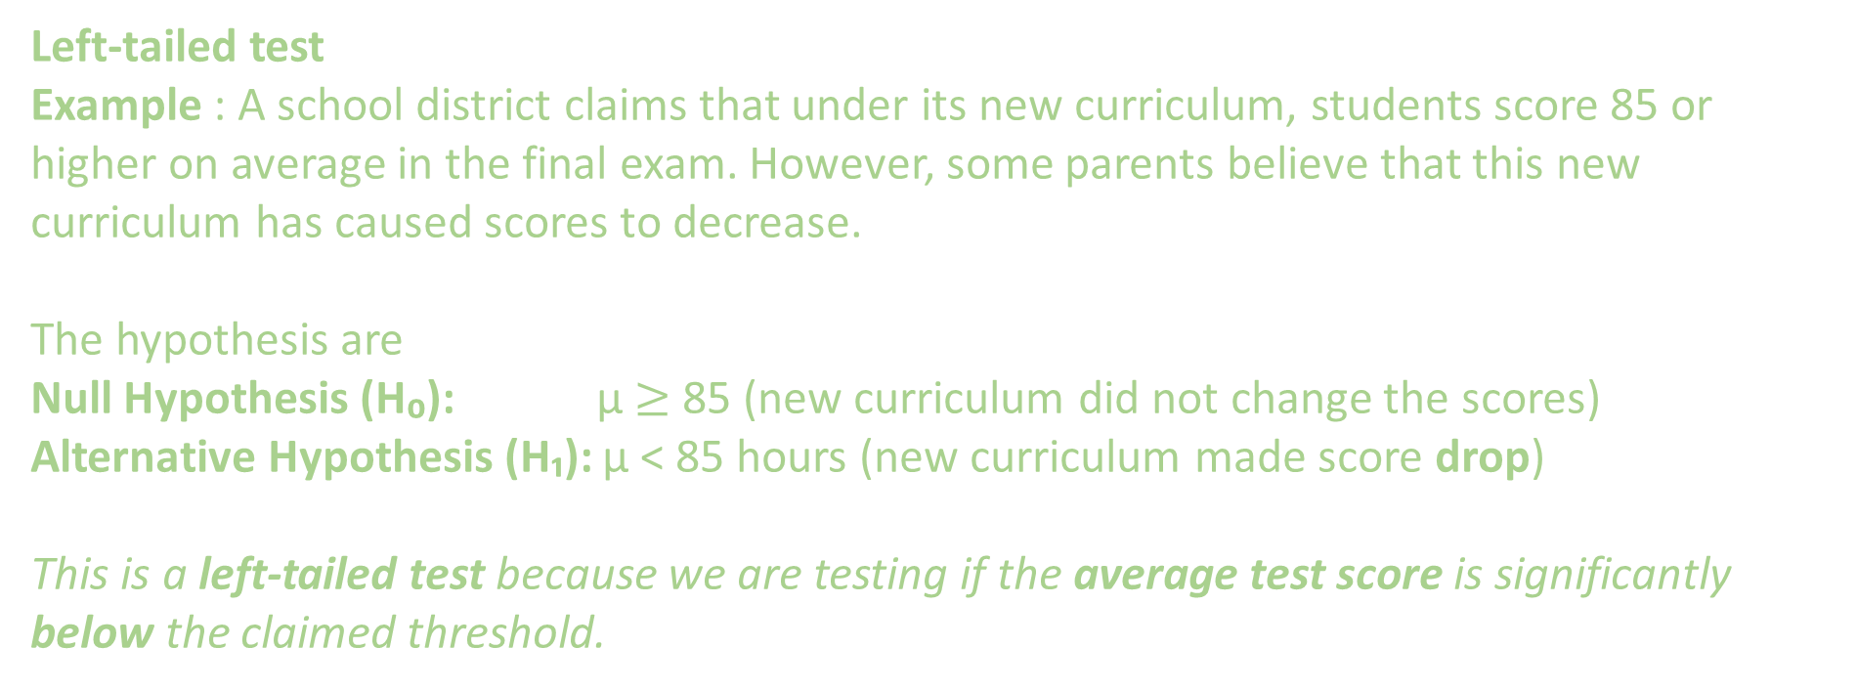
Left-tailed test
Example : A school district claims that under its new curriculum, students score 85 or higher on average in the final exam. However, some parents believe that this new curriculum has caused scores to decrease.
The hypothesis are
Null Hypothesis (H₀): μ $≥$ 85 (new curriculum did not change the scores)
Alternative Hypothesis (H₁): μ < 85 hours (new curriculum made score drop)
This is a left-tailed test because we are testing if the average test score is significantly below the claimed threshold.
85

Slide 9
Left-tailed test
Example: A water treatment plant claims their new filtration system reduces contaminant levels to below 5 ppm. Environmental engineers want to verify the claim that filtration system performs better.
The hypothesis are
Null Hypothesis (H₀): μ = 5 ppm (The mean contaminant level is = 5 ppm. No change)
Alternative Hypothesis (H₁): μ < 5 ppm (The mean contaminant level is less than 5 ppm)
This is left-tailed because we're testing if the contaminant level is significantly below the claimed threshold.

Slide 10
Right tailed test
Example : An engineer develops a new protective coating to increase the lifetime of a metal component used in automotive manufacturing. If the mean lifetime of the component without the coating is 36 months, then the engineer’s hypothesis are:
Null Hypothesis (H₀): μ = 36 month (the coating does not change the mean lifetime)
Alternative Hypothesis (H₁): μ > 36 months (the coating increases the mean lifetime)
This is right-tailed because we're specifically testing if after application of coating, the
lifetime significantly exceeds the minimum threshold.

Slide 11
Right tailed test
Example : Imagine you normally jog an average distance of 5 km in an hour. After 2 weeks of a new jogging plan, you want to prove that your average jogging distance has improved.
Null Hypothesis (H₀): μ = 5 Km (the new jogging plan does not change the average)
Alternative Hypothesis (H₁): μ > 5 Km (the new jogging plan did increase the average )
This is right-tailed because we're specifically testing if employing new plan, the
average distance jogged significantly increased.

Slide 12
2-tailed test
Example : A medical researcher is interested in finding out whether a new medication will have any undesirable side effects on pulse rate: will the pulse rate increase, decrease, or remain unchanged after a patient takes the medication? The researcher knows that the mean pulse rate for the population under study is 82 beats per minute.
The hypothesis for this situation are
Null Hypothesis (H₀): mean μ = 82 ( mean will remain unchanged)
Alternative Hypothesis (H₁): mean μ ≠ 82 BPM ( mean will change: the mean could be either > 82 or < 82 BPM
This test is called a two-tailed test since the possible side effects of the medicine could be to significantly raise or lower the pulse rate.

Slide 13
2-tailed test
Example : A soft drink company has a bottling machine that's supposed to fill bottles with exactly 500 ml of soda. The quality control manager suspects the machine might be malfunctioning - it could be overfilling OR underfilling bottles.
The hypothesis for this are
Null Hypothesis (H₀): μ = 500 ml (the machine is filling correctly - No change)
Alternative Hypothesis (H₁): μ ≠ 500 ml (the machine is NOT filling correctly - There is change . Could be more OR less.)
This test is called a two-tailed test since the machine could be filling less or more.

Slide 14
EXTRA
Ffnbksdfd
Fdslj;f
Fl;ds

