Slide 1
When the population standard deviation is unknown, the z-test is not typically used for testing hypotheses involving means.
A different test, called the t-test, is used.

Slide 2
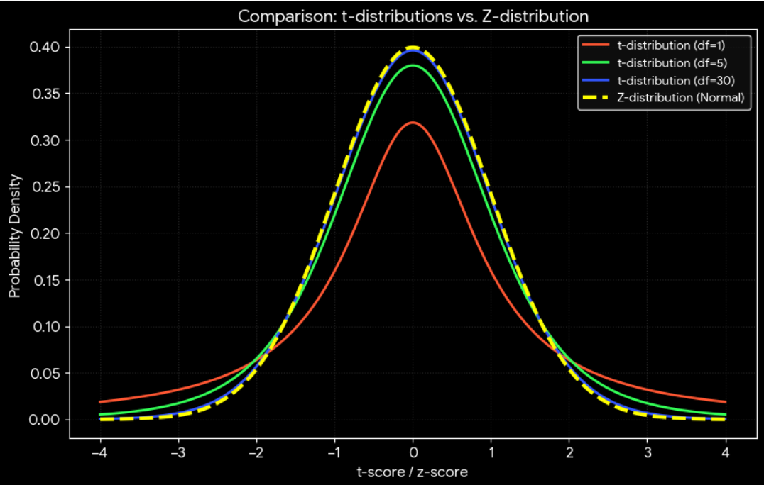
Here we make use of t-distribution curve. Itis similar to the standard normal distribution in the following ways.
It is bell-shaped and symmetric about the mean.
The mean, median, and mode are equal to 0
The curve approaches but never touches the x axis.

Slide 3
The t distribution differs from the standard normal distribution in the following ways.
The variance is greater than 1.
2. The t distribution is a family of curves based on the degrees of freedom, which is a number related to sample size.
3. As the sample size increases, the t-distribution approaches the normal distribution

Slide 4



The t-test is a statistical test for the mean of a population and is used when
the population is approximately normally distributed and
population std. dev. σ is unknown.
The formula for the t test is
$μ$ = Population mean
$\overline{x}$ = Sample mean
s = Sample standard deviation
Assumptions for the t-test for a Mean When σ Is Unknown
1. The sample is a random sample.
2. Either n >= 30 or the population is normally distributed when n < 30.

Slide 5
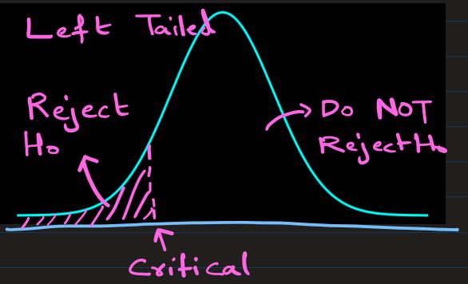
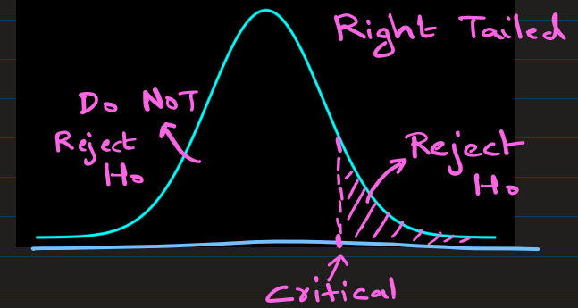
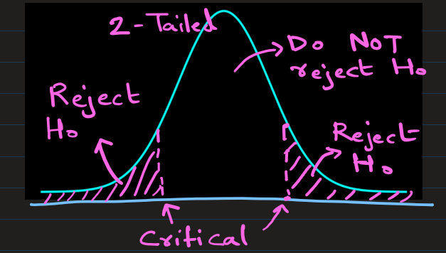
When you test hypotheses by using the t-test (traditional method), follow the same procedure as for the z-test, ( except use different table to find t-value) .
Step 1) State the hypothesis and identify the claim.
Step 2) Find the critical value from table.
Step 3) Compute the t-test value.
Step 4) Make the decision to reject or not reject the null hypothesis.
Step 5) Summarize the results.

Slide 6
In a population of metal components, the average lifetime without a protective paint coating is 101 months. The lifetime is assumed to be normally distributed, but the population standard deviation is unknown. An engineer claims that applying the new protective paint coating increases the mean lifetime of the component beyond 101 months. She tests this claim by selecting a random sample of 20 components
[112 107 113 121 106 106 121 114 104 112 104 104 110 92 94 103 100 111 100 96]
The mean of above is 107 and standard deviation 8:
Test the engineer’s claim at α=0.05.

Slide 7


Step 1)
State the hypothesis and identify the claim.
H0: μ= 101
The mean lifetime is 101 months; the coating has no effect
H1: μ > 101
( claim: The mean lifetime is greater than 101 months; the coating increases lifetime.)
Step 2)
Find the critical value.
Since α = 0.05 and the test is a right-tailed test,
and d.f. = 20-1 = 19,
the critical value is tα = 1.729 (use t-dist. table)
Step 3)
Compute the t test value .
Using formula,
Step 4)
Make the decision to reject or not reject the null hypothesis.
Since 3.35 > 1.729 (the critical value),
so, reject the null hypothesis.
Step 5)
Summarize the results:
There is enough evidence to reject Null hypothesis. So, the paint coating increases the mean lifetime of the component.

Slide 8
Let’s redo this using python code

Slide 9
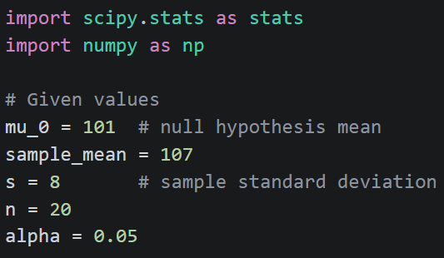
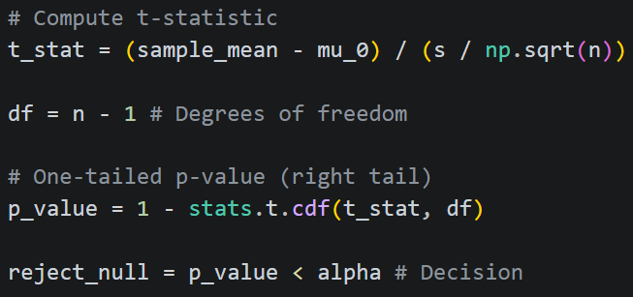
In a population of metal components, the average lifetime without a protective paint coating is 101 months. The lifetime is assumed to be normally distributed, but the population standard deviation is unknown.
An engineer claims that applying the new protective paint coating increases the mean lifetime of the component beyond 101 months. She tests this claim by selecting a random sample of 20 components with the coating and finds that the sample mean lifetime is 107 months with a sample standard deviation of 8 months.
Test the engineer’s claim at α=0.05.

Slide 10

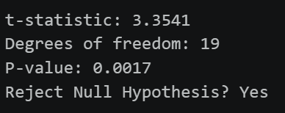

Slide 11
Example:
A water treatment plant claims their new filtration system reduces contaminant levels to below 5 ppm (the historical population mean). Environmental engineers want to verify that the system performs better than this standard.
A random sample of 15 water samples is taken after treatment.
The sample shows a mean contaminant level of 4.7 ppm, with a sample standard deviation of 0.6 ppm.
Test the water treatment plant claim at α = 0.10.

Slide 12


Step 1)
State the hypothesis and identify the claim.
H0: μ = 5 mm (no improvement)
H1: μ < 5
(claim: system reduces mean contaminant level)
Step 2)
Find the critical value.
Since α = 0.10 and the test is a left-tailed test, and d.f. = 15-1 = 14,
the critical value is tα = -1.345
(use t-dist table, and use – sign because it is left-tailed)
Step 3)
Compute the t test value.
Using formula
Step 4)
Make the decision to reject or not reject the null hypothesis.
Since −1.94 < −1.345 (the critical value)
-> so, reject the null hypothesis.
Step 5)
Summarize the results:
There is enough evidence to reject Null hypothesis. So, the new filtration system reduces the mean contaminant level below 5 ppm.

Slide 13
Let’s redo this using python code

Slide 14
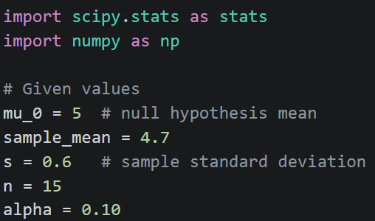
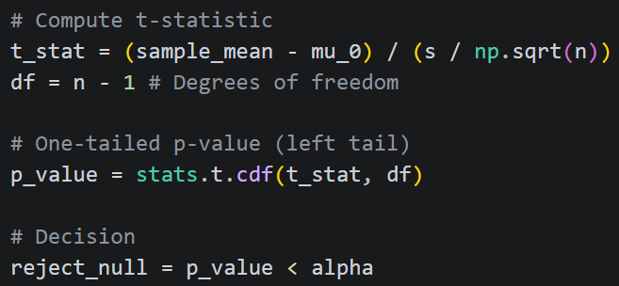
A water treatment plant claims their new filtration system reduces contaminant levels to below 5 ppm (the historical population mean).
Environmental engineers want to verify that the system performs better than this standard.
A random sample of 15 water samples is taken after treatment. The sample shows a mean contaminant level of 4.7 ppm, with a sample standard deviation of 0.6 ppm.
Test the water treatment plant claim at α = 0.10.

Slide 15

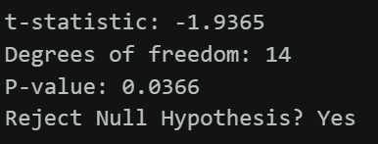
A water treatment plant claims their new filtration system reduces contaminant levels to below 5 ppm (the historical population mean).
Environmental engineers want to verify that the system performs better than this standard.
A random sample of 15 water samples is taken after treatment. The sample shows a mean contaminant level of 4.7 ppm, with a sample standard deviation of 0.6 ppm.
Test the water treatment plant claim at α = 0.10.

Slide 16
A medical researcher is interested in finding out whether a new medication will have any undesirable side effects on patients’ pulse rates. The researcher is concerned whether the pulse rate increases, decreases, or stays the same after taking the medication. The mean pulse rate for the population under study is 82 bpm, but the population standard deviation is unknown.
To investigate, the researcher selects a random sample of 25 patients who take the medication. The sample shows a mean pulse rate of 80.7 bpm, with a sample standard deviation of 4.5 bpm.
Test the claim that the medication does affect the mean pulse rate at α=0.01.

Slide 17

Step 1)
State the hypothesis and identify the claim.
H0: μ = 82 BPM (The medication has no effect)
H1: μ != 82 BPM (claim: The medication does affect the mean pulse rate (it could be higher or lower))
Step 2)
Find the critical value. Since α = 0.01 and the test is a two-tailed test, and d.f. = 25-1 = 24, the critical value is tα/2 = 2.797. (use t-dist table, and we use α/2 = 0.005 to find t value because it is 2-tailed)
Step 3)
Compute the t test value .
Step 4)
Make the decision to reject or not reject the null hypothesis.
Since -2.0137 (the critical value) < -1.44, so do not reject the null hypothesis.
Step 5)
Summarize the results:
There is not enough evidence to conclude that the medication has any effect on mean pulse rate.

Slide 18
Let’s redo this using python code

Slide 19
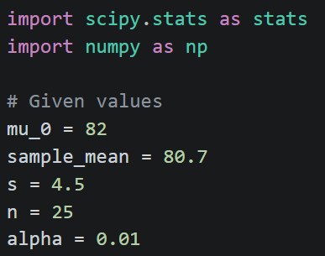
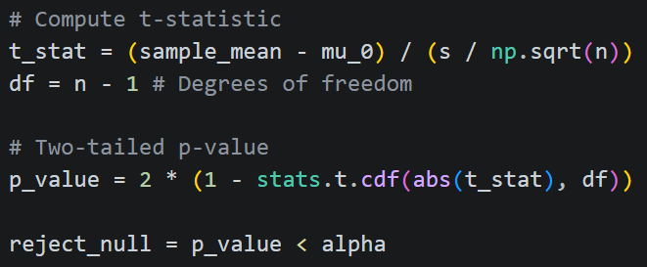
A medical researcher is interested in finding out whether a new medication will have any undesirable side effects on patients’ pulse rates. The researcher is concerned whether the pulse rate increases, decreases, or stays the same after taking the medication.
The mean pulse rate for the population under study is 82 bpm, but the population standard deviation is unknown.
To investigate, the researcher selects a random sample of 25 patients who take the medication. The sample shows a mean pulse rate of 80.7 bpm, with a sample standard deviation of 4.5 bpm.
Test the claim that the medication does affect the mean pulse rate at α=0.01.

Slide 20

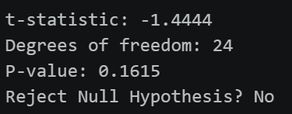
A medical researcher is interested in finding out whether a new medication will have any undesirable side effects on patients’ pulse rates. The researcher is concerned whether the pulse rate increases, decreases, or stays the same after taking the medication.
The mean pulse rate for the population under study is 82 bpm, but the population standard deviation is unknown.
To investigate, the researcher selects a random sample of 25 patients who take the medication. The sample shows a mean pulse rate of 80.7 bpm, with a sample standard deviation of 4.5 bpm.
Test the claim that the medication does affect the mean pulse rate at α=0.01.

Slide 21
Dggfdfgf
gdfgfd

