Slide 2
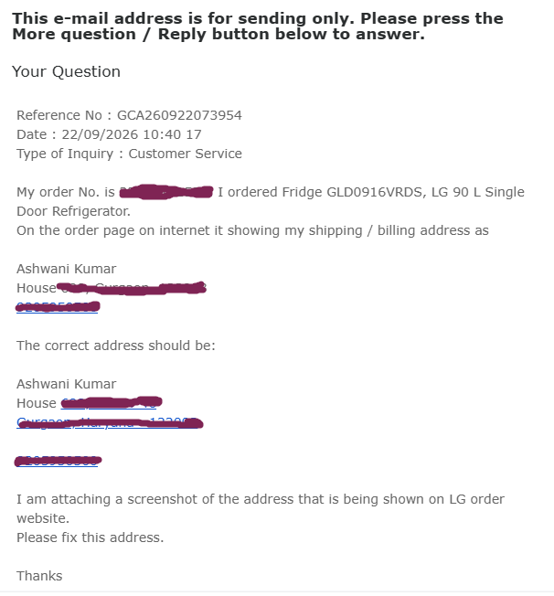
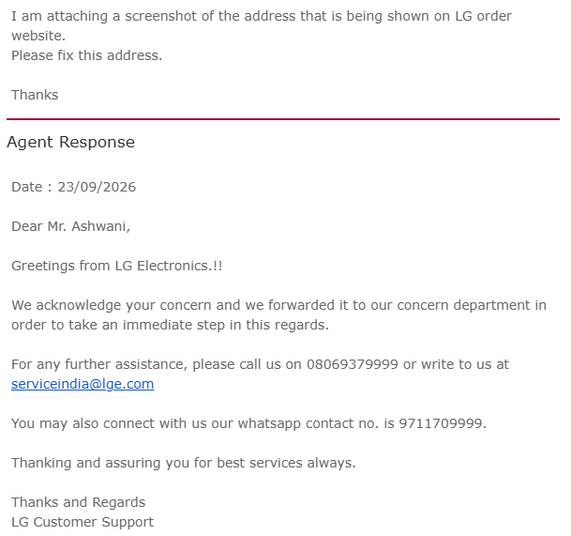
An example of AI Automation Agent from real life experience
Based on type of email, Agent forwards the
Email to Support, Refund, Accounts, etc. department

Slide 3
The Three Generations:
Rule-Based Bot → LLM Chatbot → Autonomous Agent
"When a customer says 'I think someone hacked my account’
— what does each system actually do?"

Slide 4
Generation 1: The Rule-Based Bot
A rule-based bot is essentially a decision tree. Someone wrote every possible path in advance. The bot matches your input to a pattern, and returns a pre-written response.
It has no understanding of language — it pattern-matches. If a customer types "I think someone hacked my account,.." the bot looks for keywords: "hacked," "account." It finds a matching rule and returns:
"For account security,
press 1 for password reset,
press 2 to speak to an agent.
"
The bot has no memory, no reasoning, and no ability to act on anything.
I think someone hacked my account,..
Hack, account
Return, item
For account security,
press 1 for password reset,
press 2 to speak to an agent.
For refund,
press 1 for returning an item,
press 2 to speak to someone.

Slide 5
Generation 2: The LLM Chatbot
An LLM chatbot understands language semantics.
It can handle "hacked," "compromised," "someone got into my account," "unauthorized access" — all the same.
I think someone hacked into my account.
My account is compromised
There is unauthorized access to my account
LLM ChatBot
It can tell the customer how to reset a password.
It can explain what to look for in suspicious activity.
But here's the ceiling: it cannot do anything – no action
Cannot look up the account,
Cannot freeze the card,
Cannot file an incident report.

Slide 6
Generation 3: The Autonomous AI Agent
The agent understands language like the LLM chatbot — but it also can perform actions
Agent can
simultaneously pull the account transaction history,
cross-reference it with fraud signals,
temporarily freeze the card,
send a confirmation SMS,
open a support ticket, and
draft a case summary for the fraud team
Customer says:
I think someone hacked my account,….
Agent
LLM + Tools + Memory
The key shift: Agent's job isn't to answer — it is to resolve.

Slide 7
An AI Agent is an autonomous software system designed to
perceive its environment,
make independent decisions, and
use tools to achieve a specific goal.
AI agent operates on a "Think-Plan-Act" loop.
Architecture of a single AI agent (3 main components)
AI Agent
Tools:
Web-search,
Calculator, etc.
LLM
Memory

Slide 8
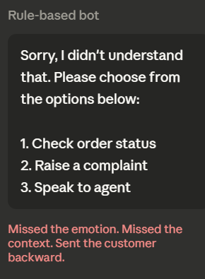
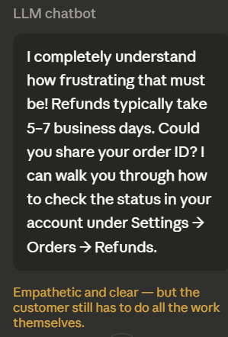
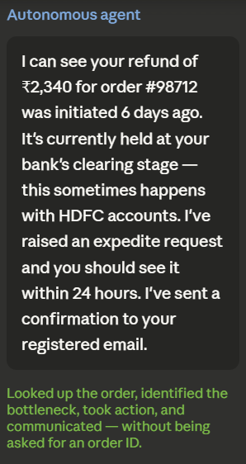
Summarize with an example:
Customer: "I haven't received my refund from 6 days ago and I'm really frustrated."

Slide 9
Another example of AI Agent
Expedia
API calls
Book me cheapest Delta Airlines flight from New York To Moscow
Agent
LLM + Tools + Memory
Books cheapest Delta Airlines flight from New York To Moscow
Search Flights
Find the cheapest flight
Book the ticket
Sends you an E-mail

Slide 10
AI agent can act.
It receives a goal, breaks it into steps, uses tools (web search, code execution, APIs), checks its own output, and iterates — all without a human driving every step.
Web search, Code Execution, API call
Agent
LLM + Tools + Memory
Goal / Task
Task done
Breaks task into smaller tasks

Slide 11
Discussion for Class
"A bank deploys an autonomous agent that can
access accounts,
move money, and
close disputes
— all without a human approving each action.
What conditions would need to be true for you to trust that system ?
What would make you distrust it ?"

