Slide 1
AI Agents

Slide 2
An AI Agent is an autonomous software system designed to
perceive its environment,
make independent decisions, and
use tools to achieve a specific goal.
AI agent operates on a "Think-Plan-Act" loop.
Architecture of a single AI agent (3 main components)
AI Agent
Tools:
Web-search,
Calculator, etc.
LLM
Memory

Slide 3
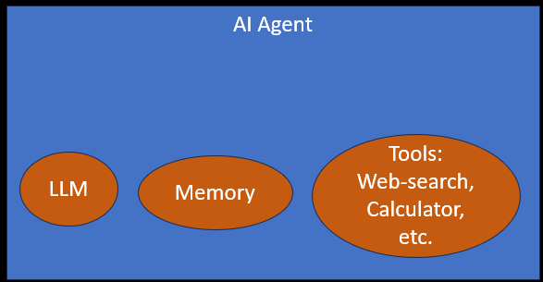
Role of LLM
An LLM (like GPT) acts as:
✅ Interpreter: Understands user input (natural language → structured meaning)
✅ Reasoner: Breaks down problems step-by-step
✅ Planner: Decides what to do next
Call tool and which one?
Ask question ?
✅ Generator: Produces final output (e.g. text, code, decisions)
Limitation of LLM
LLMs are:
NOT always correct and
NOT logical all the time
They:
Can hallucinate
Depend on prompt quality – That’s why prompts are important
Don’t have real understanding

Slide 4
Role of Memory:
To remember and build on information over time.
Without memory, an AI agent would not remember previous conversations.
Memory helps in
maintaining conversational continuity
executing complex multi-step planning, and
delivering highly personalized user experiences.

Slide 5
Role of Tool:
A tool is a function the agent is allowed to call.
When the agent decides it needs information or needs to do something it calls a tool and waits for a result to come back before continuing.
Examples of tools:
Check weather
Calculate monthly payment
Check prices of Laptops
Read data from cloud, storage, etc.
Book a ticket
Send email

Slide 6
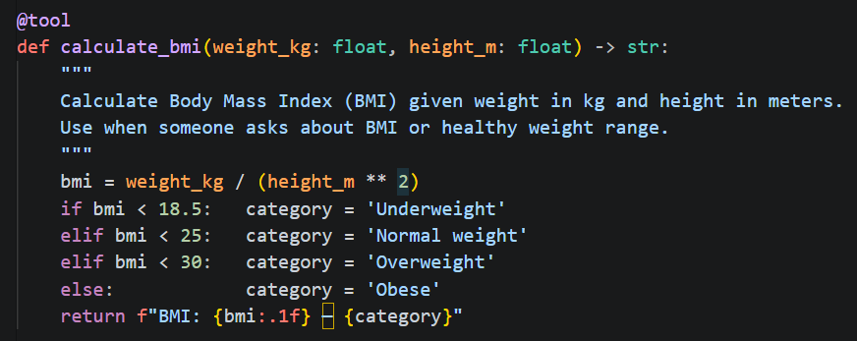
Tools:
Components of Tools
Name
Define what the tool does
Function description: Describe what it needs as input
Input and output field: Specify the expected input format and the output type

Slide 7

ChatBot vs AI Agent
A simple chatbot (like ChatGPT) takes your input, thinks once, and gives you an answer.
That's it — one shot, done.
Example: “How to reach from Delhi to Srinagar”
It will advise you. NO ACTION
An AI agent can plan, take actions, observe the results, and keep going until a goal is achieved.
Example: “Book a train ticket from Delhi to Srinagar with 1st class AC for summer.”
THERE IS ACTION
The workflow of an AI Agent:
Plan
(Uses LLM)
Take action
(Uses Tools)
Observe the result
(Uses LLM + Memory)
Goal Achieved ?
Yes: Stop
No: Loop

Slide 8
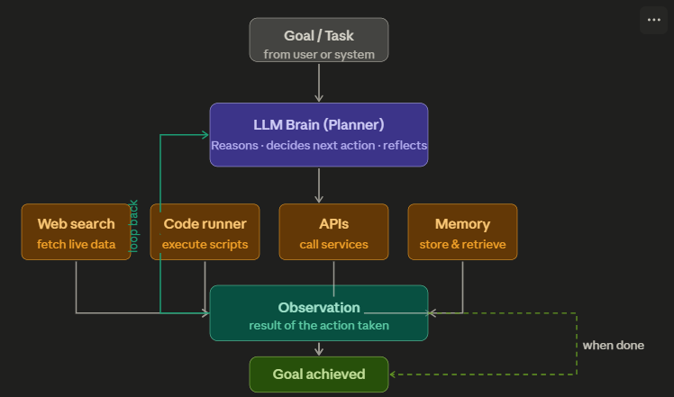





👉 Example: “Book me the cheapest flight”
AI Agent would
search flights, (by searching the web )
compares prices, (by using regular code)
decides best option and
books ticket (by making API calls)

Slide 9
Automation vs AI Agent
Automation follows a predefined path
AI agents can dynamically adapt their approach based on
  context and
  intermediate results.
They do NOT follow predefined paths,
AI agent are capable of executing a given task without ongoing direct human intervention.
AI Agent
Tools:
Web-search,
Calculator, etc.
LLM
Memory

Slide 10

Agents can collaborate/communicate with other agents to achieve the goal.
Goal
Agent1
Agent2
Agent3
Agent4
Result
GOAL: Add an automatic 'dark mode' toggle to our web app that triggers based on the user's local sunset time.
Agent1 (Product Mgr. ) – Creates/Analyses the requirements, and defines success criteria.
Agent2 (Planner) - Takes the requirements and assigns it the software Dev agent and QA
Agent3 (Developer) - Develops the code
Agent4 (Quality Assurance) - Reviews code, writes tests, and hunts for bugs.

Slide 11
Agents share data among each other through shared state
AI Agent 1
AI Agent 2
AI Agent 3
Memory
Tools
Memory
Tools
Memory
Tools
LLM
LLM
LLM
Shared State
Shared state acts as a centralized information hub or a common environment that all agents can read from and write to

Slide 12
Summary
AI agent is a system of modules working together:
Component | Role
Planner (LLM) | Decides what steps to take – Needs LLM for this
Memory | Stores past information
Tools | External capabilities (APIs, DBs, calculators)
Executor (Code runner) | Actually, performs the actions by calling tools - Runs the code

Slide 13
Example 1

Slide 14
🪙 Running Example (FinTech)
🎯 User Query:
“Analyze my spending this month and tell me if I can invest ₹10,000 in stocks.”

Slide 15
1️⃣ Planner (The Strategist)
💡 What it does:
Breaks the problem into steps
Decides how to solve the task
🧠 In our example:
Planner creates a plan like:
Step 1: Fetch user transaction data
Step 2: Calculate total expenses
Step 3: Calculate savings
Step 4: Check if ₹10,000 is affordable
Step 5: Suggest investment decision

Slide 16
2️⃣ Memory (The Context Keeper)
💡 What it does:
Stores:
  User history
  Preferences
  Past interactions
🧠 In our example:
Memory may store:
- User monthly income: ₹50,000
- Previous spending patterns
- Risk appetite: Moderate
- Past investments: Mutual funds
👉 With memory:
Agent becomes personalized advisor

Slide 17
3️⃣ Tools (The Capabilities Layer)
💡 What it does:
Allows agent to interact with the outside world
🔧 Examples in FinTech:
Bank API → fetch transactions
Calculator → compute savings
Stock API → get market data
Risk model → evaluate investment
🧠 In our example:
Agent may use:
Tool 1: get_transactions(user_id)
Tool 2: calculate_total_expense(data)
Tool 3: stock_price_api()

Slide 18
4️⃣ Executor (The Doer)
💡 What it does:
Executes the plan created by Planner
Calls tools
Collects results
Sends back to LLM
🧠 In our example:
Executor workflow:
→ Call get_transactions()
→ Run expense calculation
→ Compute savings
→ Send results back to LLM

Slide 19
Example 2

Slide 20
Example: Booking vacations
Imagine you're trying to book a vacation.
You need to research flights -> find hotels -> check restaurant reviews -> and keep track of your budget.
Traditional workflow automation
A traditional automation system follows a predetermined sequence:
It takes inputs such as dates, location, and budget, and make calls to predefined APIs in a fixed order.
However, if any unexpected situations arise, such as flights being sold out, or the specified hotels being unavailable, it cannot adapt.
Input
step1
step2
step3
Output

Slide 21






Example: Booking vacations
Agent Workflow
An agent combines AI's ability to make judgements and call the relevant tools to execute the task.
If flights or hotels are unavailable, an agent can reassess and suggest a new itinerary with altered dates or locations, and continue executing your travel booking.
An agent's output will be nondeterministic given: real-time availability and pricing changes, dynamic prioritization of constraints, ability to recover from failures, and adaptive decision-making based on intermediate results.

Slide 22
An AI agent continuously follows this loop:
Perception (Observe)
  Takes input from environment
  Example: text, images, sensors, user queries
Decision (Think / Reason)
  Uses logic, rules, or ML models
  Example: LLM deciding next step
Action (Act)
  Performs a task
  Example: sending email, calling API, generating response
Learning (Optional)
  Improves over time
  Example: reinforcement learning, memory updates

Slide 23
Some More Examples

Slide 24
Some examples of AI Agent
Simple tasks
A customer says "I was charged twice for my Netflix subscription." An agent checks the transaction history, identifies the duplicate, calls the refund API, sends a confirmation, and logs the case — without human involvement. It escalates to a human only if the situation is genuinely ambiguous or the customer is distressed.
Agent that could help me review my emails and create tasks on a digital to-do list based on the highest priority emails coming in.
Agent that could respond to people reporting bugs and automatically gather missing information and seek clarification on confusing parts of a bug report and then route the bug to the appropriate team to resolve.

Slide 25
Complicated tasks performed by Agents:
Agent also to build a travel planning agent that takes my preferences and needs into account, researches things like destinations and hotels and even activities, and then suggests an itinerary for me and use a collaborating agent to book everything all in one shot.
Agent to find a list of suppliers, email them for quotes, and sort replies according to the best price.
Agent to create a shopping list based on a recipe, purchase the ingredients online, and have them delivered to you.
Agents that monitor patients' vitals, and suggest treatment plans and even support surgical procedures by providing realtime data to surgeons

Slide 26
AI Agents in FinTech Industry
Fraud Detection
A transaction comes in — $85,000 to a new payee at 2 AM from a device never used before.
A rules-based system might let it through (amount is under limit).
An agent instead:
→ checks device fingerprint
→ looks up IP geolocation
→ compares against the user's last 90 days of behaviour
→ queries if the payee account is newly created
→ calculates a risk score
→ blocks the transaction and sends an OTP challenge
— all in under 200ms.

Slide 27
AI Agents in FinTech Industry
Credit Underwriting
A loan application arrives.
The agent pulls the applicant's credit bureau report,
fetches bank statement PDFs and parses income/expense patterns,
runs a risk model,
checks for negative news about the employer, and
produces a structured recommendation with reasons.
What used to take a human analyst 2–3 days happens in minutes.

Slide 28
AI Agents in FinTech Industry
Algorithmic Trading
An agent watches price feeds,
reads earnings call transcripts,
monitors news sentiment in real time, and
executes trades based on a defined strategy — automatically managing position sizes and stop-losses.
It can also flag unusual market conditions and pause itself, which a static algorithm cannot.

Slide 29
AI Agents in FinTech Industry
One important caveat for fintech
Agents in financial services need human-in-the-loop guardrails for high-stakes decisions.
Fully autonomous agents are fine for low-risk actions (sending a statement, blocking a suspicious transaction).
But for large loan approvals, account closures, or large trades, best practice is to have the agent prepare a recommendation and a human confirm it.
Regulators in most countries — including India's RBI — expect an audit trail and human accountability for consequential financial decisions.

