Slide 1
RAG (Retrieval-Augmented Generation)

Slide 2
Traditional RAG
How it works:
RAG system takes a user query, converts it into a vector embedding,
2) retriever finds similar chunks from Vector DB,
3) dumps the text chunks + query into the prompt window,
4) sends the prompt to the LLM,
5) LLM generates a response and sends it to the user.
5
User
LLM
(ChatGPT, etc.)
Retriever
1
4
3
2
Private Data
PDF, DB, etc.
Vector DB

Slide 3
Query: Compare our Q2 2026 revenue with our main competitor, and explain why our marketing spend didn't yield the expected ROI based on our internal strategy deck.
❌ Traditional RAG (The Linear Path)
Traditional RAG tries to do everything in one single shot.
Embedding & Search: The system converts the entire complex user query into a single vector embedding.
Cont….
5
User
LLM
(ChatGPT, etc.)
Retriever
1
4
3
2
Private Data
PDF, DB, etc.
Vector DB

Slide 4
…cont
2. Retrieval: It searches the vector database for text blocks matching that vector. It pulls a messy mix of Q2 financial spreadsheets, competitor analysis folders, and marketing strategy presentations.
The Bottleneck: Because it does only one search, the top 5 retrieved chunks might contain our Q2 revenue numbers, but completely miss the competitor's data or the specific marketing strategy insights.
5
User
LLM
(ChatGPT, etc.)
3. Generation: The LLM gets a prompt stuffed with incomplete fragments.
Output: "According to our documents, Q2 revenue was $10M. However, I cannot find data on our competitor's revenue or the specific marketing ROI breakdown in the context provided."
Retriever
1
4
3
2
Private Data
PDF, DB, etc.
Vector DB

Slide 5
Traditional RAG
The Problem:
It cannot handle multi-step reasoning.
If your query requires fetching information from Document A, realizing it needs a missing variable, and tracking that variable down in Document B, traditional RAG will usually fail or give an incomplete answer.
5
User
LLM
(ChatGPT, etc.)
Retriever
1
4
3
2
Private Data
PDF, DB, etc.
Vector DB

Slide 6
Agentic RAG
Here the RAG system has memory + tool + reasoning capability
Planning & Routing: The agent analyzes the user prompt and determines an intelligent strategy. For instance, it can look at a query and route it to an SQL database for numbers, or a vector store for policy documentation.
Tool Usage: It treats data stores as tools (tool_use). It can call a calculator, execute code via an interpreter, or hit an external web API to get real-time info if the local vector storage falls short.
Critique & Reflection: If the agent retrieves information and notices a gap or an ambiguity, it rewrites the query, runs a brand-new retrieval pass, or pulls from a secondary system until it is satisfied with the evidence compiled

Slide 7
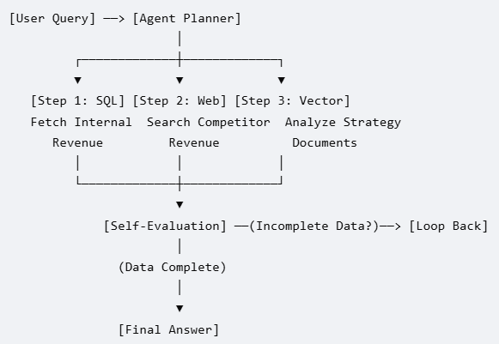
Query: Compare our Q2 2026 revenue with our main competitor, and explain why our marketing spend didn't yield the expected ROI based on our internal strategy deck.
Agentic RAG (The Dynamic Loop)
Agentic RAG breaks the request into a multi-step project plan and executes it sequentially using specialized tools.

Slide 8
Step 1 (Internal Data Lookup): The agent identifies that it needs precise company revenue. It calls an SQL Database Tool to run a query:
SELECT revenue FROM financial_reports WHERE quarter='Q2_2026’.
It retrieves precisely: $10 Million.
Step 2 (Competitor Research): The agent realizes competitor data isn't in the internal SQL db. It switches tools and triggers a Web Search Tool for "Competitor X Q2 2026 revenue earnings report". It retrieves: $12 Million.

Slide 9
Step 3 (Internal Qualitative Analysis): The agent uses a Vector DB Search Tool to query the marketing folder for keywords like "marketing spend ROI failure Q2". It pulls chunks explaining that a major ad platform went down during their main campaign week.
Step 4 (Evaluation & Synthesis): The agent reviews its gathered notes. If it notices that the ad platform breakdown isn't fully explained, it loop-backs and searches the engineering logs. Once satisfied, it compiles the final answer.
Output: "In Q2 2026, our revenue was $10M, lagging behind our competitor's $12M. Our marketing ROI fell short because $2M of our budget was allocated to Platform X, which suffered a massive global outage during our peak launch week, as detailed in our internal strategy deck."

Slide 10
EXTRA
Ffnbksdfd
Fdslj;f
Fl;ds

