Slide 1
MCP

Slide 2
Steps To Install
> python3 -m venv .venv
> .\.venv\Scripts\activate
(.venv) > python -m pip install httpx==0.28.1 mcp==1.28.1

Slide 3
Steps To Install
The server
Create file multi_server.py
Do NOT Run the server:

Slide 4
Steps To Install
The client
Create file multi_client.py
Run the client in powershell – This would automatically run the server
(.venv) PS …mcp_weather_calculator> python -m multi_client

Slide 5
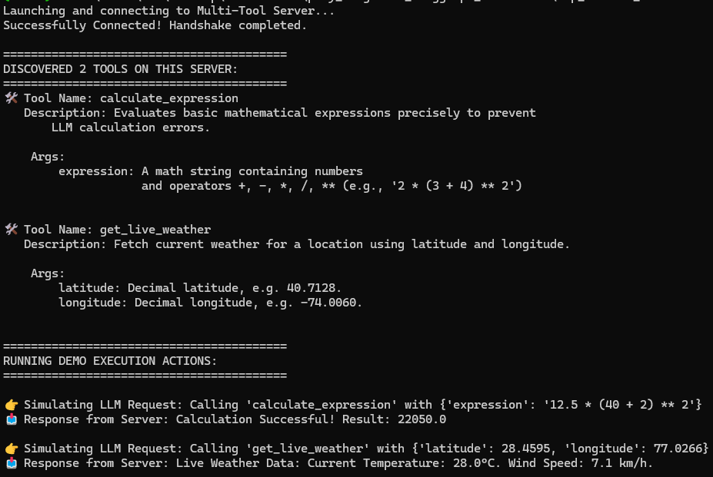
Client output

