Slide 1
  The Evolution of AI: From Rules to Imagination

Slide 2

AI Is Not New – 70+ years old
AI was formally coined in 1956 at the Dartmouth Conference.
Early pioneers like Alan Turing laid the groundwork (Turing Test).
The test involves a human judge who interacts with both a machine and another human, without knowing which is which. Communication occurs through text, allowing the judge to ask questions and receive responses from each participant.
A
Human or
Machine ?
B
Judge

Slide 3

Judge: What is your favorite food?
Machine: I don't actually eat, but if I had to choose based on popular foods, I'd probably pick pizza.
Judge : Why pizza?
Machine: Because it's versatile—you can change the toppings, and it's easy to share.
……………..
The Judge then asks increasingly varied questions to determine whether the responses appear to come from a human or a machine - Important: The Turing Test is not simply a test of factual knowledge.
Type | Example question | What it tests
General knowledge | "Who was Albert Einstein?" | Knowledge
Reasoning | "If all cats are animals and Tom is a cat, is Tom an animal?" | Logical reasoning
Common sense | "Why can't you put a wet shirt directly into a fire?" | Common-sense understanding
Ambiguous questions | "I saw a man with a telescope. Who had the telescope?" | Language ambiguity
Humor | "Why did the chicken cross the road?" | Understanding humor
Emotion | "How would you respond if your friend lost their job?" | Social/emotional language
Personal experience | "What did you do yesterday?" | Human-like conversation
Trick questions | "How many months have 28 days?" | Careful reasoning
A
Human or
Machine ?
The test’s goal is simple:
If the judge cannot consistently identify which respondent is the machine, the machine is considered to have “passed” the Turing Test
B
Judge

Slide 4
1️. Initially were Rule-Based Systems or used symbolic reasoning (1950s–1980s)
Rule-based:
If X, then Y.
Else Z.
These were expert systems.
They are like giant flowcharts built by humans with hand-coded rules.
Example:
E.g.1: In healthcare sector, rule-based system helps diagnose diseases by checking if symptoms match a list.
If ( fever=True, blood_marker_number > 40, rash_size > 20 mm): then skin_cancer
else: no skin cancer

Slide 5






Is a person healthy ?
Age>50
Yes
No
Steps walk ?
Obsese ?
<100
100-200
>200
UnHealthy
Healthy
UnHealthy
UnHealthy
Healthy

Slide 6
We can represent knowledge in the form of if–then rules:
Rule 1: IF patient has fever AND cough THEN patient might have flu.
Rule 2: IF patient has fever AND body ache AND sore throat THEN patient might have flu.
Rule 3: IF patient has fever AND cough AND loss of smell THEN patient might have COVID-19.
How Symbolic Reasoning Works
Input (facts): Patient has fever AND Patient has cough.
Rule 1 matches → Conclusion: "Patient might have flu."

Slide 7
E.g.2: In the financial sector, rule-based system might flag a transaction as suspicious:
Transaction
transaction > 30000 AND
transaction > Max_amt_spent_till_today AND
transaction_time between 1AM - 4AM AND
country=“Crooked Land”
Yes
No
Suspicious
Not
Suspicious
These systems apply predefined rules to transaction data to identify anomalies.
No learning. No adaptation. Just rules.
(Fraudster may change his behaviour and rule-based system would fail)

Slide 8
2️. Machine Learning (1990s–2010s)
IDEA : “Don’t tell me the rules—show me the data and I’ll figure rules out.”
Machine Learning Model
Data
Learn
Rules

Slide 9
Algorithms began learning from patterns in data. This was aka as statistical learning
Key Milestones:
1990s-2000s: The development of more advanced ML algorithms, including support vector machines and decision trees.
Example:
Spam filters that learn to block new types of spam based on examples.
Recommendation systems (like Amazon and Netflix)

Slide 10
3️. Deep Learning (2012–Now)
Inspired by neurons in the brain, with multiple layers (hence deep learning).
Deep neural networks started outperforming humans in image recognition, speech, and more.
Breakthroughs in convolutional neural networks (CNNs) and recurrent neural networks (RNNs) led to major advancements in image and speech recognition.
Example:
Self-driving cars
Facial recognition
Real-time language
Speech to Text

Slide 11
4️. Generative AI (2020s–Future)
They can learn, imagine, write, and make up new things.
These models generate brand new content: text, art, code, music—even deepfakes.
Example:
ChatGPT writing stories
DALL·E creating images from words
MusicLM generating songs in custom styles

Slide 12


An example of Generative AI in answering emails

Slide 13
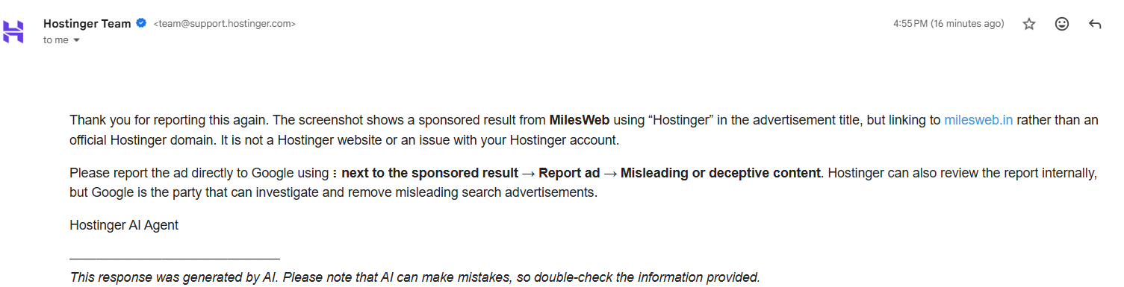

Response from Hostinger

Slide 14
Traditional AI vs. Generative AI

Slide 15
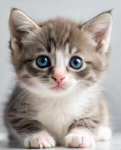

Traditional AI analyzes existing data to make predictions or decisions.
Traditional AI spots patterns and points out anomalies and making predictions.
Generative AI uses existing data to create entirely new content.
Generative AI uses its training to invent something that may have never existed before.
Traditional
AI
Cat
Create a picture of an eagle
Generative
AI
Traditional
AI
Eagle

Slide 16
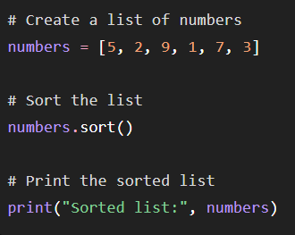
Traditional AI
Email Classification
Generative AI
Code Generation
Write python code to sort a list of numbers
Generative
AI
Congrats
You have won 100,000 dollars.
Click here to claim your prize
Traditional
AI
Spam
Are you coming to the 10AM meeting ?
Traditional
AI
Not Spam

Slide 17
Traditional AI vs. Generative AI
Feature | Traditional AI | Generative AI
Main Role | Predicts or classifies | Creates new content
Learns From | structured data: tables | Massive unstructured data (text, images, audio)
Output Type | Decisions, labels, scores | Text, images, code, music, videos, 3D models
Examples | Spam filters, fraud detection, recommendation systems | ChatGPT, DALL·E, MidJourney, Sora, Gemini, MusicLM
Can't Do | Write a novel or paint a picture | Make a critical business decision based only on rules

Slide 18
Traditional AI focuses on classification, recognition, and prediction. It is strictly bound by logic and probability. It evaluates a situation and gives you a definitive answer based on historical data.
Pattern Recognition: It looks at millions of credit card transactions to instantly flag one that looks suspicious or fraudulent.
Classification: It processes an image of an X-ray and categorizes it as either "healthy" or "containing a tumor."
Deterministic Nature: If you feed it the exact same data twice, it will give you the exact same prediction or calculation every single time. It leaves no room for imagination.
Common Examples: Netflix recommendation algorithms, predictive text on your phone keyboard, chess bots, and financial market forecasting models.

Slide 19
Generative AI uses deep learning architectures—specifically Transformers—to understand the underlying structure of data and generate brand-new variations.
Content Generation: Instead of just recognizing a picture of a cat, it can draw a completely unique picture of a cat wearing a spacesuit on Mars.
Probabilistic Text: It doesn't look up answers in a database. It calculates the most statistically likely word to follow your prompt, allowing it to write poetry, essays, or functional computer code.
Probabilistic Variation: Generative models have a setting called "temperature" (creativity). If you ask it the same question twice, it can rephrase its answer or generate a completely different style of image.
Common Examples: Large Language Models (like ChatGPT and Claude), image generators (like Midjourney), and synthetic voice clones.

Slide 20
Why deep learning is needed for gen ai ?

Slide 21
Why can't traditional ML easily do GenAI ?
Suppose we want a model to generate: "The cat is sitting on the table."
The model needs to understand relationships between:
words
grammar
meaning
context
long-range dependencies
Traditional ML algorithms (i.e. decision trees or linear regression) aren't designed to learn these extremely high-dimensional relationships.
Deep neural networks can.

Slide 22

Deep learning provides the neural-network foundation
Modern GenAI models use architectures such as:
CNN
Image generation
RNN/LSTM
sequence generation
Transformers
Image generation
Diffusion
Image/video generation
Deep learning provides the neural-network technology that allows GenAI models to learn complex representations from massive datasets and use those representations to generate new content.

