Slide 2
Text to image
Image to image
Image to text
Text to 3D
Text to Text
Text to Code
Code to Text
Text to Audio
Audio to Text
Text to Movies

Slide 3
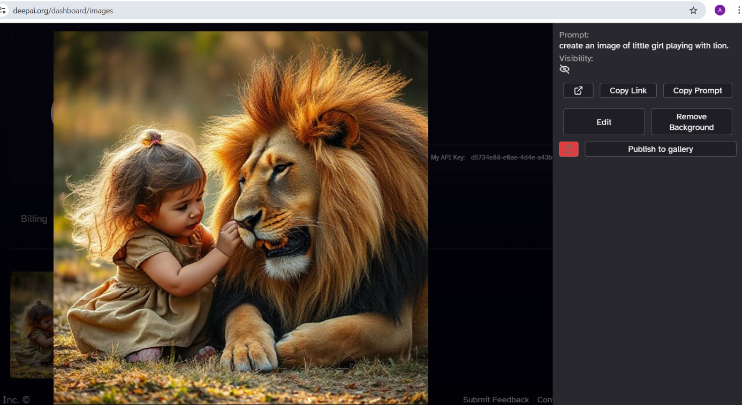
Example: Text to image (Deep ai)

Slide 4
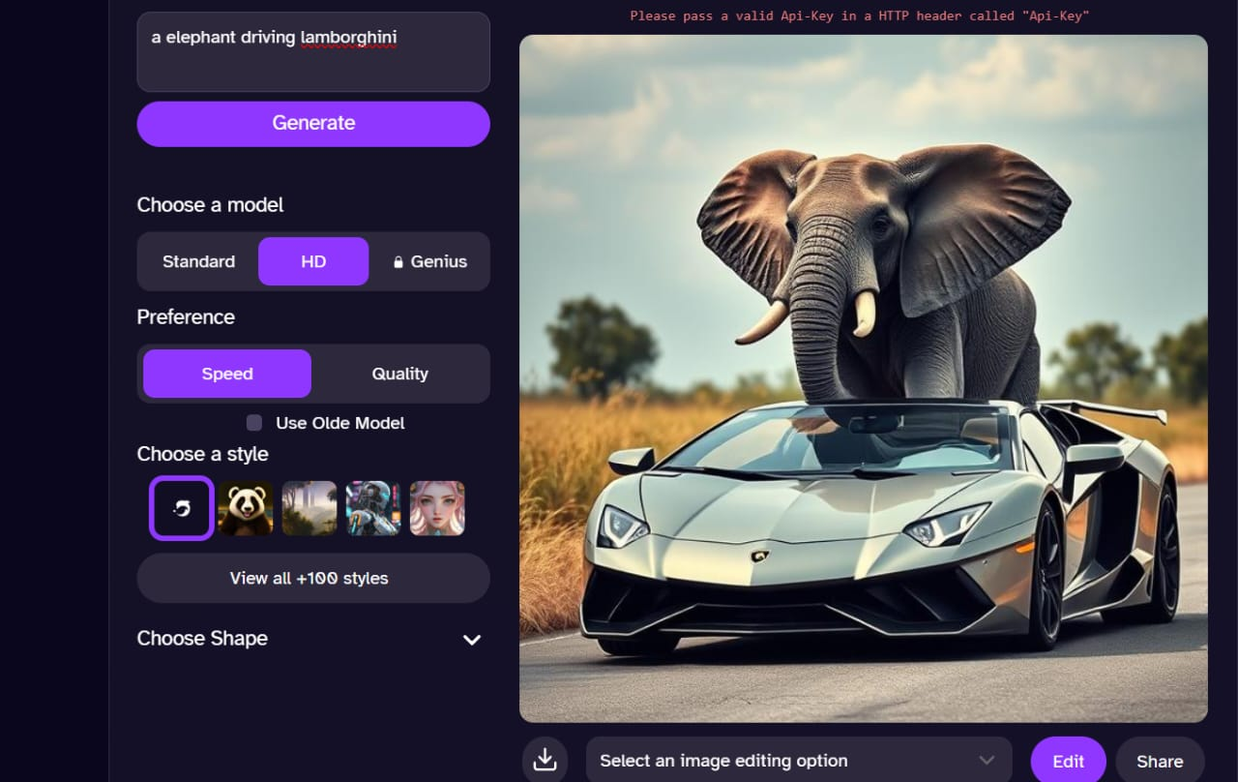
Example: Text to image (Deep ai)

Slide 5
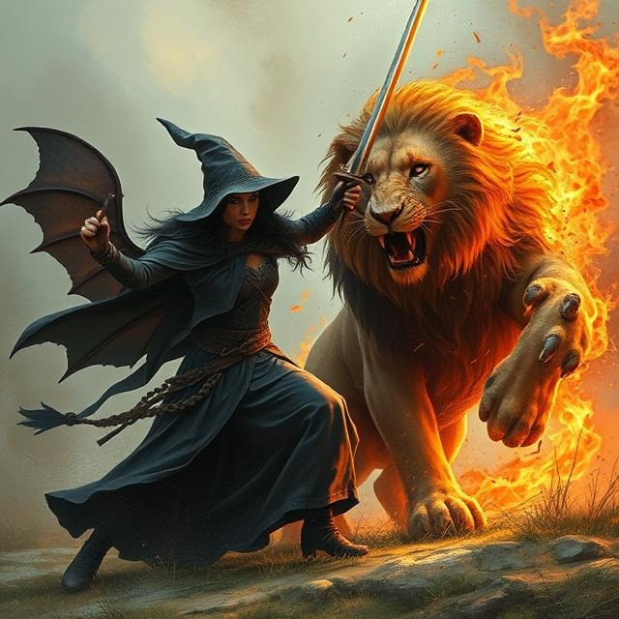
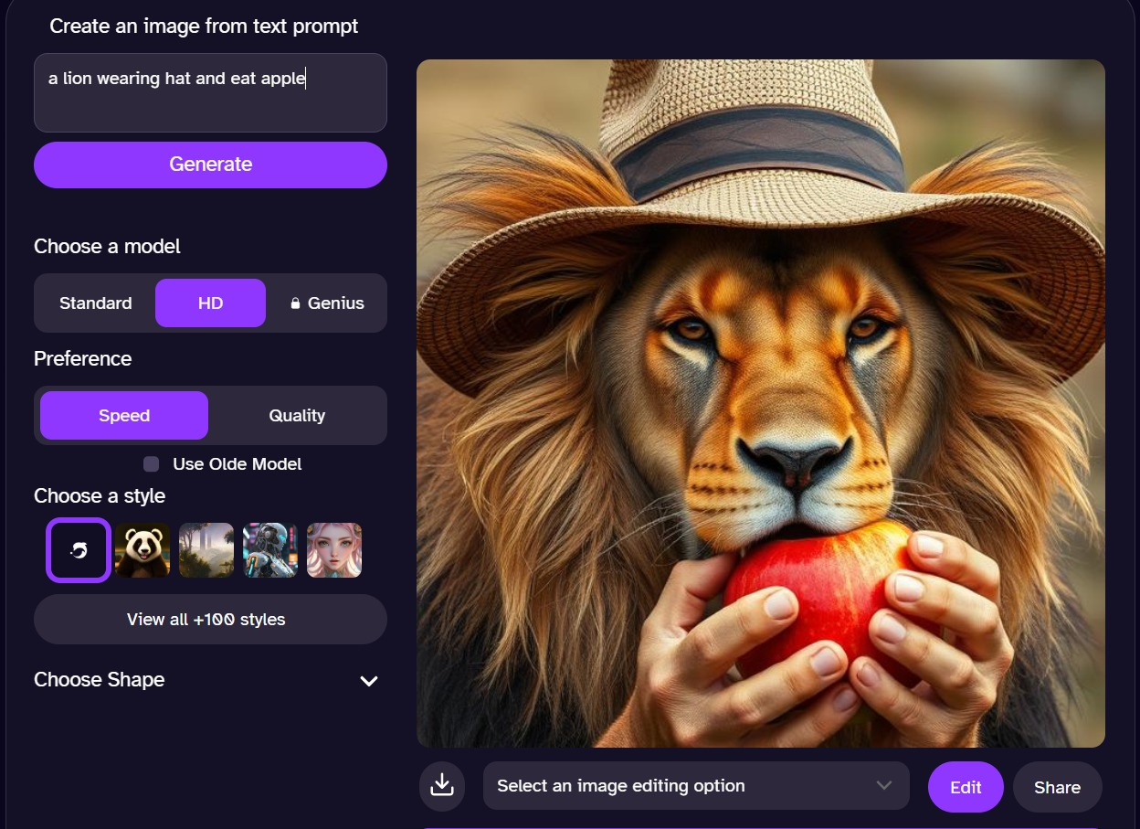
Text -> Image. Here the prompt was not very descriptive -> Lion has hat, Lion has human hands

Slide 6
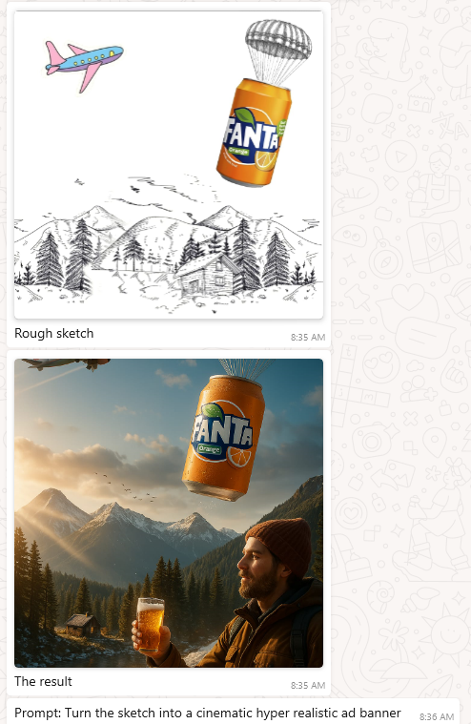
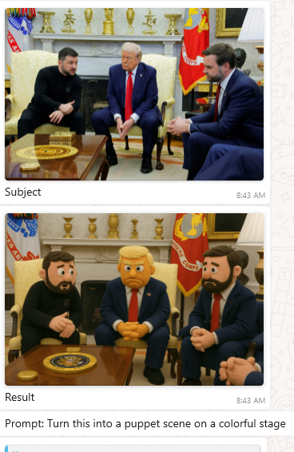
Example:
Image to image

Slide 7
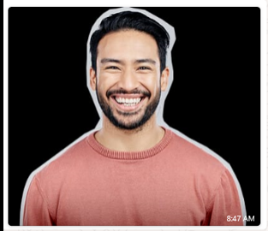
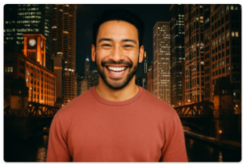
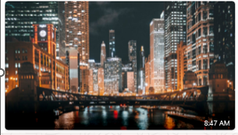
Example:
Image to image
Input: 2 image
Prompt: Merge both the pictures and also blend the color tone
Output: 1 image
GenAI

Slide 8
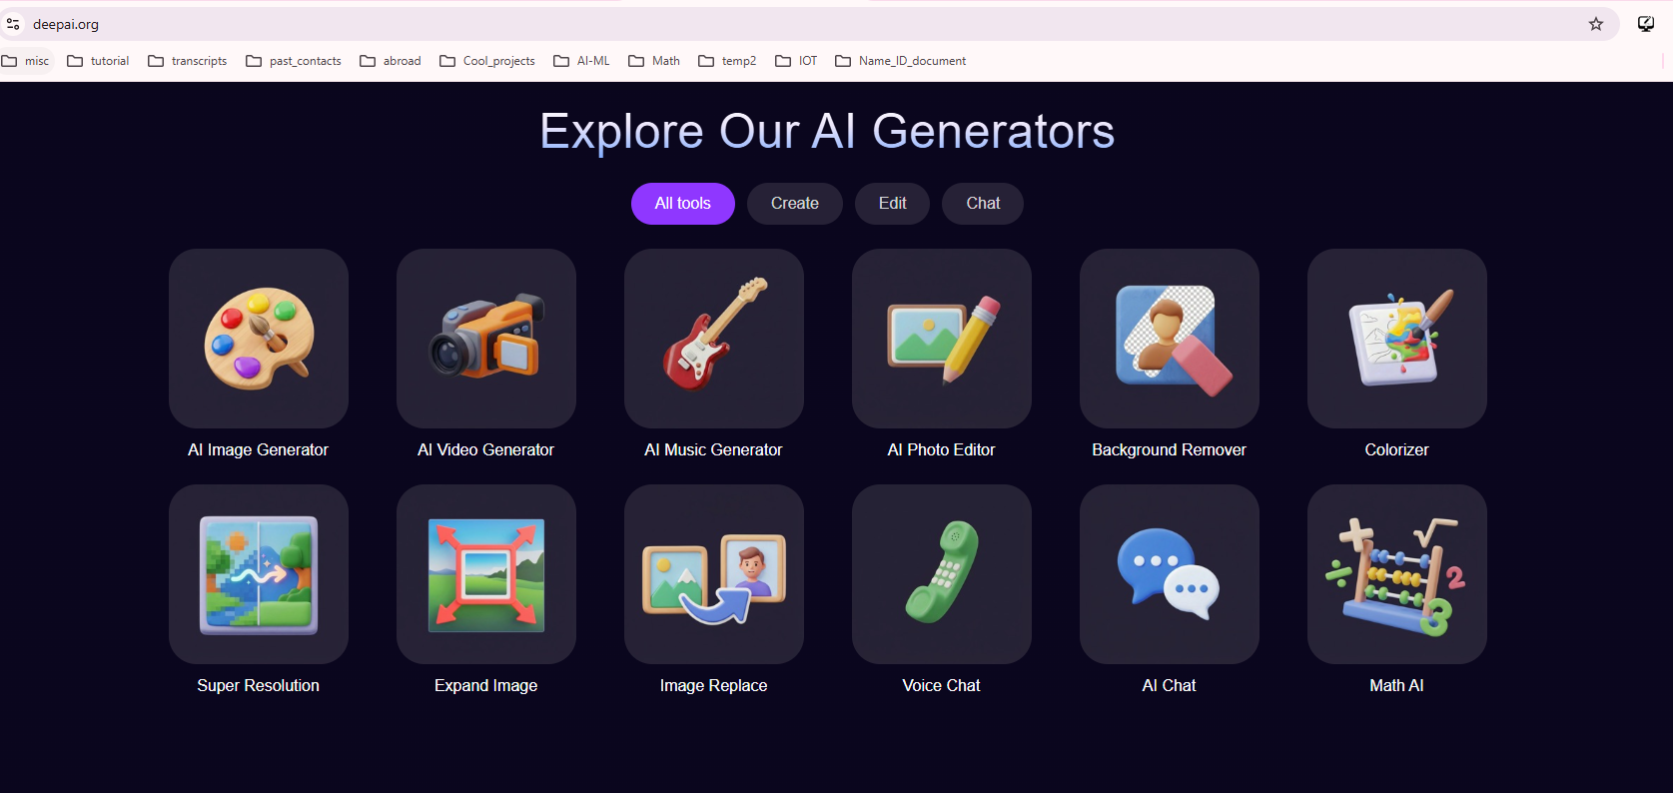
Some examples: https://deepai.org/styles

Slide 9
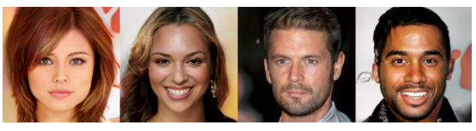
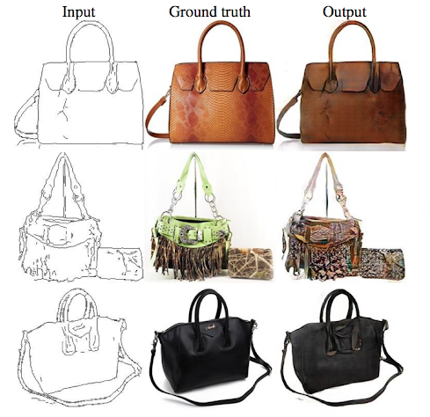
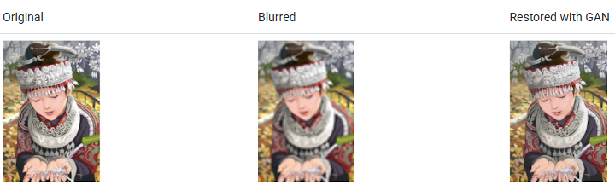
Some examples: https://deepai.org/styles
These people do not exist

Slide 10
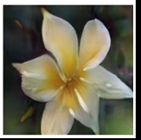
Image to Text
GenAI
Prompt:
Describe the image in one sentence

Slide 11
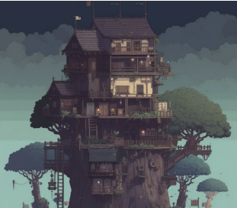
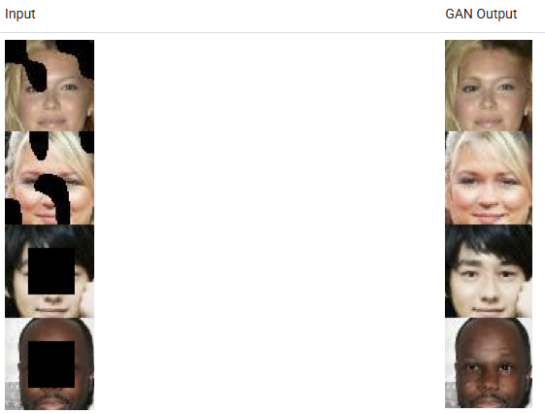
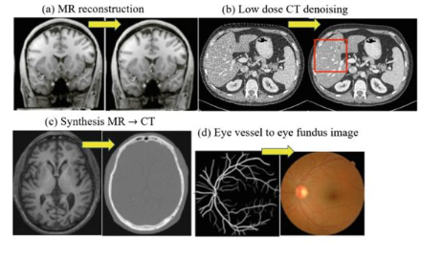
Face Inpainting: (Semantic Image Inpainting)
In the inpainting task, chunks of an image are blacked out, and the system tries to fill in the missing chunks.

Slide 12
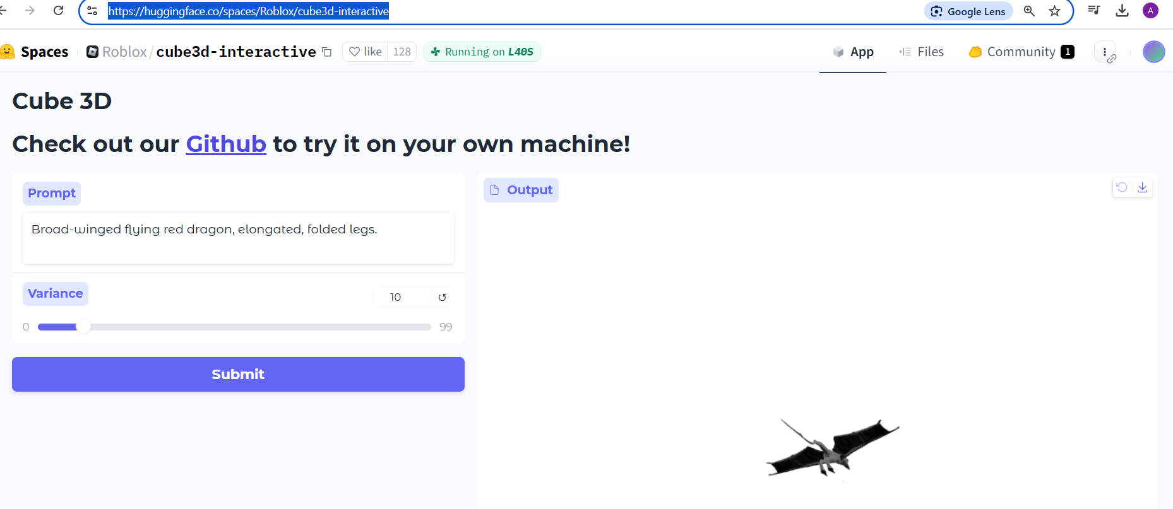

Text to 3D images
It took 3 minutes to generate this 3D image. It rotates with mouse
Prompt: Broad-winged flying dragon, elongated, folded legs
https://huggingface.co/spaces/Roblox/cube3d-interactive

Slide 13
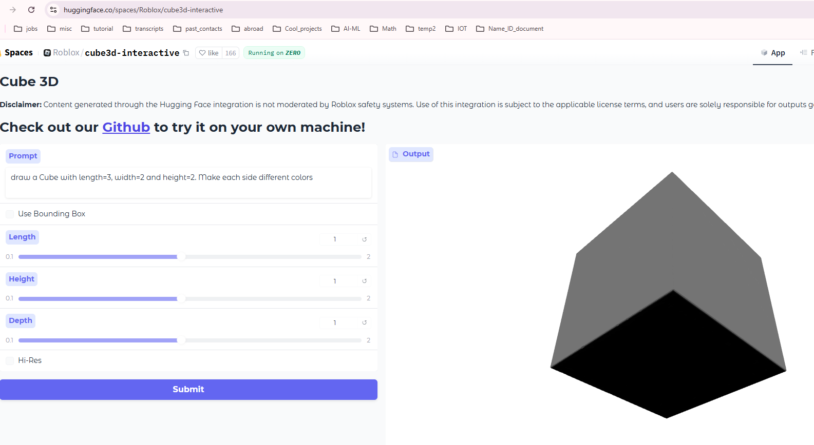
Text to 3D images
It took 3 minutes to generate this 3D image. It rotates with mouse
Prompt: Draw a Cube with length=3, width=2 and height=2. Make each side different colors
https://huggingface.co/spaces/Roblox/cube3d-interactive

Slide 14
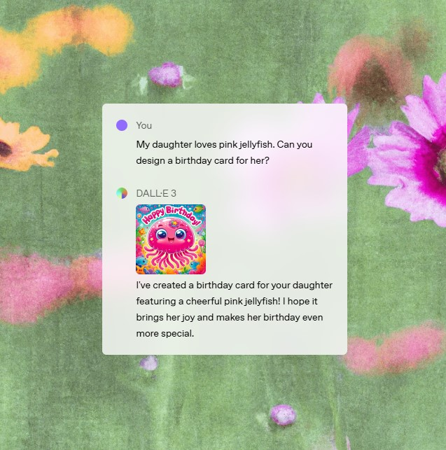
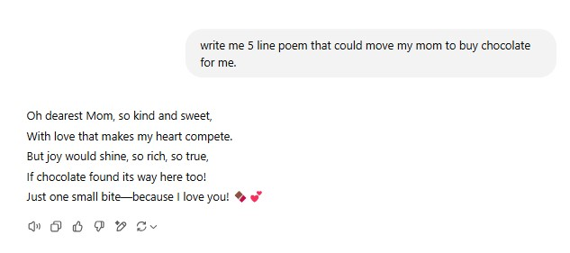
Text to Text generation
Text to Image generation
ChatGPT

Slide 17
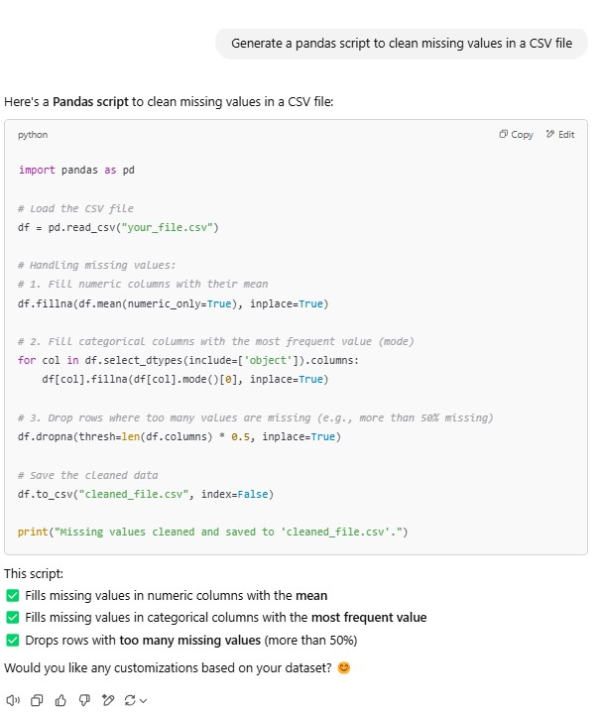
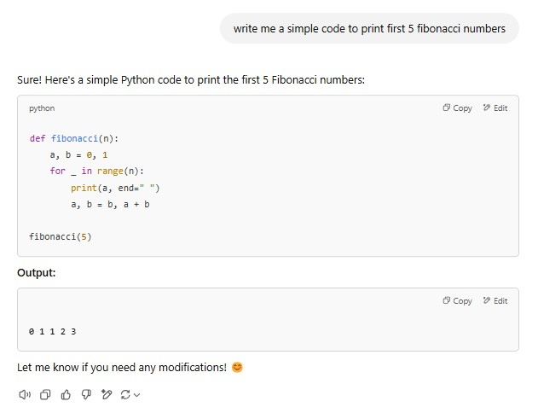
Text to Code generation: ChatGPT
At the end, it recommends you the next step

Slide 18
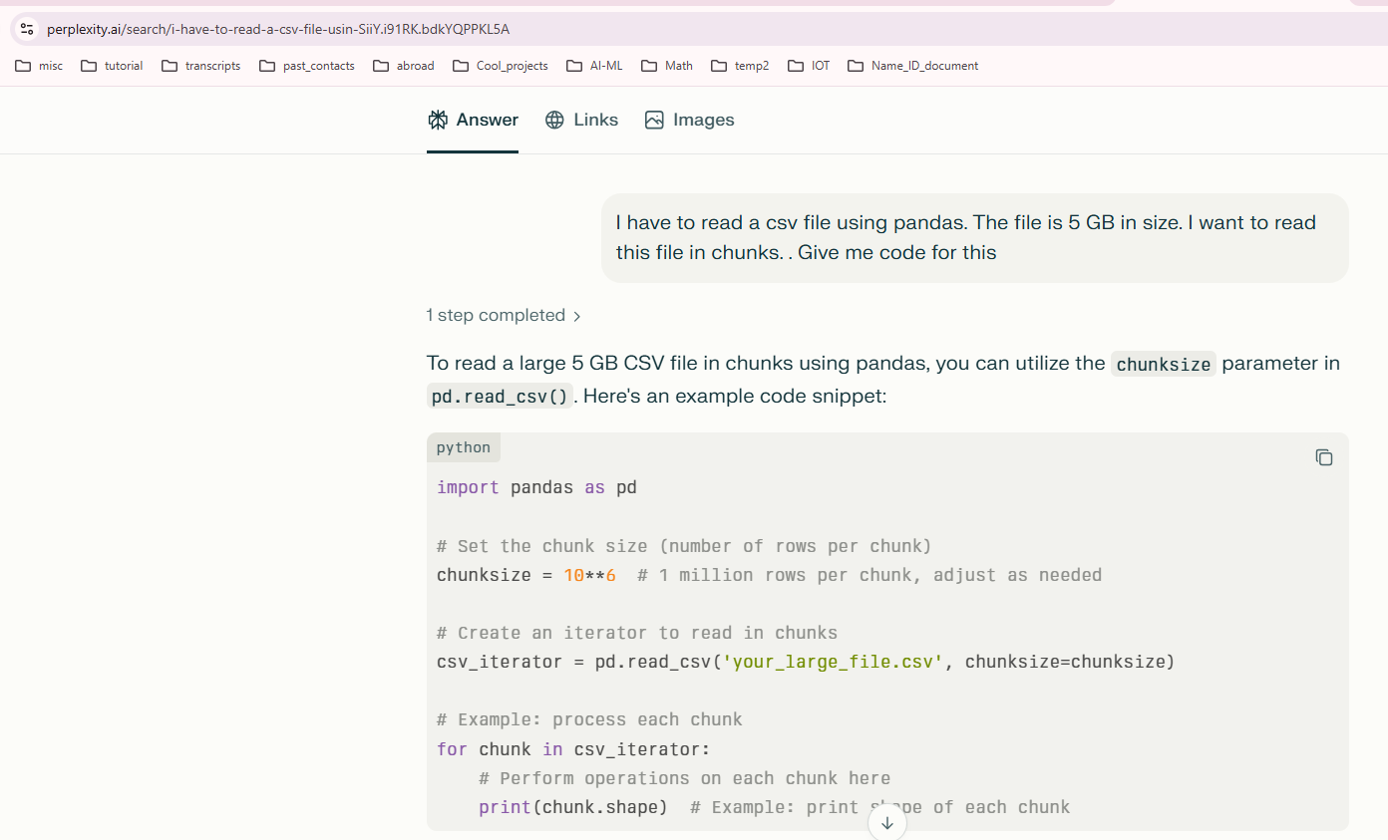
Text to Code generation: Perplexity AI
Prompt: I have to read a csv file using pandas. The file is 5 GB in size. I want to read this file in chunks. . Give me code for this

Slide 19
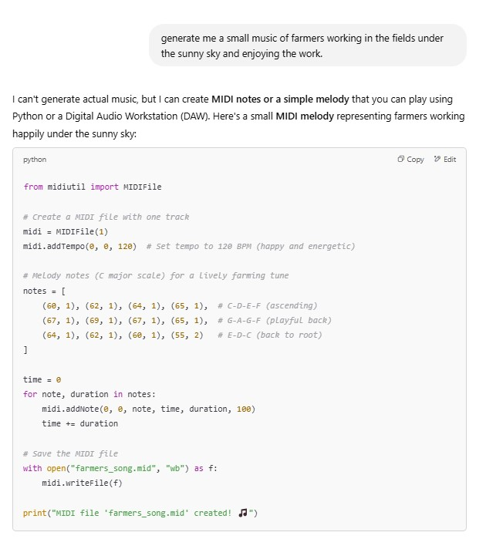

Example: Text to Music generation
ChatGPT wrote a code that generated the music

Slide 20
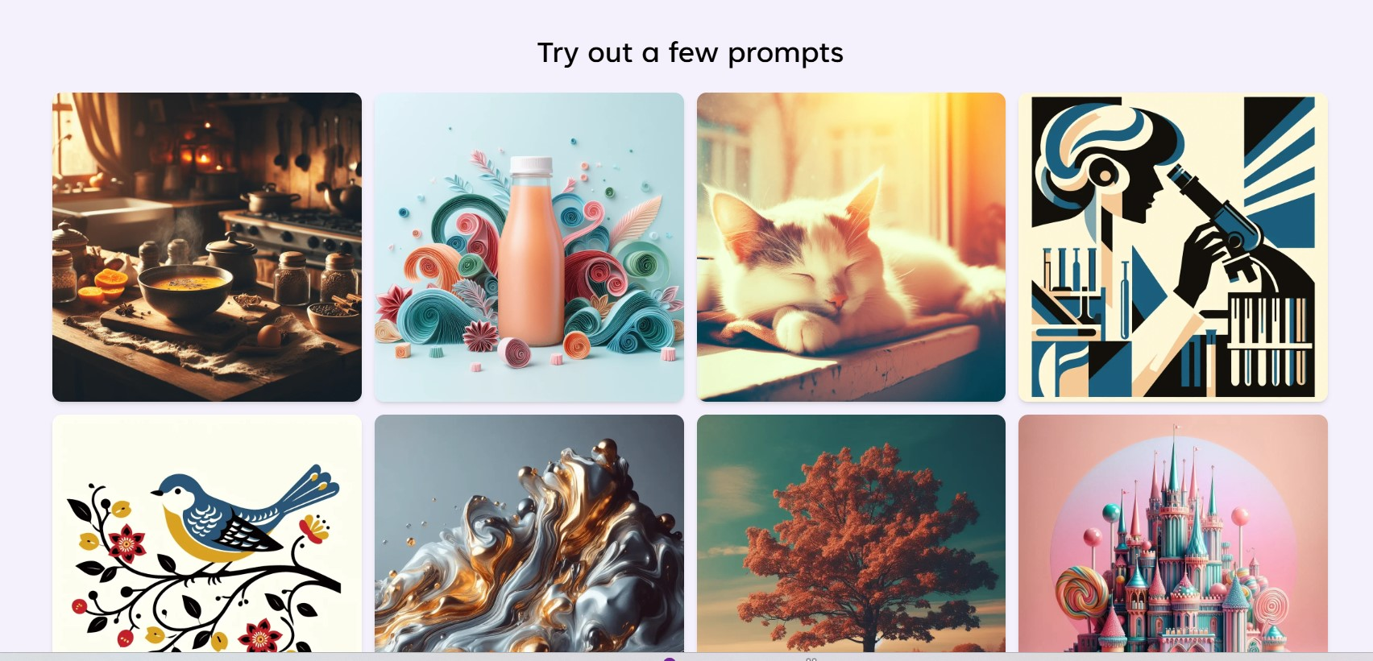
Microsoft image generator
Website: https://create.microsoft.com/en-us/features/ai-image-generator
Here you have to sign in.
Click on any of the following image

Slide 21
Simple example
Video created by faculty: https://youtu.be/w6S-lzWcQ8I?si=L899Cv66f1OjlDzu
Openai Sora Chair: https://youtu.be/lfbImB0_rKY?si=L9MOOoNDNCUIFlzx
GenAI in Arts
Artist Refik Anadol uses data-driven AI algorithms to 'paint' machine hallucinations: https://youtu.be/S9J96Pq_rvg?si=Dg2R1YHTUNq9UTdP
Commercialization of Gen AI
Coca-cola ad-Masterpiece: https://youtu.be/VGa1imApfdg?si=3CC3ZllRR7KoYwnO
Coca-cola ad Christmas: https://youtu.be/IQWUKWM2JrQ?si=r4X6yUSubbRjPjxP
Deep fake example:
Celebrity Deepfake video (Tom Cruise): https://youtu.be/iyiOVUbsPcM?si=33IivcwtXBedT7rp
Construction workers: https://youtu.be/JxkWMOEMu-Q?si=HAwdJkJKvrIjPE3T
Runaway: https://youtu.be/nByslCkykj8?si=ErJahz3rUfj4YEzQ
Video reels: https://youtu.be/6R7v8JVrkr0?si=jgFNufJmPVdrLqIg

Slide 22
Sites that create GenAI content:
https://www.imagine.art
https://www.midjourney.com/home
https://www.bing.com/images/create
https://lexica.art/
chatGPT -> image generator
(No Longer Active) https://huggingface.co/spaces/editing-images/ledits -> upload your photo image and put sunglasses on your photo
https://invideo.io/

Slide 23
Video examples:
Top German sports channel Ran.de, part of ProSieben, Germany’s second largest broadcaster, is already producing these sports news updates with the Hour One’s editing platform. After selecting a 3D “Studio” from the template library, the channel’s staff upload the latest game stats and opinions into the editor, — and minutes later, their custom human anchor presents the latest scores and updates with viewers in their native language

Slide 24
Applications (p1)
1. Content creation: GenAI can assist in generating customized content for marketing, advertising, and social media campaigns. It can create engaging visuals, write persuasive content, and even compose music or design graphics.
Drafting content: Generate complete text sections based on given parameters like topic, tone, and style, which can then be edited and refined by the content creator.
Content personalization: Analyze user data to create customized content that aligns with individual preferences and interests
Summarization: Extract key points from existing content to create summaries or generate new pieces with a concise perspective. Example→ https://notebooklm.google.com/
Visual content generation: Create images, illustrations, or design elements based on textual descriptions, allowing for rapid prototyping and visual ideation.
Translation and adaptation: Translate content between languages and adapt it to different cultural contexts. Enables businesses to communicate effectively across different languages and cultures. They can provide real-time translation services, improving global collaboration and customer support.
Social media post generation: Generate engaging captions, hashtags, and post formats for social media platforms. Example → Use NotebookLLM to generate description for videos

Slide 25
Applications (p2)
2. Virtual assistants: GenAI-powered virtual assistants can provide personalized and interactive support to employees. They can answer queries, schedule appointments, automate tasks, and engage in natural language conversations.
3. Creative design: GenAI can aid designers in creating unique and innovative designs. They can generate variations of design elements, layouts, or color schemes, providing inspiration and saving time in the creative process. The model that does this is text-toz-image, image-to-image, audio-to-image.
4. Science and medicine: In life sciences, generative AI is being used to design novel drug candidates, cutting the discovery phases to a matter of days instead of years. For medical imaging, GANs are now being used to generate synthetic brain MRI images for training AI. This is particularly useful in scenarios where data is scarce due to privacy concerns.

