Slide 1
https://www.youtube.com/watch?v=8L11aMN5KY8&t=234s

Slide 2
Generative Adversarial Networks (GANs)
GANs were invented by Jan Goodfellow, and his colleagues at the University of Montreal in 2014
GAN is a class of algorithmic machine learning framework having two neural networks:
Generator + Discriminator
Generator
Model
Discriminator
Model

Slide 3
The generator and discriminator compete against each other:
The generator generates fake data and tries to fool the discriminator.
The discriminator tries to keep from being fooled.
The generator will keep making newer, improved versions of fake data values until the discriminator can no longer distinguish fake from original.
Generator + Discriminator work against one another; hence called adversarial networks.
Generator
Model
Discriminator
Model

Slide 4
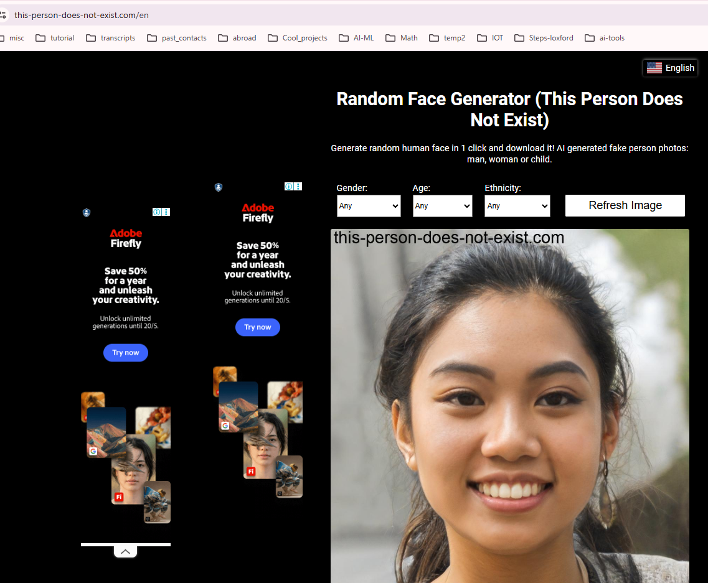
Uses of GAN

Slide 5
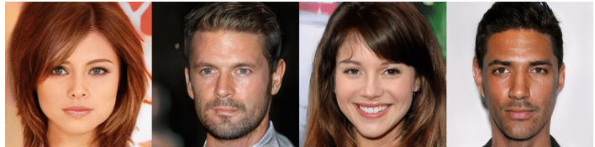
Uses of GAN
These people do not exist
https://www.researchgate.net/figure/These-people-do-not-exist-Synthetic-faces-generated-by-a-GAN-trained-on-human-pictures_fig1_332553686

Slide 6
Architecture of GAN
Steps
1) Some noisy random image is generated from Latent space
2) and 3) Generator model attempts to generate an image and this gets fed into Discriminator model
4) and 5) The Discriminator compares the Fake generated image agains the real images and identifies the real / fake.
5
6
4
Discriminator
Model
Identify
Real/ Fake
Real image
Loss
3
1
2
7
Latent Space
Generator
Model
Generated image
Back propagation to update weights

Slide 7
Architecture of GAN
6) The Loss function compares the real and fake image and computes how much different they are: High Loss mean large difference
7) The Loss number is fed into the Generator and Discriminator. The Generator now uses this Loss to generate next image.
And this process goes in Loop until the Loss becomes small.
5
6
4
Discriminator
Model
Identify
Real/ Fake
Real image
Loss
3
1
2
7
Latent Space
Generator
Model
Generated image
Back propagation to update weights

Slide 8
Generator:
Generator is an unsupervised machine learning method.
Used to generate fake samples based on actual training data sets.
It is also a neural network with hidden layers, activation, and loss function.
The generator focuses on generating fake data based on feedback given by the discriminator.
Generator objective is to fool the discriminator so that it cannot identify the real vs fake data
5
6
4
Discriminator
Model
Identify
Real/ Fake
Real image
Loss
3
1
2
7
Latent Space
Generator
Model
Generated image
Back propagation to update weights

Slide 9
Discriminator: It uses a supervised machine learning approach in which a simple
classifier is appointed to discriminate between real and fake data.
The discriminator's training data comes from two sources:
Real data instances, such as real pictures of people. The discriminator uses these instances as positive examples during training.
Fake data instances created by the generator. The discriminator uses these instances as negative examples during training.
It gives feedback to the generator.
5
6
4
Discriminator
Model
Identify
Real/ Fake
Real image
Loss
3
1
2
7
Latent Space
Generator
Model
Generated image
Back propagation to update weights

Slide 10
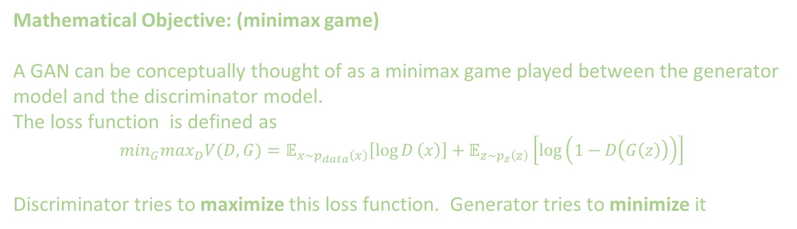
Mathematical Objective: (minimax game)
A GAN can be conceptually thought of as a minimax game played between the generator model and the discriminator model.
The loss function is defined as
$$\min_{G}\max_{D}V(D, G)=𝔼_{x∼p_{data}\left(x\right)}\left[\log{D}\left(x\right)\right]+𝔼_{z∼p_{z}\left(z\right)}\left[log⁡\left(1−D\left(G\left(z\right)\right)\right)\right]$$
Discriminator tries to maximize this loss function. Generator tries to minimize it
5
6
4
Discriminator
Model
Identify
Real/ Fake
Real image
Loss
3
1
2
7
Latent Space
Generator
Model
Generated image
Back propagation to update weights

Slide 11
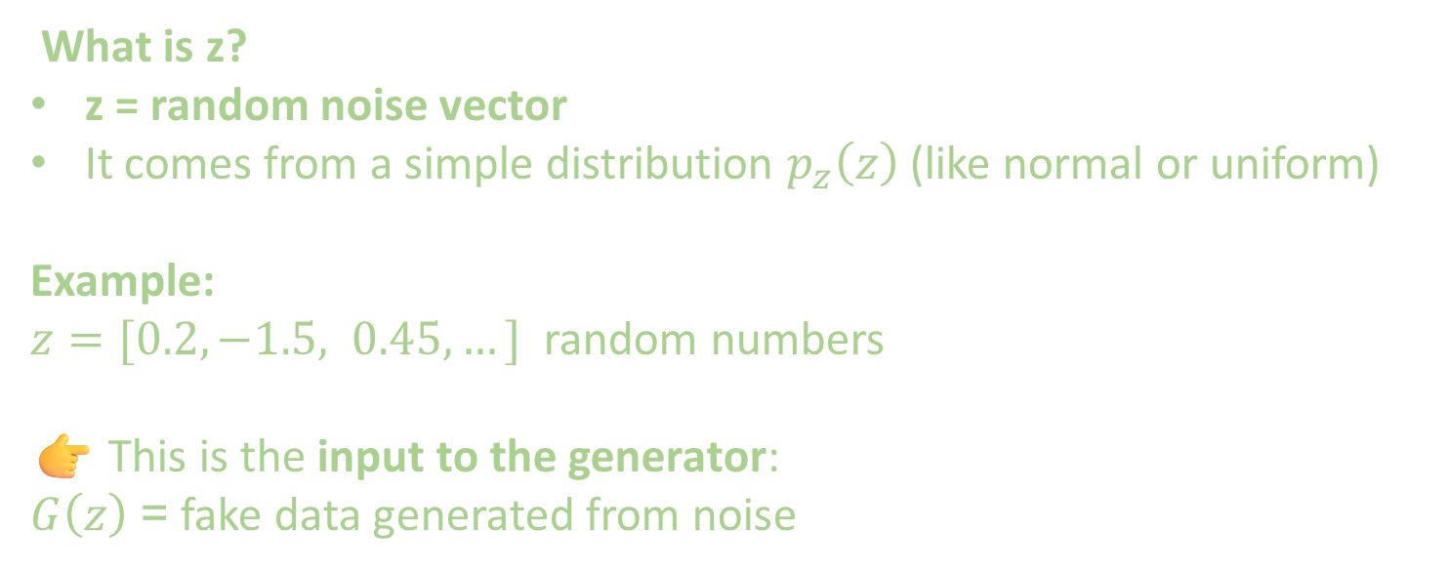
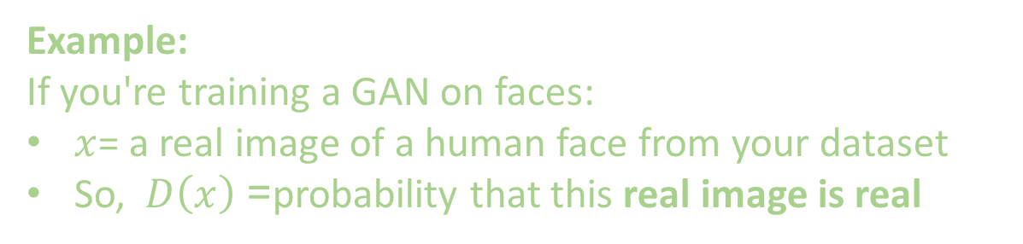
Example:
If you're training a GAN on faces:
$x$= a real image of a human face from your dataset
So, $D\left(x\right)$= probability that this real image is real
What is z?
z = random noise vector
It comes from a simple distribution $p_{z}\left(z\right)$ (like normal or uniform)
Example:
$z=[0.2, −1.5, 0.45, …]$ random numbers
👉 This is the input to the generator:
$G\left(z\right)$= fake data generated from noise

Slide 12
Practical View (What actually happens in code)
In real implementations, we don’t use this exact form directly for both models. Instead
🔹 Discriminator Loss
Maximizes:
  log(D(real)) + log(1 − D(fake))
real = x, fake=z
🔹 Generator Loss (modified)
Instead of minimizing log(1 − D(G(z))), we use:
maximize log(D(G(z)))
or equivalently minimize −log(D(G(z)))
5
6
4
Discriminator
Model
Identify
Real/ Fake
Real image
Loss
3
1
2
7
Latent Space
Generator
Model
Generated image
Back propagation to update weights

Slide 13
Why?
The original form causes vanishing gradients
This trick gives stronger learning signals

Slide 14
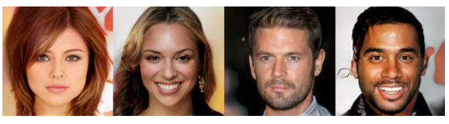
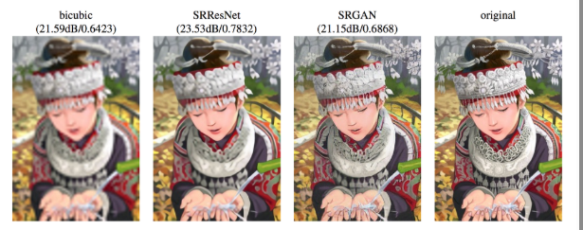
After training:
Generator learns the data distribution
Can generate:
Realistic faces: Image generation, Deepfakes
Art: Super-resolution
Synthetic data : Data augmentation
These people do not exist
Source: Medium (Jonathan Hui)
High resolution

Slide 15
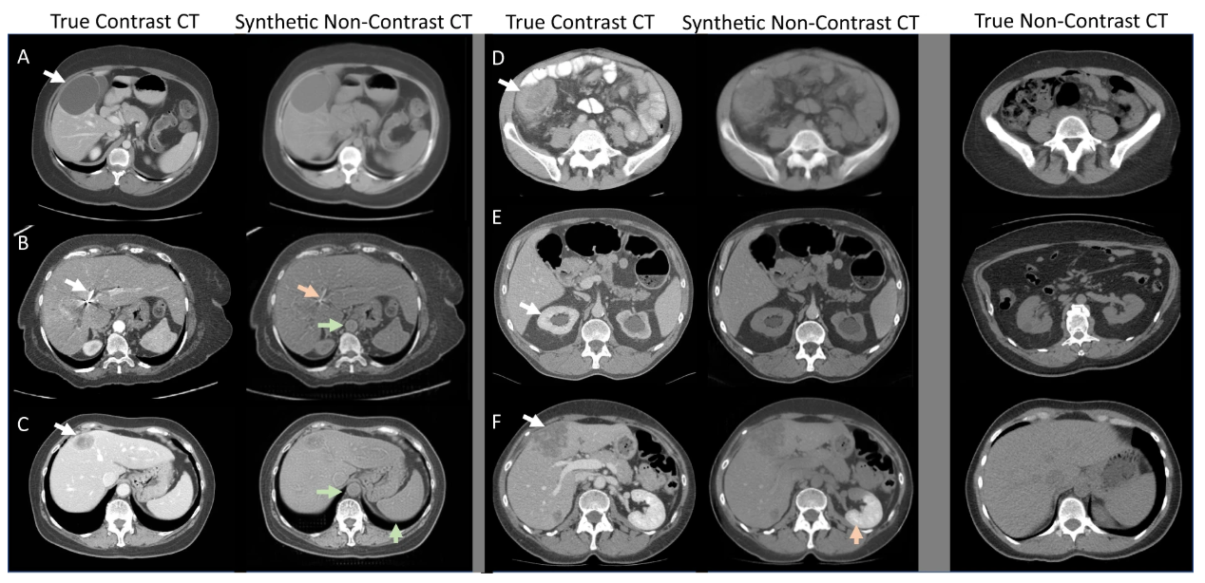
After training:
Generator learns the data distribution
Can generate:
Realistic faces: Image generation, Deepfakes
Art: Super-resolution
Synthetic data : Data augmentation
Source: Nature
Data augmentation

Slide 16
🧩 Why GANs Are Special
Unlike traditional ML:
No explicit labels needed
Learns by competition instead of supervision
5
6
4
Discriminator
Model
Identify
Real/ Fake
Real image
Loss
3
1
2
7
Latent Space
Generator
Model
Generated image
Back propagation to update weights

Slide 17
GAN challenges
GANs can be computationally intensive, both in terms of machine learning training and inference.
GAN often require large amounts of data (at the real input image side)and can take a long time to train.
GANs can be difficult to deploy because they require a lot of computational resources.
Solutions
use parallel training, which can help to speed up training.
use distributed training, which can help to distribute the computational burden across multiple nodes or machines, for example, with edge computing.

Slide 18
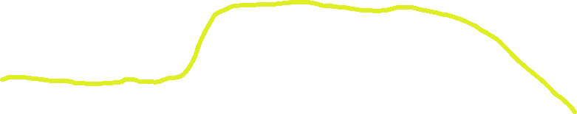
Back-propagation in Disc. training
Discriminator Loss
Real Image Data
Real Sample
Discriminator
Random Input
Generator
Fake Sample
Back-propagation in Gen training
Generator Loss

Slide 19
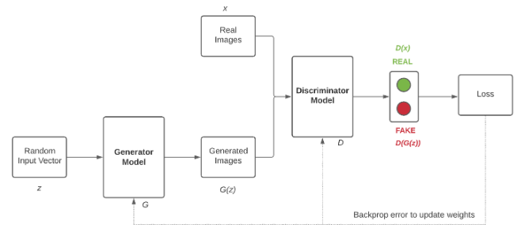
Step 1.Training the Discriminator
The discriminator connects to two loss functions. During discriminator training, the discriminator ignores the generator loss and just uses the discriminator loss. (We use the generator loss during generator training.)
During discriminator training:
The discriminator classifies both real data and fake data from the generator.
The discriminator loss penalizes the discriminator for misclassifying a real instance as fake or a fake instance as real.
The discriminator updates its weights through backpropagation from the discriminator loss through the discriminator network.

Slide 20
Step 2. Using the Discriminator to Train the Generator
To train a neural net, we alter the net's weights to reduce the error or loss of its output. In our GAN, however, the generator is not directly connected to the loss that we're trying to affect. The generator feeds into the discriminator net, and the discriminator produces the output we're trying to affect. The generator loss penalizes the generator for producing a sample that the discriminator network classifies as fake.
Backpropagation adjusts each weight in the right direction by calculating the weight's impact on the output — how the output would change if you changed the weight. But the impact of a generator weight depends on the impact of the discriminator weights it feeds into. So backpropagation starts at the output and flows back through the discriminator into the generator. At the same time, we don't want the discriminator to change during generator training. So we train the generator with the following procedure:
Sample random noise.
Produce generator output from sampled random noise.
Get discriminator "Real" or "Fake" classification for generator output.
Calculate loss from discriminator classification.
Back-propagate through both the discriminator and generator to obtain gradients.
Use gradients to change only the generator weights.
This is one iteration of generator training.

Slide 21
Some key points:
In its most basic form, a GAN takes random noise as its input. The generator then transforms this noise into a meaningful output.
By introducing noise, we can get the GAN to produce a wide variety of data, sampling from different places in the target distribution.

Slide 22
Problem: Because a GAN contains two separately trained networks, its training algorithm must address two complications:
1. GANs must juggle two different kinds of training : generator and discriminator. This makes GAN convergence hard to identify.
2. The generator and the discriminator have different training processes.
Solution:
GAN training proceeds in alternating periods:
The discriminator trains for one or more epochs.
The generator trains for one or more epochs.
Repeat steps 1 and 2 to continue to train the generator and discriminator networks.
We keep the generator constant during the discriminator training phase. As discriminator training tries to figure out how to distinguish real data from fake, it has to learn how to recognize the generator's flaws. That's a different problem for a thoroughly trained generator than it is for an untrained generator that produces random output.
Similarly, we keep the discriminator constant during the generator training phase. Otherwise, the generator would be trying to hit a moving target and might never converge.
It's this back and forth that allows GANs to tackle otherwise intractable generative problems. We get a toehold in the difficult generative problem by starting with a much simpler classification problem. Conversely, if you can't train a classifier to tell the difference between real and generated data even for the initial random generator output, you can't get the GAN training started.

Slide 23
Convergence Problem
As the generator improves with training, the discriminator performance gets worse because the discriminator can't easily tell the difference between real and fake. If the generator succeeds perfectly, then the discriminator has a 50% accuracy. In effect, the discriminator flips a coin to make its prediction.
This progression poses a problem for convergence of the GAN as a whole: the discriminator feedback gets less meaningful over time. If the GAN continues training past the point when the discriminator is giving completely random feedback, then the generator starts to train on junk feedback, and its own quality may collapse.

Slide 25

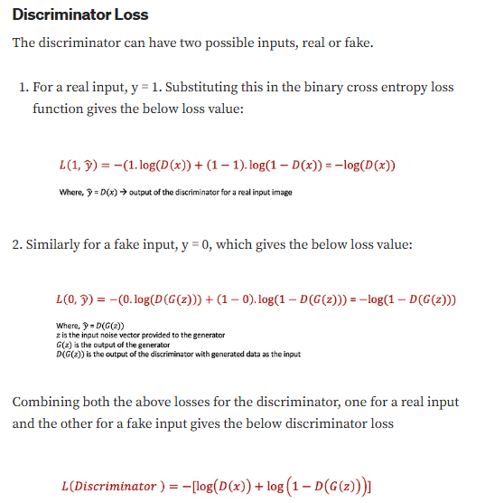
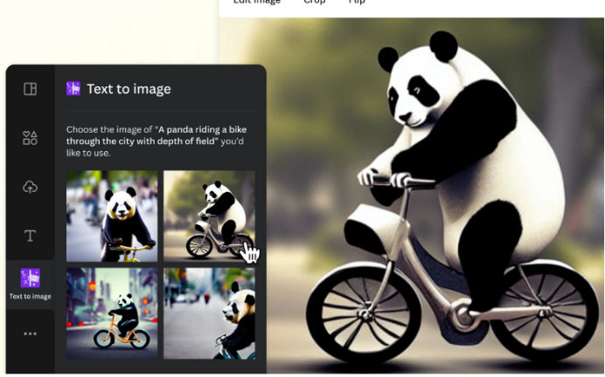
Math of GAN p2
Let us try to derive this equation to understand it better.
Binary Cross-Entropy Loss
Both the generator and the discriminator use the binary cross-entropy loss to train the models. In general, binary cross entropy loss can be written as:

Slide 26
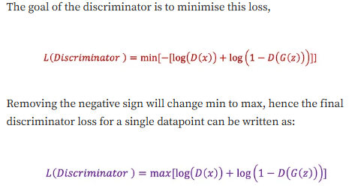
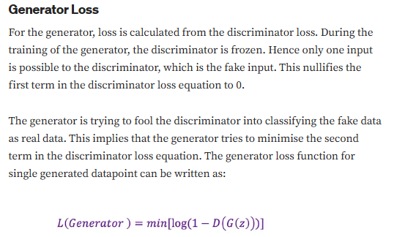
Math of GAN p3

Slide 27
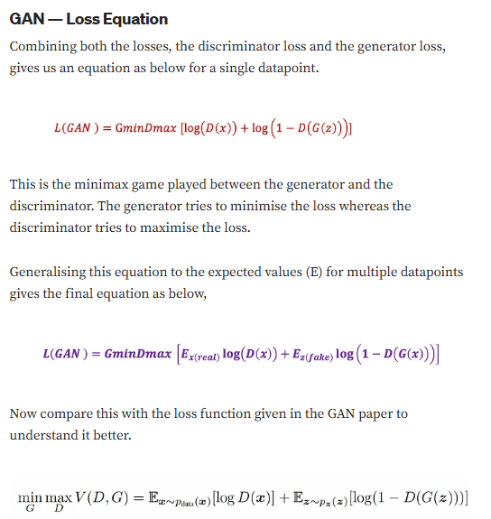
Math of GAN p4

Slide 28
Limitations of GAN
1. Mode collapse
This is a state where the model Generator G gets stuck at a point with producing limited varieties of samples or one sample repeatedly during or after training the GAN.
During the GAN training when the discriminator is not really forcing more diversity in the generator G, the generator fails to learn the representation of the complex real-word data.
Remember the generator ‘s goal is to trick the discriminator D into thinking that the outputs by G are real,
if generator G produces one sample which is realistic to the original data, then the discriminator finds it hard to distinguish between them.
At this time the generator G keeps on producing the same image over and over This leads to “Complete mode collapse”.
if the generator G learns very few properties and produces few varieties of samples then that is “Partial mode collapse”.

Slide 29
2. Failure to converge due to which the discriminator feedback can get less meaningful to the generator thus impacting its quality

Slide 30
Add the implementations of GAN here
Use https://www.analyticsvidhya.com/blog/2021/06/a-detailed-explanation-of-gan-with-implementation-using-tensorflow-and-keras/
https://www.datacamp.com/tutorial/generative-adversarial-networks
https://www.digitalocean.com/community/tutorials/implementing-gans-in-tensorflow
https://realpython.com/generative-adversarial-networks/
https://www.w3computing.com/articles/implementing-gans-generative-adversarial-networks-from-scratch/
https://www.digitalocean.com/community/tutorials/implementing-gans-in-tensorflow#visualizing-samples-during-training

