Slide 1
Evaluating your LLM Apps

Slide 2
🤔 Why LLM Evaluation is Different
Traditional ML:
Clear labels → accuracy, precision, recall
LLMs:
Open-ended outputs
Multiple correct answers
Subjective quality (tone, helpfulness, safety)
👉 Example:
Question: "Explain AI to a 10-year-old"
There is no single correct answer → evaluation becomes nuanced.

Slide 3
Types of LLM Evaluation
Automatic Evaluation
String-based metrics
Semantic similarity
LLM-as-a-Judge ( Important )
B. Human Evaluation (Gold Standard)
C. Task-Based Evaluation (Best for Applications)

Slide 4
Types of LLM Evaluation
A. Automatic Evaluation (Fast but Limited)
1. String-based metrics
BLEU – Bi-Lingual Evaluation Understudy
ROUGE - Recall-Oriented Understudy for Gisting Evaluation
Used in
Machine translation
Summarization
⚠️ Problem: They measure text overlap, not meaning.

Slide 5

BLEU
BLEU measures how much the generated text overlaps with the reference text, mainly using n-grams.
It was originally developed for machine translation.
Example: Image-To-Text Model
What does BLEU look at?
It can consider:
1-gram: individual words
2-gram: pairs of words
3-gram: triples
4-gram: four-word sequences
Image to Text Model
Reference - The cat is sitting on the mat.
LLM output - The cat is sitting on the mat.
The output has almost complete n-gram overlap
→ BLEU ≈ 1 / 100%.
If the LLM output is - A cat sits on a rug.
There is less exact word/phrase overlap → lower BLEU.

Slide 6
ROUGE
ROUGE measures how much of the reference text is captured by the generated text.
It is particularly common in text summarization.
Example:
Reference : Python is a popular programming language used for AI and data science.
LLM Answer: Python is widely used for AI and data science.
There is large overlap in important words, so ROUGE would be relatively high.
LLM
What is Python Language?
Common variants of ROUGE:
Metric | What it measures
ROUGE-1 | 1-word overlap
ROUGE-2 | 2-word sequence overlap
ROUGE-L | Longest Common Subsequence

Slide 7
Limitations of BLEU and ROUGE
BLEU and ROUGE are lexical-overlap metrics.
They primarily care about whether the same words or sequences appear.
That creates a limitation –
Reference: The automobile is very fast.
LLM: The car is extremely quick.
BLEU/ROUGE would give a relatively low score (because the exact words differ), but a human will consider these semantically similar.

Slide 8
2. Semantic similarity
Cosine similarity using embeddings
👉 Example:
"AI is machine intelligence"
"Artificial intelligence is intelligence shown by machines“
Different words → same meaning → good score

Slide 9
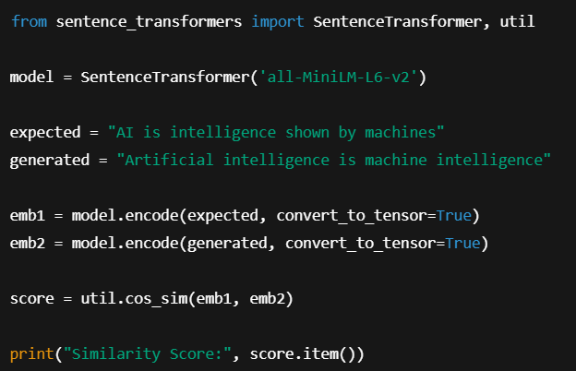
2. Semantic similarity
Example of Cosine similarity using embeddings
Generated by LLM
Output (maybe):
0.84

Slide 10
3. LLM-as-a-Judge (Very Important Concept)
Use one LLM to evaluate another LLM
User Input:
Explain the difference between a list and a tuple in Python.
LLM Output
LLM
(To Be Evaluated)
LLM-as-a-Judge
(Scale of 1-10)
Correctness = 7
Clarity = 4
Completeness = 9

Slide 11
Example prompt:
You are an expert AI evaluator.
Grade the model's response below.
[User Request]:
“Explain the difference between a list and a tuple in Python.”
[LLM Response]:
"Lists and tuples are both used to store collections of data in Python. The main difference is that lists use square brackets [] and are mutable, meaning you can change them. Tuples use parentheses () and are faster.”
[Evaluation Criteria]:
Score the answer from 1–10 based on:
Correctness
Clarity
Completeness
Provide a score for each criterion, a brief justification, and an overall final score out of 10.

Slide 12
B. Human Evaluation (Gold Standard)
Humans rate outputs on:
Correctness
Helpfulness
Tone
Safety
👉 Scale example:
1 = Bad
5 = Excellent
⚠️ Downsides:
Expensive
Slow
Subjective – Person A and Person B may have different evaluation

Slide 13
C. Task-Based Evaluation (Best for Applications)
Evaluate based on real task success
👉 Example:
Application | Metric
Chatbot | % of correct answers
RAG system | Retrieval relevance
Code generator | Code runs successfully

Slide 14
Modern LLM evaluation often also uses:
BLEU / ROUGE
↓
Lexical similarity
Embedding / semantic similarity
↓
Meaning similarity
LLM-as-a-Judge
↓
Quality, correctness, relevance, reasoning, etc.

Slide 15
4. 📊 Key Metrics in Evaluation
1. Accuracy
Correct vs incorrect answers
2. Hallucination Rate
% of answers that are factually wrong
3. Relevance
Does the answer match the question?
4. Faithfulness (Important for RAG)
Does the answer stick to provided context?
5. Latency
How fast is the response?
6. Cost
API usage cost per request

