Slide 1
Module 1: Introduction to GitHub Copilot (15 min)
What is Copilot?
AI-powered coding assistant
Developed by GitHub and OpenAI
Works inside VS Code
Generates code, explanations, tests, documentation, and refactoring suggestions

Slide 2
Benefits
Faster development
Reduced repetitive coding
Learning new APIs/frameworks
Documentation assistance
Copilot Editions
Copilot Individual
Copilot Business
Copilot Enterprise

Slide 3
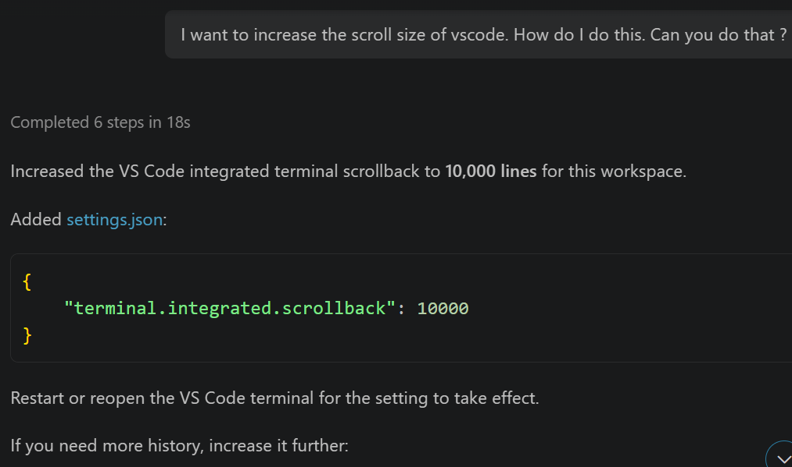
Examples of Human In The Loop:
I wanted to increase the scroll size of the terminal in vscode.
Cont….

Slide 4
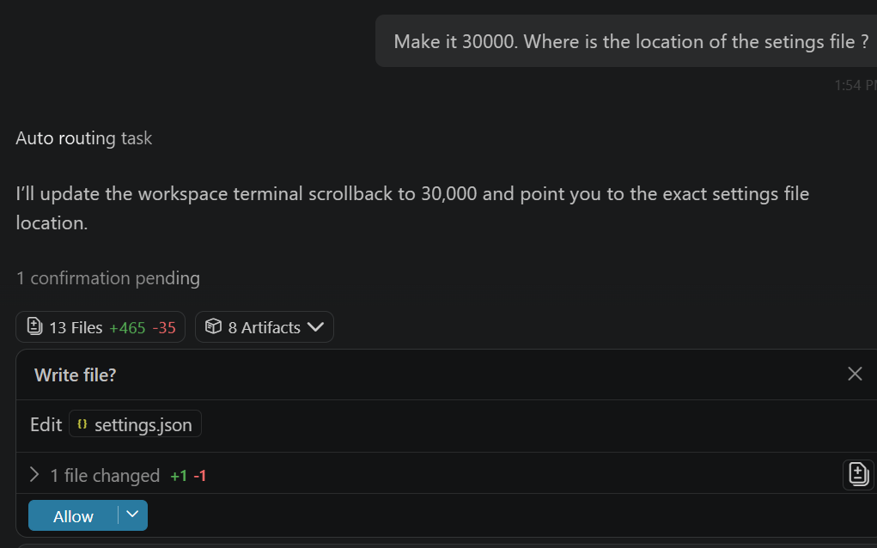
….Cont
I asked it to increase scroll back size to 30,000 and also tell me the file location
Human In the Loop

Slide 5
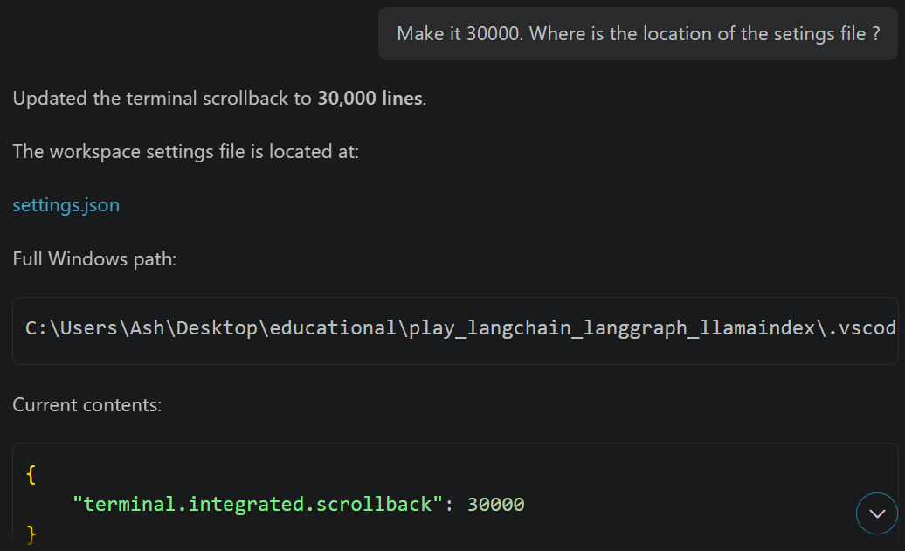
….Cont

