Slide 1
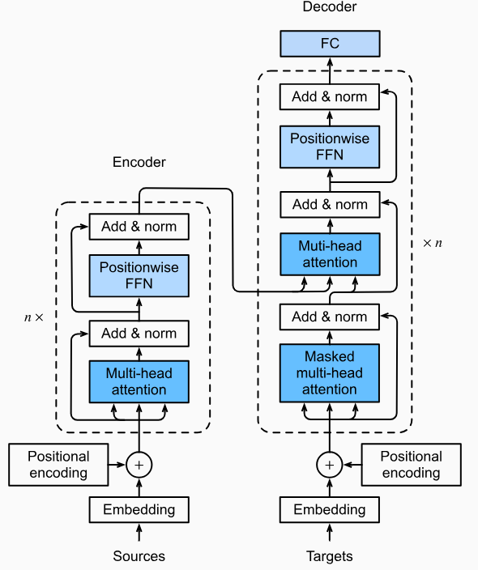
Transformers

Slide 2
Playground: https://poloclub.github.io/transformer-explainer/
Source:
https://youtu.be/ZhAz268Hdpw?si=jQXkVM058uJkEWCw
https://youtu.be/zxQyTK8quyY?si=C-flWWBSxwrqWao7
3 parts:
1) https://youtu.be/OxCpWwDCDFQ?si=xo2r5jOoc3YQgji6
2) https://youtu.be/UPtG_38Oq8o?si=fYUN8D7y1fvW2vCw
3) https://youtu.be/qaWMOYf4ri8?si=iA8GmBLLFfcZgCQk
https://www.datacamp.com/tutorial/how-transformers-work

Slide 3
What are Transformers?
Definition:
Neural Network that learns the
context of sequential data and
generates new data out of it.
Origin: “Attention is All You Need” by Vaswani et al. (2017)

Slide 4
They are meant to solve any task that
transforms an input sequence to an output sequence.
This is why they are called “Transformers”.

Slide 5
Applications: Where are Transformers used ?
NLP
Text classification (BERT)
Text generation (GPT)
Translation (T5, MarianMT)
Question answering (RoBERTa)
Vision
Vision Transformers (ViT)
Object detection, segmentation
Speech
Whisper, wav2vec
Multimodal
CLIP (image + text)
Flamingo, Gemini

Slide 6
Why transformers are successful ?
Transformers overcame limitations of RNNs and LSTMs

Slide 7









RNN Limitation:
Sequential processing and therefore no parallelism
An RNN reads one word at a time.
The → movie → that → I → watched → last → week → with → my → friends → was → absolutely → amazing
It cannot process "movie" before finishing "The."
Since every step waits for the previous one, GPU cannot process all words together.
->Training becomes slow.
RNN
The movie that I watched last week with my friends was absolutely amazing

Slide 8
2) Hard to capture long-term dependencies due to vanishing gradients
Consider sentence:
"The book that I borrowed from the university library shelf after attending yesterday seminar was good read. I think I will buy it.“
The word “it” refers to the “book” and appeared may words later. The RNN model struggles to associate the word “it” to the “book”
Vanishing Gradient -> As you proceed further in sentence, because of multiplication of small derivatives, RNN would forget the previous words
RNN
The book that I borrowed from the university library shelf after attending yesterday seminar was good read. I think I will buy it.

Slide 9
Another example:
Long sentences → model forgets important words
RNN
The movie I watched yesterday in the theater with my friend was really amazing. It was about an Astronaut stuck in space and his journey back to Earth.”
A basic model may forget:
movie
amazing (main sentiment)

Slide 10
Attention in Transformers
Idea:
“Instead of remembering everything equally, the model focuses more on important words.”
When you read:
“The movie was really amazing. We came back late night”
You naturally focus on:
movie
Amazing
night
Not on: “the”, “was”, “really”
That is attention: highlighting important parts dynamically
Transformer Model

Slide 11
General idea of transformer
Use case 1: It is good for figuring out the context
Sentence: “…I drank juice from the bottle. It was cold”
“It” can refer to “juice” or “bottle”
Transformer can figure out that “it” refers to “juice”
Use case 2: It is good for predicting next word
Command: What is LLM in Deep Learning ?
Response: LLM
Response: LLM stands
Response: LLM stands for
Response: LLM stands for Large
Response: LLM stands for Large Language
Response: LLM stands for Large Language Models

Slide 12
Transformers enabled parallel processing of large text corpora
Led to models like GPT, BERT, T5, ViT

Slide 13

Why training a Transformer from scratch is not preferred?
01. Computational Cost
High GPU Demand
Requires massive GPU resources, long runtimes, and extensive hyperparameter tuning.
02. Data Inefficiency
Sparse Labeled Data
Downstream tasks have limited data; training from scratch leads to poor generalization.
The Ideal Solution
Pre-trained Transformers
Fine-tuning leverages existing weights efficiently to achieve comparable or better performance.
huggingface.co
03. Information Loss
Representation Discard
Training anew completely discards rich linguistic or visual features already learned.
04. Constraints
Resource & Time
Fails to leverage existing weights, demanding excessive cost and budget investments.

Slide 14
Key Concepts of Transformers
Self-Attention
Parallel Processing
Encoder-Decoder Structure
Positional Encoding
Multi-Head Attention

Slide 15



Core Components of a Transformer
Transformers consist of encoder and decoder stacks. Most models use either:
Encoder-only (e.g., BERT – understanding tasks) – sentiment analysis
Decoder-only (e.g., GPT – generation tasks)
Both (e.g., T5 – translation/summarization)
Encoder
layer
Decoder
layer
Positive
output
Transformer
input
I am feeling awesome ?
Stacking Layers: A typical transformer model stacks 6–96 of these encoder or decoder blocks.

Slide 16



Core Components of a Transformer
Transformers consist of encoder and decoder stacks. Most models use either:
Encoder-only (e.g., BERT – understanding tasks)
Decoder-only (e.g., GPT – generation tasks) – Write a python code
Both (e.g., T5 – translation/summarization)
Encoder
layer
Decoder
layer
CODE
output
Transformer
input
Write python code to read CSV file ?
Stacking Layers: A typical transformer model stacks 6–96 of these encoder or decoder blocks.

Slide 17

Core Components of a Transformer
Transformers consist of encoder and decoder stacks. Most models use either:
Encoder-only (e.g., BERT – understanding tasks)
Decoder-only (e.g., GPT – generation tasks)
Both (e.g., T5 – translation/summarization) – Translate into Spanish
Encoder
layer
Decoder
layer
Como Estas ?
output
Transformer
input
How are you ?
Stacking Layers: A typical transformer model stacks 6–96 of these encoder or decoder blocks.

Slide 18
BERT has only the encoder part
GPT has only the decoder part
Generic

Slide 19
Core Components of a Transformer
(Word) Embedding + Positional Encoding
Words are converted into vectors via embedding layers.
Swim -> [ 1, 0, 0, 0.7, ]
Fishing -> [ 0.9, 0.1, 0.6, 0.03, ]
We use these vectors to find which words are similar.
The values are found through training data
Googles Word2Vec uses 300 dimension
Other word embedding packages are Glove, etc.
4 Dimension
 | Sea | Air | Land | Love
Swim | 1 | 0 | 0 | 0.7
Fly | 0.01 | 0.9 | 0.2 | 0.8
Walk | 0 | 0 | 1
Stand | 0 | 0 | 0.9 | 0
Studying | 0.1 | 0.4 | 0.3 | -0.01
Fishing | 0.9 | 0.1 | 0.6 | 0.03

Slide 20
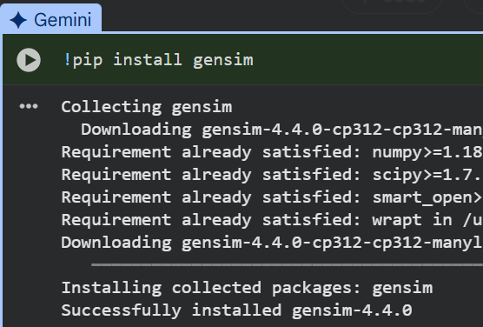
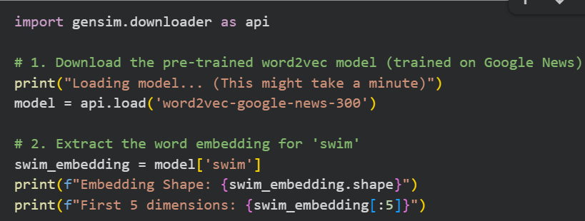
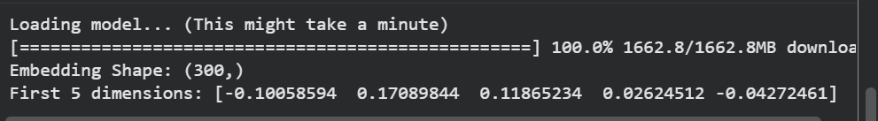

Slide 21
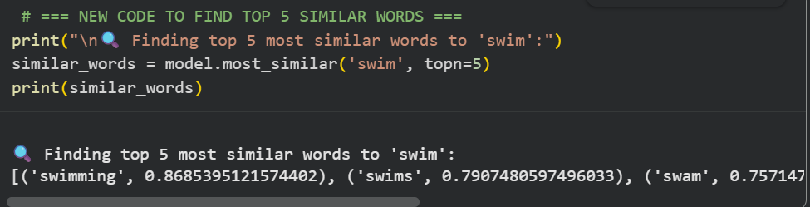
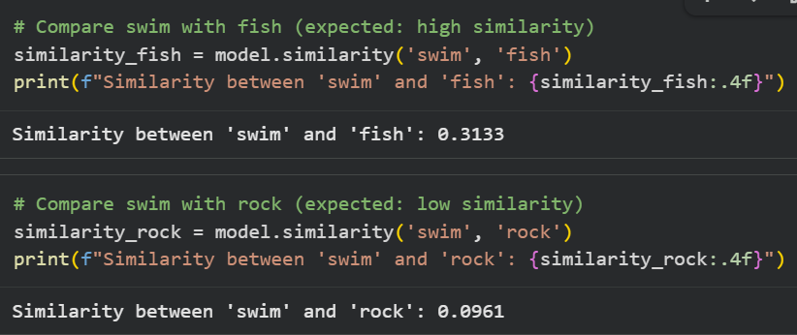

Slide 22
Core Components of a Transformer
Positional embeddings
Sentence: “I went to the bank to deposit money. Later, I sat near the river bank.”
Here we use positional embeddings that would distinguish the 2 banks.
Since the model has no sense of word order (no recurrence), we add positional encoding to preserve sequence information.
Positional Embeddings are learned during training
It treat position like a word
pos 1 (I) → [0.3, 0.2, ...]
pos 2 (went) → [0.4, 0.2, ...]
pos 3 (to) → [-0.3, 0.8, ...]

Slide 23

Final embeddings = Word embedding + positional embeddings
Sentence: “I went to the bank to deposit money. Later, I sat near the river bank.”
0.1
0.3
0.4
…..
0.6
0.9
-0.6
…..
Word
embedding
0.3
0.2
-0.7
…..
0.4
0.2
-0.6
…..
Position
embedding
0.4
0.5
-0.3
…..
1.0
1.1
-1.2
…..
Final
embedding

Slide 24
Core Components of a Transformer
Problem with Word Embedding:
They are static
I went to the bank to deposit money. Later, I sat near the river bank.
If bank is [0, -0.3, 0.2, …], then it cannot represent the word bank in above 2 sentences in a meaningful manner
Solution: Self-Attention Mechanism
Key concept: Every word (token) in a sentence "looks at" all other words to understand their importance in context.
Example
Sentence: "The cat sat on the mat and it was sleeping"
When encoding "cat", attention may also focus on "sat", "mat", etc.
For "it" in “and it was sleeping", attention helps resolve that "it" refers to "cat".

Slide 25








Self-Attention Mechanism
Self-attention calculates the similarity between first word (The) and all the words in a sentence and
It does this for all the words in the sentence
The cat sat on the mat and it was sleeping
The attention mechanism would find the similarity score between it and all words:
it → cat (high importance)
it → mat (low importance)
The cat sat on the mat and it was sleeping
The cat sat on the mat and it was sleeping

Slide 26

Self-Attention Mechanism
For each word there is Attention(Q, K, V)
Each word is converted into 3 vectors:
Query (Q) → “What am I looking for?”
Key (K) → “What do I contain?”
Value (V) → “What information do I give?”
Given token vectors, the model creates: Query (Q) , Key (K), Value (V)
This measures how much attention each word pays to others and helps model know which words are important to focus on.

Slide 27
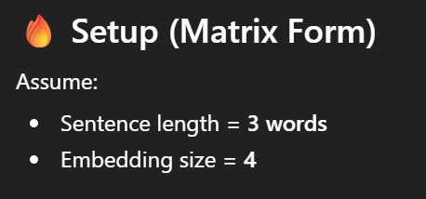
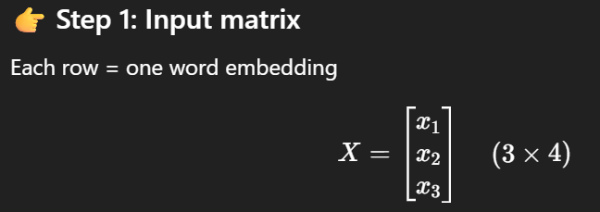
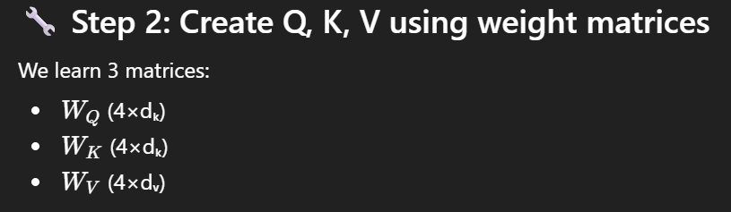

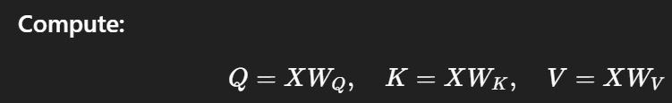
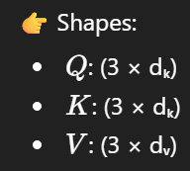
Self-Attention Mechanism: This is math (OPTIONAL)

Slide 28
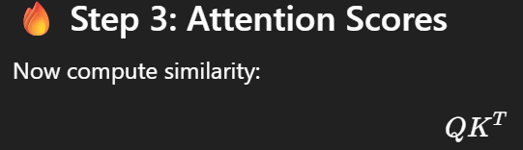
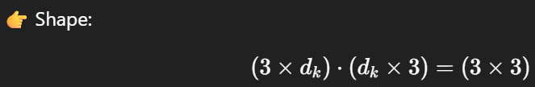
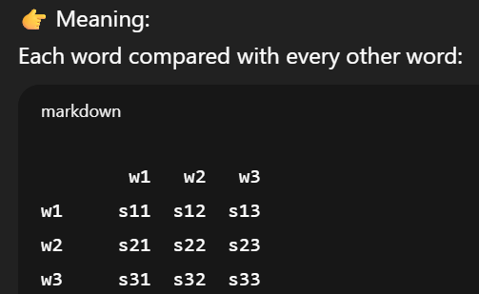
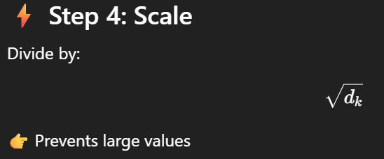
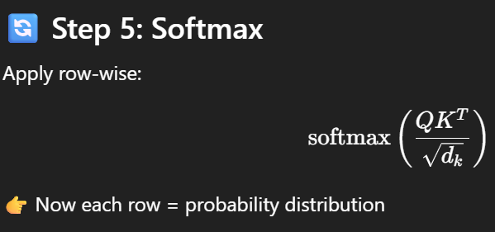

Slide 29
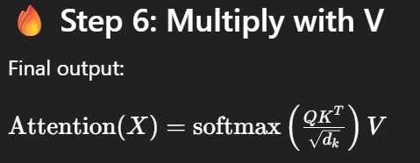
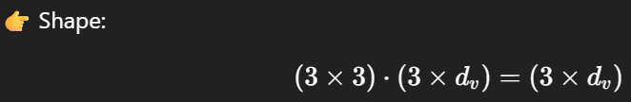
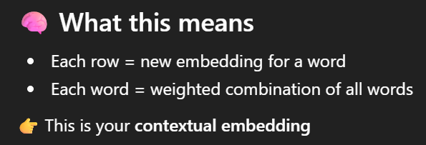
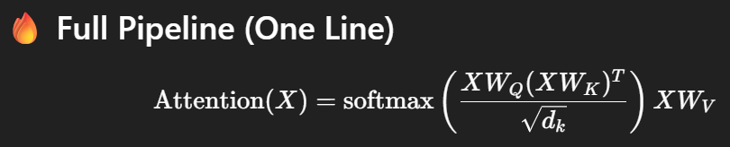

Slide 30
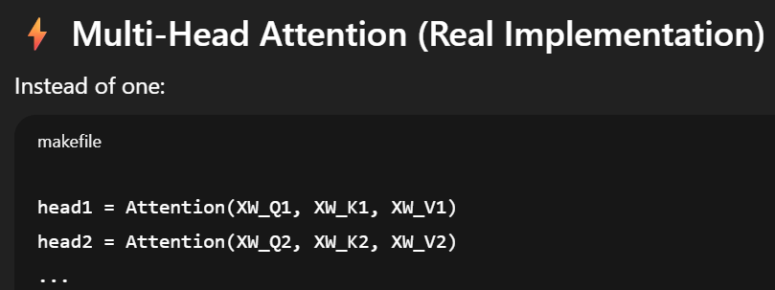
Multi-Head Attention
Instead of one attention layer, we use multiple heads in parallel.
Advantages:
1) Each head captures different types of relationships (syntax, semantics, etc.).
For example:
“The bank of the river was muddy,"
Head1 : Focuses on the syntax (verb-object relationship)
Head 2: Focuses on semantic context ("river" explaining which type of "bank" it is)

Slide 31

2) Stable and Robust Learning:
Relying on a single attention head makes training highly sensitive to that specific head's initialization and performance.
Multiple heads act like an ensemble within a single layer, making the network less prone to overfitting
Then we concatenate and linearly transform the outputs of all heads.

Slide 32
Core Components of a Transformer
Output Process
For classification tasks (like BERT),
the final token representations are passed to a classifier.
In BERT
Output = contextual embeddings
Used for: classification , NER , QA
For generation tasks (like GPT),
the decoder predicts the next word/token step-by-step.
GPT predicts next word

Slide 33
Pros & Cons Of Transformers
Pros
Parallel processing
Better long-range understanding
Cons
Requires large data
Expensive training (GPU/TPU)

Slide 35


Core Components of a Transformer
Add Residual Connections + Layer Normalization
Add Residual connection:
Output of each block is added back to its input (helps gradient flow).
Layer normalization:
Keeps values in good range + Stabilizes training.

Slide 36
Core Components of a Transformer
Feed Forward Network (FFN)
Each word independently passes through a small neural network:

