Slide 2
Problem Statement
I have course content in excel format. I have to transform that in MS Word format. I already have format template in MS Word.

Slide 3
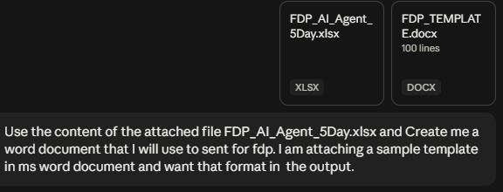
Prompt
Use the content of the attached file FDP_AI_Agent_5Day.xlsx and create me a word document that I will use to sent for fdp.
I am attaching a sample template in ms word document and want that format in the output.

Slide 4
