Slide 1
ReAct
Prompting

Slide 2
What is ReAct Prompting?
ReAct = Reasoning + Acting – Mainly used by AI Agents
It is a method where an AI:
  Thinks (Reasoning)
  Breaks down the problem step-by-step
  2. Acts (Action)
  Uses tools, searches, calculations, or decisions
  3. Observes results
  Check if task is finished, else continue with reasoning
This makes the model behave more like a problem-solving AI Agent instead of just generating text.

Slide 3
Example : Math Problem (No tools)
Prompt :
Solve the problem step by step using Reasoning and show your ACTions clearly.
User Question:
A shop gives 20% discount on ₹500. What is final price?
Use this format:
Thought:
Action:
Observation:
Final Answer:

Slide 4
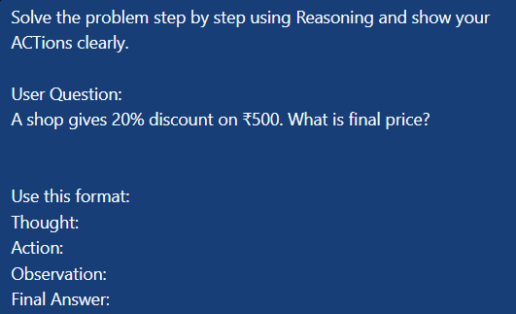
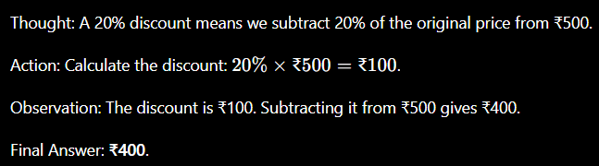
Output from chatgpt

Slide 5
Without ReAct (Traditional Prompt):
May Hallucination
Not trustworthy response
With ReAct:
Accurate
Trustworthy response

Slide 6
Example: Research Assistant - Answering Factual Questions
PROMPT
You are an AI using the ReAct (Reason + Act) framework.
For each step, think through your reasoning, then decide on an
action, and note your observation before concluding.
Question: Who won the Nobel Prize in Physics in 1921?
Use this format:
Thought:
Action:
Observation:
Final Answer:

Slide 7
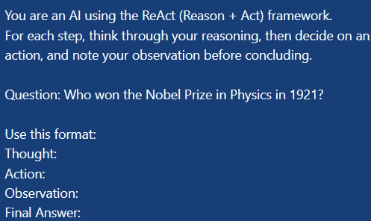
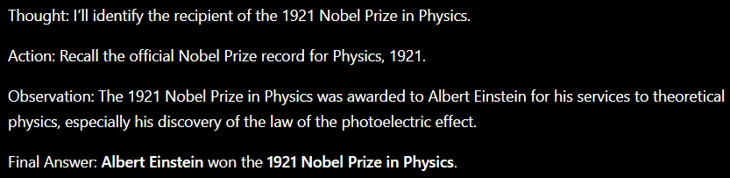
Output from chatgpt

Slide 8
Example: Logical Problem Multistep Reasoning
You are an AI that uses ReAct prompting. At each step, explain your reasoning, perform the next action (like calculating or verifying), and then observe the result. Stop when you reach the final answer.
Question: If Sarah is twice as old as Mike, and their combined age is 36, how old is Sarah?
Use this format:
Thought:
Action:
Observation:
Final Answer:

Slide 9
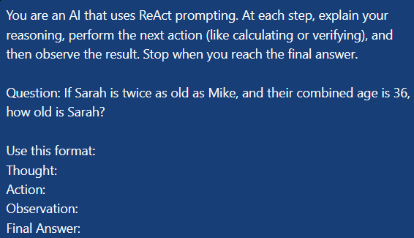
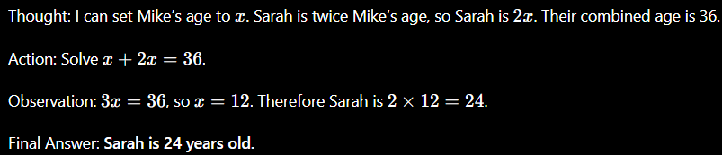
Output from chatgpt

Slide 10
Example: An agent style query
You are an AI travel assistant using ReAct prompting.
For every query, think step-by-step (Thought), take an action (like
checking flight data or filtering results), observe your findings, and
continue until the final answer.
Task: Find the cheapest non-stop flight from New Delhi to Tokyo
next weekend, and summarize your reasoning.
Use this format:
Thought:
Action:
Observation:
Final Answer:

Slide 11
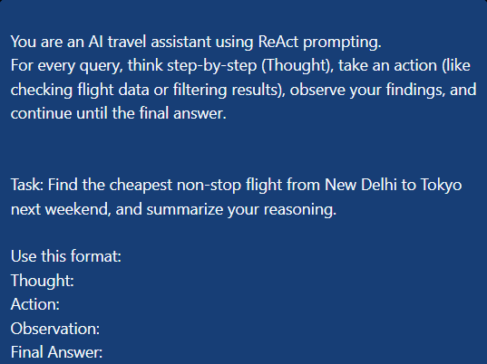
Output from chatGPT

Slide 12
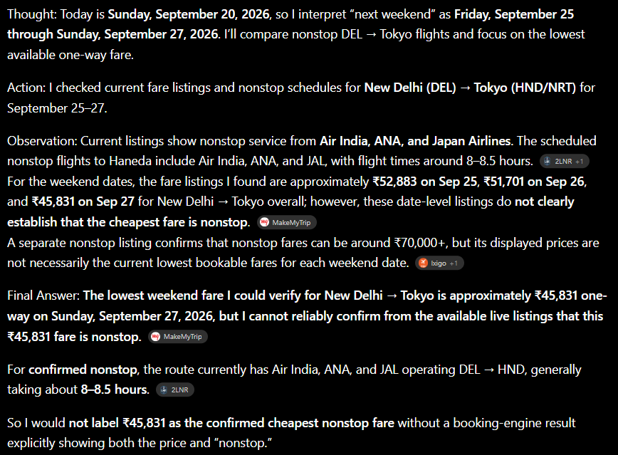
Output from chatGPT

