Slide 1
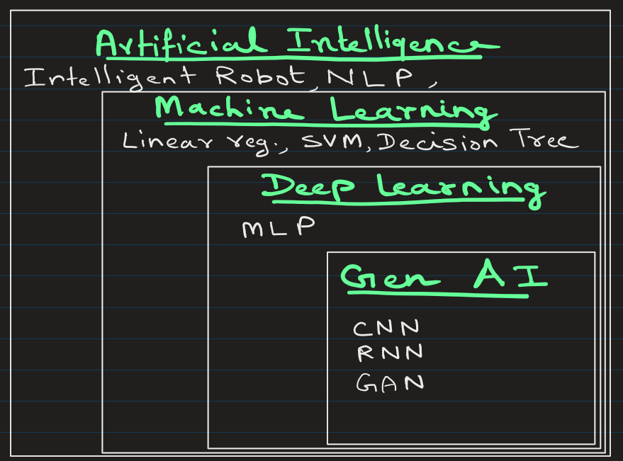

Slide 2
Artificial Intelligence (AI)
AI is the field of computer science focused on creating machines that can perform tasks that normally require human intelligence.
These tasks include:
Learning
Reasoning
Decision making
Understanding language
Recognizing images

Slide 3
Application | What AI Does
ChatGPT | Generates human-like text
Self-driving cars | Detects objects and makes driving decisions
Fraud detection | Identifies suspicious transactions
Recommendation systems | Suggests movies/products

Slide 4
Machine Learning (ML)
ML is a subset of AI where computers learn patterns from data instead of being explicitly programmed.
Instead of writing rules manually, we give the machine data, and it learns the rules.

Slide 5
Traditional Programming vs Machine Learning
Traditional Programming
Data + Rules → Output
Example
temperature = 76
if temperature > 40:
print("Very Hot")
Here
Data -> temperature
Rule -> If logic
Machine Learning
Data + Output → Model learns Rules
Example:
We give the model:
Size | Weight | Label
Small | 1kg | Cat
Medium | 5kg | Dog
Large | 20kg | Dog
Large | 3kg | Cat
… | … | ….
The model learns the pattern automatically.

Slide 6
Deep Learning (DL)
DL is a subset of Machine Learning that uses neural networks with many layers to learn complex patterns from large data.
It is inspired by the human brain.

Slide 7
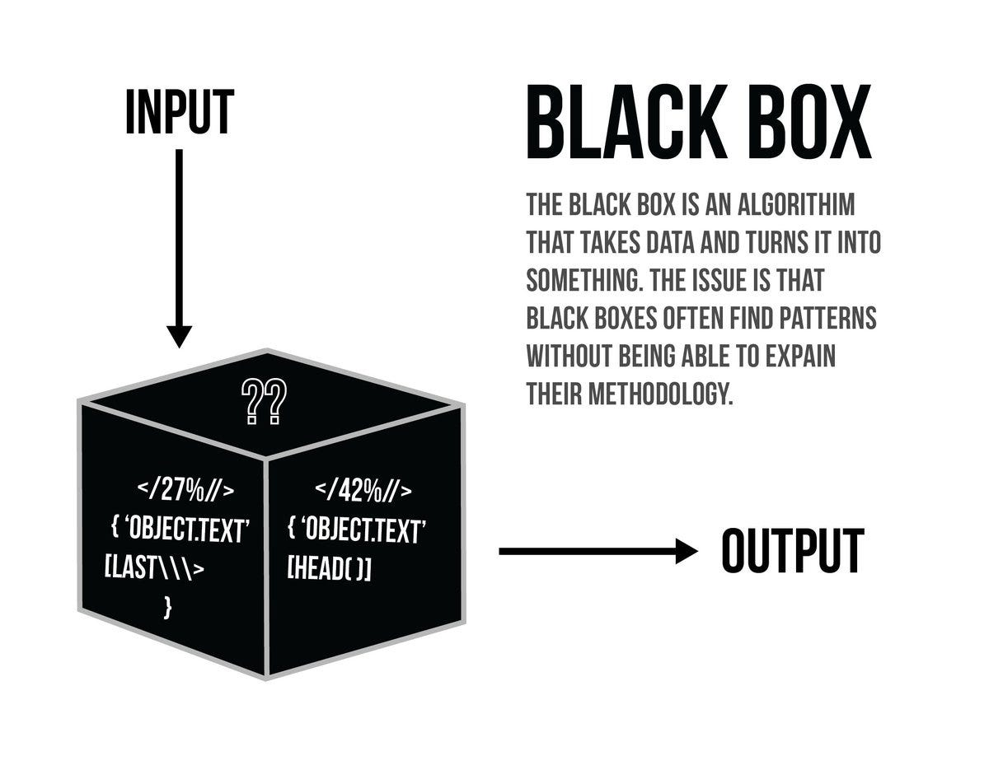
Example structure:
Input Layer → Hidden Layer1 → Hidden Layer2 → Hidden Layer3 → Output
The more layers → the deeper the network.
DL models are generally considered "black boxes," because they are difficult interpret/explain how decisions are made.

Slide 8
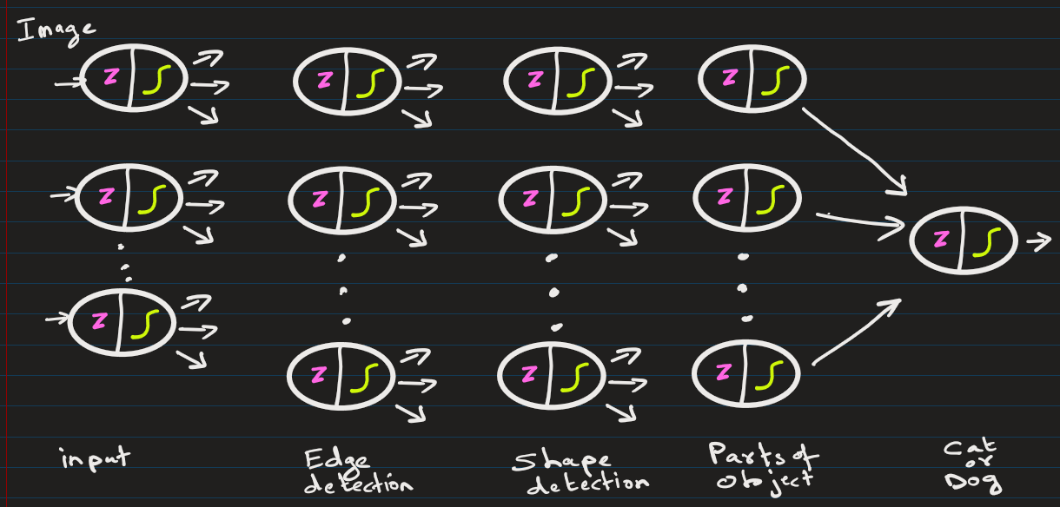
Input: Image
Image → Edge Detection → Shape Detection → Parts of Object → Full Object Recognition
(layer1) (layer2) (layer3) (layer4)
Each layer learns higher level features.

Slide 9
Why Deep Learning Matters
Deep learning became powerful because of three major factors.
1. Big Data
Huge datasets are now available
Examples:
YouTube videos
Medical images
Social media text
2. Powerful Hardware
GPUs and TPUs allow training massive neural networks.
Example hardware:
NVIDIA GPUs
Google TPUs
3. Better Algorithms
Modern neural networks like:
CNN
RNN
Transformers

Slide 10
Real-World Applications of Deep Learning
1. Image Recognition
Example: Face Unlock on Smartphones
2. Self Driving Cars
Deep learning helps detect:
pedestrians
traffic lights
lanes
vehicles

Slide 11
Real-World Applications of Deep Learning
4. Speech Recognition
Used in:
Alexa
Google Assistant
Siri
5. Language Translation
Example: Google Translate.
6. Chatbots and Generative AI: ChatGPT

Slide 12
When to Use Deep Learning vs Machine Learning
Problem Type | Best Approach
Small dataset | ML
Tabular data | ML
Images | Deep Learning
Speech | Deep Learning
Text (NLP) | Deep Learning

Slide 13
Generative Artificial Intelligence (GenAI)
Instead of only predicting or classifying, generative models create new content.
They learn the underlying distribution of data and generate new samples similar to the training data.

Slide 14
Example outputs:
Text
Images
Music
Videos
Code

Slide 15
EXTRA
Xxxxxxxxxxx
xxxxxxxxxxxx

Slide 16
from sklearn.datasets import load_digits
from sklearn.model_selection import train_test_split
from sklearn.neural_network import MLPClassifier
from sklearn.metrics import accuracy_score
# load dataset
X, y = load_digits(return_X_y=True)
# split dataset
X_train, X_test, y_train, y_test = train_test_split(X, y, test_size=0.2)
# neural network
model = MLPClassifier(hidden_layer_sizes=(100,50))
# train
model.fit(X_train, y_train)
# prediction
pred = model.predict(X_test)
print("Accuracy:", accuracy_score(y_test, pred))

