Slide 1
Artificial Neural Network
ANN

Slide 2
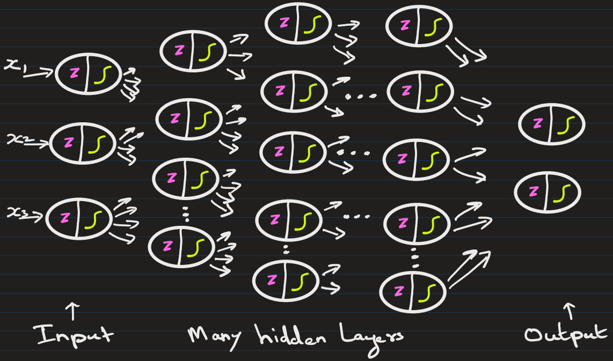
Deep Neural Network has many hidden layers

Slide 3
What type of activation unction should be used on output layer?
Choice of activation function in the output layer depends directly on the type of problem you’re solving with an Artificial Neural Network (ANN).
1. Regression Problems
Goal: Predict continuous values (e.g., house prices, temperature).
Output activation:
Linear (identity) → no activation, just raw output.
f(x)=x
Sometimes ReLU if the output can’t be negative (e.g., predicting age, distance).
Loss function used here:
a) Mean Squared Error (MSE)
b) Mean Absolute Error (MAE) if you care more about absolute deviations.
Example: Predicting house price in dollars.

Slide 4


2. Binary Classification Problems
Goal: Predict two classes (yes/no, spam/not spam).
Output activation:
Sigmoid → squashes output to [0,1], interpretable as probability.
Loss function used here: Binary Cross-Entropy (Log Loss)
Example: Predicting if a tumor is malignant (1) or benign (0).

Slide 5
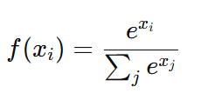

3. Multi-class Classification Problems (One-label)
Goal: Predict one class out of many (mutually exclusive).
Output activation:
Softmax → gives a probability distribution across classes, all adding up to 1.
Loss function used here:
Categorical Cross-Entropy (when labels are one-hot encoded)
Sparse Categorical Cross-Entropy (when labels are integers, not one-hot).
Example: Handwritten digit recognition (0–9).

Slide 6
4. Multi-label Classification Problems (Multiple labels possible)
Goal: Predict multiple independent labels (not mutually exclusive).
Output activation:
Sigmoid (per output node) → each output is treated as independent probability.
Loss function used here:
Binary Cross-Entropy applied independently per label.
Example: Predicting which tags apply to a movie (action, comedy, romance — could be more than one).

Slide 7
Few facts about ANN
Feedforward networks (MLPs, CNNs) process inputs all at once — they don't depend on previous steps.
Suppose you have 1000 words or pixels.
A feedforward network takes all 1000 together, passes them through layers at the same time (matrix multiplication).
In math terms: matrix × vector — super fast because modern hardware (like GPUs) is built for parallel matrix operations.
No waiting for "previous word" or "previous pixel" — everything is independent at each layer.
This is called parallelism.

Slide 8
Increasing the number of hidden layers:
Increasing the number of hidden layers in a neural network transforms it from a shallow to a deep network — a concept known as deep learning.
Potential Benefits
Ability to Learn Complex Patterns: More layers allow the network to build hierarchies of features.
Example: In image classification, early layers detect edges, deeper layers detect shapes, and even deeper layers recognize objects.
More Expressive Power: A deeper network can approximate more complex functions and decision boundaries.
Better for Large Datasets: Deep networks perform better with large datasets and non-linear problems, assuming proper tuning.

Slide 9
Increasing the number of hidden layers:
Drawbacks:
Overfitting: More layers = more parameters = risk of memorizing the training data instead of generalizing.
Training Time Increases: More layers = more computations = longer training times.
Vanishing/Exploding Gradients: In very deep networks, gradients can become extremely small or large, making training unstable or slow (especially with sigmoid/tanh). (EXPLAINED ON NEXT PAGE)

Slide 10
Increasing the number of hidden layers(p2)
What Is the Vanishing Gradient Problem?
When training a neural network using backpropagation, gradients (partial derivatives of the loss with respect to weights) are used to update the weights. In deep networks, as the gradients are back-propagated through many layers, they get smaller and smaller, eventually becoming too tiny to have any effect — this is called vanishing gradients.
It comes down to repeated multiplication of small numbers (gradients) through the chain rule:
Backpropagation uses chain rule, which uses many multiplication of activations functions.
Repeatedly multiplying by <1 derivatives → gradients vanish.

Slide 11
Difference between hyperparameter and parameter:
Parameters:
Learned from data: Parameters are internal variables of a model whose values are estimated or learned directly from the training data during the model training process.
Examples: In a linear regression model, the coefficients (weights) are parameters. In a neural network, the weights and biases of the connections between neurons are parameters.

Slide 12
Difference between hyperparameter and parameter:
Hyperparameters:
Set before training: Hyperparameters are external configuration settings whose values are determined and set before the model training process begins. They are not learned from the data.
Tuned for optimal performance: The selection of appropriate hyperparameter values is crucial for achieving optimal model performance and is often done through a process called hyperparameter tuning or optimization.
Examples: Common hyperparameters include the learning rate in gradient descent, the number of hidden layers or neurons in a neural network, the regularization strength, or the number of clusters in a clustering algorithm like K-Means.

