Slide 1
Single Layer Perceptron

Slide 2
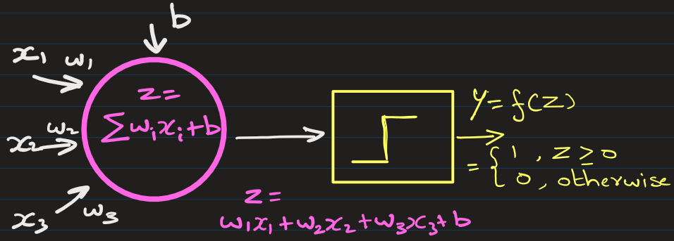
1. What is a Single Layer Perceptron?
A Single Layer Perceptron (SLP) is one of the simplest types of artificial neural networks, used primarily for binary classification tasks (i.e., deciding whether an input belongs to one class or another).
It was introduced by Frank Rosenblatt in 1958.
“Single layer” means there is only one layer of weights connecting inputs directly to outputs.
It cannot solve non-linearly separable problems (like XOR).

Slide 3
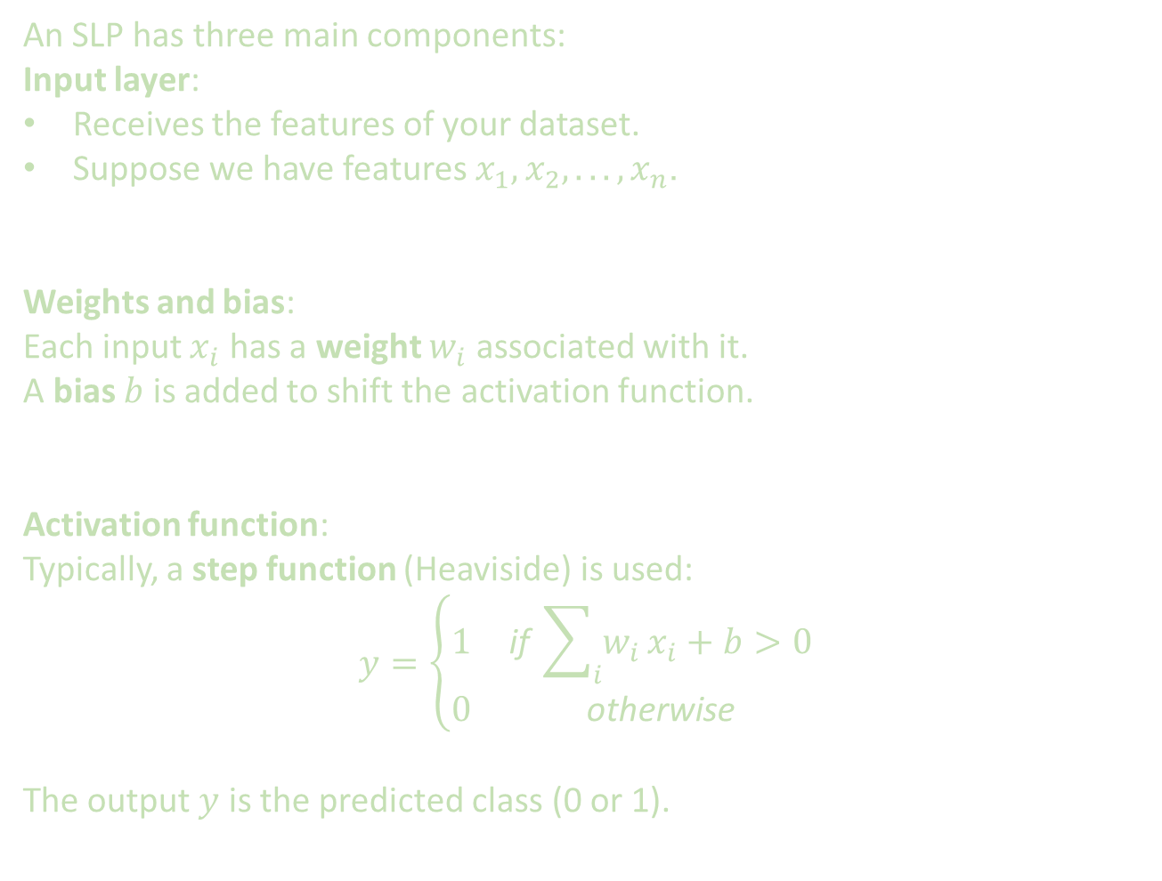
2. Structure of a Single Layer Perceptron
An SLP has three main components:
Input layer:
Receives the features of your dataset.
Suppose we have features $x_{1},x_{2},...,x_{n}$.
Weights and bias:
Each input $x_{i}$ has a weight $w_{i}$ associated with it.
A bias $b$ is added to shift the activation function.
Activation function:
Typically, a step function (Heaviside) is used:
$$y=\left\{\begin{matrix}1 & \text{if} \sum_{i}{w_{i}}x_{i}+b>0 \\ 0 & \text{otherwise}\end{matrix}\right.$$
The output $y$ is the predicted class (0 or 1).

Slide 4
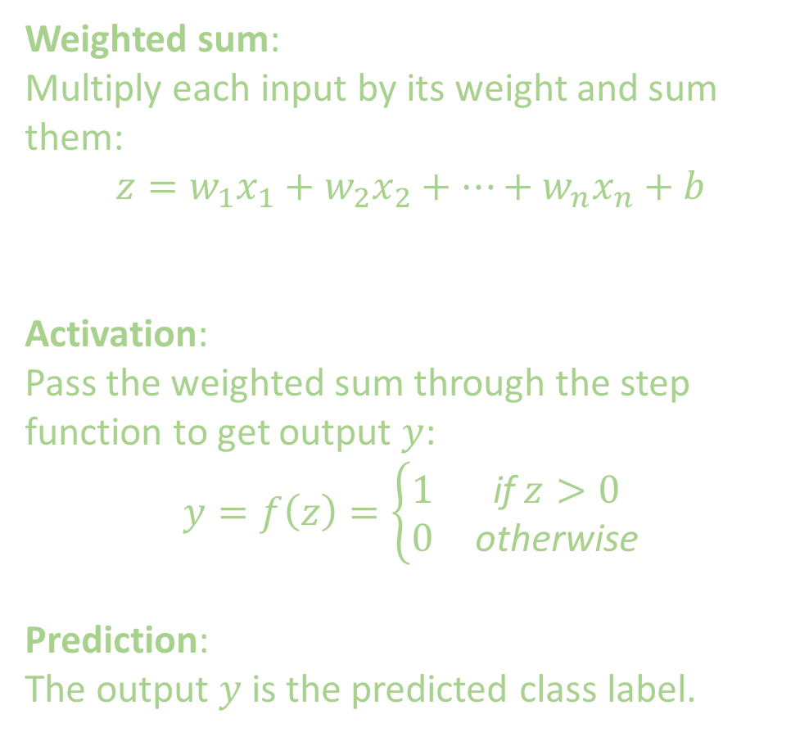
3. How it Works to make prediction (Step-by-Step)
Weighted sum: Multiply each input by its weight and sum them:
$$z=w_{1}x_{1}+w_{2}x_{2}+⋯+w_{n}x_{n}+b$$
Activation: Pass the weighted sum through the step function to get output $y$:
$$y=f\left(z\right)=\left\{\begin{matrix}1 & \text{if} z>0 \\ 0 & \text{otherwise}\end{matrix}\right.$$
Prediction: The output $y$ is the predicted class label.

Slide 5
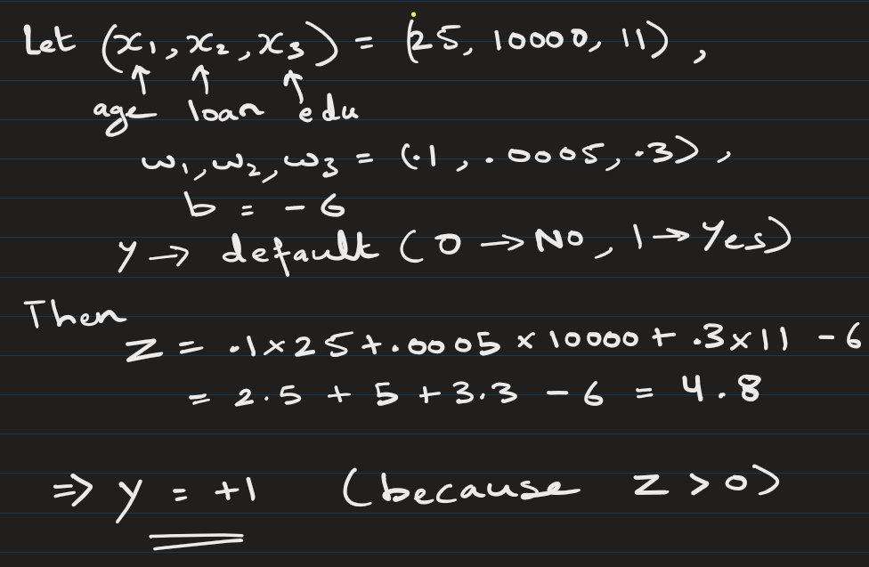
3. How it Works to make prediction (Step-by-Step)
Example

Slide 6
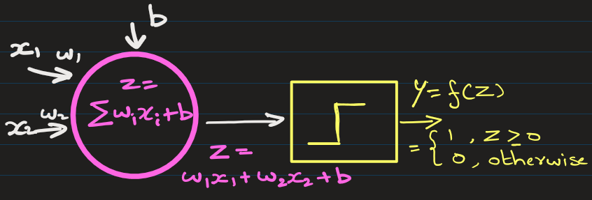
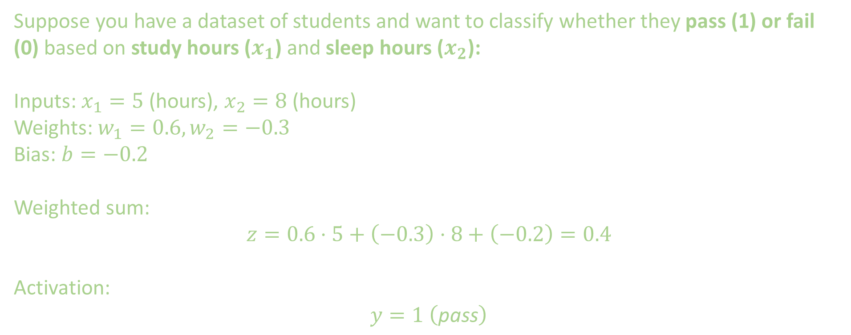
3. How it Works to make prediction (Step-by-Step)
Example
Suppose you have a dataset of students and want to classify whether they pass (1) or fail (0) based on study hours ($x_{1}$) and sleep hours ($x_{2}$):
Inputs: $x_{1}=5$(hours), $x_{2}=8$ (hours)
Weights: $w_{1}=0.6,w_{2}=−0.3$
Bias: $b=−0.2$
Weighted sum:
$$z=0.6⋅5+\left(−0.3\right)⋅8+\left(−0.2\right)=0.4$$
Activation:
$$y=1 \left(\text{pass}\right)$$

Slide 7
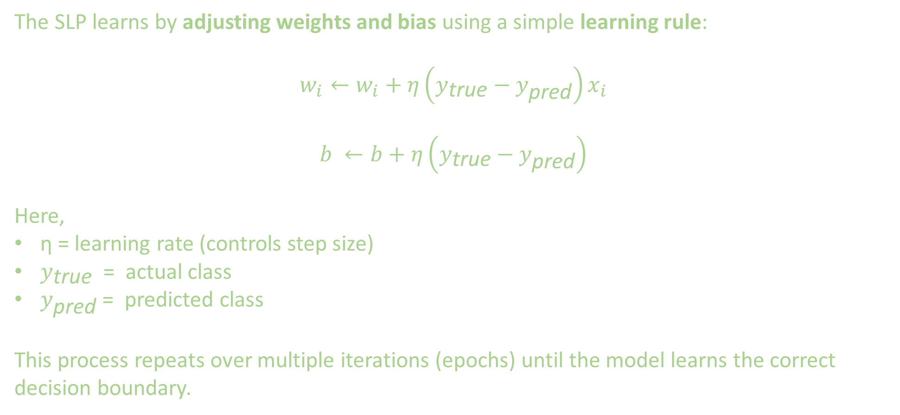
4. Training a Single Layer Perceptron: (Finding weights and bias)
The Whole Game Is Finding Weights and Bias
The SLP learns by adjusting weights and bias using a simple learning rule:
$$w_{i}←w_{i}+η\left(y_{\text{true}}−y_{\text{pred}}\right)x_{i}$$
$$b ←b+η\left(y_{\text{true}}−y_{\text{pred}}\right)$$
Here,
η = learning rate (controls step size)
$y_{\text{true}}$ = actual class
$y_{\text{pred}}$ = predicted class
This process repeats over multiple iterations (epochs) until the model learns the correct decision boundary.

Slide 8
4. Training a Single Layer Perceptron: (Finding weights and bias)
Example:
Find weights and bias from following training sample.
Age (x1) | Salary (x2) | Loan (y)
25 | 3 | 0
40 | 8 | 1
35 | 6 | 1
Initialize Weights
w1 = 0
w2 = 0
b = 0
learning_rate = 0.01

Slide 9
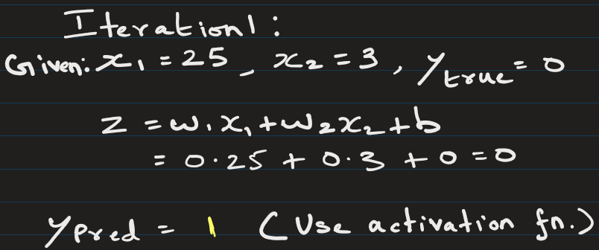
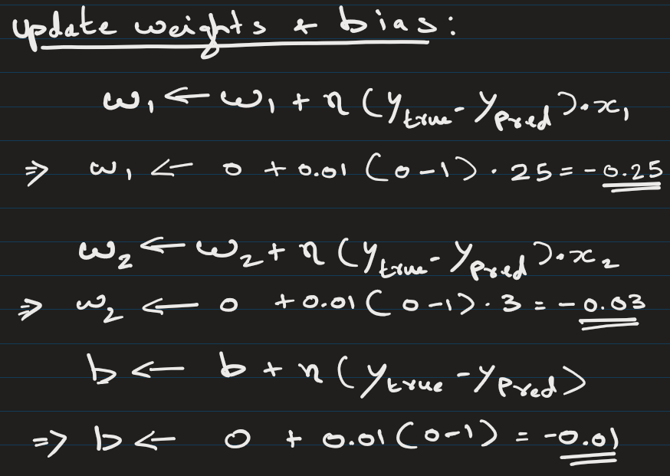
Age (x1) | Salary (x2) | Loan (y)
25 | 3 | 0
40 | 8 | 1
35 | 6 | 1

Slide 10
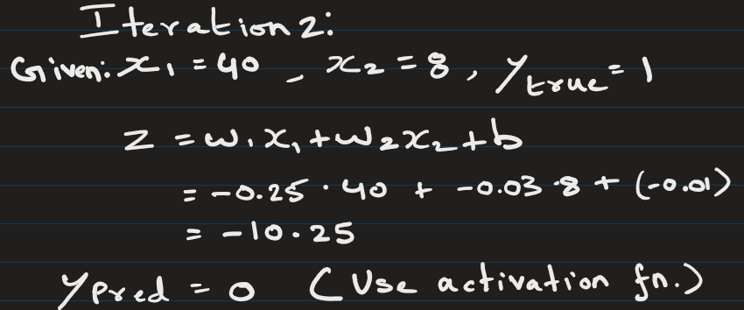
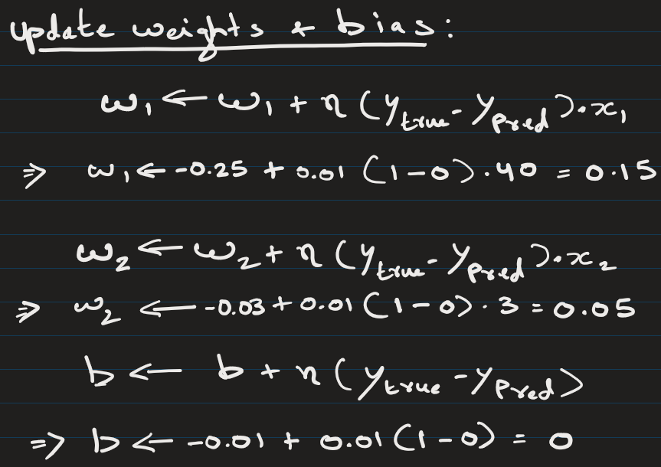
Age (x1) | Salary (x2) | Loan (y)
25 | 3 | 0
40 | 8 | 1
35 | 6 | 1

Slide 11
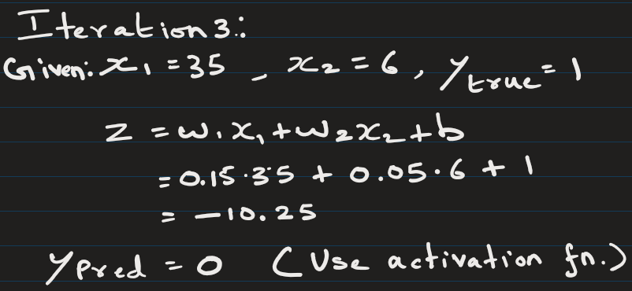
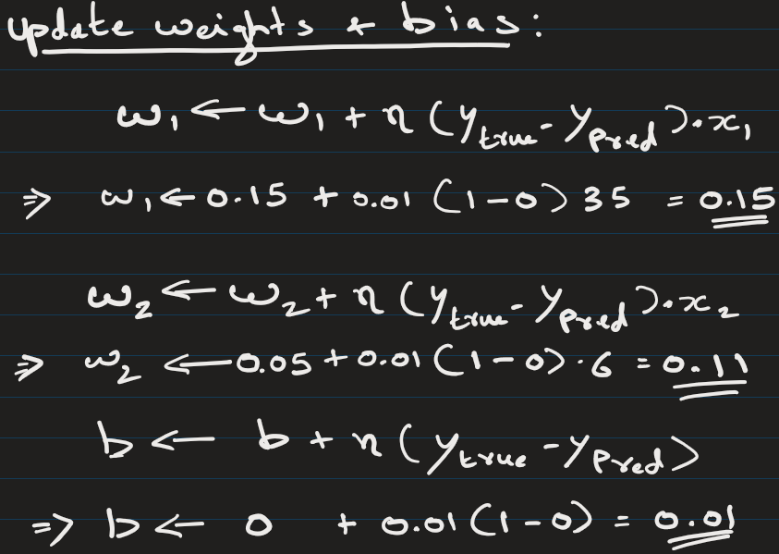
Age (x1) | Salary (x2) | Loan (y)
25 | 3 | 0
40 | 8 | 1
35 | 6 | 1
This is the end of epoch 1

Slide 12
Age (x1) | Salary (x2) | Loan (y)
25 | 3 | 0
40 | 8 | 1
35 | 6 | 1
Now we do this all over again.
We go over all 3 data points and update the weights and bias.
That would be epoch 2
We keep doing until stopping condition is met

Slide 13
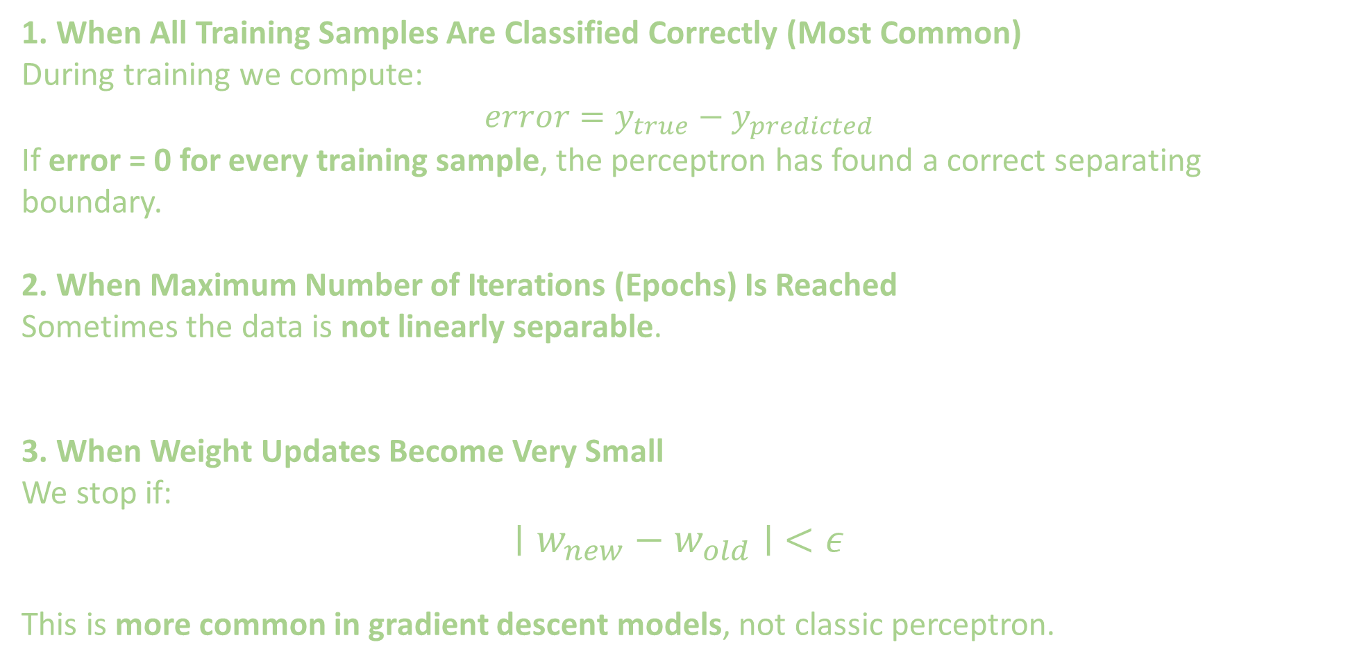
Training a Single Layer Perceptron (SLP) stops when one of the following conditions is satisfied.
1. When All Training Samples Are Classified Correctly (Most Common)
During training we compute:
$$error=y_{true}−y_{predicted}$$
If error = 0 for every training sample, the perceptron has found a correct separating boundary.
2. When Maximum Number of Iterations (Epochs) Is Reached
Sometimes the data is not linearly separable.
3. When Weight Updates Become Very Small
We stop if:
$$∣w_{new}−w_{old}∣ <ε$$
This is more common in gradient descent models, not classic perceptron.

Slide 14
5. Key Points
Works only for linearly separable problems.
Fast to train due to its simplicity.
SLP forms the foundation of more complex neural networks.

Slide 15
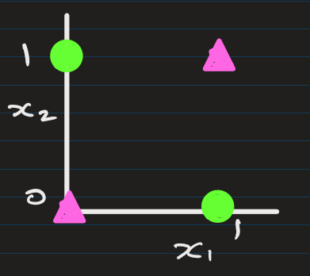
Example of problems that perceptron cannot solve:
You cannot find a perceptron that can simulate following XOR operation:
x₁ | x₂ | y
0 | 0 | 0
0 | 1 | 1
1 | 0 | 1
1 | 1 | 0
Not Possible to find weights and bias that would simulate this non-linear XOR output.
This is the limitations of Perceptron.
So, we need Multi Layer Perceptron
with nonlinear activation functions.

Slide 16
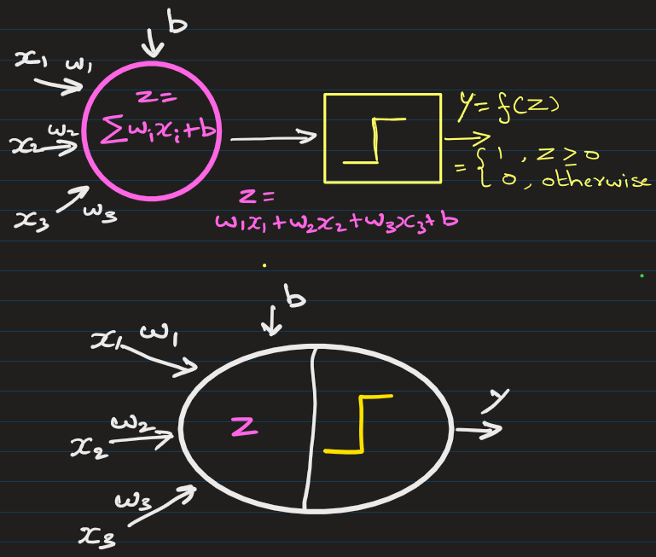
Alternate representation:

Slide 17
EXTRA
Xxxxxxxxxxx
xxxxxxxxxxxx

Slide 18
from sklearn.datasets import load_digits
from sklearn.model_selection import train_test_split
from sklearn.neural_network import MLPClassifier
from sklearn.metrics import accuracy_score
# load dataset
X, y = load_digits(return_X_y=True)
# split dataset
X_train, X_test, y_train, y_test = train_test_split(X, y, test_size=0.2)
# neural network
model = MLPClassifier(hidden_layer_sizes=(100,50))
# train
model.fit(X_train, y_train)
# prediction
pred = model.predict(X_test)
print("Accuracy:", accuracy_score(y_test, pred))

