Slide 1
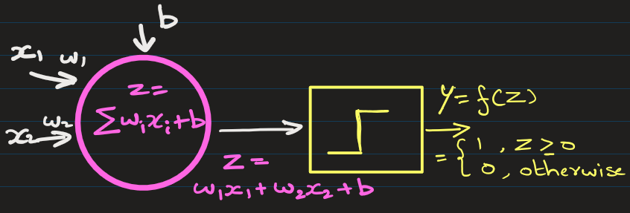
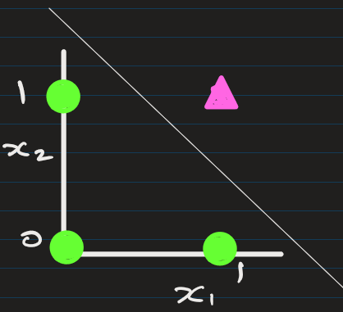
Example of problems that perceptron can solve: (jupyter n/b)
Find a perceptron that can simulate following AND operation:
x₁ | x₂ | y
0 | 0 | 0
0 | 1 | 0
1 | 0 | 0
1 | 1 | 1

Slide 2
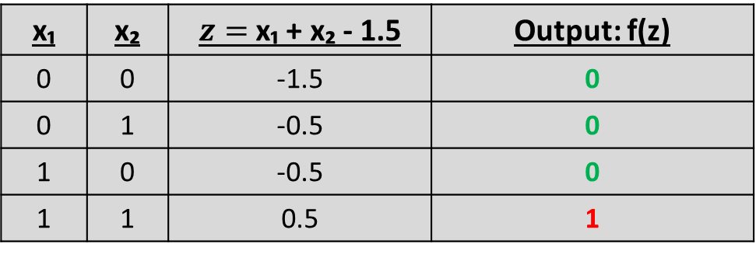
Example of problems that perceptron can solve: (jupyter n/b)
Solution: Here is a perceptron with
W1=1.0, W2=1.0 and b=-1.5
x₁ | x₂ | $z=$ x₁ + x₂ - 1.5 | Output: f(z)
0 | 0 | -1.5 | 0
0 | 1 | -0.5 | 0
1 | 0 | -0.5 | 0
1 | 1 | 0.5 | 1
Output simulates AND operation

Slide 3
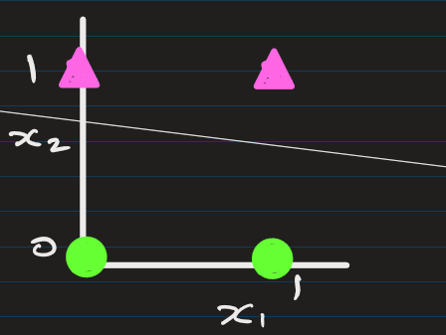
Example of problems that perceptron can solve: (jupyter n/b)
Find a perceptron that can simulate following operation:
x₁ | x₂ | y
0 | 0 | 0
0 | 1 | 1
1 | 0 | 0
1 | 1 | 1

Slide 4
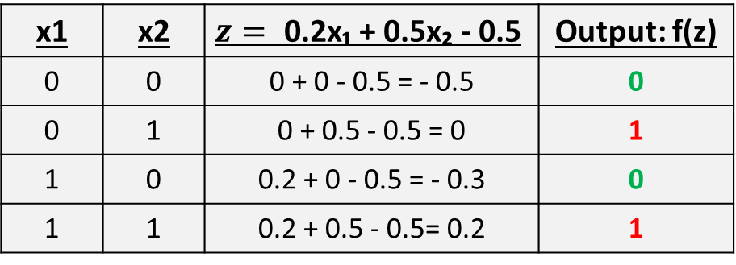
Solution: Here is a perceptron with
W1 = 0.2, W2 = 0.5 and b = -0.5
x1 | x2 | $$z= \text{0.2}\text{x}\text{₁ + 0.5}\text{x}\text{₂ − 0.5}$$ | Output: f(z)
0 | 0 | 0 + 0 - 0.5 = - 0.5 | 0
0 | 1 | 0 + 0.5 - 0.5 = 0 | 1
1 | 0 | 0.2 + 0 - 0.5 = - 0.3 | 0
1 | 1 | 0.2 + 0.5 - 0.5= 0.2 | 1
X2
x1

Slide 5
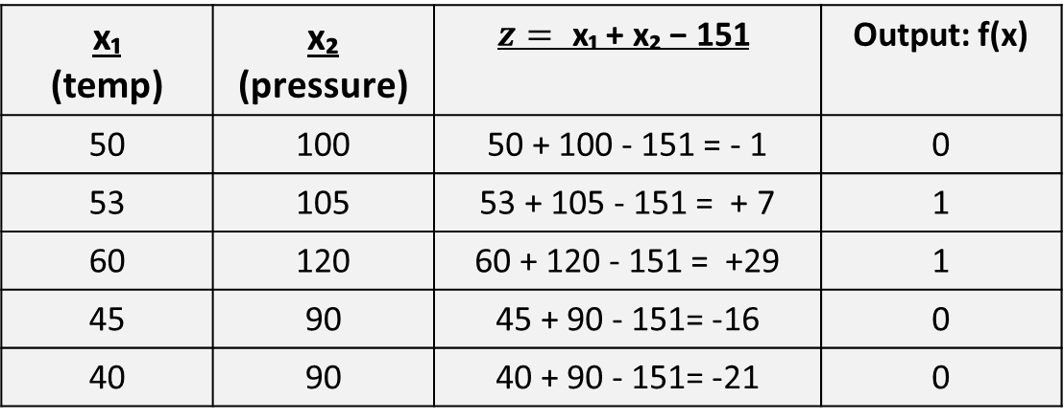
A tiny realistic scenario(jupyter n/b):
We want the neuron to fire (output = 1) only if:
temperature > 50, and pressure > 100
Here is a perceptron with
W1 = 1, W2 = 1 and b = -151
$$\text{x}\text{₁}$$ (temp) | $$\text{x}\text{₂}$$ (pressure) | $$z= \text{x}\text{₁ + }\text{x}\text{₂ − 151}$$ | Output: f(x)
50 | 100 | 50 + 100 - 151 = - 1 | 0
53 | 105 | 53 + 105 - 151 = + 7 | 1
60 | 120 | 60 + 120 - 151 = +29 | 1
45 | 90 | 45 + 90 - 151= -16 | 0
40 | 90 | 40 + 90 - 151= -21 | 0
X2

Slide 6
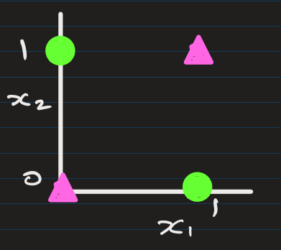
Example of problems that perceptron cannot solve:
You cannot find a perceptron that can simulate following XOR operation:
x₁ | x₂ | y
0 | 0 | 0
0 | 1 | 1
1 | 0 | 1
1 | 1 | 0
Not Possible to find weights and bias that would simulate this XOR output.
This is non-linearly separable
This is the limitations of Perceptron.
So, we need Multi Layer Perceptron

Slide 7
Key Points
Works only for linearly separable problems.
Cannot model XOR-like problems — for that, we need multi-layer perceptron with nonlinear activation functions.

Slide 9
EXTRA
Xxxxxxxxxxx
xxxxxxxxxxxx

