Slide 1
Multi-Layer Perceptron

Slide 2
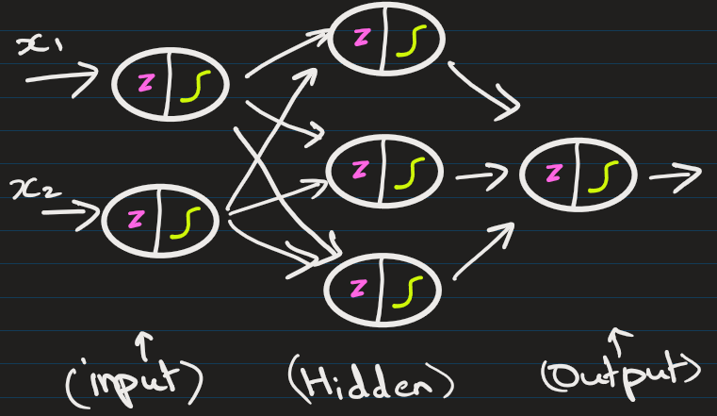
Multi-layer Feedforward Networks
Multi-layer feedforward networks, also called Multi-Layer Perceptron’s (MLPs), are a fundamental type of artificial neural network.

Slide 3
Key terms:
Structural Components (Architecture):
Neurons/Nodes
Input Layer
Hidden Layers
Output Layer
Weights
Bias
Operational Terms (Forward & Backward Pass):
Forward Propagation
Activation Function: ReLU (Rectified Linear Unit), Sigmoid, Tanh, SoftMax
Loss Function (Cost Function)
Backpropagation
Gradient Descent
Training & Hyperparameters:
Learning Rate
Optimizer
Epoch
Batch Size
Batch Normalization

Slide 4
Basic Structure of a feedforward network:
Input Layer: Receives the raw data/features
Hidden Layer(s): One or more layers that process information
Output Layer: Produces the final prediction or classification
The term "multi-layer" means there's at least one hidden layer between input and output.

Slide 5
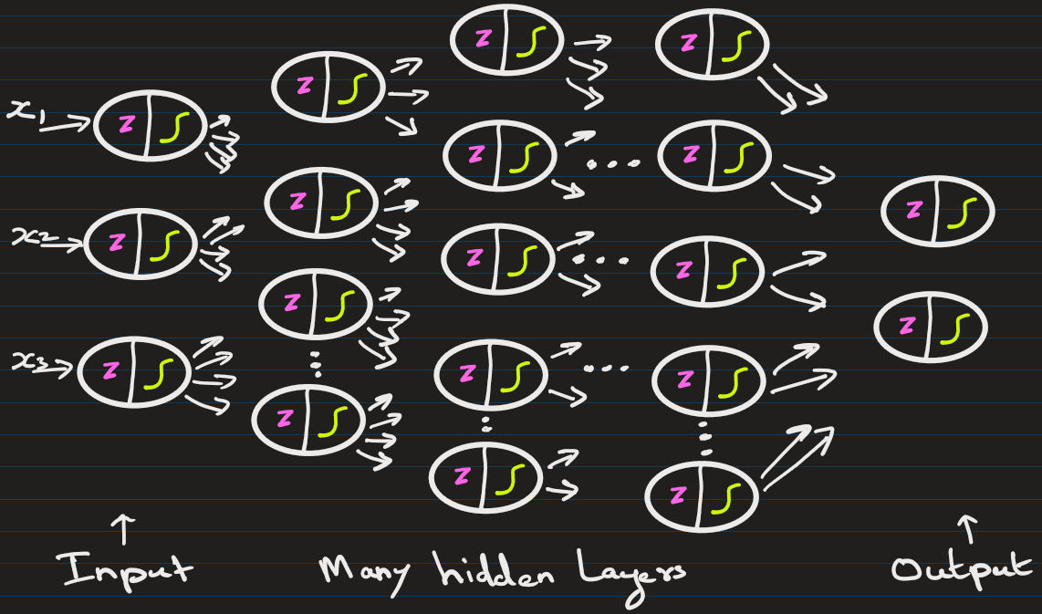
The MLP are consists of multiple fully connected layers.

Slide 6
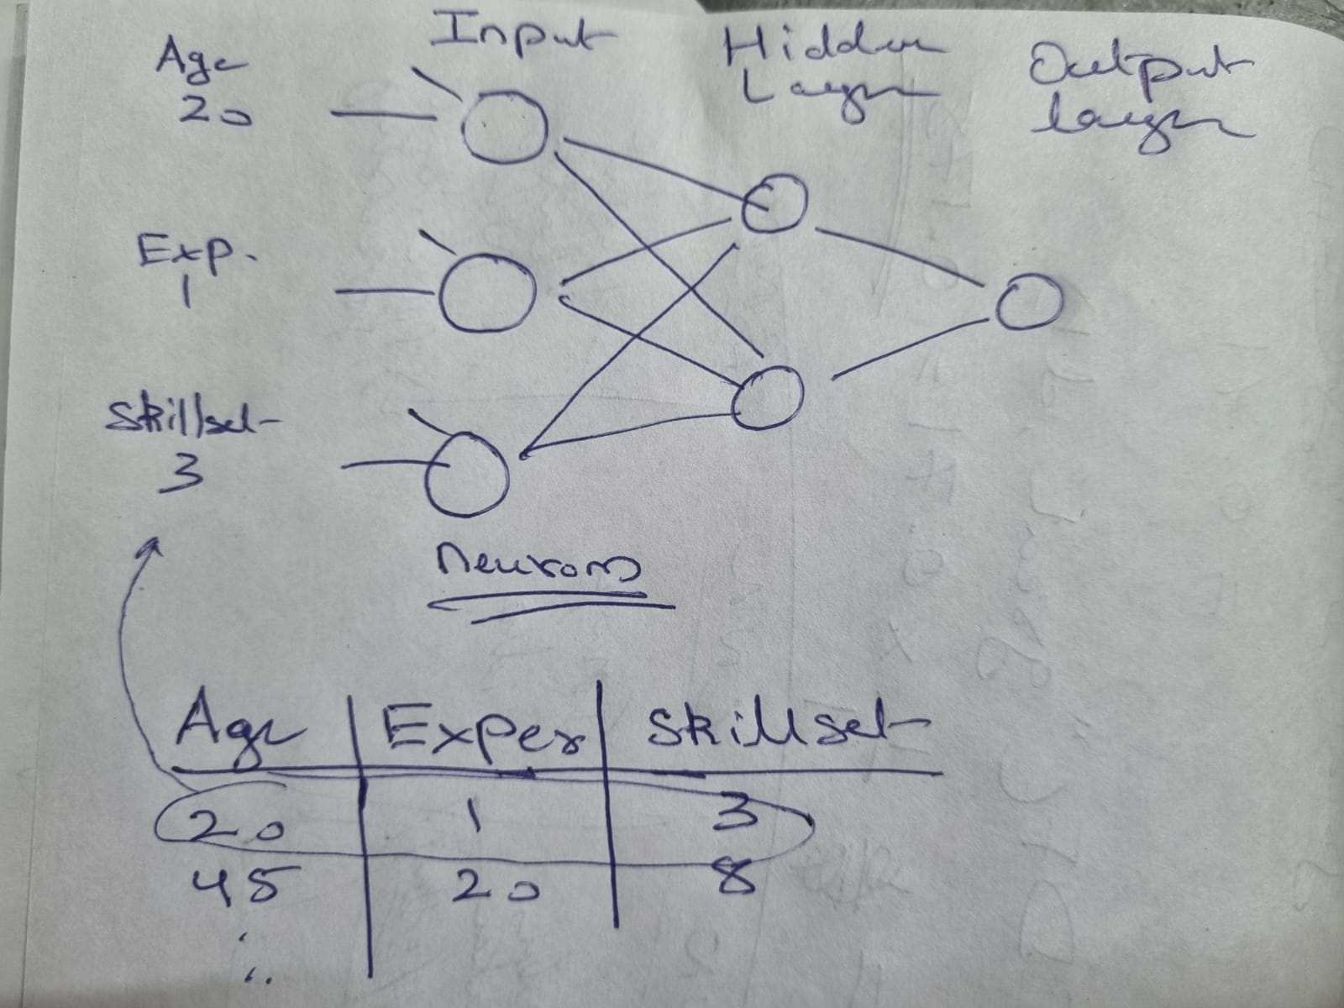
The number of neurons in input layer = number of input features.
In regression problem, output layer has 1 neuron.
In binary classification, output layer has 1 neuron: value -> 0/1
Here the number of features = 3
Input: Age, Experience, Skillset
Output: Salary (Regression)

Slide 7
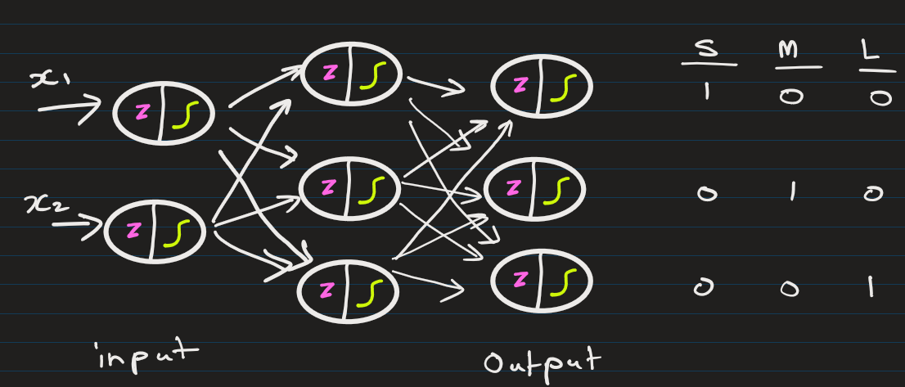
In multi-classification, output layer has number of classes neurons.
Suppose a MLP predicts the size of shirt based on age and height of a customer: Here the number of features = 2
Input: Age, Height
Output: Size of shirt -> S, M or L Here, S = [1, 0, 0] M = [0, 1, 0] L = [0, 0, 1]

Slide 8
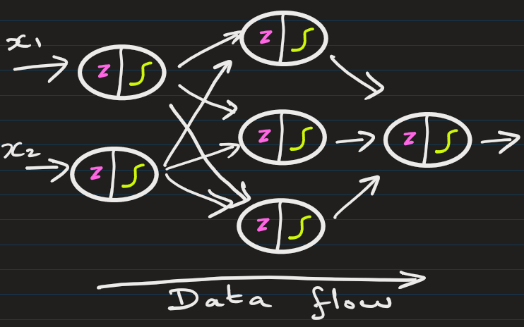
How "Feedforward" Works
Information flows in one direction only:
Data enters through the input layer
Passes through hidden layers sequentially
Exits through the output layer
No cycles or loops (unlike recurrent networks)
Think of it like a assembly line where each station processes the product and passes it forward — never backward.

Slide 9
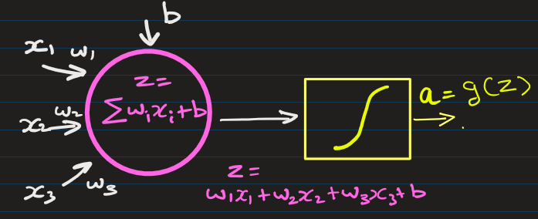
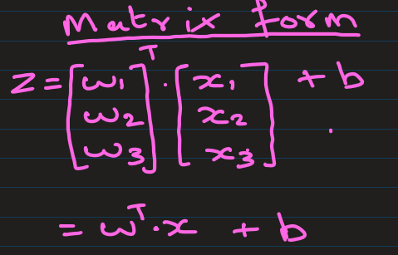
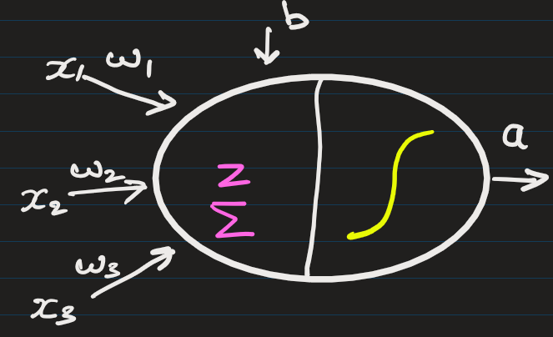
Key Components
Neurons (Nodes): Each layer contains multiple neurons that perform computations.
1 Neuron ->
OR ->

Slide 10
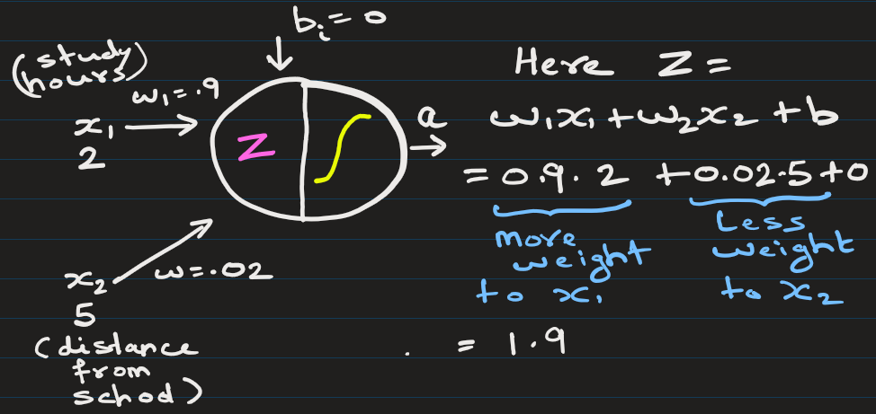
Key Components:
Weights
Weights represent the importance of inputs: A higher absolute value = more influence.
Positive weights amplify input; negative weights can invert it.
Each connection between two neurons has a weight.
Weights can be (–inf to +inf).
These are learned during training.

Slide 11
Bias allows the network to shift the activation function.
Without a bias, the neuron output would always pass through the origin (zero input = zero output).

Slide 12
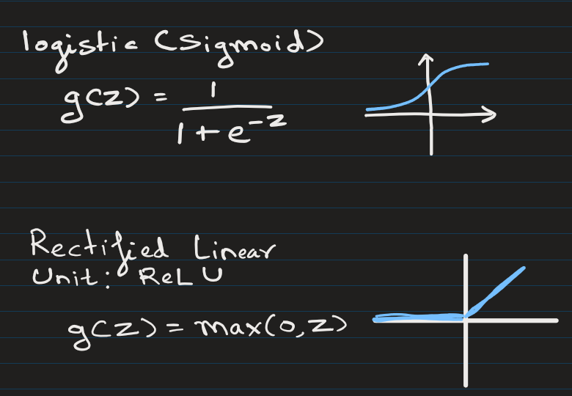
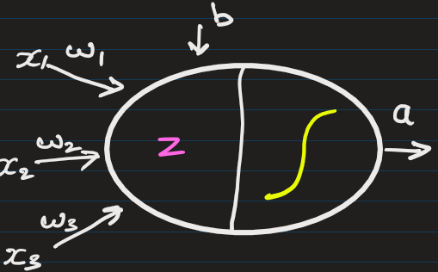
Key Components
Activation Functions: Each neuron applies a non-linear function (like ReLU, sigmoid, or tanh) to enable the network to learn non-linear patterns.

Slide 13
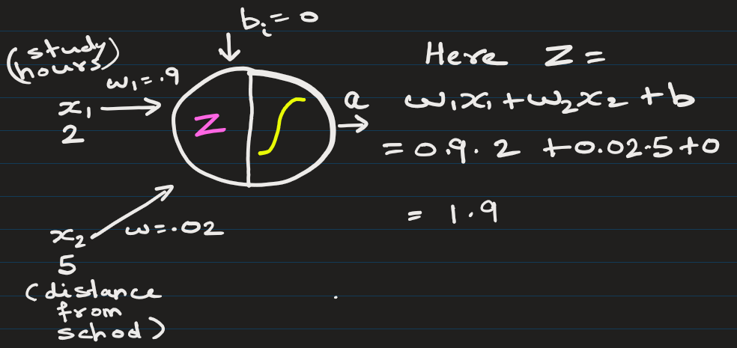
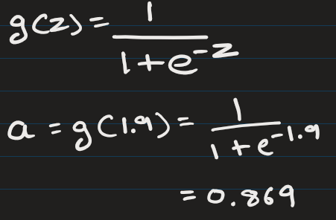
For each neuron, the process is
Take weighted sum of inputs and add a bias term,
Apply activation function
Pass result to next neurons (next layer)
Pass result to next neurons, i.e. next layer
This becomes input to next neuron

Slide 14
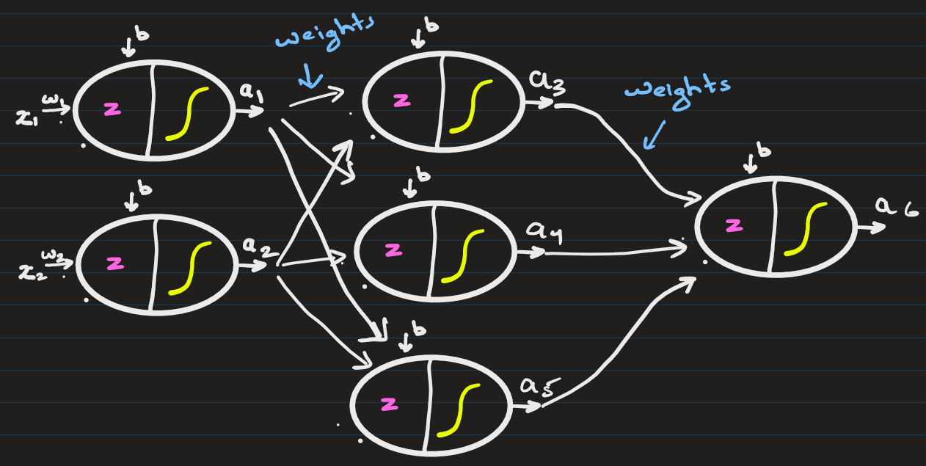
The free parameters (bias + weights) of the neural network are changed as a result of training.
THE WHOLE GAME OF NEURAL NETWORK IS FINDING WEIGHTS, BIAS, etc.

Slide 15
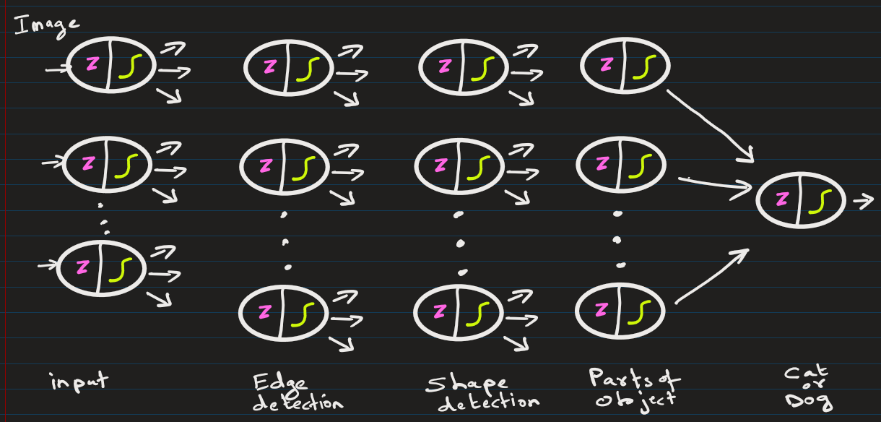
Why "Multi-layer" Matters
Multiple layers allow the network to learn hierarchical representations:
Early layers detect simple patterns (edges, basic features)
Deeper layers combine these into complex patterns (shapes, objects, abstract concepts)

Slide 16
Difference between perceptron and neuron
Perceptron is a fundamental, binary-output artificial linear classifier.
Neuron (specifically an artificial neuron or node) is a more advanced, continuous-output unit used in modern deep learning. Neurons utilize non-linear activation functions.

Slide 17
Training

Slide 18
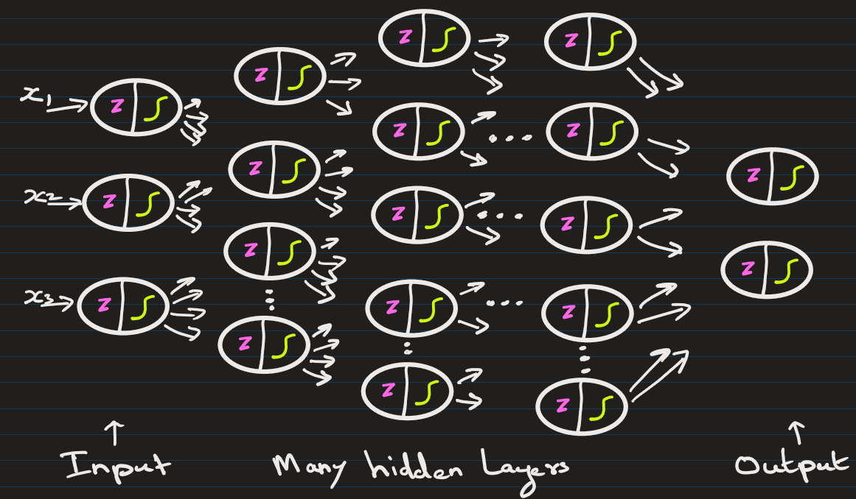
The flow of info. when NN are trained
Loss function = defines the feedback signal
which is used for learning
Optimizer = Algorithm that adjusts the attributes of the neural network, such as weights and learning rates.
Prediction target y`
Updates weights + bias
Optimizer
Loss score
Loss function
True target y
E.g.: Gradient Descent, Stochastic GD, AdamOptimzer, RMSProp, AdaGrad, etc.
E.g. : Mean Squared Error, Cross-Entropy, etc.

Slide 19
These networks typically learn through backpropagation:
Make predictions (forward pass)
Calculate error between predictions and actual values
Propagate error backward through the network
Update weights using gradient descent to minimize error/loss
Prediction target y`
Updates weights + bias
Optimizer
Loss score
Loss function
True/Actual target y
E.g.: SGD, AdamOptimzer, RMSProp, AdaGrad, etc.
E.g. : Mean Squared Error, Cross-Entropy, etc.

Slide 20


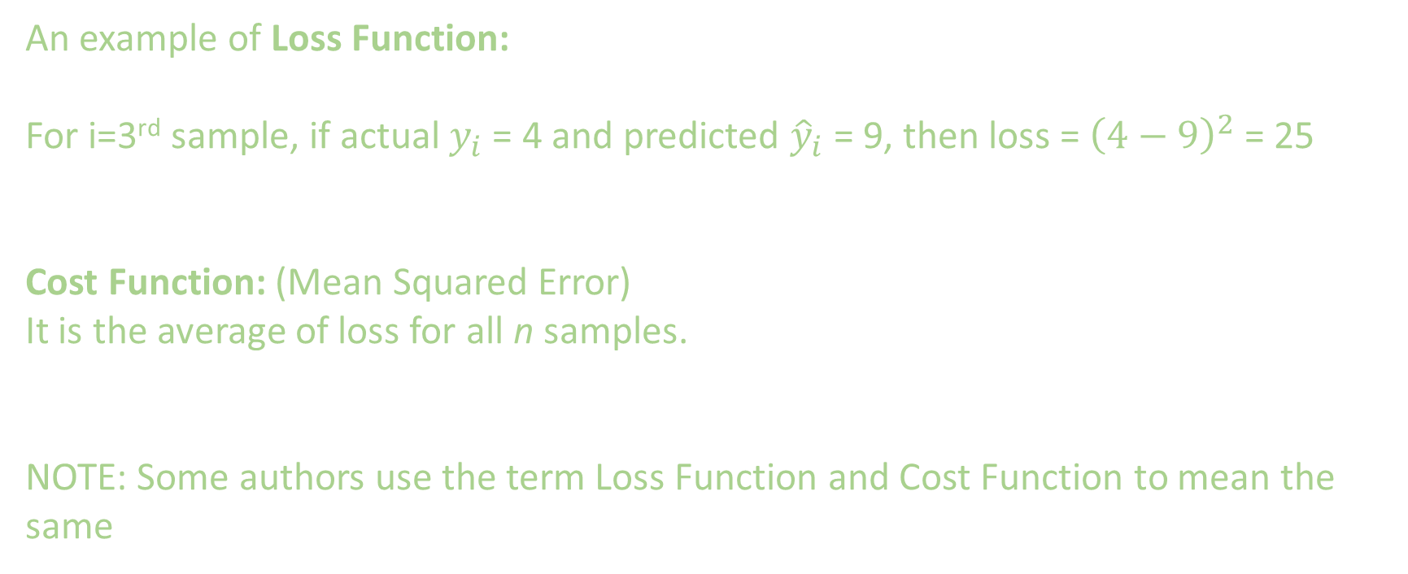
An example of Loss Function:
For i=3rd sample, if actual $y_{i}$ = 4 and predicted ${\hat{y}}_{i}$ = 9, then loss = ${\left(4−9\right)}^{2}$ = 25
Cost Function: (Mean Squared Error)
It is the average of loss for all n samples.
NOTE: Some authors use the term Loss Function and Cost Function to mean the same

Slide 21
Initializing weights and bias:
Weights and biases are usually initialized with small random values.
Common Weights:
Uniform Initialization: W∼U(−a,a), where a is typically small (e.g., 0.01, or based on input size).
Normal Initialization: W∼N(0,σ^2) with small standard deviation.
Biases are often
Initialized to zero, or
Initialized with small values like 0.01.

Slide 22
Updating weights and bias is computationally expensive.
Emergence of GPU(Graphical Processing Unit) and TPU(Tensor Processing unit) has helped.

Slide 23
Common Applications
Image classification
Speech recognition
Natural language processing
Regression problems
Function approximation

Slide 24
EXTRA
Xxxxxxxxxxx
xxxxxxxxxxxx

