Slide 1
Training and classification using a continuous perceptron with a step-by-step example.

Slide 2
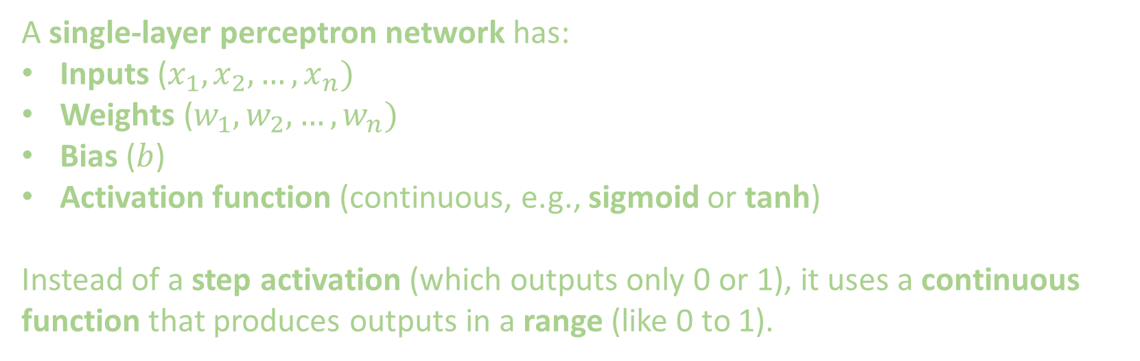
. 1. What is a Single-Layer Continuous Perceptron?
A single-layer perceptron network has:
Inputs ($x_{1},x_{2},…,x_{n})$
Weights ($w_{1},w_{2},…,w_{n})$
Bias ($b$)
Activation function (continuous, e.g., sigmoid or tanh)
Instead of a step activation (which outputs only 0 or 1), it uses a continuous function that produces outputs in a range (like 0 to 1).

Slide 3
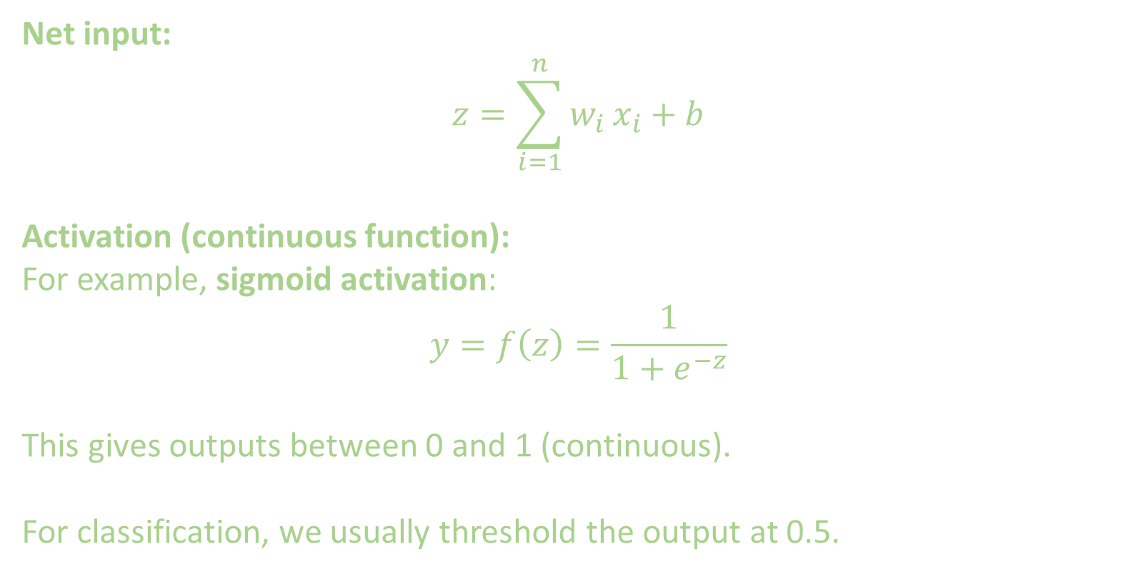
2. The Model
Net input:
$$z=\sum_{i=1}^{n}{w_{i}}x_{i}+b$$
Activation (continuous function):
For example, sigmoid activation:
$$y=f\left(z\right)=\frac{1}{1+e^{−z}}$$
This gives outputs between 0 and 1 (continuous).
For classification, we usually threshold the output at 0.5.

Slide 4
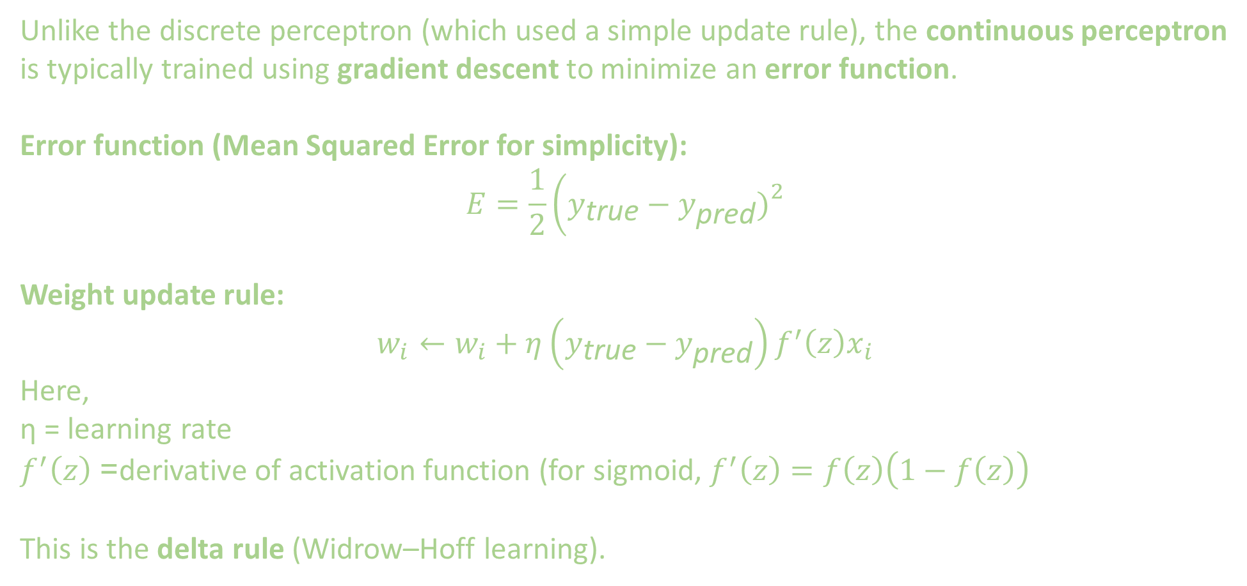
3. Training Rule (Continuous Perceptron)
Unlike the discrete perceptron (which used a simple update rule), the continuous perceptron is typically trained using gradient descent to minimize an error function.
Error function (Mean Squared Error for simplicity):
$$E=\frac{1}{2}\left(y_{\text{true}}−y_{\text{pred}}{\left.)\right.}^{2}\right.$$
Weight update rule:
$$w_{i}←w_{i}+η\left(y_{\text{true}}−y_{\text{pred}}\right)f^{′}\left(z\right)x_{i}$$
Here,
η = learning rate
$f^{′}\left(z\right)$= derivative of activation function (for sigmoid, $f^{′}\left(z\right)=f\left(z\right)\left(1−f\left(z\right)\right)$
This is the delta rule (Widrow–Hoff learning).

Slide 5

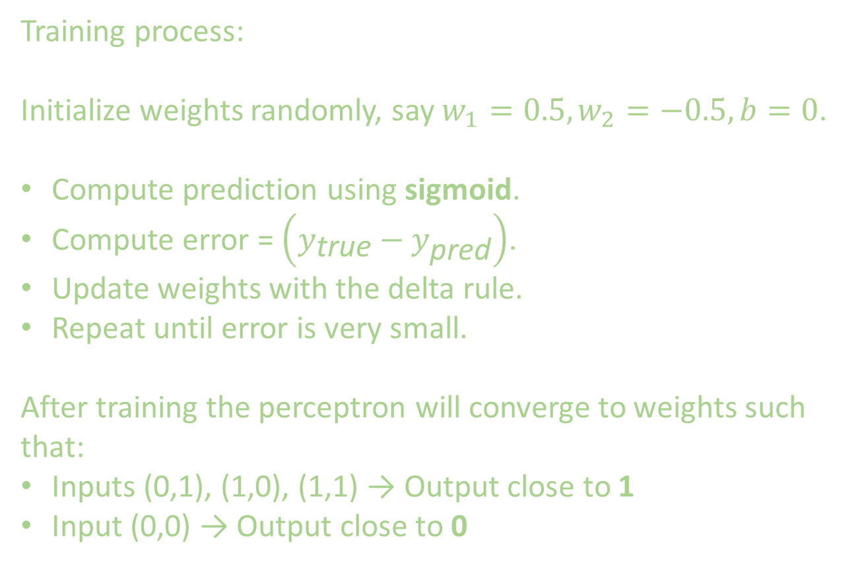
4. Example: OR Function with Continuous Perceptron
Training process:
Initialize weights randomly, say $w_{1}=0.5,w_{2}=−0.5,b=0$.
Compute prediction using sigmoid.
Compute error = $\left(y_{\text{true}}−y_{\text{pred}}\right)$.
Update weights with the delta rule.
Repeat until error is very small.
After training the perceptron will converge to weights such that:
Inputs (0,1), (1,0), (1,1) → Output close to 1
Input (0,0) → Output close to 0

Slide 6
5. Decision Regions
Even though the output is continuous, the decision boundary in feature space is still linear.
Example: For two features, the decision boundary is the line:
w1​x1​ + w2​x2​ + b=0
One side of the line → classified as Class 0
Other side → classified as Class 1
So, it works well only for linearly separable problems (just like discrete perceptron).

Slide 7
6. Key Differences: Discrete vs. Continuous Perceptron
Feature | Discrete Perceptron | Continuous Perceptron
Activation | Step function (0 or 1) | Sigmoid / Tanh (continuous)
Output | Binary only (0, 1) | Continuous (0–1, or -1 to 1)
Training Rule | Simple perceptron rule | Delta rule (gradient descent)
Error Function | Not differentiable | Differentiable (MSE, Cross-Entropy)
Learning | Works only if data is linearly separable | More robust, smoother convergence

Slide 8
EXTRA
Xxxxxxxxxxx
xxxxxxxxxxxx

