Slide 1
(On Dev) Deep Learning-ANN
Artificial Neural Network

Slide 2
Neural Networks:
Mathematical model of neuron devised by McCulloch and Pitts (1943)
The neural network has wts and bias. The free parameters (bias + weights) of the neural network are changed as a result of training. THE WHOLE GAME OF NN IS FINDING WEIGHTS AND BIAS.
Updating wt. and bias is computationally expensive. Emergence of GPU(Graphical Processing Unit), TPU(Tensor Processing unit) has helped.

Slide 3
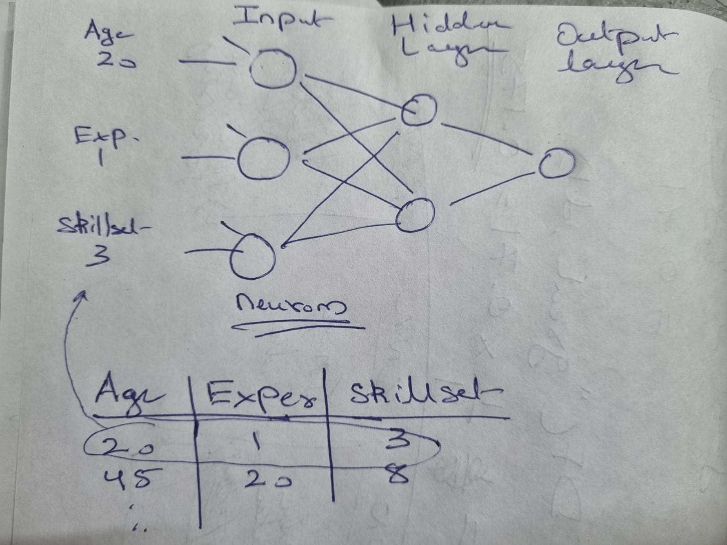
Quick Overview of DNN
Show more examples from internet
NOTES:
1) The number of input neuron in input layer = number of input features
2) In regression problem, output layer has 1 neuron.
In binary classification, output layer has 1 neuron.
In multi-classification, output layer has num_of_classes neurons.(see next slide on how to handle this case)
3) The number of hidden layer is determined by hyper parameter tuning:
kerasTuner
Input layer takes in 3 features: ( Age, Exp, Skillset)
Output layer generates: Income for regression or Income category(High/Low) for binary classification
Cont…..

Slide 4
Cont…..
Output layer of multi-class classification ( say HR/Accounting/Sales/IT) will have 4 neurons that generate the prediction for each department based on 1-hot encoding
HR
Accounting
Sales
IT
1
0
0
0
0
1
0
0
0
0
1
0
0
0
0
1

Slide 5
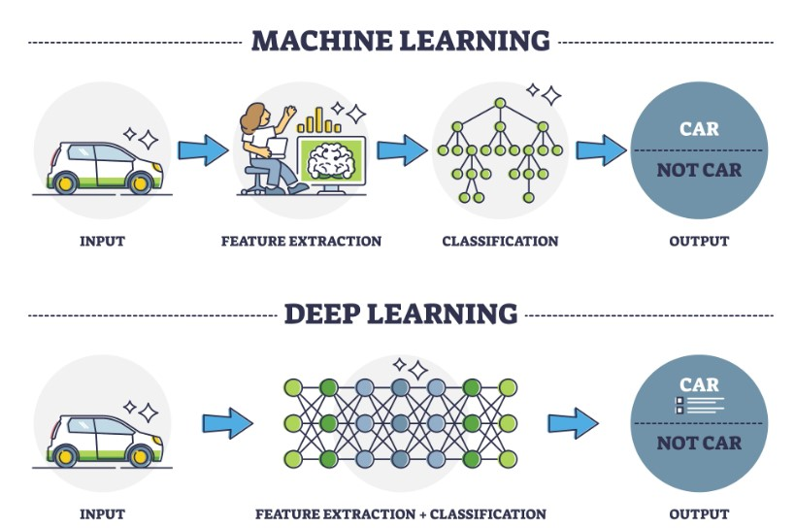
What is Deep Learning?
Deep learning is a type of ML where it learns from examples, much like humans. Instead of defining specific features (e.g., wings and engines for identifying planes), deep learning models analyze thousands of images to recognize patterns on their own.
At its core, deep learning uses neural networks, inspired by the human brain. These networks consist of multiple layers of interconnected nodes that process information. The deeper the network, the more complex patterns it can learn, enabling it to handle sophisticated tasks like image recognition, language processing, and more.

Slide 6
Types of DNN
Deep NN
ANN:
Feedforward neural network : The FNN is one of the most basic artificial neural networks. In this ANN, the data or the input provided travels in a single direction. It enters into the ANN through the input layer and exits through the output layer while hidden layers may or may not exist. So the feedforward neural network has a front-propagated wave only and usually does not have backpropagation.
Used in tabular data: age, experience, salary
CNN
A CNN has some similarities to the feed-forward neural network, where the connections between units have weights that determine the influence of one unit on another unit. But a CNN has one or more than one convolutional layer that uses a convolution operation on the input and then passes the result obtained in the form of output to the next layer. CNN has applications in speech and image processing which is particularly useful in computer vision.
RNN
The RNN saves the output of a layer and feeds this output back to the input to better predict the outcome of the layer. The first layer in the RNN is quite similar to the feed-forward neural network and the recurrent neural network starts once the output of the first layer computed.
Used in NLP and Time series forecasting
Others:
Radial basis function Neural Network,
Modular Neural Network

Slide 7
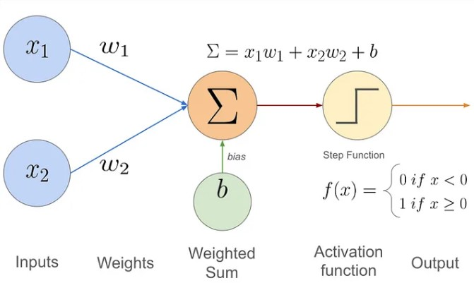

Perceptron(p1)
A perceptron is the earliest form of a neural network unit, introduced by Frank Rosenblatt in 1958. It is a binary classifier that makes predictions based on a linear combination of input features. The perceptron algorithm was one of the first algorithms used to implement a simple neural network. It is a is a type of an ANN
Components of a Perceptron:
Inputs: The perceptron takes several inputs (x1, x2,…, xn)
Weights: Each input is associated with a weight (w1, w2, …, wn).
Bias: A bias term (b) is added to shift the decision boundary.
Activation Function: The perceptron uses a step function (a simple thresholding function) to determine whether the weighted sum of inputs plus the bias is above or below a certain threshold.
Binary Output: The output of a perceptron is binary (1 or 0), making it suitable for linearly separable classification problems.

Slide 8
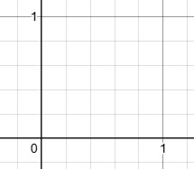
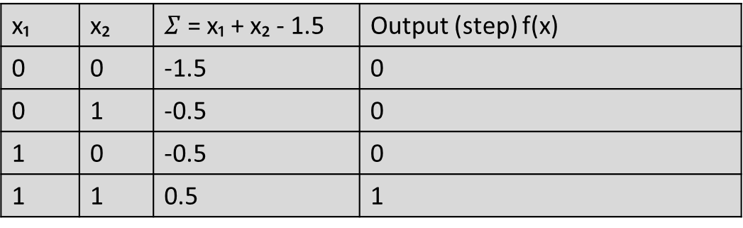
Perceptron(p2): See jupyter n/b
W1=1.0
W2=1.0
b = -1.5
x₁ | x₂ | $Σ$ = x₁ + x₂ - 1.5 | Output (step) f(x)
0 | 0 | -1.5 | 0
0 | 1 | -0.5 | 0
1 | 0 | -0.5 | 0
1 | 1 | 0.5 | 1
Output simulates AND operation
X2
Hyper-plane that separates points
x1

Slide 9
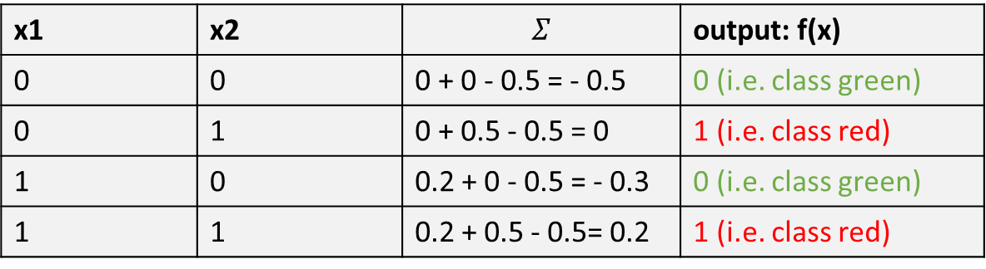
Perceptron(p3)
W1=0.2
W2=0.5
b = - 0.5
x1 | x2 | $$Σ$$ | output: f(x)
0 | 0 | 0 + 0 - 0.5 = - 0.5 | 0 (i.e. class green)
0 | 1 | 0 + 0.5 - 0.5 = 0 | 1 (i.e. class red)
1 | 0 | 0.2 + 0 - 0.5 = - 0.3 | 0 (i.e. class green)
1 | 1 | 0.2 + 0.5 - 0.5= 0.2 | 1 (i.e. class red)
X2
Hyper-plane that separates points
x1

Slide 10
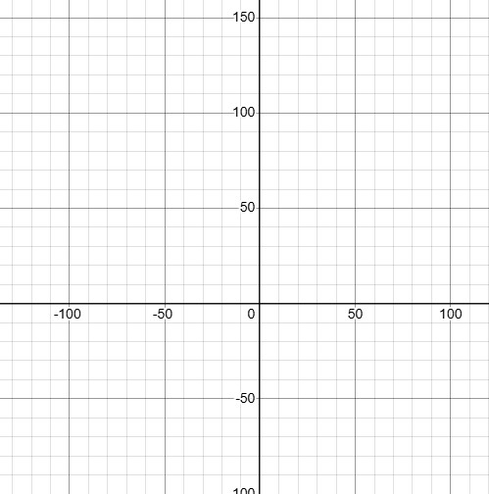
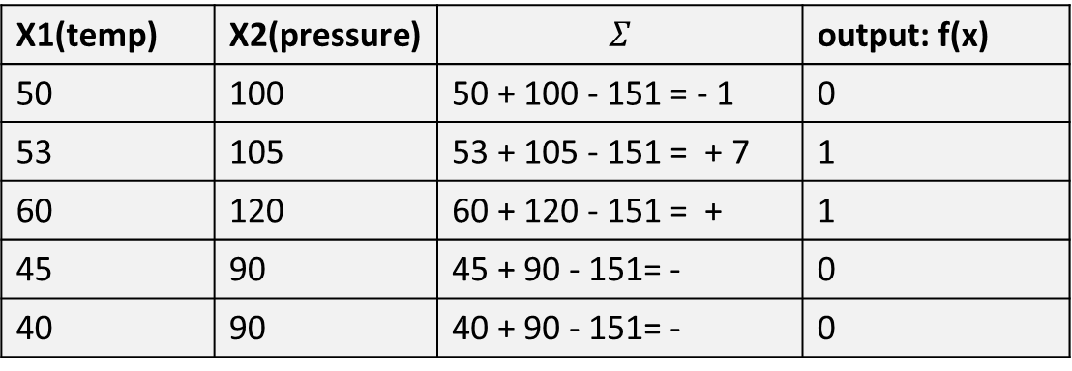
Perceptron(p4)
A tiny realistic scenario(see jupyter n/b):
We want the neuron to fire (output = 1) only if:
temperature > 50, and
pressure > 100
W1=1
W2=1
b = -151
X1(temp) | X2(pressure) | $$Σ$$ | output: f(x)
50 | 100 | 50 + 100 - 151 = - 1 | 0
53 | 105 | 53 + 105 - 151 = + 7 | 1
60 | 120 | 60 + 120 - 151 = + | 1
45 | 90 | 45 + 90 - 151= - | 0
40 | 90 | 40 + 90 - 151= - | 0

Slide 11
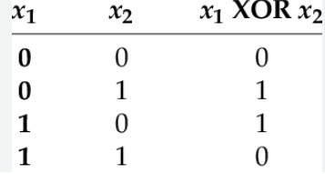
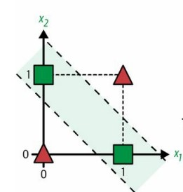
Perceptron(p3)
Limitations of Perceptron:
Linear separability: The perceptron can only solve problems that are linearly separable (i.e., it can only classify data that can be separated by a straight line or hyperplane). It cannot solve more complex problems like XOR.
Single-layer model: The original perceptron is a single-layer model and does not have hidden layers, limiting its expressiveness.
You cannot find w1,w2 and b values in single perceptron that would give XOR output.

Slide 12
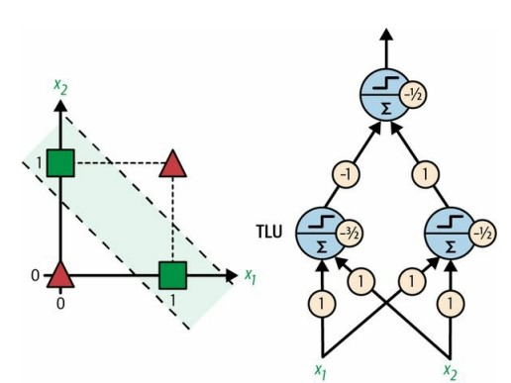
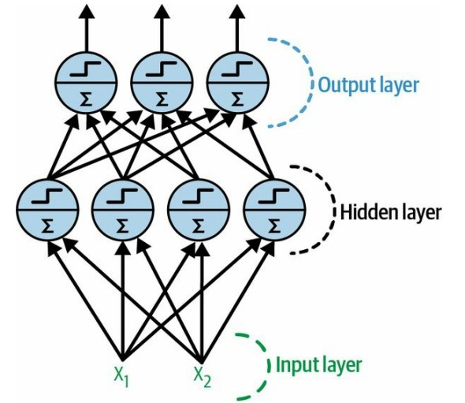
Perceptron(p4)
Multi Layer Perceptron solves XOR problem:
A Multi-Layer-Perceptron is composed of one input layer, one or more hidden layers, and one output layer.

Slide 13
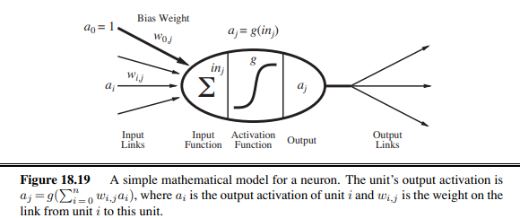
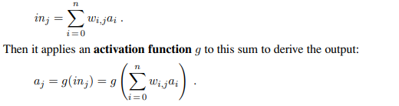
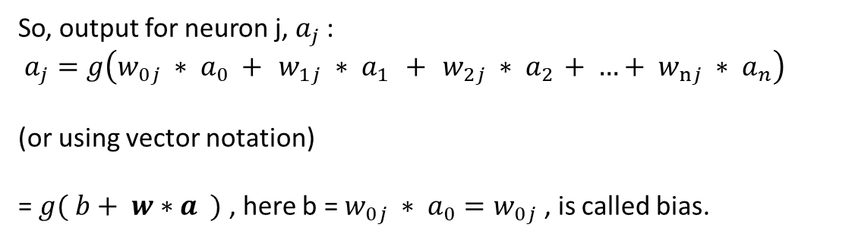
Neuron
g() = activation function
w = weight given to input (determined during training)
a = input/output values
So, output for neuron j, $a_{j}$ :
$$a_{j}=g\left(w_{0j} ∗ a_{0} +{ w_{1j} ∗ a}_{1} +{ w_{2j} ∗ a}_{2} + …+{ w_{nj} ∗ a}_{n}\right)$$
(or using vector notation)
= $g( b+ w∗a )$ , here b = $w_{0j} ∗ a_{0}=w_{0j}$ , is called bias.

Slide 14
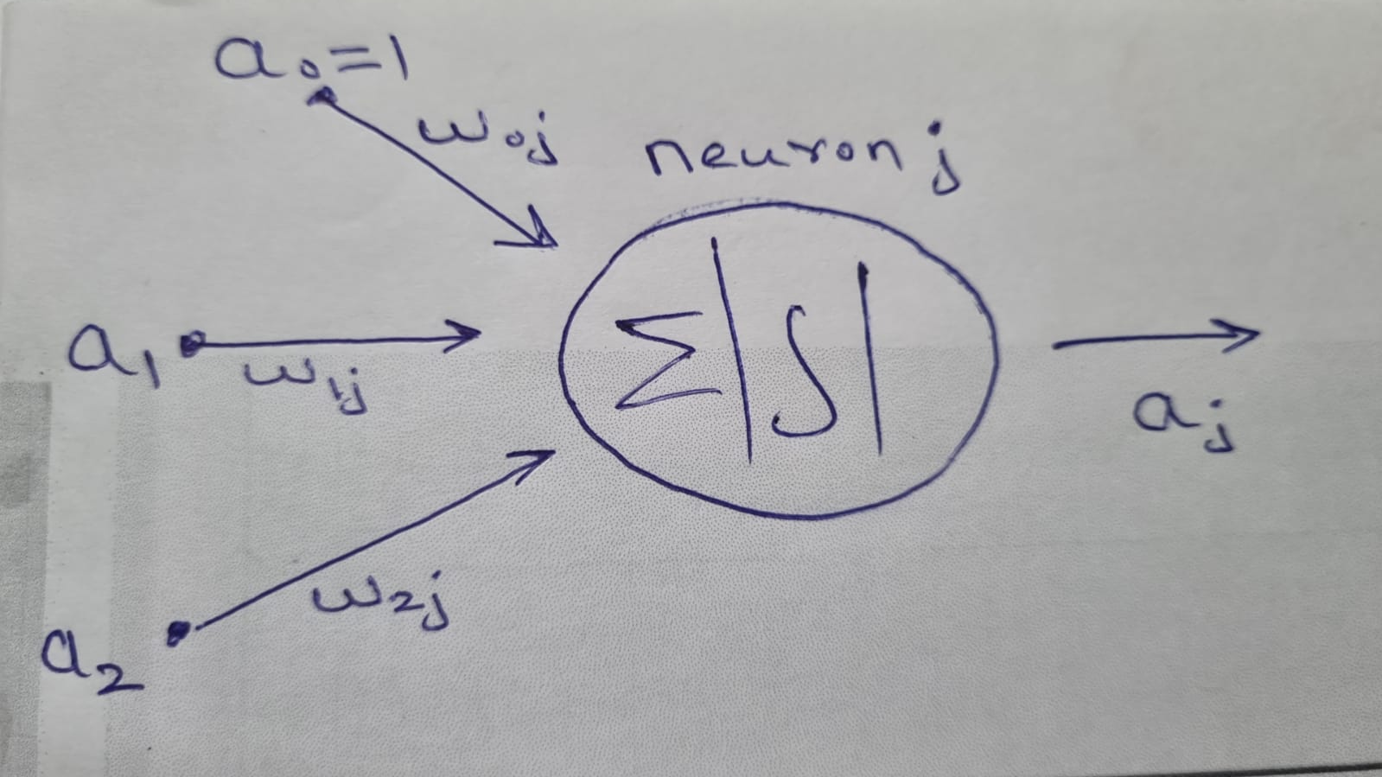
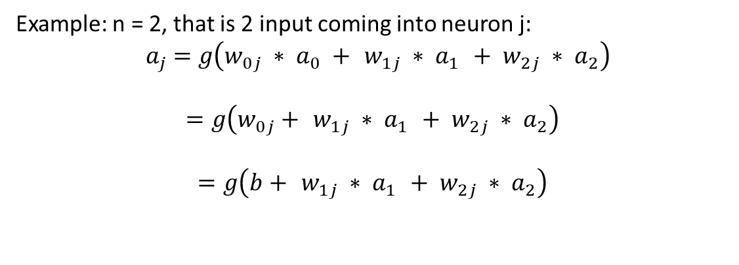
Example of output from neuron labelled j with 2 input
Example: n = 2, that is 2 input coming into neuron j:
$${ a}_{j} =g\left(w_{0j} ∗ a_{0} +{ w_{1j} ∗ a}_{1} +{ w_{2j} ∗ a}_{2}\right)$$
$$=g\left(w_{0j}+{ w_{1j} ∗ a}_{1} +{ w_{2j} ∗ a}_{2}\right)$$
$$=g\left(b+{ w_{1j} ∗ a}_{1} +{ w_{2j} ∗ a}_{2}\right)$$

Slide 15
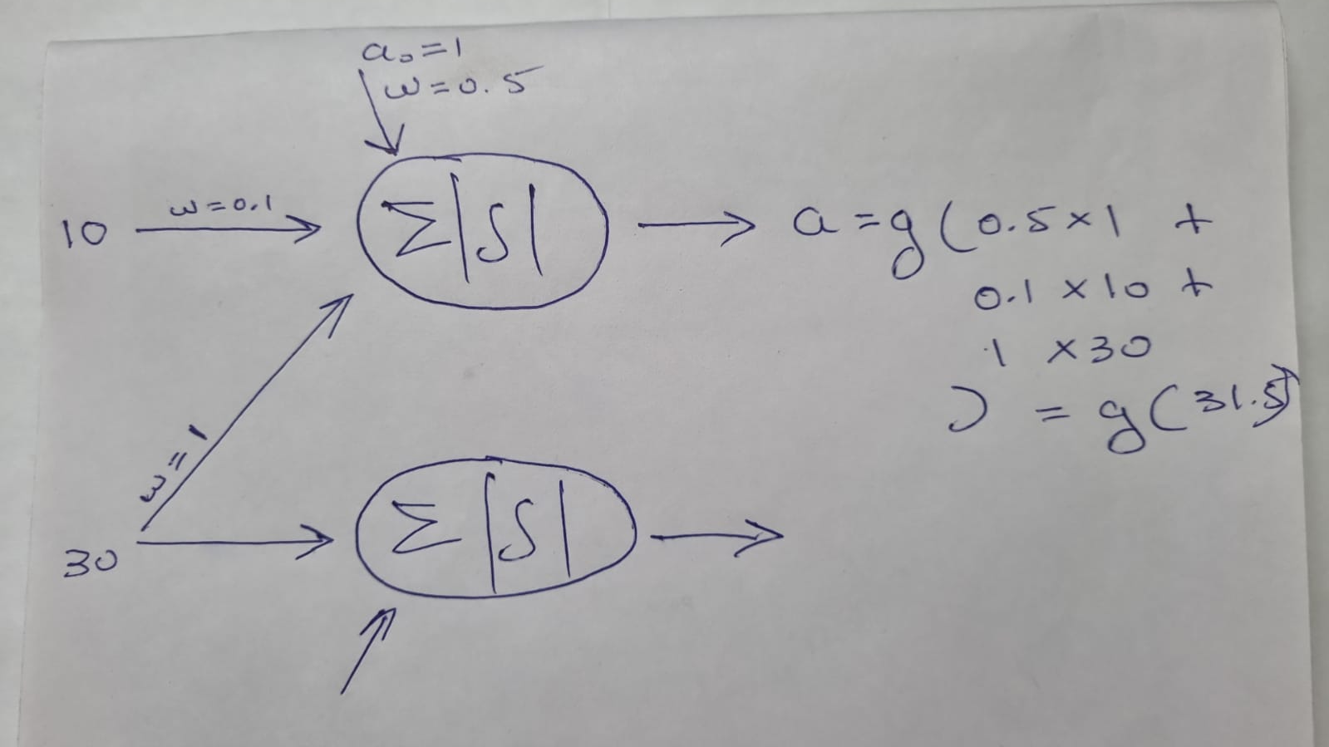
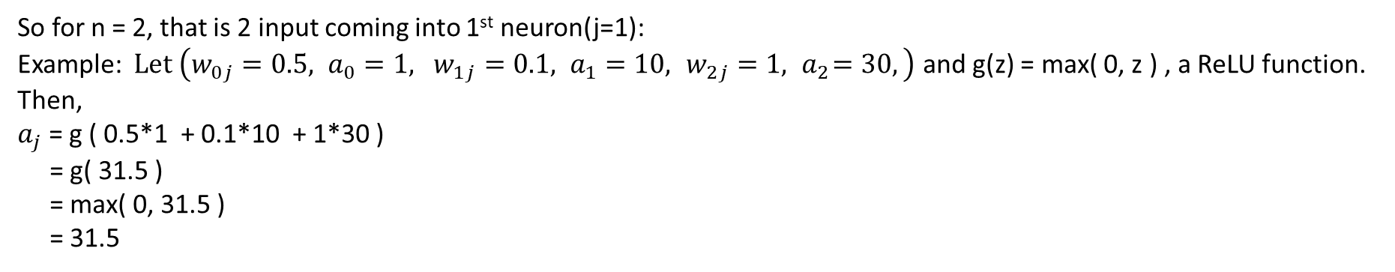
So for n = 2, that is 2 input coming into 1st neuron(j=1):
Example: $Let \left(w_{0j}=0.5, a_{0}=1, { w_{1j}=0.1, a}_{1}=10,{ w_{2j}=1, a}_{2}=30,\right)$ and g(z) = max( 0, z ) , a ReLU function.
Then,
$a_{j}$ = g ( 0.5*1 + 0.1*10 + 1*30 )
= g( 31.5 )
= max( 0, 31.5 )
= 31.5
See next page for activation function

Slide 16
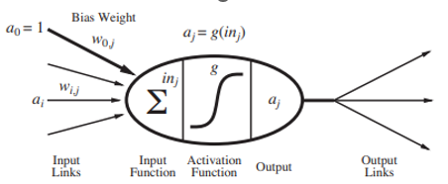
Output layer
Input layer
Hidden layer

Slide 17
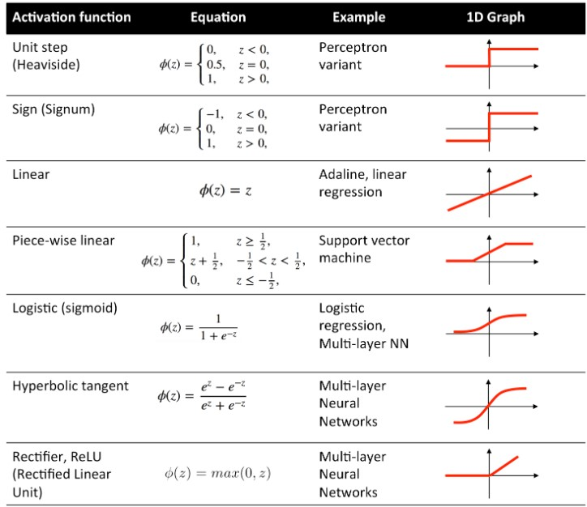

Slide 18

What type of activation unction should be used on output layer?
Choice of activation function in the output layer depends directly on the type of problem you’re solving with an Artificial Neural Network (ANN).
1. Regression Problems
Goal: Predict continuous values (e.g., house prices, temperature).
Output activation:
Linear (identity) → no activation, just raw output.
f(x)=x
Sometimes ReLU if the output can’t be negative (e.g., predicting age, distance).
Loss function used here:
a) Mean Squared Error (MSE)
b) Mean Absolute Error (MAE) if you care more about absolute deviations.
Example: Predicting house price in dollars.

Slide 19


2. Binary Classification Problems
Goal: Predict two classes (yes/no, spam/not spam).
Output activation:
Sigmoid → squashes output to [0,1], interpretable as probability.
Loss function used here: Binary Cross-Entropy (Log Loss)
Example: Predicting if a tumor is malignant (1) or benign (0).

Slide 20
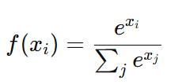

3. Multi-class Classification Problems (One-label)
Goal: Predict one class out of many (mutually exclusive).
Output activation:
Softmax → gives a probability distribution across classes, all adding up to 1.
Loss function used here:
Categorical Cross-Entropy (when labels are one-hot encoded)
Sparse Categorical Cross-Entropy (when labels are integers, not one-hot).
Example: Handwritten digit recognition (0–9).
4. Multi-label Classification Problems (Multiple labels possible)
Goal: Predict multiple independent labels (not mutually exclusive).
Output activation:
Sigmoid (per output node) → each output is treated as independent probability.
Loss function used here:
Binary Cross-Entropy applied independently per label.
Example: Predicting which tags apply to a movie (action, comedy, romance — could be more than one).

Slide 21
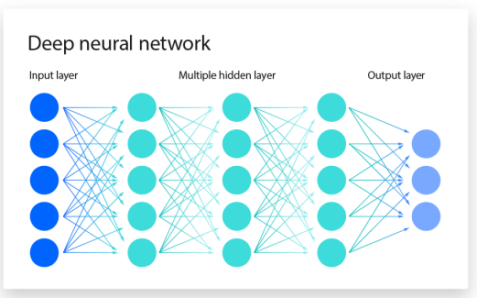
The flow of info. when NN are trained
Loss function = defines the feedback signal
which is used for learning
Optimizer = function or an algorithm that
adjusts the attributes of the neural network,
such as weights and learning rates.
Thus, it helps in reducing the overall loss
and improving accuracy
Prediction target y`
Epoch is a complete cycle of training a machine learning model on an entire dataset.
Parameters (weights and biases) are updated once per batch during training.
So, if you have 1,000 training examples and a batch size of 100, then
→ You get 10 batches per epoch,
→ Therefore, parameters are updated 10 times per epoch.
Updates weights+bias
Optimizer
Loss function
E.g.: SGD, AdamOptimzer, RMSProp, AdaGrad, etc
Loss score
E.g. : Mean Squared Error, Cross-Entropy, etc.
True target y

Slide 22
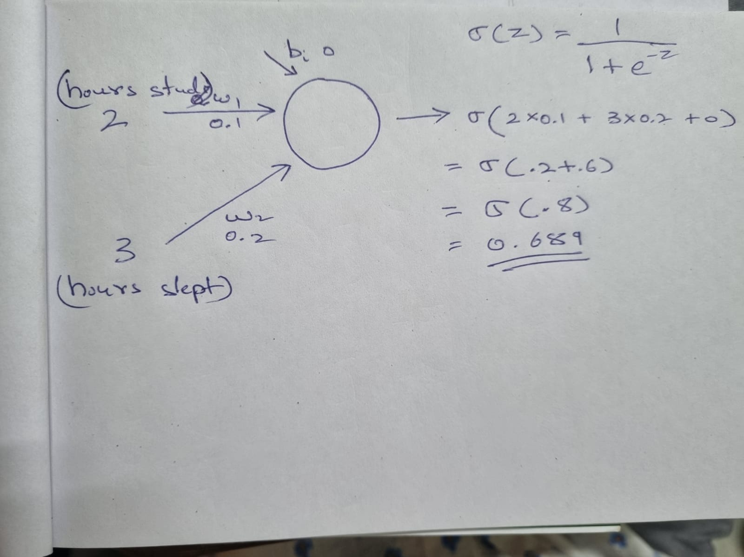
weights and bias(p1):
Weights represent the importance of inputs.
A higher absolute value = more influence.
Positive weights amplify input; negative weights can invert it.
Each connection between two neurons has a weight.
Wts can be (–inf to +inf).
Bias allows the network to shift the activation function.
Without a bias, the neuron output would always pass through the origin (zero input = zero output).

Slide 23
weights and bias(p2):
Weights and biases are usually initialized with small random values. Common ranges depend on the initialization strategy:
Uniform Initialization: W∼U(−a,a)
where a is typically small (e.g., 0.01, or based on input size).
Normal Initialization: W∼N(0,σ^2) with small standard deviation.
Biases are often:
Initialized to zero, or
Initialized with small values like 0.01.

Slide 24
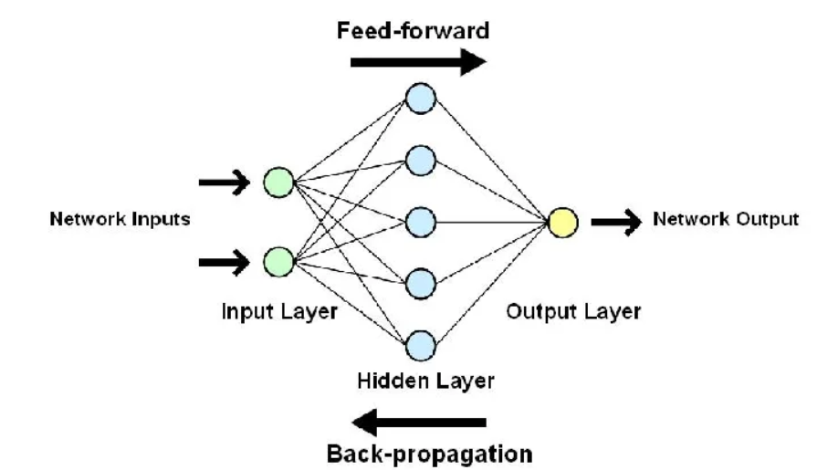
Another representation of NN with 1 hidden layer

Slide 25
ANN Architecture(p1)
1. Layers of an ANN
An ANN consists of three main types of layers:
a. Input Layer
The first layer that receives raw data (e.g., images, text, numbers).
Each node (neuron) in this layer represents a feature (e.g., pixel values in images, numerical values in datasets).
b. Hidden Layers
These layers extract patterns and relationships in the data.
Each neuron in a hidden layer applies a mathematical operation (activation function) to transform inputs.
More hidden layers allow the model to learn complex patterns (Deep Learning uses many layers).
c. Output Layer
Produces the final prediction or classification.
The number of neurons in this layer depends on the task:
Regression → 1 neuron (e.g., predicting house prices)
Binary Classification → 1 neuron (sigmoid activation) (e.g., spam vs. not spam)
Multi-class Classification → Multiple neurons (softmax activation) (e.g., identifying different animals)

Slide 26
ANN Architecture(p2)
2. Structure of an ANN
Each neuron in a layer is connected to neurons in the next layer through weights and biases:
Weights (W): Determine the importance of each input.
Bias (b): Adjusts the output for better accuracy.
Activation Function (σ): Applies non-linearity to introduce learning capability.
Mathematical representation of a neuron:
Y = σ (W*X + b),
where X = input,
W= weights,
B = bias,
σ = activation function,
Y = output

Slide 27
ANN Architecture(p3)
3. Activation Functions
Activation functions decide whether a neuron should be activated (fire) or not

Slide 28
ANN Architecture(p4)
4. Learning Process (Backpropagation & Optimization)
To train an ANN, we use an iterative process:
Forward Propagation: Inputs pass through the network to generate an output.
Loss Calculation: The error is measured using a loss function (e.g., Mean Squared Error for regression, Cross-Entropy for classification).
Backpropagation: The error is propagated backward to update weights using gradient descent (or advanced optimizers like Adam, RMSprop).
Weight Update: The weights are adjusted to minimize the error.

Slide 29
Few facts about ANN
Feedforward networks (MLPs, CNNs) process inputs all at once — they don't depend on previous steps.
Suppose you have 1000 words or pixels.
A feedforward network takes all 1000 together, passes them through layers at the same time (matrix multiplication).
In math terms: matrix × vector — super fast because modern hardware (like GPUs) is built for parallel matrix operations.
No waiting for "previous word" or "previous pixel" — everything is independent at each layer.
This is called parallelism.

Slide 30
Increasing the number of hidden layers:
Increasing the number of hidden layers in a neural network transforms it from a shallow to a deep network — a concept known as deep learning.
Potential Benefits
Ability to Learn Complex Patterns: More layers allow the network to build hierarchies of features.
Example: In image classification, early layers detect edges, deeper layers detect shapes, and even deeper layers recognize objects.
More Expressive Power: A deeper network can approximate more complex functions and decision boundaries.
Better for Large Datasets: Deep networks perform better with large datasets and non-linear problems, assuming proper tuning.
Drawbacks:
Overfitting: More layers = more parameters = risk of memorizing the training data instead of generalizing.
Training Time Increases: More layers = more computations = longer training times.
Vanishing/Exploding Gradients In very deep networks, gradients can become extremely small or large, making training unstable or slow (especially with sigmoid/tanh). (EXPLAINED ON NEXT PAGE)

Slide 31
Increasing the number of hidden layers(p2)
What Is the Vanishing Gradient Problem?
When training a neural network using backpropagation, gradients (partial derivatives of the loss with respect to weights) are used to update the weights. In deep networks, as the gradients are back-propagated through many layers, they get smaller and smaller, eventually becoming too tiny to have any effect — this is called vanishing gradients.
It comes down to repeated multiplication of small numbers (gradients) through the chain rule:
Backpropagation uses chain rule, which uses many multiplication of activations functions.
Repeatedly multiplying by <1 derivatives → gradients vanish.

Slide 32
Difference between hyperparameter and parameter:
Parameters:
Learned from data: Parameters are internal variables of a model whose values are estimated or learned directly from the training data during the model training process.
Define the model's predictions: These values are intrinsic to the model and are used to make predictions on new, unseen data.
Examples: In a linear regression model, the coefficients (weights) are parameters. In a neural network, the weights and biases of the connections between neurons are parameters.
Hyperparameters:
Set before training: Hyperparameters are external configuration settings whose values are determined and set before the model training process begins. They are not learned from the data.
Control the learning process: Hyperparameters govern the behaviour of the learning algorithm and the overall architecture of the model.
Tuned for optimal performance: The selection of appropriate hyperparameter values is crucial for achieving optimal model performance and is often done through a process called hyperparameter tuning or optimization.
Examples: Common hyperparameters include the learning rate in gradient descent, the number of hidden layers or neurons in a neural network, the regularization strength, or the number of clusters in a clustering algorithm like K-Means.

Slide 33
Some interesting site
https://playground.tensorflow.org/

