Slide 1
Box Plot
Problem:
Suppose we are given following numerical data:
[5, -2, 20, 13, 4, -20, 15, 8, 10, 12, 6, 40, 45, 1]
Which single graph can show the data’s spread, center, outliers, and symmetry—all at once ?
Box plot
Scatter plot
Histogram

Slide 2
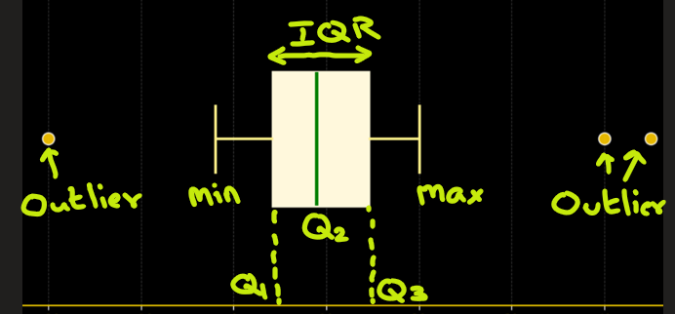
Box Plot
A boxplot (a.k.a. box-and-whisker plot) is a graphical representation of data distribution based on five key summary statistics:
Minimum whisker– smallest non-outlier value
Q1 (First Quartile) – 25% of data lies below this (25th percentile)
Q2 (Median) – middle value (50th percentile)
Q3 (Third Quartile) – 75% of data lies below this (75th percentile)
Maximum whisker– largest non-outlier value
The box plot show following:
The box shows the Interquartile Range (IQR)
IQR = Q3 - Q1 (the middle 50% of data).
The line inside is the median — the center of your data.
The whiskers extend to min and max values (excluding outliers).
Dots or stars outside whiskers indicate outliers.

Slide 3
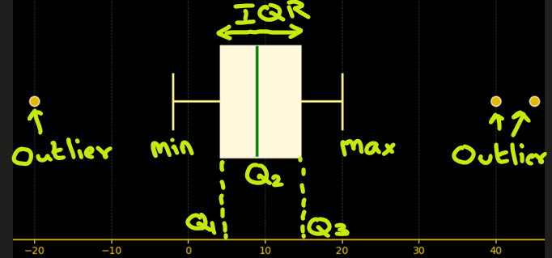
Box Plot
Example: Let’s say we have temperature readings:
[5, -2, 20, 13, 4, -20, 15, 8, 10, 12, 6, 40, 45, 1]
I want to see the 5 key summaries: Minimum, Q1, Q2, Q3, Maximum
Ans:
Let’s sort the data first:
-20, -2, 1, 4, 5, 6, 8, 10, 12, 13, 15, 20, 40, 45
From numerical computation we see that,
Minimum whisker= -2
Q1: 4.25
Q2: (Median) 9.00
Q3: 14.50
Maximum whisker: +20
Outliers: [-20, 40, 45]
IQR = Q3 – Q1
= 14.5 – 4.25
= 10.25 (the middle 50% of the data lies within a range of 10.25 units)

Slide 4
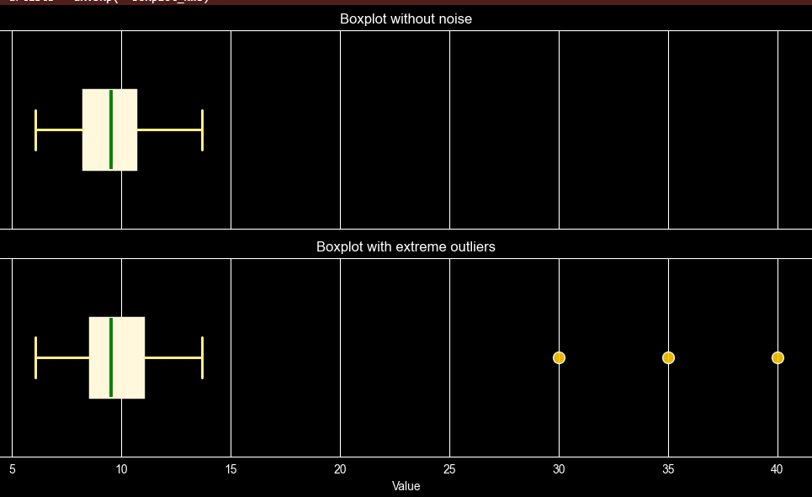
Box Plot: Robust To Noise
Example: Let’s say we receive some noise to temperature readings:
[ 10.99, 9.72, 11.3, 13.05, 9.53, 9.53, 13.16, 11.53, 9.06, 11.09, 9.07, 9.07, 10.48, 6.17, 6.55, 8.88, 7.97, 10.63, 8.18, 7.18, 12.93, 9.55, 10.14, 7.15, 8.91, 10.22, 7.7, 10.75, 8.8, 9.42, 8.8, 13.7, 9.97, 7.88, 11.65, 7.56, 10.42, 6.08, 7.34, 10.39, 11.48, 10.34, 9.77, 9.4, 7.04, 8.56, 9.08, 12.11, 10.69, 6.47, 30, 35, 40]
The noise is shown in red underline. Let’s plot boxplot for both data without and with noise
We see that
The median (center line) barely changes.
The box (IQR) stays almost the same.
Outliers are shown separately as points:
showing that the boxplot is robust to
extreme values.

Slide 5
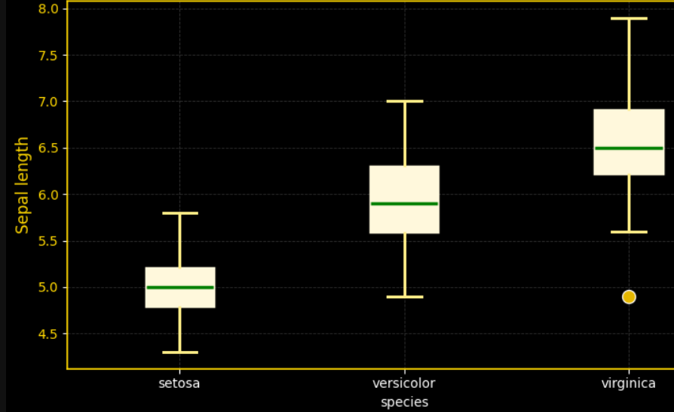
Box Plot: Comparing Groups
Box plots are used to compare distribution of data among groups
Setosa
Has the smallest sepal lengths overall.
The median is around 5.0 cm.
The spread (IQR) is tight → values are consistent.
No outliers
Versicolor
Intermediate sepal length
(median around 5.9–6.0 cm).
Slightly wider IQR → moderate variation.
No outliers
Virginica
Has the largest sepal lengths, median around
6.5–6.6 cm.
Slightly more spread, indicating more variation
within the species.
Whiskers extend higher → presence of some longer sepals.
Has an outlier

Slide 6
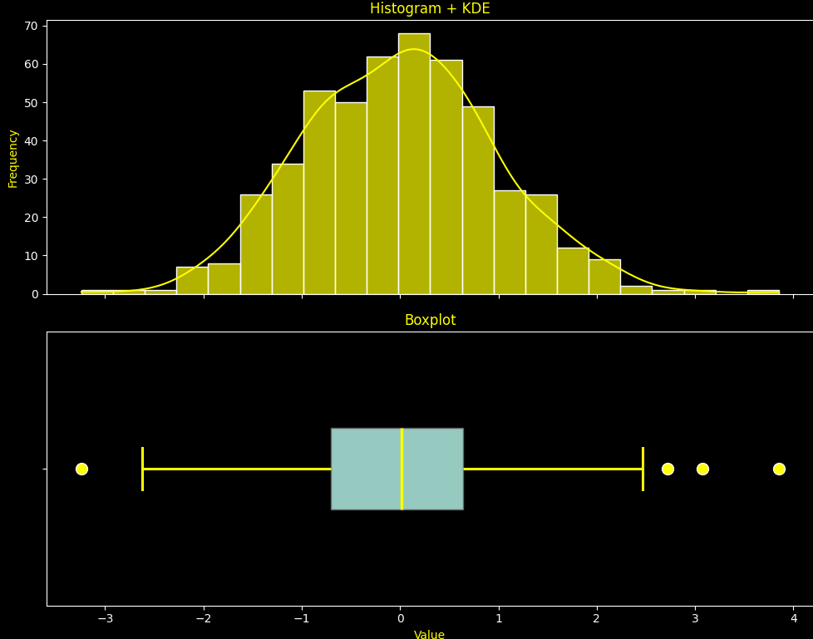
Box Plots shows Skewness of the data
Normally Distributed :
Here Median is at the center of the Box and the whiskers are almost the same on both the ends

Slide 7
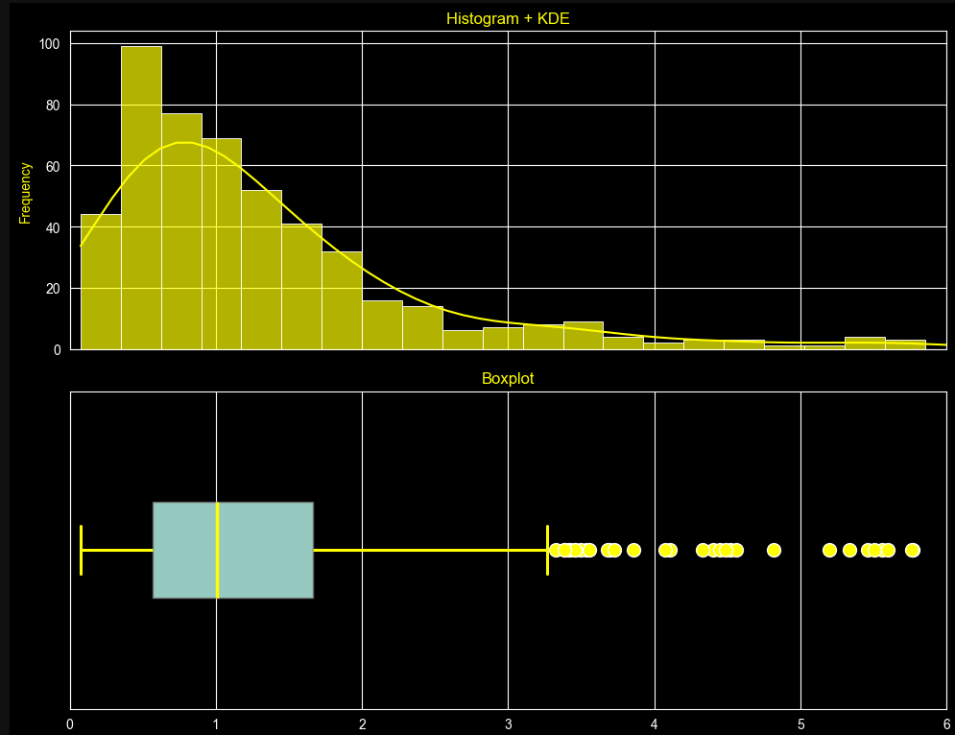
Box Plots shows Skewness of the data
b) Positive Skew (Right Skew):
Here the Median(Q2) lies closer to the First Quartile(Q1) and the whisker at the lower end is shorter

Slide 8
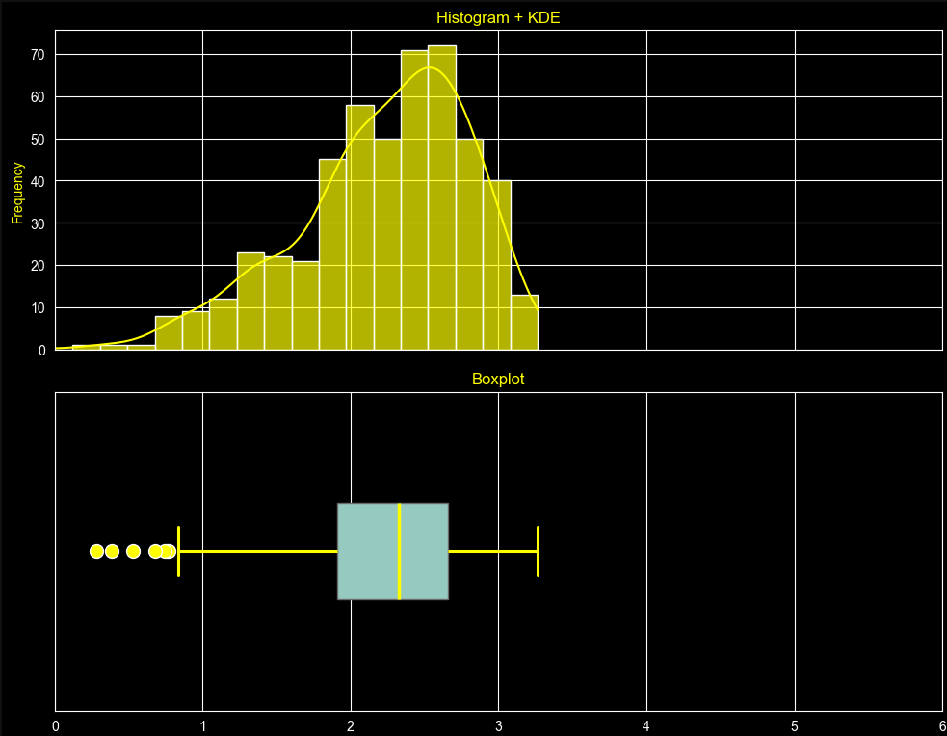
Box Plots shows Skewness of the data
c) Negative Skew (Left Skew):
Here the Median(Q2) lies closer to the Third Quartile(Q3) and the whisker at the upper end is shorter.

Slide 9
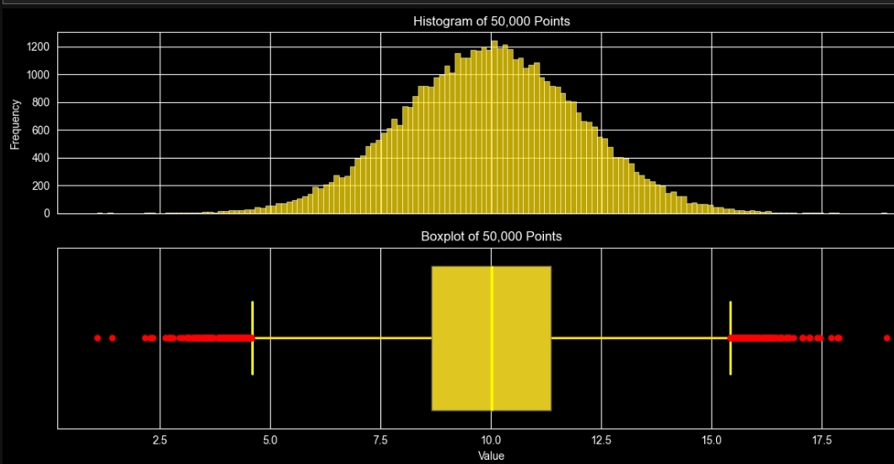
Box Plots: Great with Large Datasets for Summary
Histogram needs many bins to make sense and can look cluttered with 50k points.
Boxplot summarizes the entire dataset in a clean, compact view with median, IQR, and outliers.
Boxplot still looks clean while the histogram may need many bins and can look messy

Slide 10
What Makes Boxplots Special ?
Outlier Detection – Instantly flags unusual data points that could indicate errors or interesting phenomena.
Robust to Noise – Uses medians and quartiles, so it’s less affected by extreme values than mean-based charts.
Group Comparison – Easily compare distributions between multiple categories side by side.
Skewness – Helps to identify skewness in data, if any.
Great with Large Datasets for Summary – While histograms need many bins, boxplots scale beautifully even with huge datasets. It summarizes thousands of data points in one small plot.

Slide 11
STOP
Hfdslfds
fksdljfsD|]
fkdslfa

