Slide 1
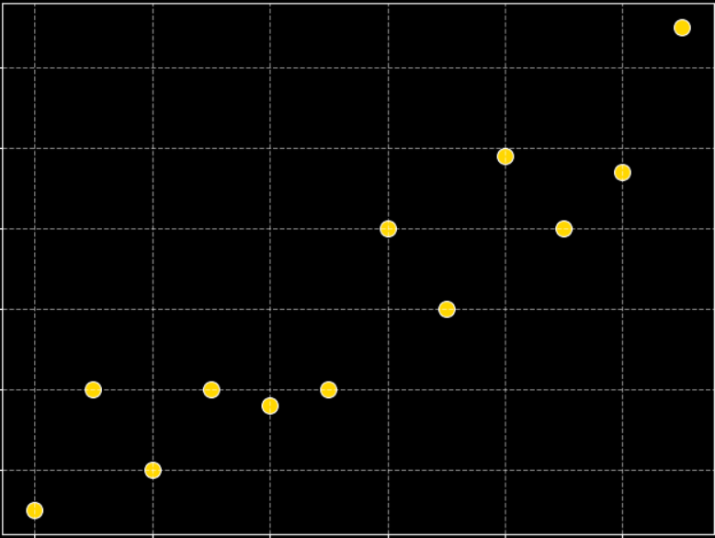
Scatter Plot
We will explore one of the most important visualization tools in statistics — the scatter plot. We will learn what it is, why it’s useful, how to interpret it with real-life examples and some common pitfalls to avoid when using scatterplots

Slide 2
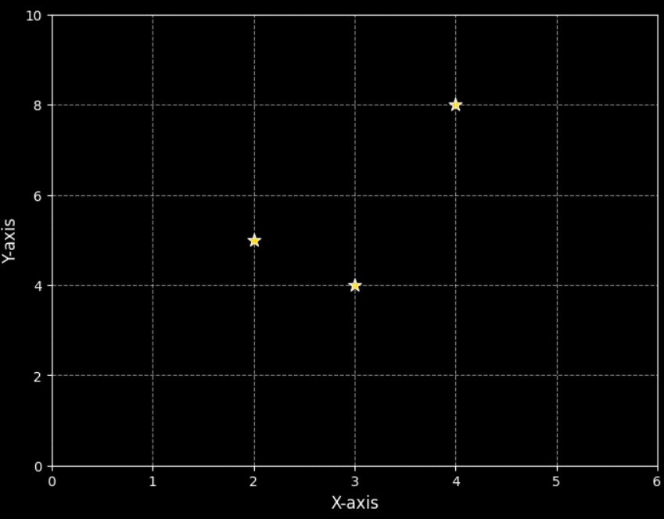
Scatter Plot
A scatter plot is a type of graph that shows the relationship between two quantitative or numerical variables using dots.
X-axis → independent variable
Y-axis → dependent variable (AKA response)
Each dot is a data point (x, y).
Example:
(2,5)
(4,8)
(3,4)
Easy to interpret and often the
first step in data analysis.

Slide 3
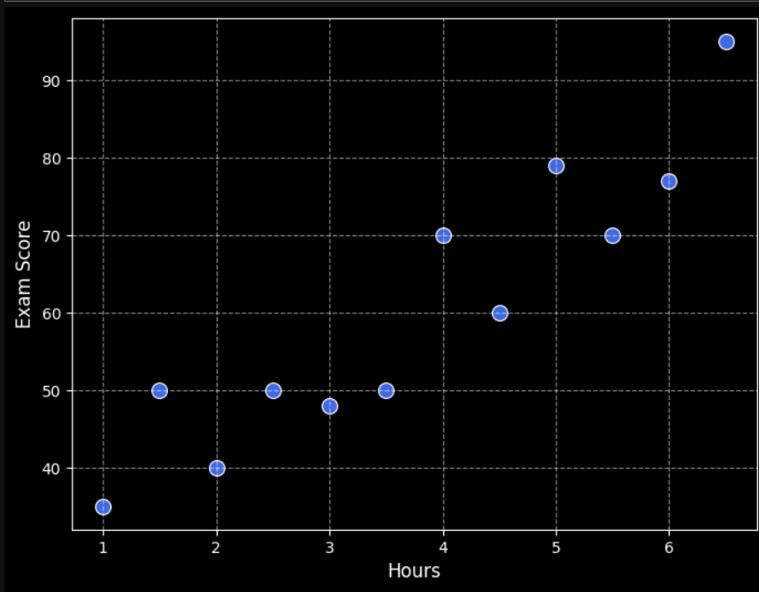
Scatter Plot
Example1: Positive linear relationship
Suppose we collect data on students — their hours of study (X) and exam scores (Y). Each point shows how much a student studied and what score they achieved.
Hours Studied | Scores
1 | 35
2 | 40
3 | 48
4 | 70
5 | 79
6 | 77
2.5 | 50
3.5 | 50
4.5 | 60
5.5 | 70
1.5 | 50
6.5 | 95

Slide 4
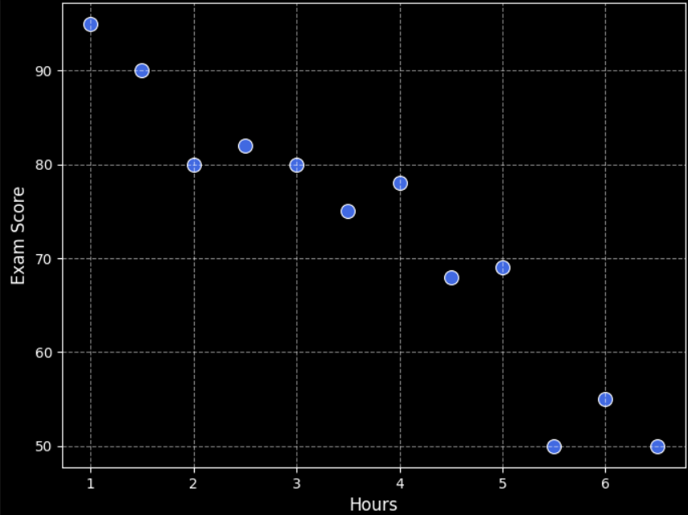
Scatter Plot
Example2: Negative linear relationship
Suppose we collect data on students — their hours of video game playtime (X) and exam scores (Y). Each point shows how much a student played video games and what score they achieved.
Hours Gaming | Scores
1 | 95
2 | 80
3 | 80
4 | 78
5 | 69
6 | 55
2.5 | 82
3.5 | 75
4.5 | 68
5.5 | 50
1.5 | 90
6.5 | 50

Slide 5
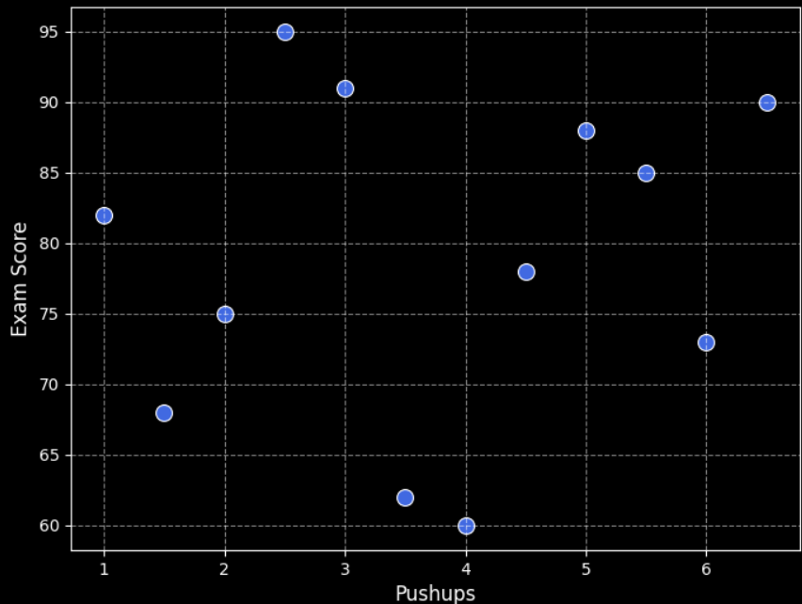
Scatter Plot
Example3: No linear relationship
Suppose we collect data on students — the number of pushups (X) and exam scores (Y). Each point shows how many pushups a student can do and what score they achieved.
Push-Ups | Scores
10 | 82
15 | 75
20 | 91
25 | 60
30 | 88
35 | 73
40 | 95
45 | 62
50 | 78
55 | 85
60 | 68
65 | 90

Slide 6

Why Scatter Plots Are Useful: Identify Relationships
Detect correlation between variables.
Direction of relationship:
Positive correlation: both increase
Negative correlation: one increases, the other decreases
No correlation: scattered, no clear trend

Slide 7
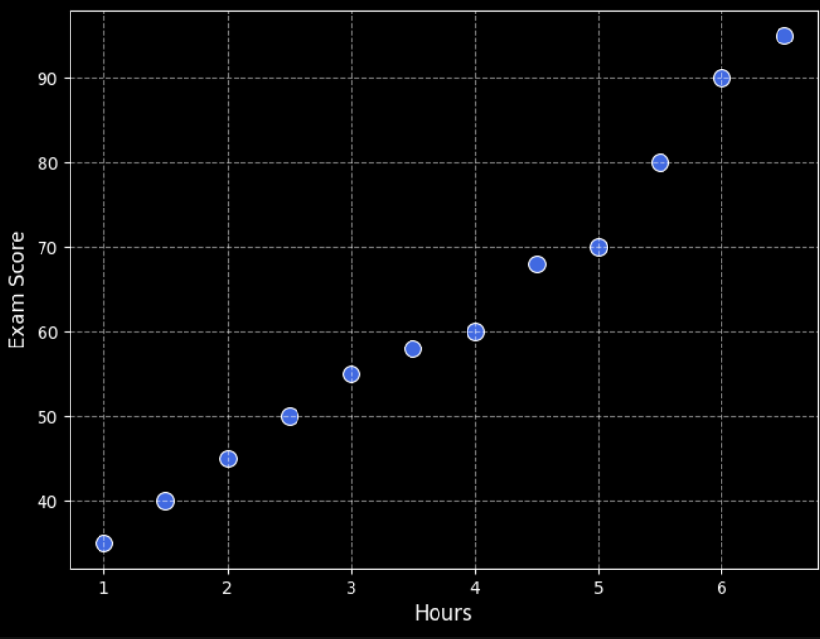
Why Scatter Plots Are Useful: Identify Strength of Relationships
Interpret strength:
If strong correlation then points are close to a straight line.
If weak correlation then points are loosely spread.

Slide 8
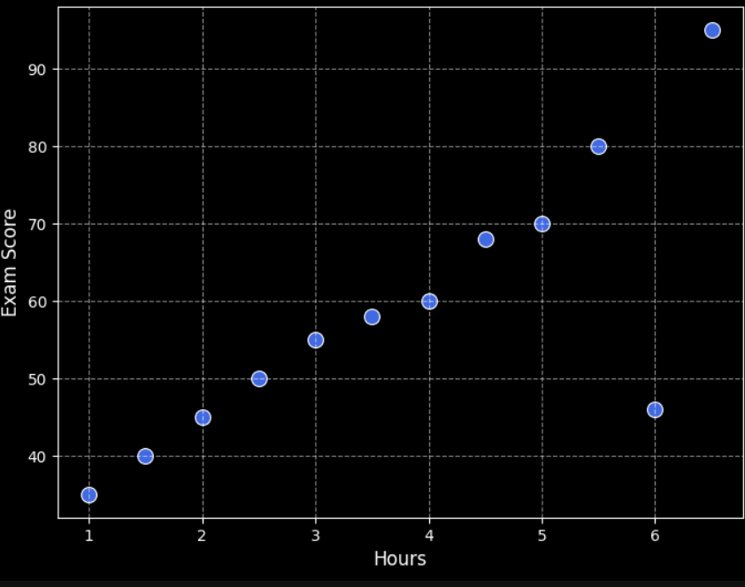
Why Scatter Plots Are Useful: Spot Outliers
Points that don’t fit the pattern indicate unusual observations.

Slide 9
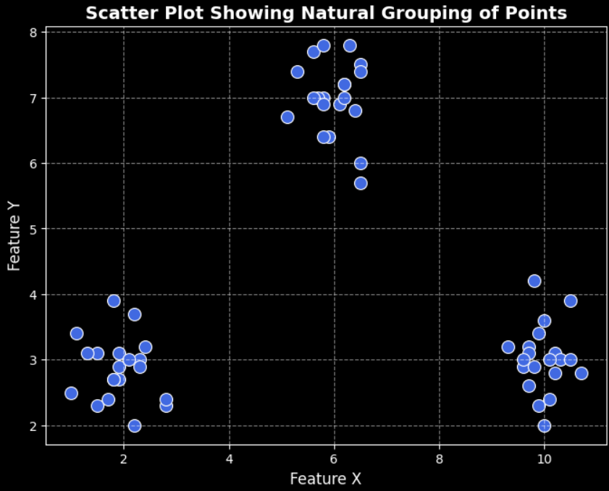
Why Scatter Plots Are Useful: Visualize Clusters
You can detect natural grouping of points.
X (distance from home) = [ 2.2, 1.9, 2.3, 2.8, 1.9, 1.9, 2.8, 2.4, 1.8, 2.3, 1.8, 1.8, 2.1, 1.0, 1.1, 1.7, 1.5, 2.2, 1.5, 1.3, 6.4, 6.1, 5.9, 5.8, 5.3, 5.6, 5.8, 6.5, 6.2, 5.1, 6.2, 5.8, 5.7, 6.3, 6.5, 6.5, 5.6, 5.8, 6.2, 6.5, 9.9, 10.2, 10.7, 9.7, 9.6, 9.7, 10.5, 10.2, 9.7, 10.3, 10.0, 10.5, 9.6, 9.8, 9.8, 9.3, 10.1, 10.1, 10.0, 9.9 ]
Y ( money spent on food ) = [ 3.7, 2.9, 3.0, 2.3, 2.7, 3.1, 2.4, 3.2, 2.7, 2.9, 2.7, 3.9, 3.0, 2.5, 3.4, 2.4, 3.1, 2.0, 2.3, 3.1, 6.8, 6.9, 6.4, 6.4, 7.4, 7.7, 7.0, 7.5, 7.2, 6.7, 7.2, 7.8, 7.0, 7.8, 5.7, 7.4, 7.0, 6.9, 7.0, 6.0, 2.3, 2.8, 2.8, 2.6, 2.9, 3.2, 3.9, 3.1, 3.1, 3.0, 2.0, 3.0, 3.0, 4.2, 2.9, 3.2, 3.0, 2.4, 3.6, 3.4 ]
It is hard to detect clusters by looking at numbers,
but easy to see them when they are plotted.

Slide 10
Common Mistakes and Tips
1. Using it for categorical data:
Scatter plots only make sense for columns that have numerical data. For example, below, the feature Department although has numeric data, but it is categorical in nature with following mapping:
1 -> HR
2 -> Sales
3 -> Finance
Name | Department | Years_of_Experience | Salary
A | 1 | 2 | 32000
B | 2 | 5 | 55000
C | 2 | 7 | 72000
D | 3 | 3 | 40000
E | 1 | 6 | 50000
F | 3 | 8 | 65000
G | 2 | 4 | 43000
H | 2 | 9 | 80000
I | 1 | 1 | 30000
J | 3 | 10 | 85000

Slide 11
Common Mistakes and Tips
2. Misinterpreting correlation as causation:
“Just because two things move together doesn’t mean one causes the other.”
A study finds that ice cream sales and electricity demand both increase during certain months of the year. We may misinterpret this and claim increased ice cream consumption led to higher electricity demand.
Actual reason could be a lurking variable. The real cause is seasonal temperature — warm weather causes both:
More ice cream sales (because people want cold desserts)
Electricity demand grows (due to more AC, etc.)

Slide 12
Real-World Applications
1. Education: Hours studied vs. marks scored.
2. Health: Calorie intake vs. weight gain.
3. Business: Advertising spend vs. sales revenue.
4. Economics: Inflation vs. unemployment (Phillips Curve).
5. Data Science: Feature relationships before modeling — to check if variables are related.
Etc…

Slide 13
STOP
Hfdslfds
fksdljfsD|]
fkdslfa

