Slide 1
Kurtosis
Suppose you are given a dataset. You want answers to following:
Are there many extreme outliers ?
Is the data flat or sharply peaked ?
How likely are rare, extreme events compared to a normal distribution ?

Slide 2
Kurtosis: Topics
What is kurtosis ?
What are some examples of kurtosis ?
How do we measure kurtosis ?
Why do we care about kurtosis ?

Slide 3
Kurtosis
Kurtosis measures the tailedness or peakedness of a distribution. In simple words:
Kurtosis tells us how much of the data lies in the tails versus near the mean.

Slide 4

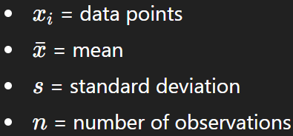
Kurtosis: Formula
The numerator’s power of 4 makes kurtosis very sensitive to extreme values (outliers).

Slide 5
Why Do We Study Kurtosis?
1. Detecting Outliers
High kurtosis means many extreme deviations — a few values are far away from the mean.
In ML, such outliers can:
Distort regression coefficients
Mislead feature scaling
Affect model convergence
Use kurtosis to detect and decide whether to cap or transform extreme values.
2. Assessing Distribution Normality
Many statistical and ML models (e.g., Linear Regression, Logistic Regression, PCA) assume data or residuals are normally distributed.
If kurtosis ≈ 0 → distribution behaves normally
If kurtosis > 0 → heavy tails (risk of outliers)
If kurtosis < 0 → too flat (underdispersed)
Helps validate whether assumptions of normality hold before training.

Slide 6
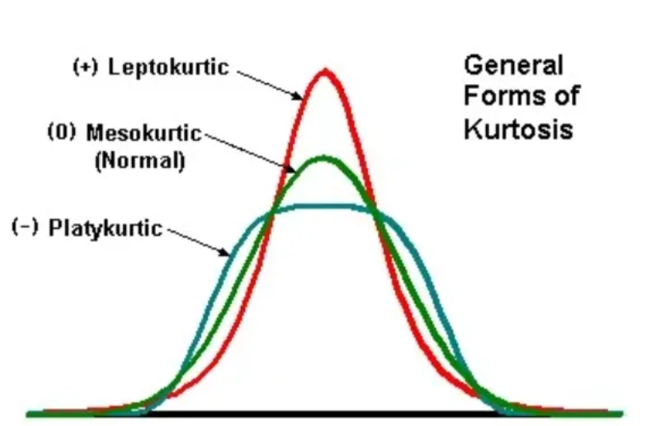
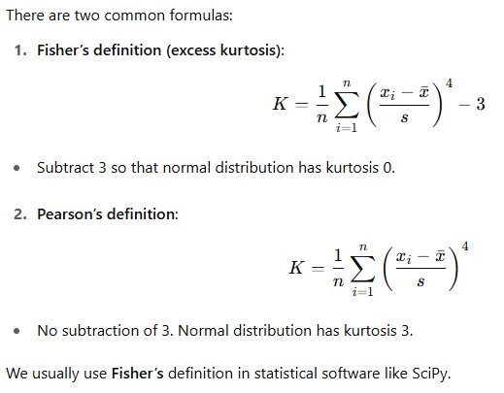
Kurtosis (see jupyter n/b):
 | Category
 | Mesokurtic | Platykurtic | Leptokurtic
Tailedness | Medium-tailed | Thin-tailed | Fat-tailed
Outlier frequency | Medium | Low | High
Kurtosis | Moderate (3) | Low (< 3) | High (> 3)
Example distribution | Normal | Uniform | Laplace
Kurtosis formula:
High kurtosis signals a greater risk of outliers, prompting further investigation or data transformation to ensure robust statistical analysis
Kurtosis can influence the choice of feature transformations. For example, if a feature has high kurtosis and a few extreme values, a transformation like a square root or logarithmic transformation might be beneficial to reduce the impact of outliers and make the data more normally distributed.

Slide 7
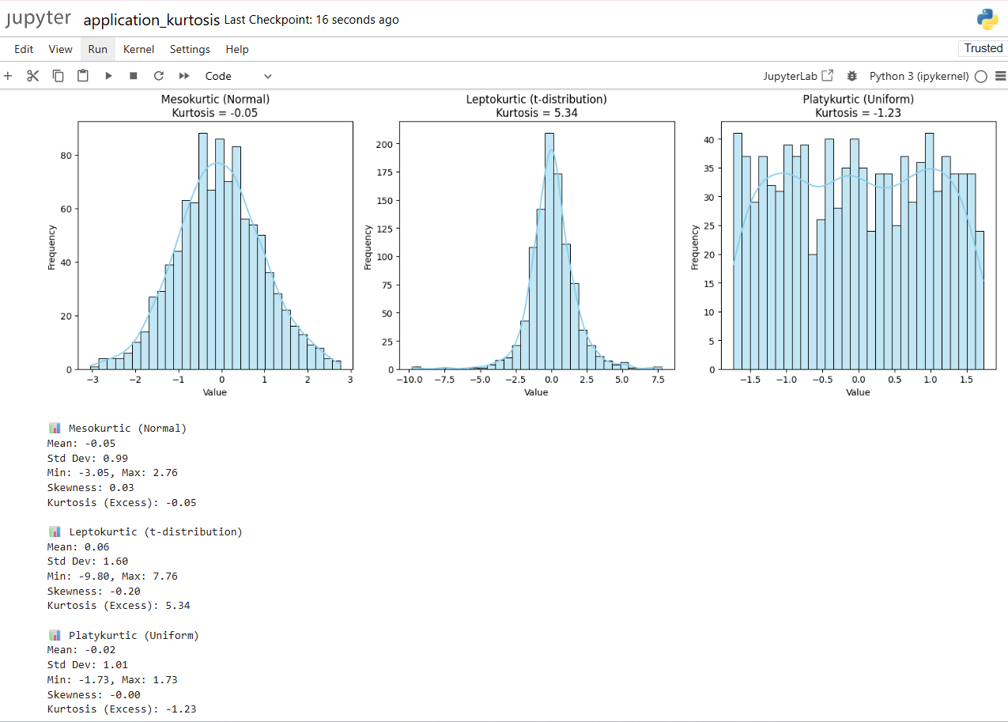

Slide 8
STOP

