Slide 1
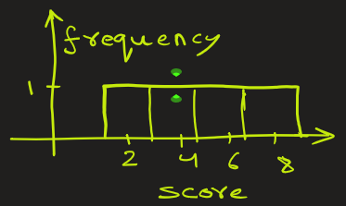
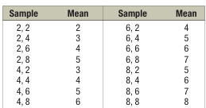
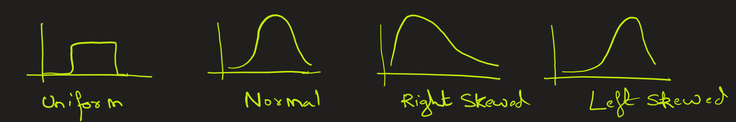
Central Limit Theorem (CLT)
Problem: A professor administered an 8-point quiz to a small class of four students — A, B, C, and D — whose scores are:
Assume these four students represent the entire population.
Here histogram graph of the population is uniform:
Suppose I take ordered samples of size = 2 with replacement from above population and compute their mean. (See the table.)
Ordered sample means that sample scores of (2,4) and (4,2)
are considered different: (2,4) ≠ (4,2)
What is the shape of the sampling distribution of the above sample means ?
Student | Score
A | 2
B | 6
C | 4
D | 8

Slide 2
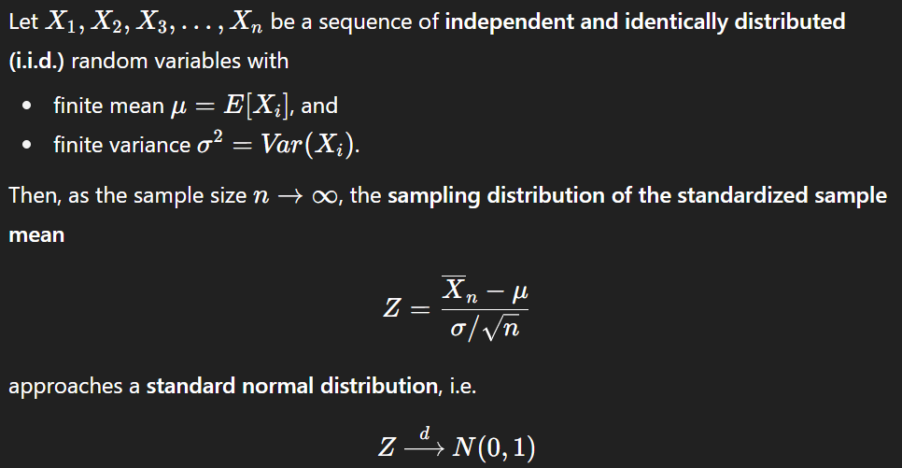

Central Limit Theorem (CLT): Theory
What is the Central Limit Theorem (CLT)?
In simple terms: No matter what the shape of the original population distribution is, the distribution of the sample means will approximate a Normal Distribution as the sample size (n) gets larger

Slide 3
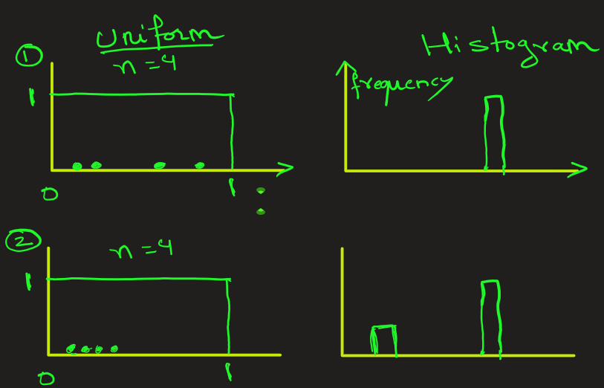
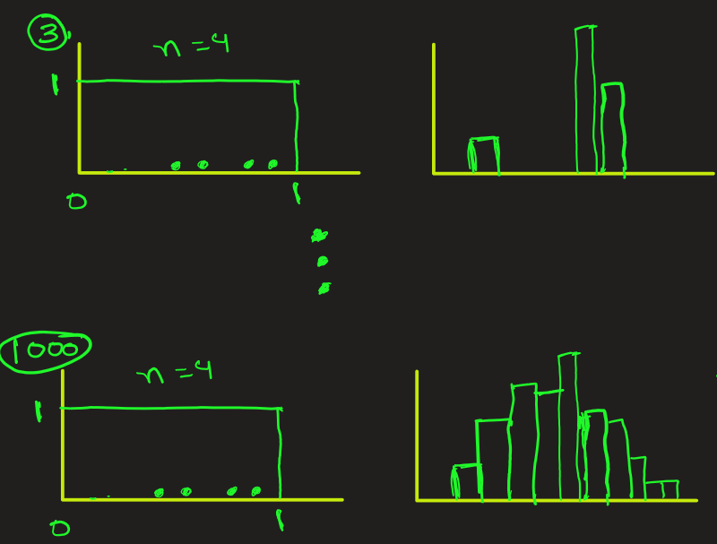
Central Limit Theorem (CLT)
Understanding CLT through an example:
Suppose you have data from a population that has uniform distribution (UD): All values within a range are equal likely
You take a sample of 4 points from UD and calculate its mean. Then plot the mean on the histogram
You take another sample of 4 points from UD and calculate its mean. Then plot the mean on the histogram
3) You take another sample of 4 points from UD and calculate its mean. Then plot the mean on the histogram
(And you keep doing this for 1000 times)
At the end histogram will take a shape of Normal Distribution.
This is the essential idea: No matter the distribution of your population, the distribution of the sample means would always come closer to normal distribution as sample size increases.

Slide 4
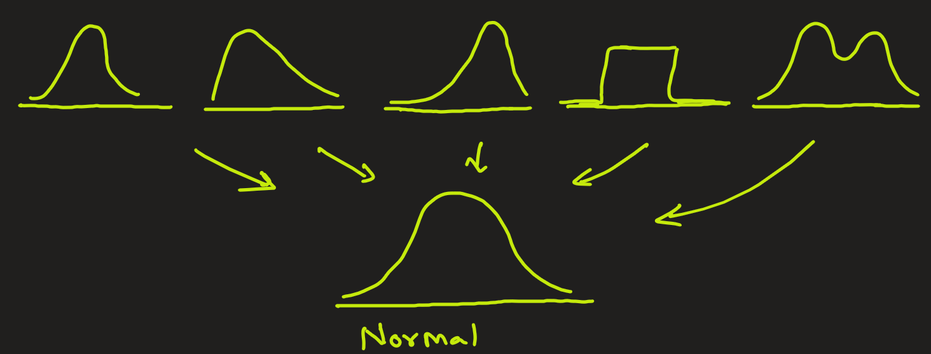
Central Limit Theorem (CLT)
Key idea of CLT:
The population can be anything: normal, skewed, uniform, bimodal or any weird shape.
If you randomly sample from it repeatedly and calculate the mean each time, then the distribution of those means will always tend toward a normal distribution.

Slide 5
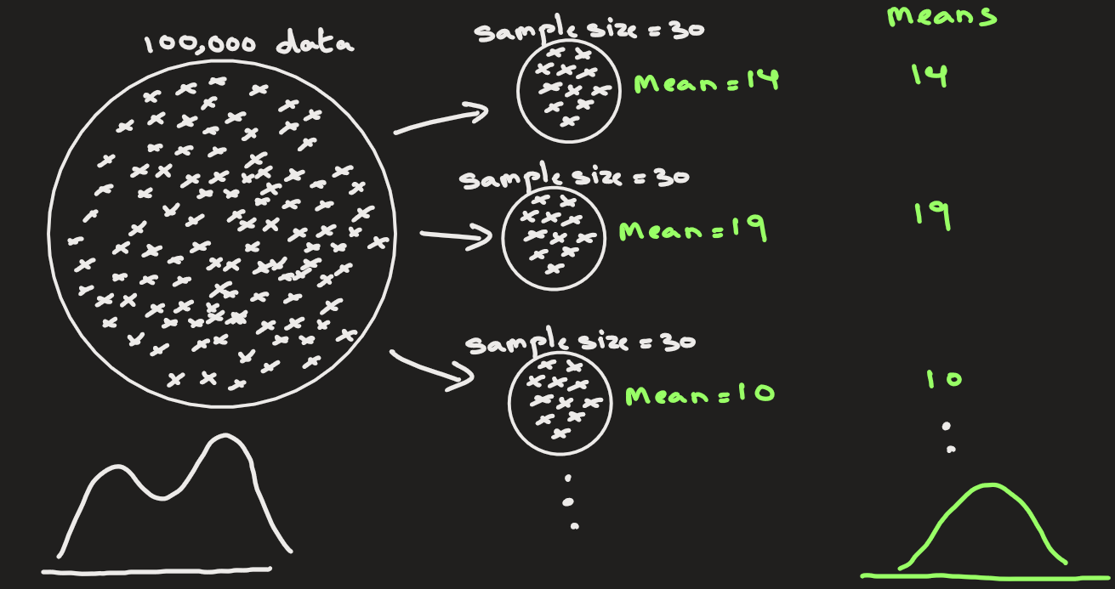
(EXTRA Add-On) Another visual way to understand CLT
Suppose you have a population of 100,000 data points.
If you randomly draw 30 sample from it repeatedly and calculate the mean each time, then the distribution of those means will always tend toward a normal distribution.

Slide 6
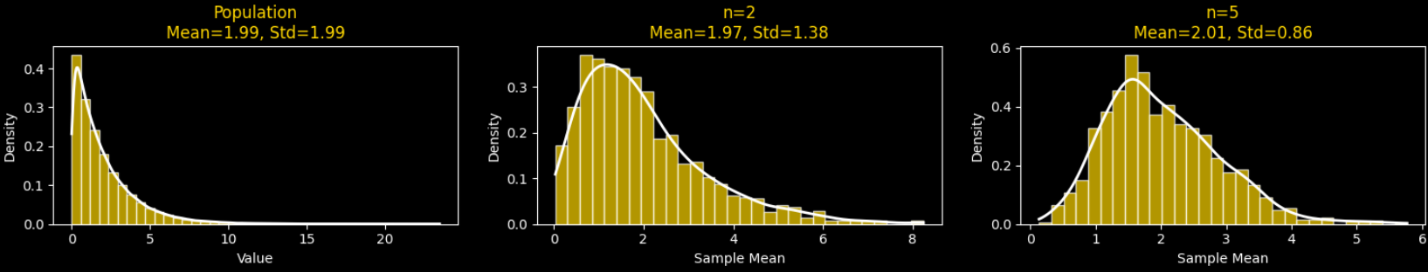
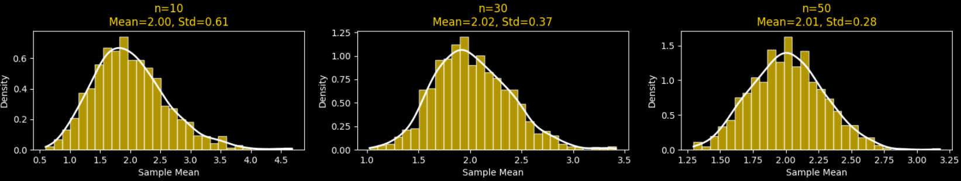
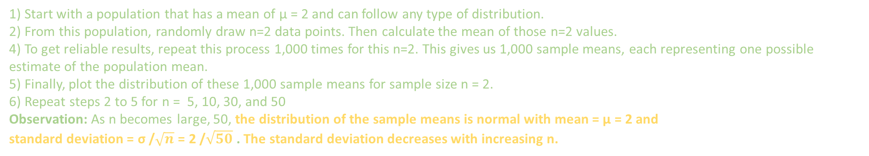
CLT: The Effect Of Sample Size n On The Distribution Of Samples Mean
1) Start with a population that has a mean of μ = 2 and can follow any type of distribution.
2) From this population, randomly draw n=2 data points. Then calculate the mean of those n=2 values.
4) To get reliable results, repeat this process 1,000 times for this n=2. This gives us 1,000 sample means, each representing one possible estimate of the population mean.
5) Finally, plot the distribution of these 1,000 sample means for sample size n = 2.
6) Repeat steps 2 to 5 for n = 5, 10, 30, and 50
Observation: As n becomes large, 50, the distribution of the sample means is normal with mean = μ = 2 and
standard deviation = σ /$\sqrt{n}$ = 2 /$\sqrt{50}$ . The standard deviation decreases with increasing n.

Slide 7


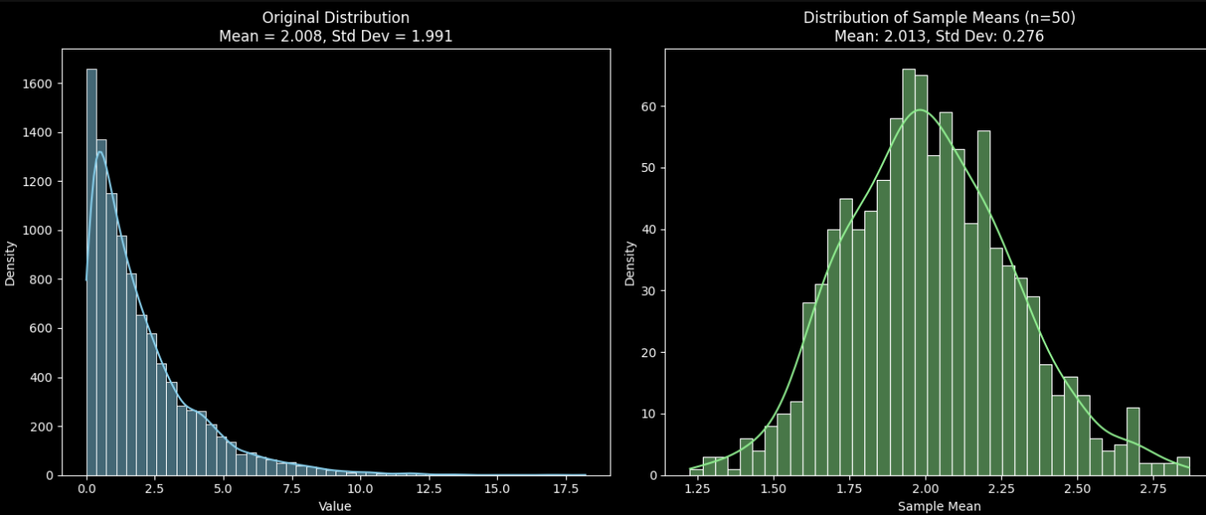
Central Limit Theorem (CLT): Effect of Population Distribution
I drew 1,000 random samples from an exponential distribution and calculated the mean of each sample.
The resulting distribution of these sample means followed an approximately normal distribution.
Exponential Distribution

Slide 8
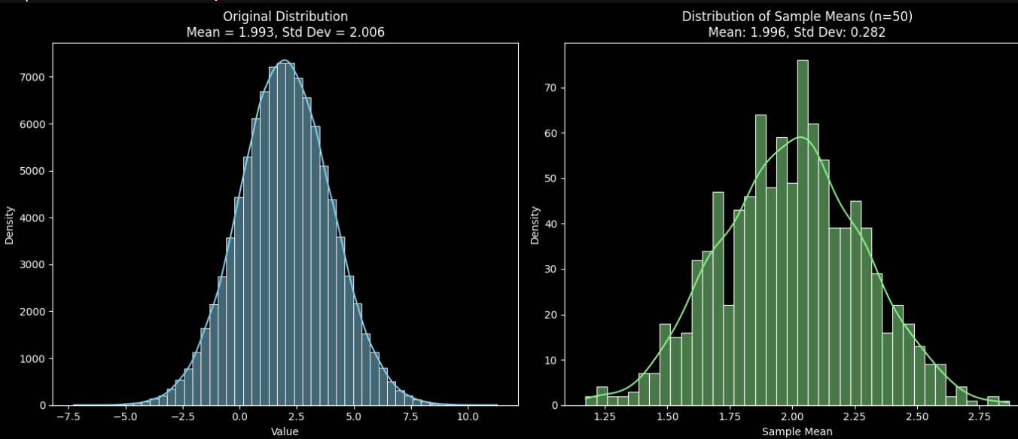
Central Limit Theorem (CLT): Effect of Population Distribution
I drew 1,000 random samples from normal distribution and calculated the mean of each sample.
The resulting distribution of these sample means followed an approximately normal distribution.
Normal Distribution

Slide 9
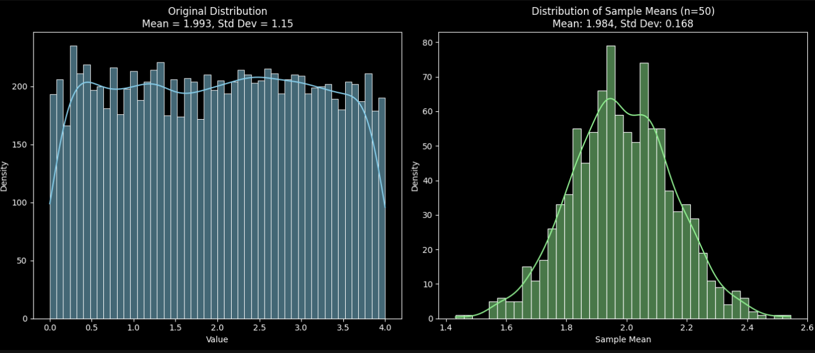
Central Limit Theorem (CLT): Effect of Population Distribution
I drew 1,000 random samples from uniform distribution and calculated the mean of each sample.
The resulting distribution of these sample means followed an approximately normal distribution.
Uniform Distribution

Slide 10
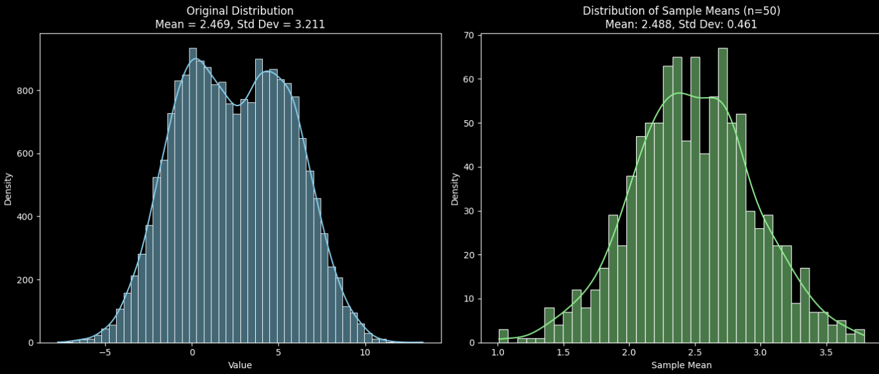
Central Limit Theorem (CLT): Effect of Population Distribution
I drew 1,000 random samples from multi-modal distribution and calculated the mean of each sample.
The resulting distribution of these sample means followed an approximately normal distribution.
Multi-modal Distribution

Slide 11
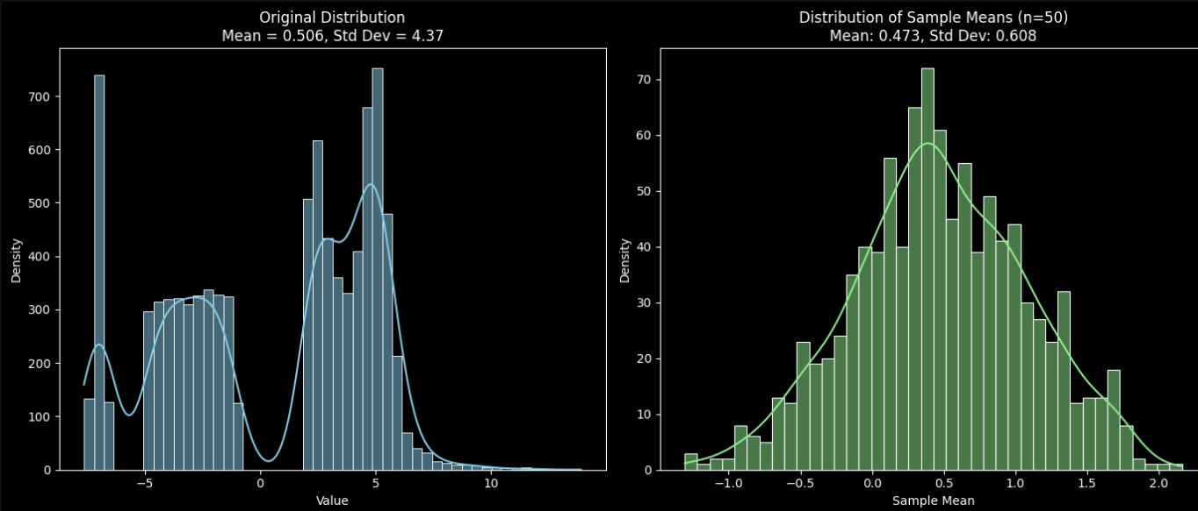
Central Limit Theorem (CLT): Effect of Population Distribution
I drew 1,000 random samples from weird distribution and calculated the mean of each sample.
The resulting distribution of these sample means followed an approximately normal distribution.
Weird-shape Distribution

Slide 12
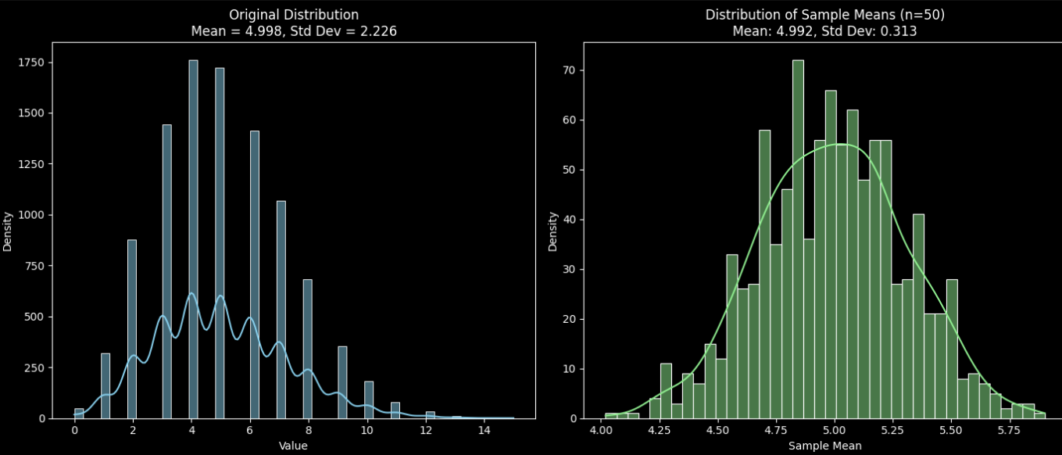
Central Limit Theorem (CLT): Effect of Population Distribution
I drew 1,000 random samples from Poisson distribution and calculated the mean of each sample.
The resulting distribution of these sample means followed an approximately normal distribution.
Poisson Distribution

Slide 13
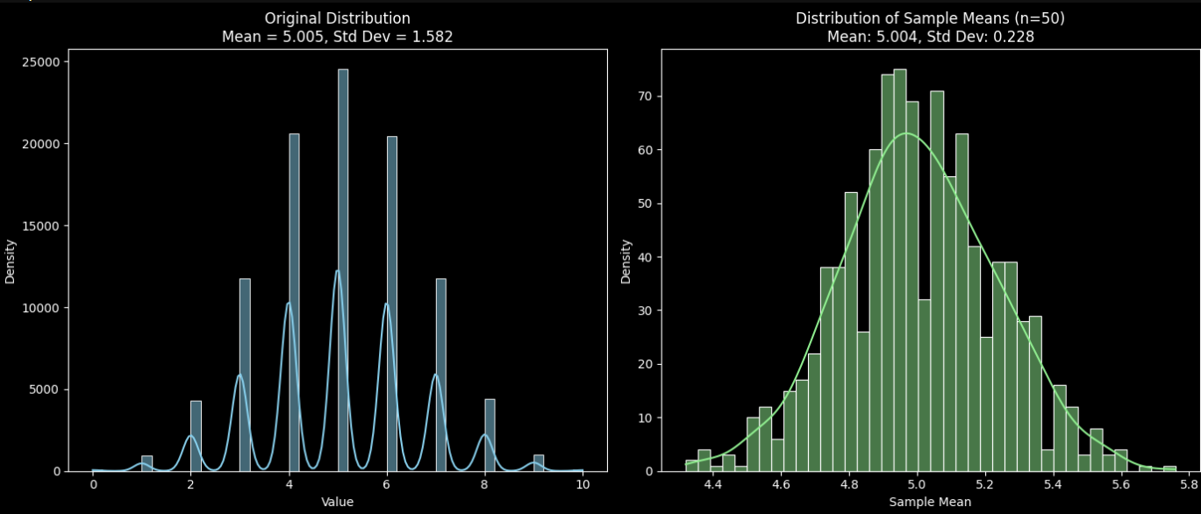
Central Limit Theorem (CLT): Effect of Population Distribution
I drew 1,000 random samples from Binomial distribution and calculated the mean of each sample.
The resulting distribution of these sample means followed an approximately normal distribution.
Binomial Distribution

Slide 14
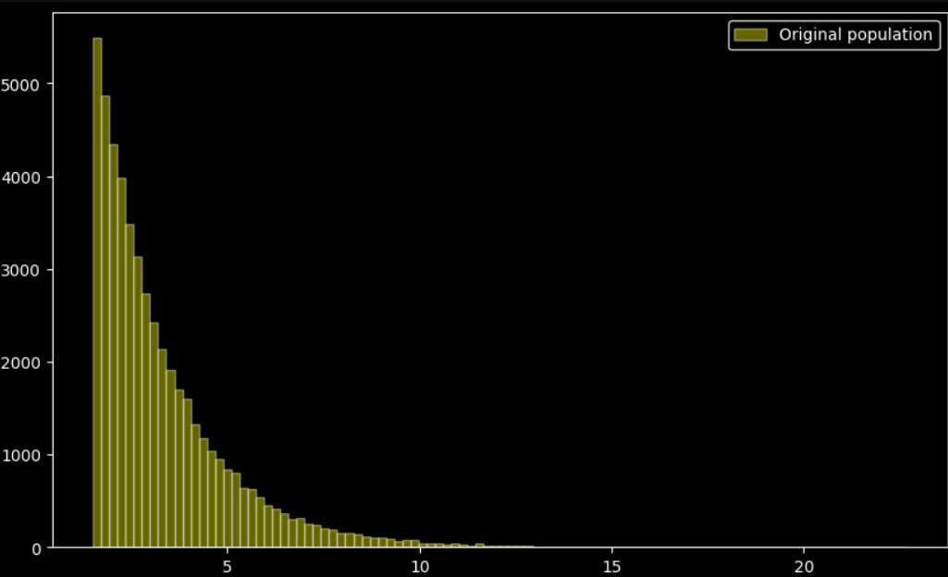
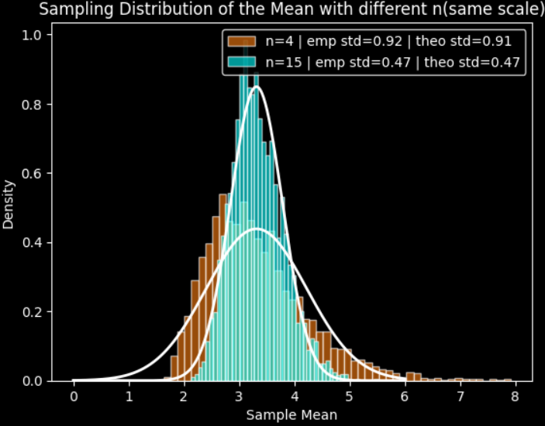
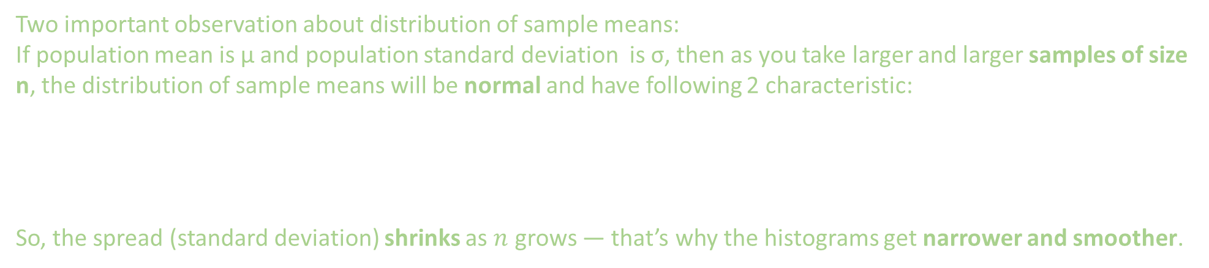
Central Limit Theorem (CLT): The Essence
Two important observation about distribution of sample means:
If population mean is μ and population standard deviation is σ, then as you take larger and larger samples of size n, the distribution of sample means will be normal and have following 2 characteristic:
So, the spread (standard deviation) shrinks as $n$ grows — that’s why the histograms get narrower and smoother.

Slide 15
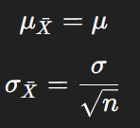
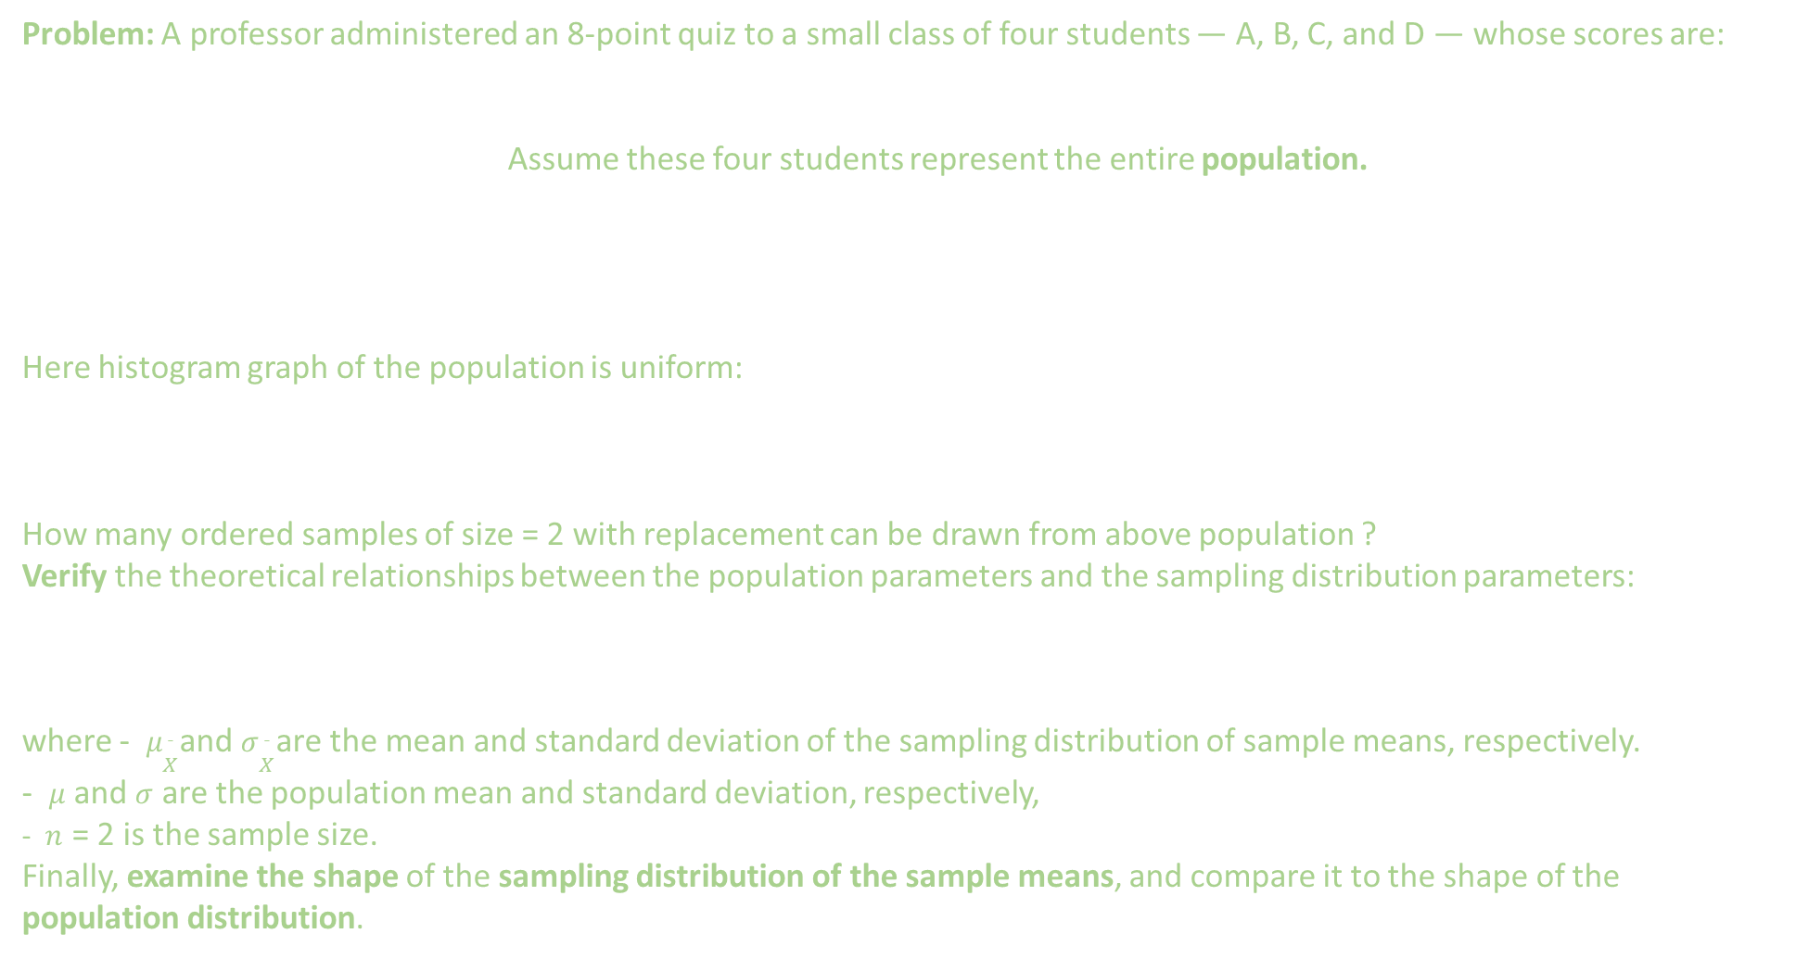
Central Limit Theorem (CLT): Application
Problem: A professor administered an 8-point quiz to a small class of four students — A, B, C, and D — whose scores are:
Assume these four students represent the entire population.
Here histogram graph of the population is uniform:
How many ordered samples of size = 2 with replacement can be drawn from above population ?
Verify the theoretical relationships between the population parameters and the sampling distribution parameters:
where - $μ_{\overset{ˉ}{X}}$and $σ_{\overset{ˉ}{X}}$are the mean and standard deviation of the sampling distribution of sample means, respectively.
- $μ$ and $σ$ are the population mean and standard deviation, respectively,
- $n$ = 2 is the sample size.
Finally, examine the shape of the sampling distribution of the sample means, and compare it to the shape of the population distribution.
Student | Score
A | 2
B | 6
C | 4
D | 8

Slide 16
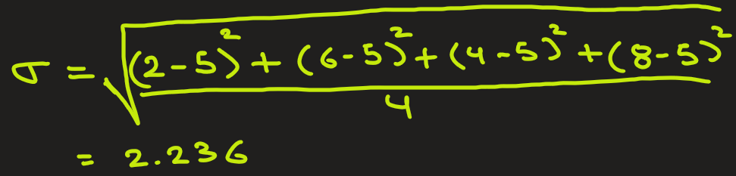

Central Limit Theorem (CLT): Application
Ans:
Here the population is [2, 6, 4, 8]. These are scores of students.
The mean of the population $μ$ is (2+6+4+8) / 4 = 5.0
The standard deviation of the population σ is
Now, if all ordered samples of size 2 are taken with replacement and the mean of each sample is found, the distribution of the samples would be as shown:
The sample means are [2, 3, 4, 5, 3, 4, 5, 6, 4, 5, 6, 7, 5, 6, 7, 8]

Slide 17
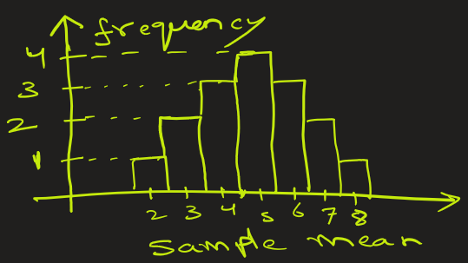
Central Limit Theorem (CLT): Application
A frequency distribution of sample means is as follows
From this we can draw the graph of the sample means which is a Bell curve(i.e. Normal) as shown:
Sample Mean | Frequency
2 | 1
3 | 2
4 | 3
5 | 4
6 | 3
7 | 2
8 | 1

Slide 18
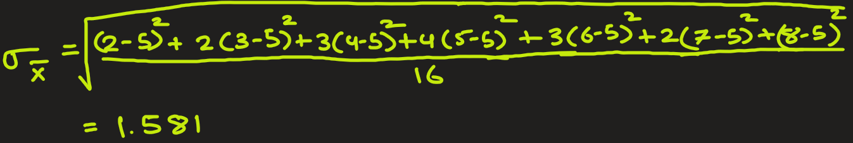
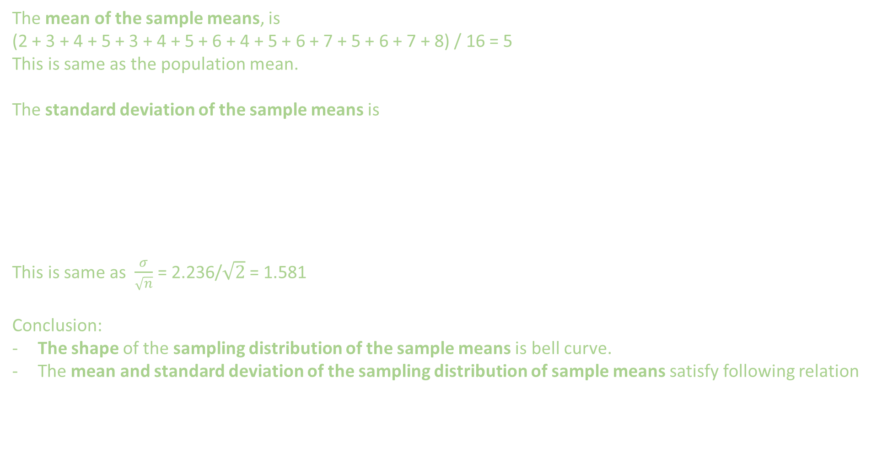
Central Limit Theorem (CLT): Application
The mean of the sample means, is
(2 + 3 + 4 + 5 + 3 + 4 + 5 + 6 + 4 + 5 + 6 + 7 + 5 + 6 + 7 + 8) / 16 = 5
This is same as the population mean.
The standard deviation of the sample means is
This is same as $\frac{σ}{\sqrt{n}}$ = 2.236/$\sqrt{2}$ = 1.581
Conclusion:
The shape of the sampling distribution of the sample means is bell curve.
The mean and standard deviation of the sampling distribution of sample means satisfy following relation

Slide 19

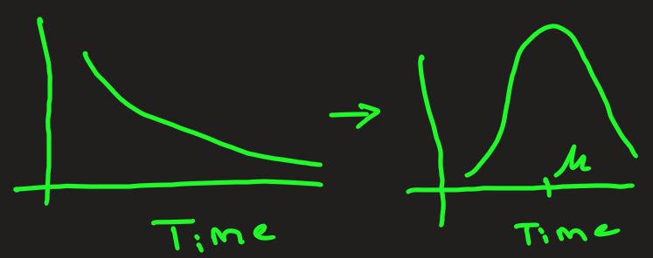
Central Limit Theorem (CLT): Application
Example:
Imagine a factory that produces light bulbs.
Each light bulb has a lifetime (in hours), and they want to determine average lifetime of bulbs.
But it’s impossible to test every single bulb — that would destroy them all!
So, instead, the quality control team takes samples — say, 30 bulbs each day — and measures their lifetimes.
Even though, the population distribution of lifetimes might be skewed (some bulbs last much longer than average, some much shorter), the Central Limit Theorem says that if enough samples are taken, say maybe for 50 days, the distribution of sample means (average lifetimes from those 30 bulbs) will be approximately normal.
Because of CLT, the company can use the normal distribution to make predictions about average lifetime.
They can calculate confidence intervals and perform hypothesis tests on the average bulb life.
Without CLT, we’d need to know the true population distribution (which we almost never do).

Slide 20
EXTRA

Slide 21
Example:
Suppose the population is daily spending by customers at a store:
It’s highly skewed because a few people spend a LOT.
Mean daily spending: $50, variance: known.
Now:
Take 1 random customer → that spending is not normal.
But take a sample of 100 customers, find the average spending → that average is nearly normally distributed.
If you repeat this process (many samples of 100), the histogram of those averages will look bell-shaped, centered at the true mean ($50).

