Slide 2
NL
Generate report on profit
Let’s understand single agent first and its limitations:
SA relies on one LLM or tool to perform all tasks sequentially.
SA work well for simple workflows.
Example: Natural Language to PDF Report Generator
Here a single agent is sufficient to handle this whole workflow because
The workflow is strictly linear. Every step depends on the previous one:
SQL Statement
Tool1
Execute SQL
Tool2
Summarize
Tool3
PDF Report
Tool4

Slide 3
3 Challenges of Single-Agent Systems:
A) Tool Overload:
1. Handling numerous tools can confuse decision-making.
2. Incorrect decisions in tool selection can cascade, causing failures in subsequent steps.
Empirical observations suggest that a sweet spot exists for single agent tool usage: 5-10 tools.
fetch_user_profile
Agent
has 15 tools like,
fetch_user_profile
query_customer_database
query_customer_database
Agents may struggle and end up using wrong tool:
Using fetch_user_profile intead of query_customer_database

Slide 4
B) Contextual Limitations: In SA system, LLMs struggle to maintain effective performance when overloaded with growing context. LLM have a finite context window, which determines how much information they can process at once.
If the agent’s contextual memory is overwhelmed by the growing number of tasks, tool outputs, and user interactions, then this leads to performance drop
Example: Imagine an agent interacting with a user and calling tools to:
1. Retrieve data - Consumes 10K tokens
2. Analyze it - Consumes 30K tokens
3. Generate a report - Consumes 40K token
By the time it reaches step 3, the LLM may have lost critical details from step 1 due to context overflow, resulting in flawed outputs.
Retrieve Data
Analyze Data
Generate Report

Slide 5
C) Specialization Deficiency:
A single agent cannot excel in diverse tasks requiring varied expertise.
Example: A user needs an AI assistant to:
Plan a project timeline.
Write a Python script for automation.
Generate a financial forecast.
A single agent may struggle to excel in all three areas simultaneously, leading to suboptimal results.
Plan Project Timeline
Write Python script
Generate Financial Forecast

Slide 6
Multi-Agent Systems - MAS
MAS is a framework that allows - multiple AI agents to collaborate to solve problems
Agent1
Single Agent
Agent2
Agent3
Agent4

Slide 7
MAS framework solves the problems that SA cannot effectively handle:
Problem (Latency) -> Single Agent is taking too much time. The task can be parallelized.
Solution -> Split single agent into multiple agent. Each agent can work in parallel
Example — Fraud detection at a bank
A transaction comes in.
The bank needs to simultaneously
check the customer's history , ~40ms
score the transaction for fraud patterns, ~60ms
verify telephone against a blacklist. ~20ms
Then the banks makes the decision. In SA, total time=120ms
Fraud Detection
Agent1- History
Single Agent
Agent1 – Fraud Score
Agent1 – Blacklist verify
Agent1- Decision

Slide 8
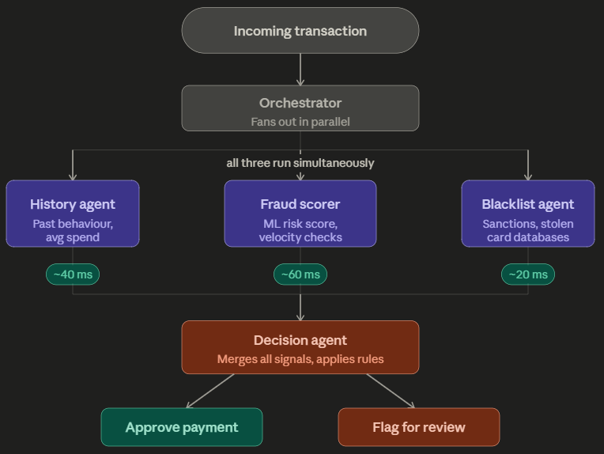
MAS:
Here
Total latency = ~60 ms (the slowest agent)
Latency wins

Slide 9
Problem -> Data privacy requires that step2 should not see the PII ( Personal Identifiable Information ) generated from step1. Single Agent cannot do this
Solution -> Split single agent into 2 agent. Agent 1 handles sensitive data, and sanitizes the output and then gives it to Agent 2.
Agent1
Single Agent
Agent2

Slide 10
Example — AI-powered hiring pipeline
A resume arrives.
One agent extracts skills and experience.
Another agent checks for bias in the language used by the recruiter's job description.
A third agent matches the candidate against the role.
The bias checker must never see the candidate's name or demographic signals — it only reads the job description.
This is a permissions problem.
A single agent that handles everything would be impossible to audit and legally risky.

Slide 11
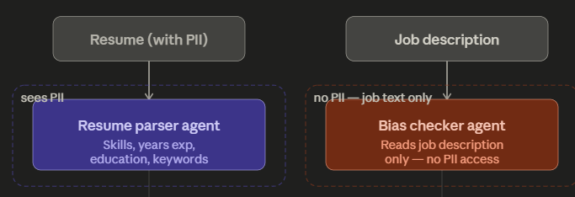
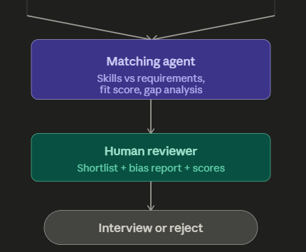
The Bias Checker agent is legally and architecturally forbidden from seeing the candidate's name, age, or any demographic signal — it only ever receives the job description text.
You cannot enforce that boundary inside a single agent that holds all the data. Separate agents with separate data inputs is the only auditable solution

Slide 12
Example — Autonomous investment research report
A fund manager asks:
"Give me a full report on Tesla before markets open."
5 things need to happen:
scrape today's news,
pull the latest financials,
check SEC filings,
get analyst sentiment, and
write the report.

Slide 13
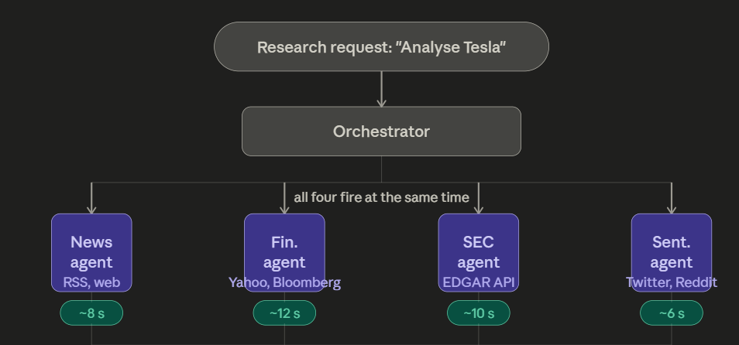
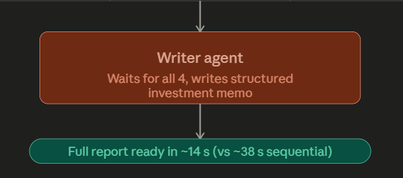
Latency -> Total time
= slowest agent(~12 s) + writing time (~2 s)
= ~14 seconds.
Scale -> 4 external APIs firing simult.

Slide 14
MAS several benefits over systems consisting of a single AI agent:
MAS are capable of taking on more complex tasks: A key reason for this is that agents in MAS can learn from the behavior of other agents as well as their environment.
MAS are modular and hence scalable – additional agents can be instantiated if the existing system isn’t up to the task, or can’t cope with growing demand.

Slide 15
When you genuinely need multiple agents ?
Situation | Why multi-agent helps
Tasks can run in parallel | Agent A fetches data while Agent B queries an API simultaneously
Agents need different models | Analyst uses GPT-4o, Reporter uses a fine-tuned summarization model
Agents have different permissions | One agent has DB write access, another is read-only
Tasks are long and independent | Research agent and writing agent work on separate subtasks
One agent validates another | A critic agent reviews and rejects the SQL agent's output

Slide 16
EXTRA
Ffnbksdfd
Fdslj;f
Fl;ds

