Slide 1
What is a Vector Database?
“Computers don’t understand text directly… they understand numbers.”
So, we convert text → numbers (called vectors)
What is a Vector?
Example:
"Machine learning is powerful“ → [0.21, -0.45, 0.78, 0.11, ..., -0.45]
“The quick brown fox jumps” -> [0.023, -0.045, 0.128, -0.011, ..., 0.087, -0.032, 0.114]
This list of numbers = vector (embedding)

Slide 2
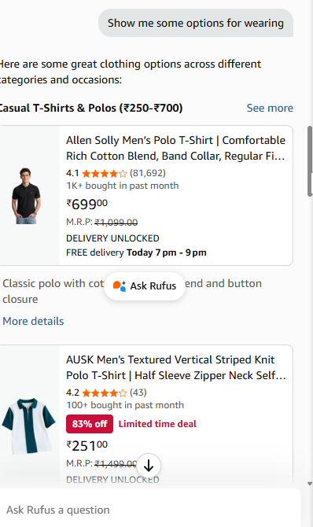
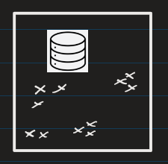
Use of Vector DB:
A Vector Database stores these vectors and helps you search similar ones quickly

Slide 3



What does it store?
Popular Vector Databases
FAISS (Facebook AI Similarity Search) – On Local Machine
Pinecone – On Cloud
Chroma DB, Weavite, etc.
Data | Stored As
Text | Vector (numbers)
Image | Vector
Audio | Vector

Slide 4
Why we need it
Fast similarity search
Works with meaning, not keywords: Cars could automobile, 4 wheelers, transport, etc.
This is the core component of RAG systems

Slide 5
Problem with normal search
Keyword search:
If you perform normal search on "car“
Results would be articles containing:
car insurance ✅
car repair ✅
car tires ✅
But a normal search would miss out
automobile ❌ (missed!)
4-wheeler ❌ (missed!)
ride ❌ (missed!)
Toyota ❌ (missed!)

Slide 6
What is Semantic Search?
Semantic Search:
Search based on meaning, not exact words
Search: "car"
Results would be :
car
automobile
Vehicle
✔ Because semantic / meanings are similar

Slide 7
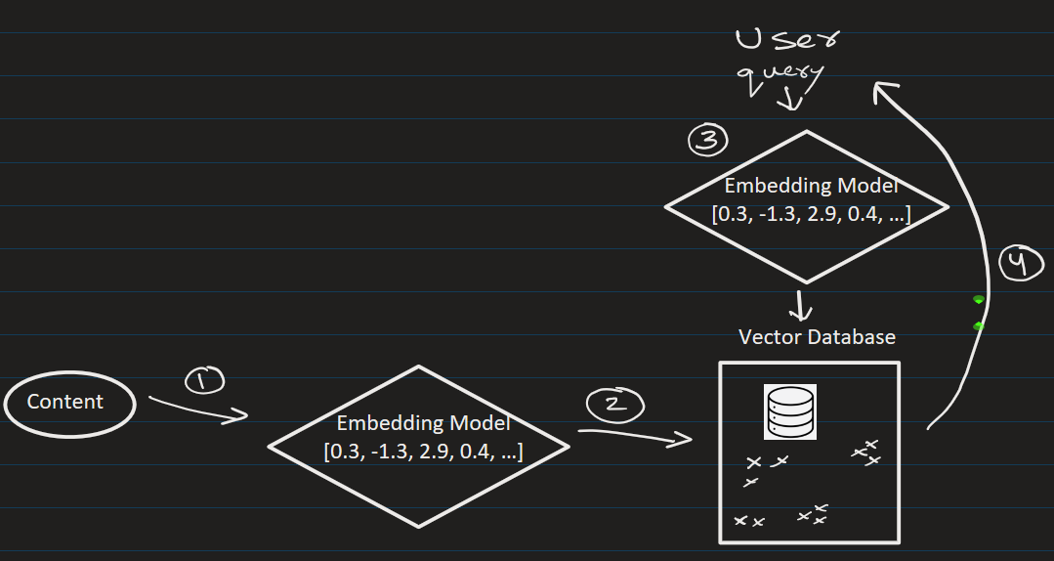








How Semantic Search works (Step-by-step)
1. We convert the content into embedded vectors
2. We store the vectors in Vector DB
3. User enters query. Convert query → vector
4. Search in Vector DB and find most similar vectors and return the result.
Example
Suppose the user query:
"best laptop for coding"
Semantic search can retrieve:
"top programming laptops"
“good computers for developers”
Even though words are different ✅

Slide 8
Where This is Used
Chatbots (like ChatGPT, or amazon)
Document search
Recommendation systems
RAG pipelines

Slide 9
Common Vector DB as of today:
FAISS
Can be done locally. (See the jupyter notebook)

Slide 10
Common Vector DB as of today:
Pine Vector DB:
User need to login (free)
Get API Key and use it (Look at docs on how to use API keys with python code)
You can have up to 5 index for free. (See the jupyter notebook)

Slide 11
FAISS vs Pinecone:
Feature | FAISS | Pinecone
Setup | Local | Cloud
Scaling | Manual | Automatic
Use Case | Learning / small apps | Production systems

Slide 13
EXTRA
Ffnbksdfd
Fdslj;f
Fl;ds

