Slide 1
Create Oracle Cloud Account
Create a free account on:
Oracle Cloud : https: //www.oracle.com/cloud
During registration , candidates would need:
Email address
Mobile number
Credit/debit card for verification
NOTE:
Oracle verifies identity using a card but does not charge for Free Tier usage within limits.

Slide 2
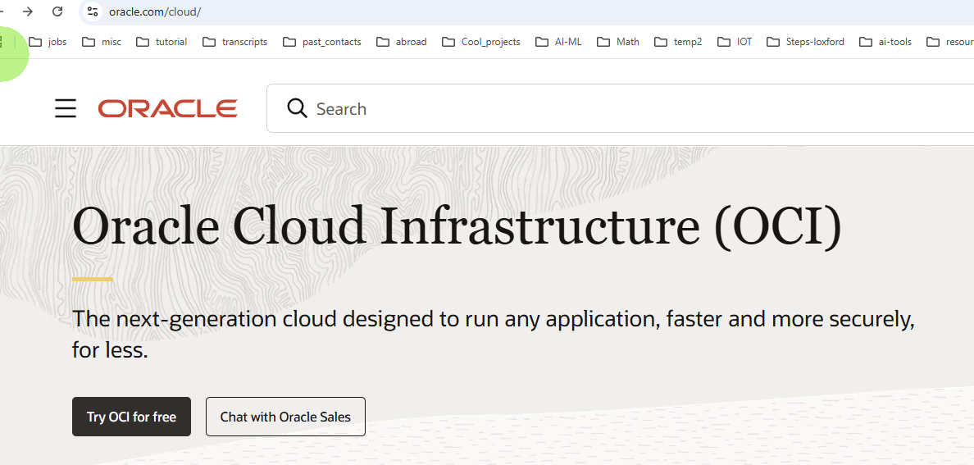


Slide 3
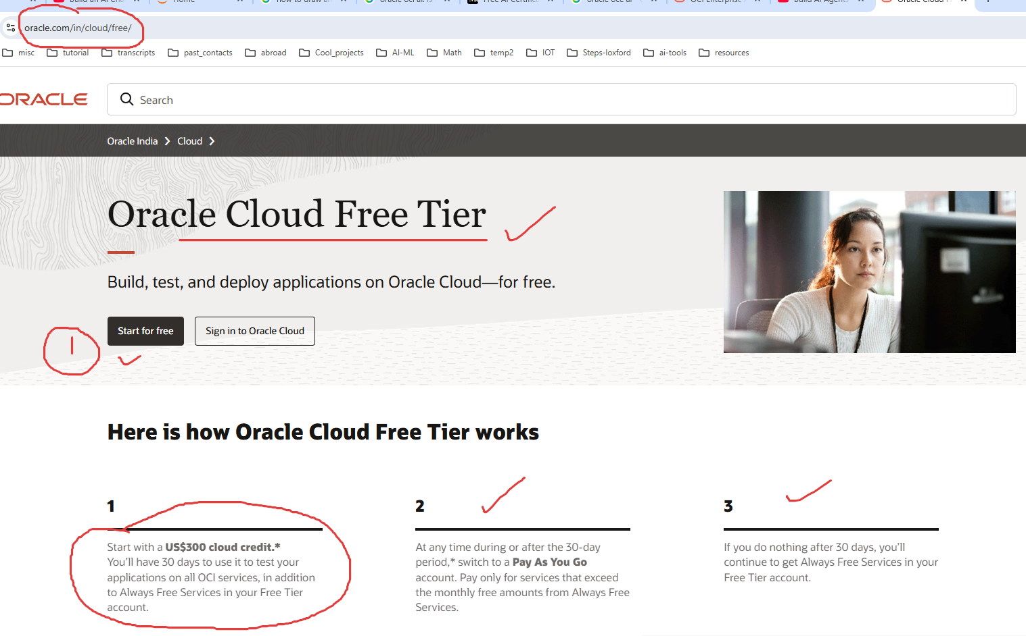

Slide 4
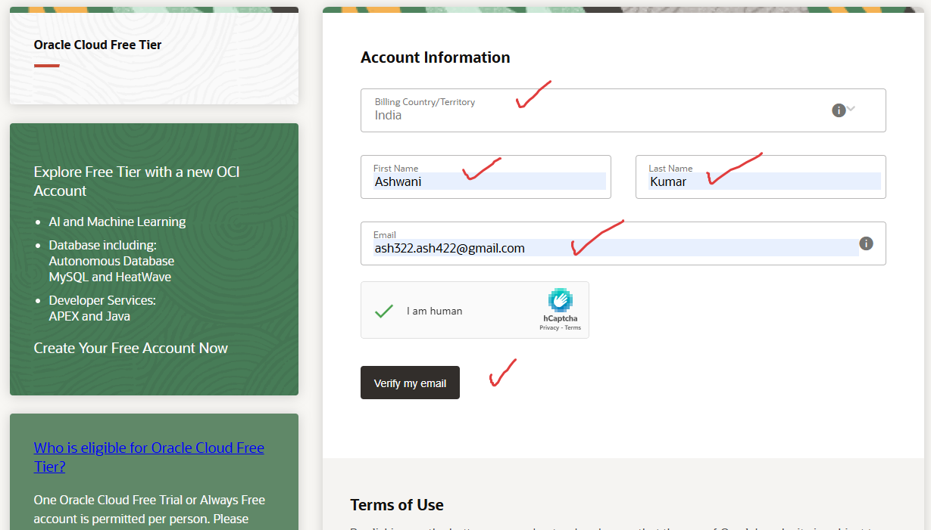

Slide 5
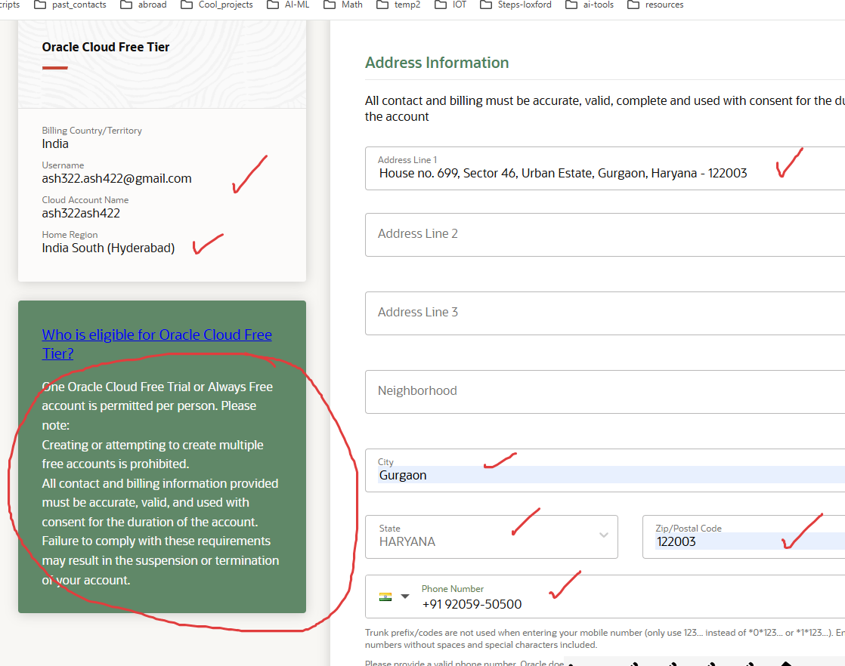

Slide 6
Enter your credit / debit card info here

Slide 7
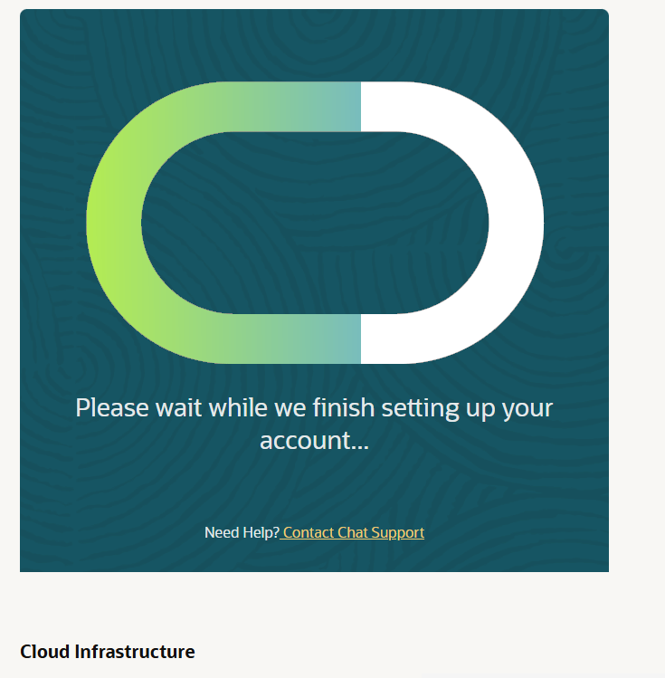
It will take 15 minutes for account to get setup

Slide 8
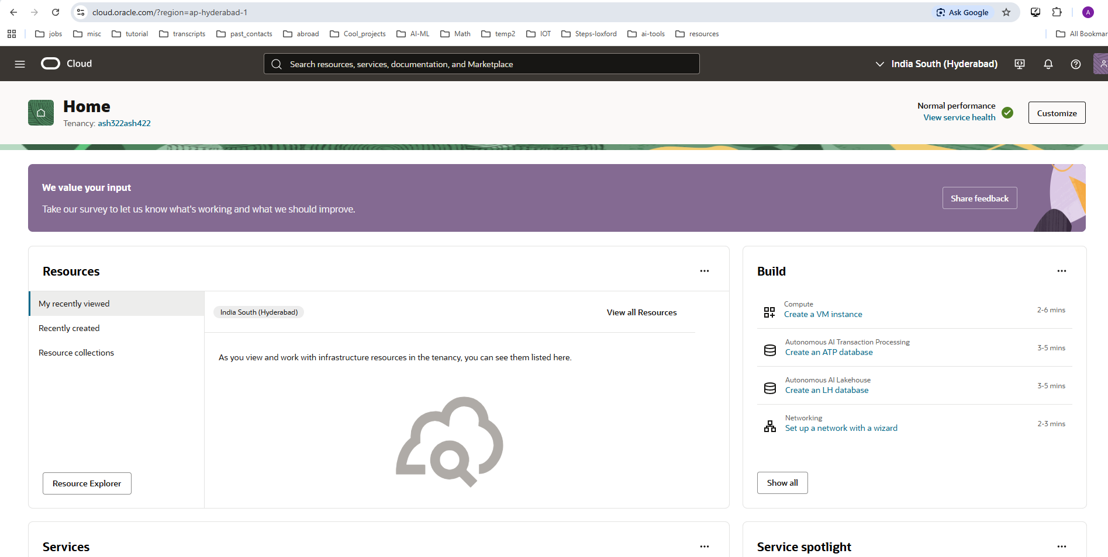
After account set up and log in.

