Slide 1
Creating Compartments

Slide 2
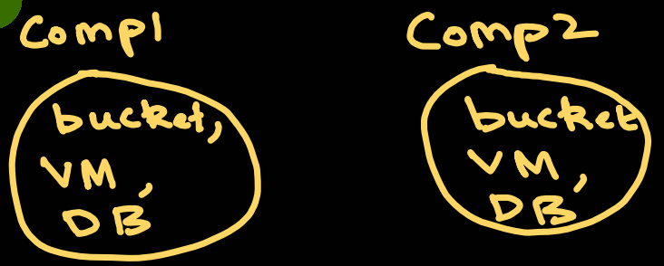
What is a Compartment in OCI ?
In Oracle Cloud Infrastructure (OCI), a compartment is a secure, logical container used to organize and isolate your cloud resources - like
buckets,
virtual machines, and
databases
Key Characteristics
Security Boundaries: You apply access policies to a compartment to control exactly which users can see or modify the resources inside it.
Hierarchical Structure: Compartments can be nested inside other compartments, much like subfolders on your computer.
The Root Compartment: Every OCI account has a default main compartment (named after your tenancy) that acts as the root folder for everything

Slide 3
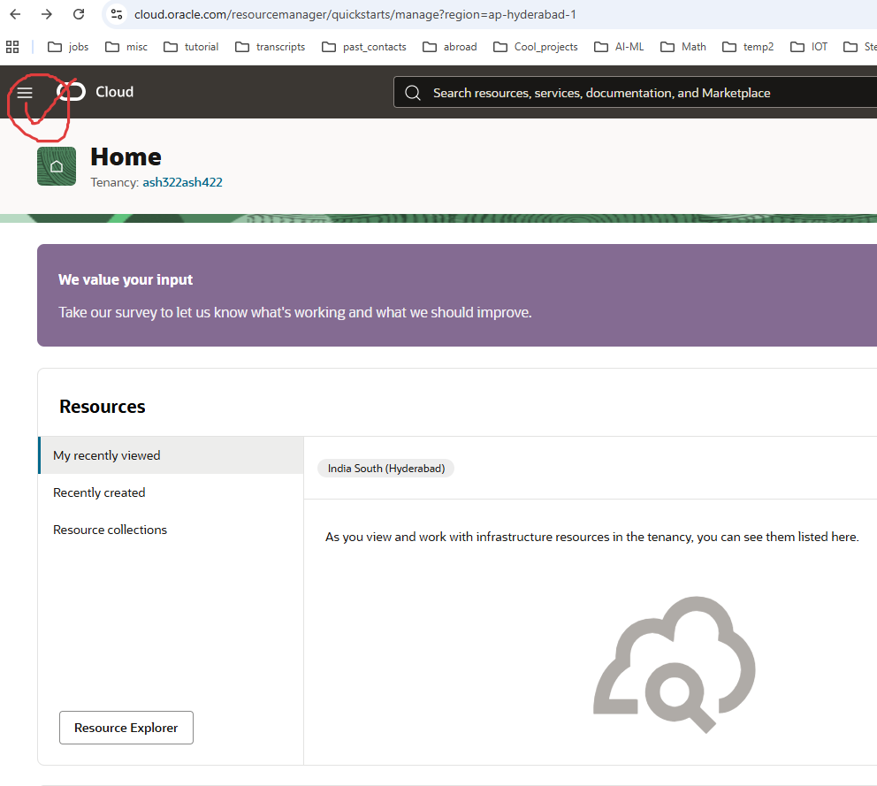

Slide 4
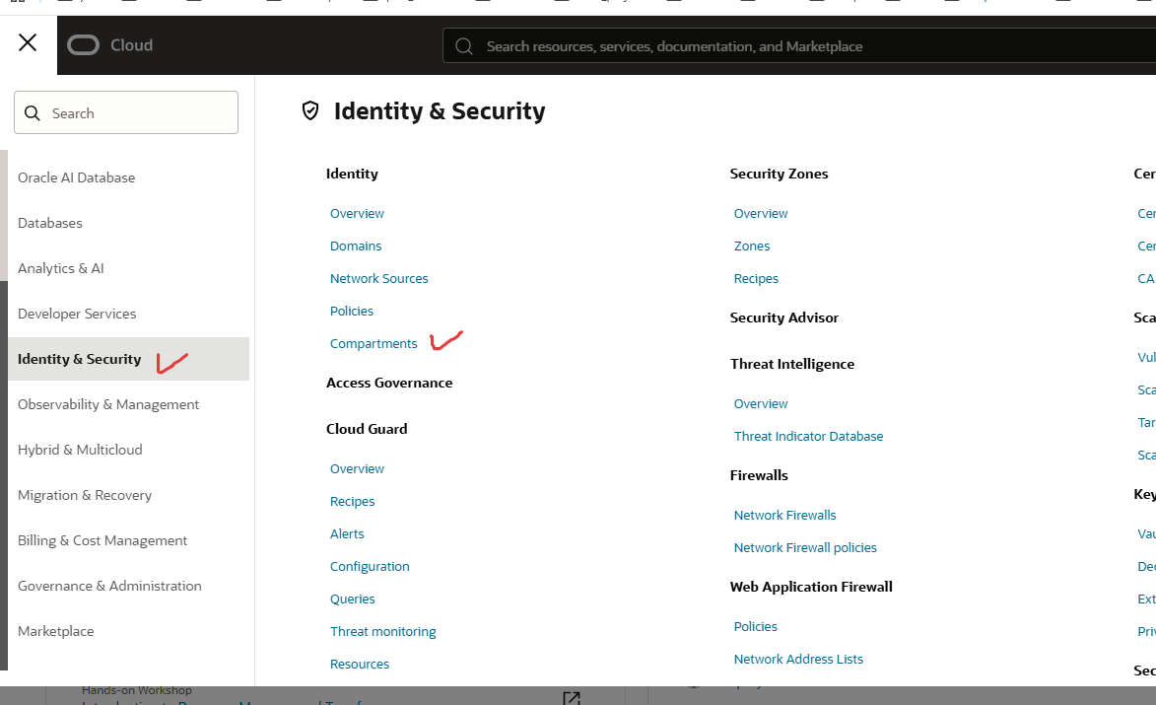

Slide 5
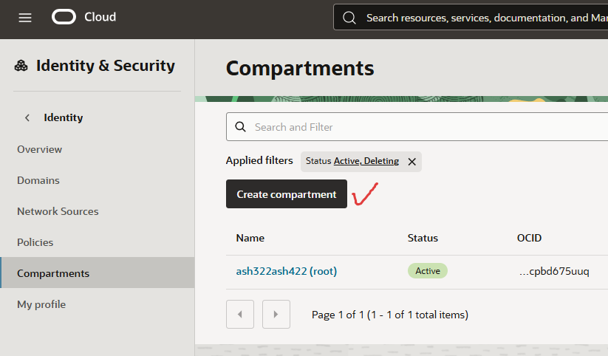

Slide 6
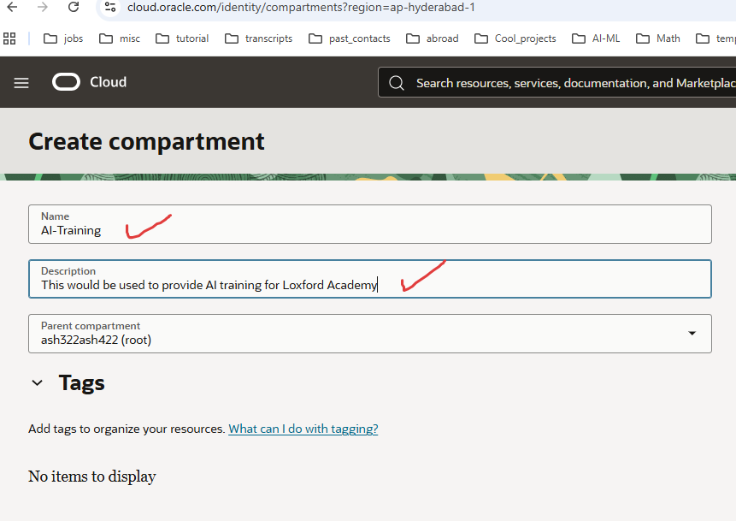





Slide 7
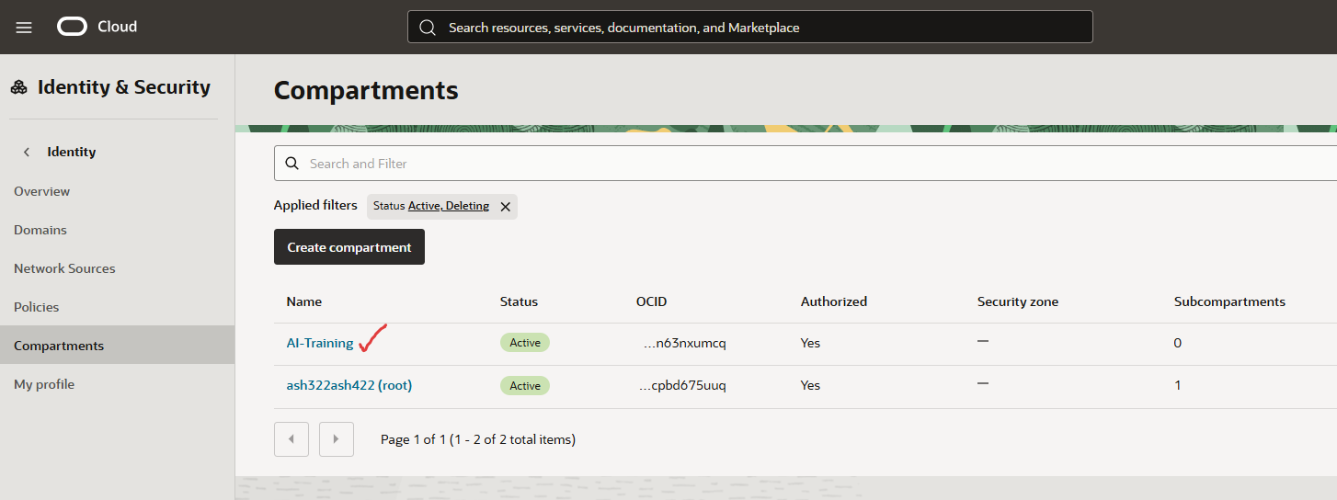





Slide 8


