Slide 1
Creating Buckets

Slide 2
In cloud computing, a bucket is a logical cloud folder used to store
files,
images,
videos, and
datasets.
In Oracle Cloud Infrastructure (OCI), buckets are the core component of Object Storage.

Slide 3
Bucket Are Needed
1) For The OCI Console UI:
If you are testing text extraction manually in the Oracle Cloud Console, the interface will require you to click "Select to change output location" and designate an Object Storage bucket before it runs the extraction.
2) For Batch / Asynchronous Jobs:
If you are processing multiple documents at once, handling very large files, or using the CreateProcessorJob API, you must set up an OCI Object Storage bucket as your output location.
Why: The AI service processes the files in the background and saves the final data extraction directly as a .json file in your bucket.

Slide 4
Buckets Are Not Needed For Single Documents / Real-time Rest APIs:
If you are extracting text from a single file in real time using the synchronous AnalyzeDocument API, you do not need an output storage location.
Why: The document is passed inline (often encoded as Base64). The service processes it immediately and returns the extracted text directly inside the API response body

Slide 5
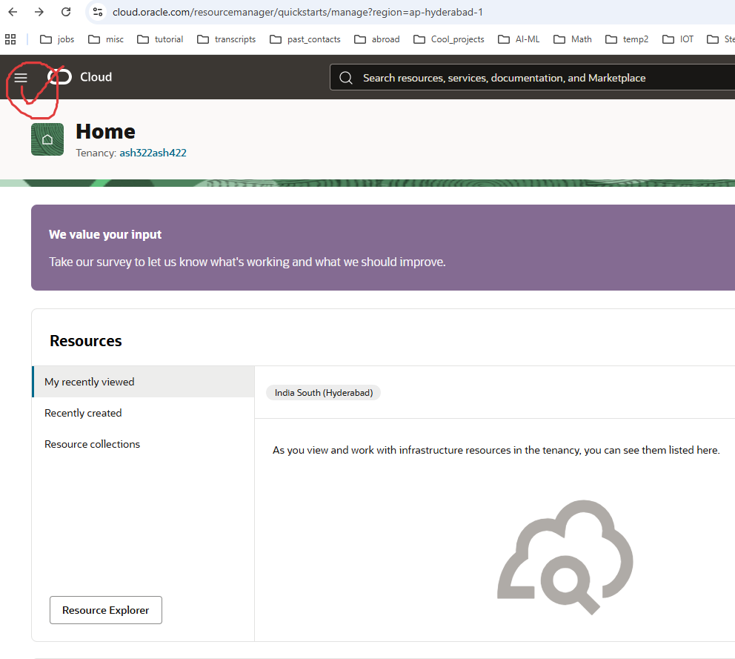

Slide 6
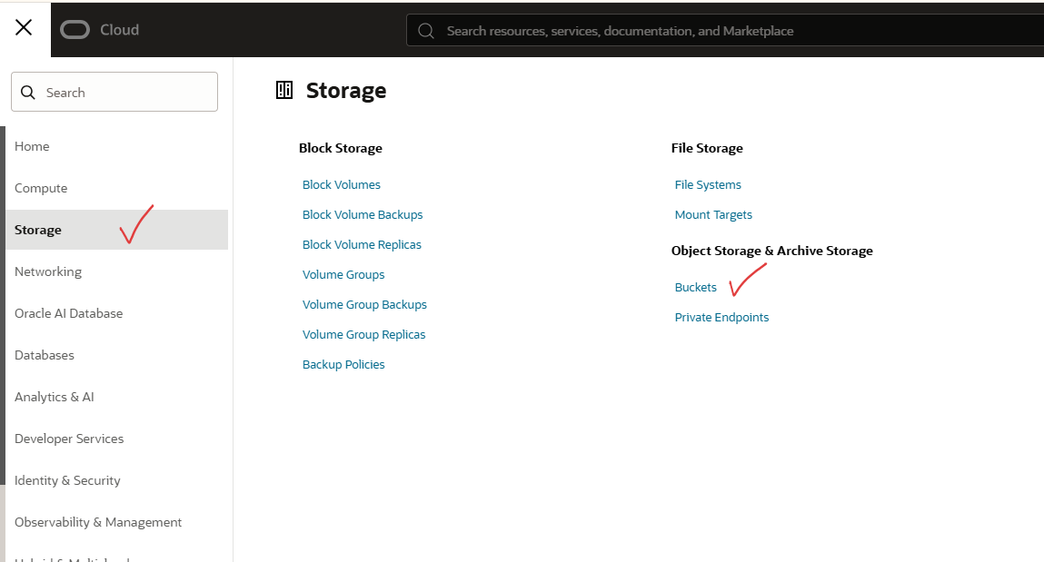

Slide 7
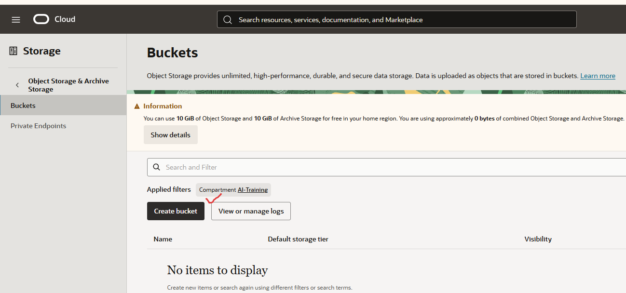

Slide 8
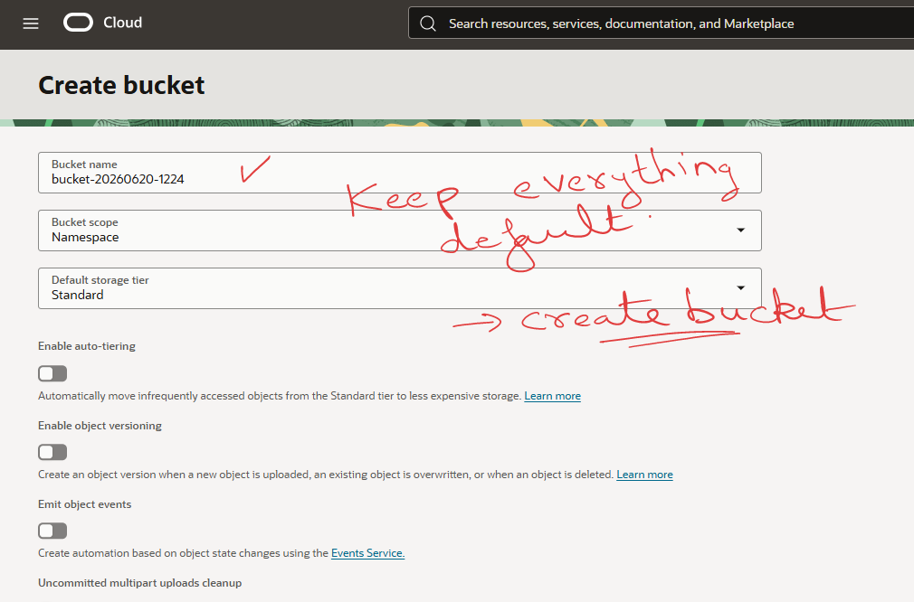

Slide 9
