Slide 1
Document Understanding Using AI

Slide 2
Document Understanding Demo
Navigate
Analytics and AI → Document Understanding
You will see :
Text Extraction
Table Extraction
Key Value Extraction
Document Classification, etc.

Slide 3
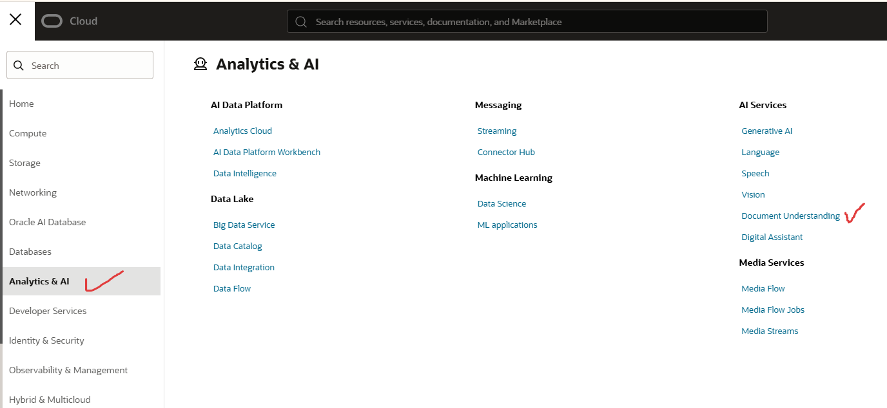

Slide 4
Text Extraction

Slide 5
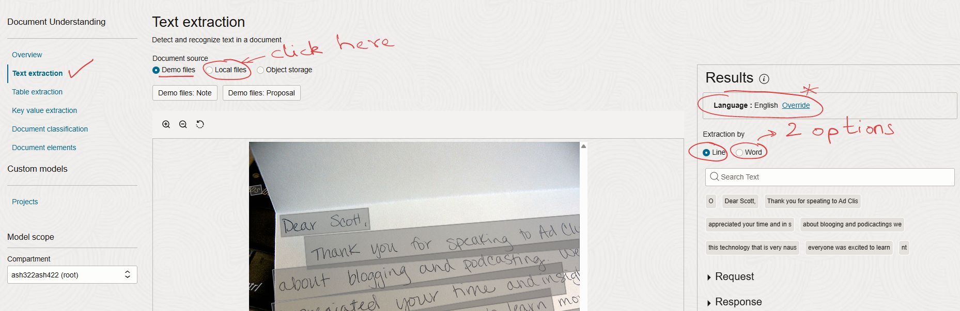

Slide 6
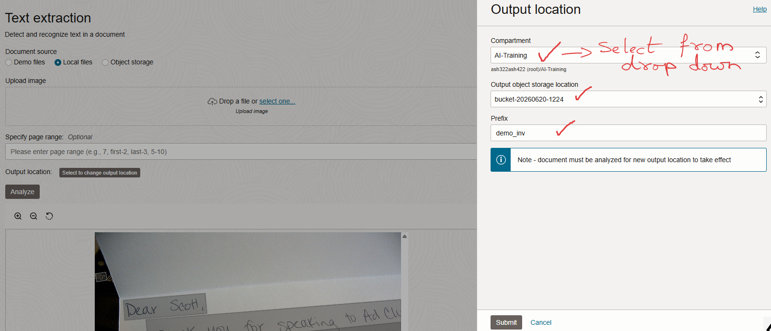

Slide 7
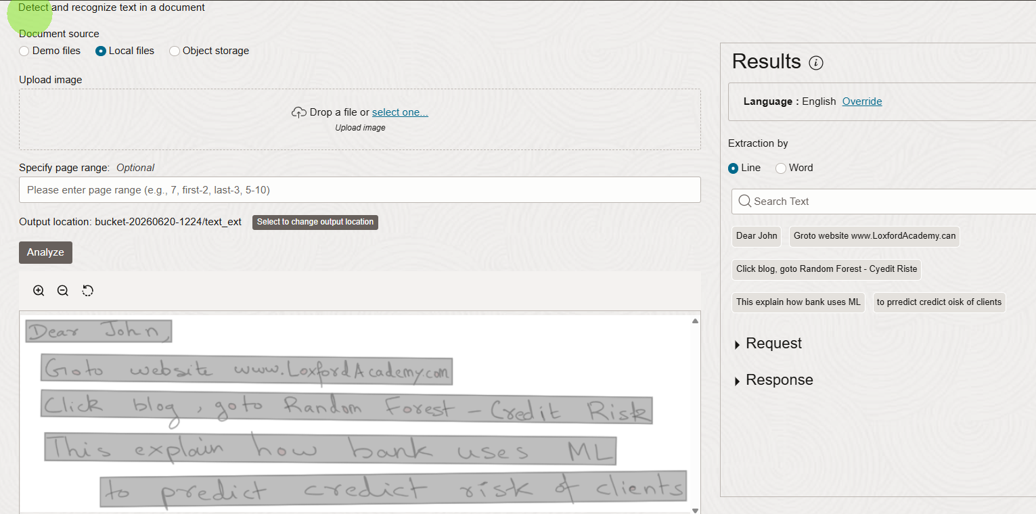


The text would appear on the right-hand side

Slide 8
Table Extraction

Slide 9
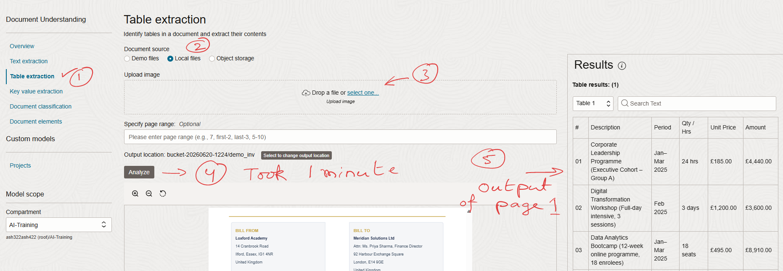

Slide 10
Key Value Extraction

Slide 11
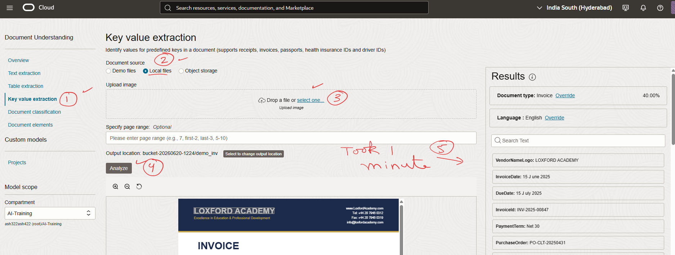

Slide 12
Document Classification

Slide 13
