Slide 1
AI Service - Language

Slide 2
OCI Language is a serverless, pre-trained AI service used to analyze unstructured text and extract insights without requiring any machine learning expertise.
You simply feed it text ,such as
customer reviews,
support tickets, or
Emails
and it processes the language instantly via REST APIs or SDKs

Slide 3
Language AI Demo
Navigate:
AI Services → Language

Slide 4
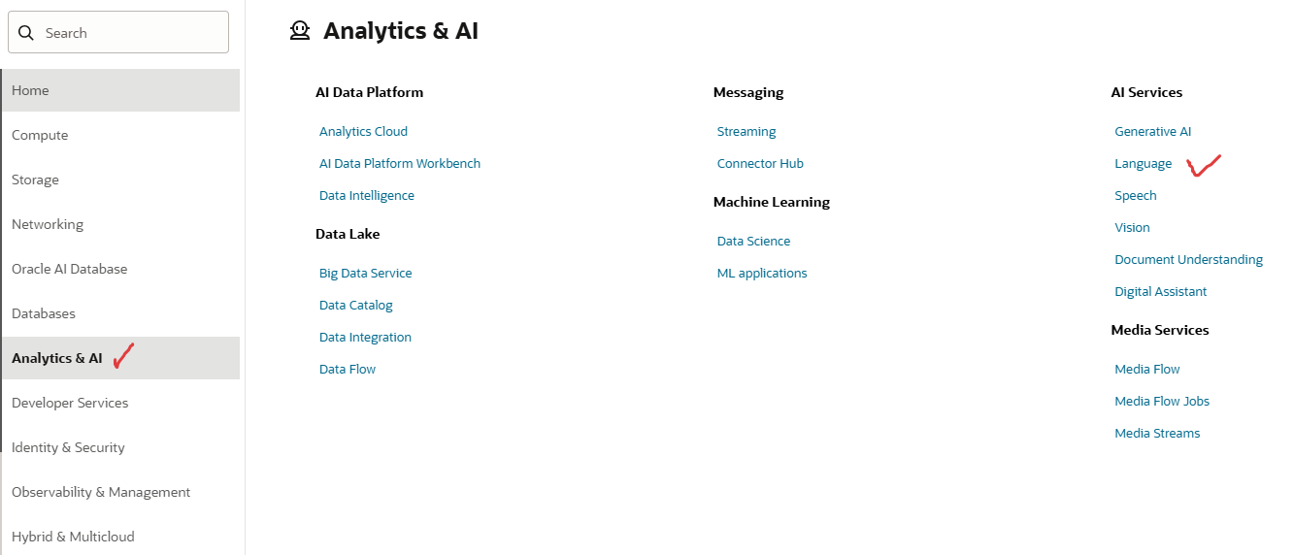

Slide 5
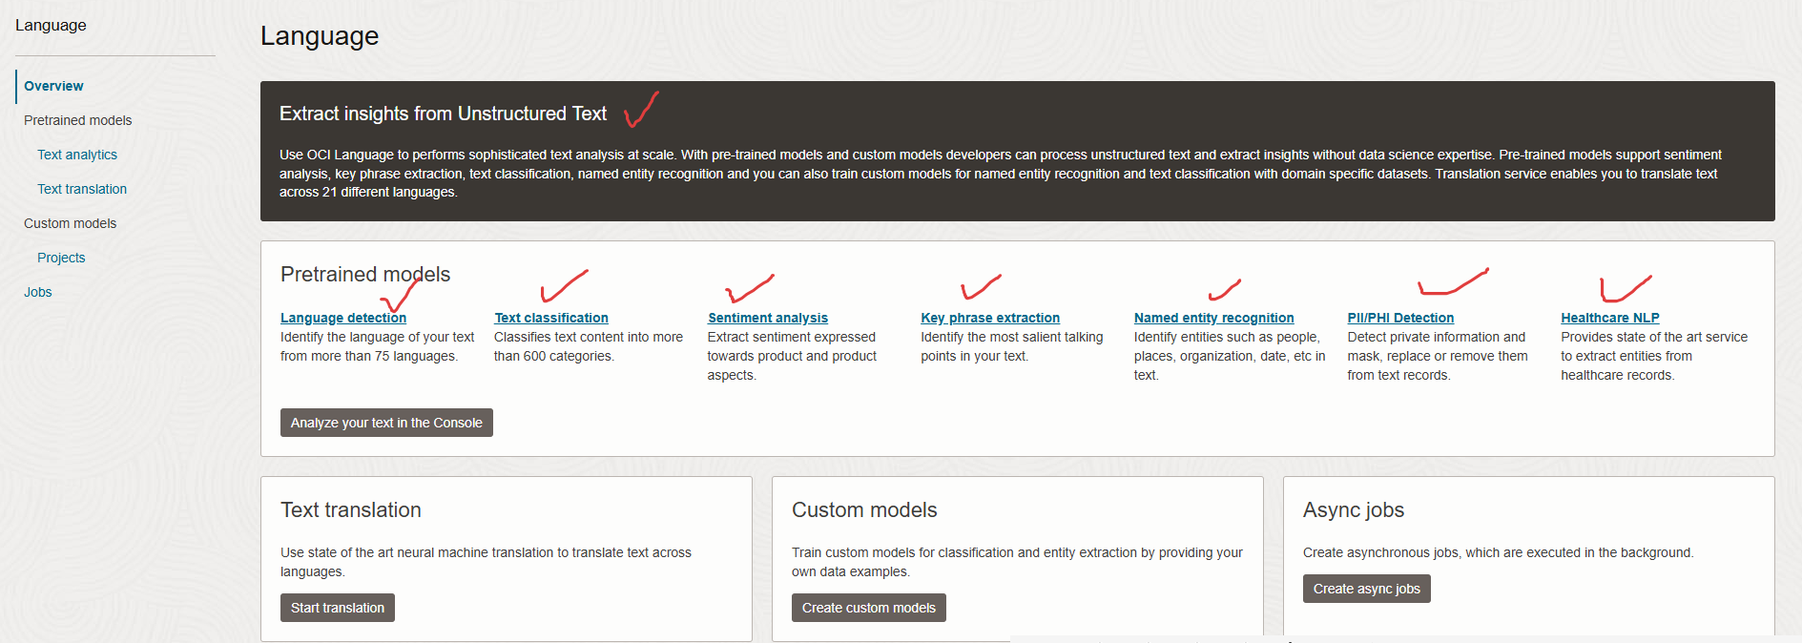
Available features:
Text Classification
Sentiment Analysis
Entity Recognition
Key Phrase Extraction
PII / PHI Detection

Slide 6
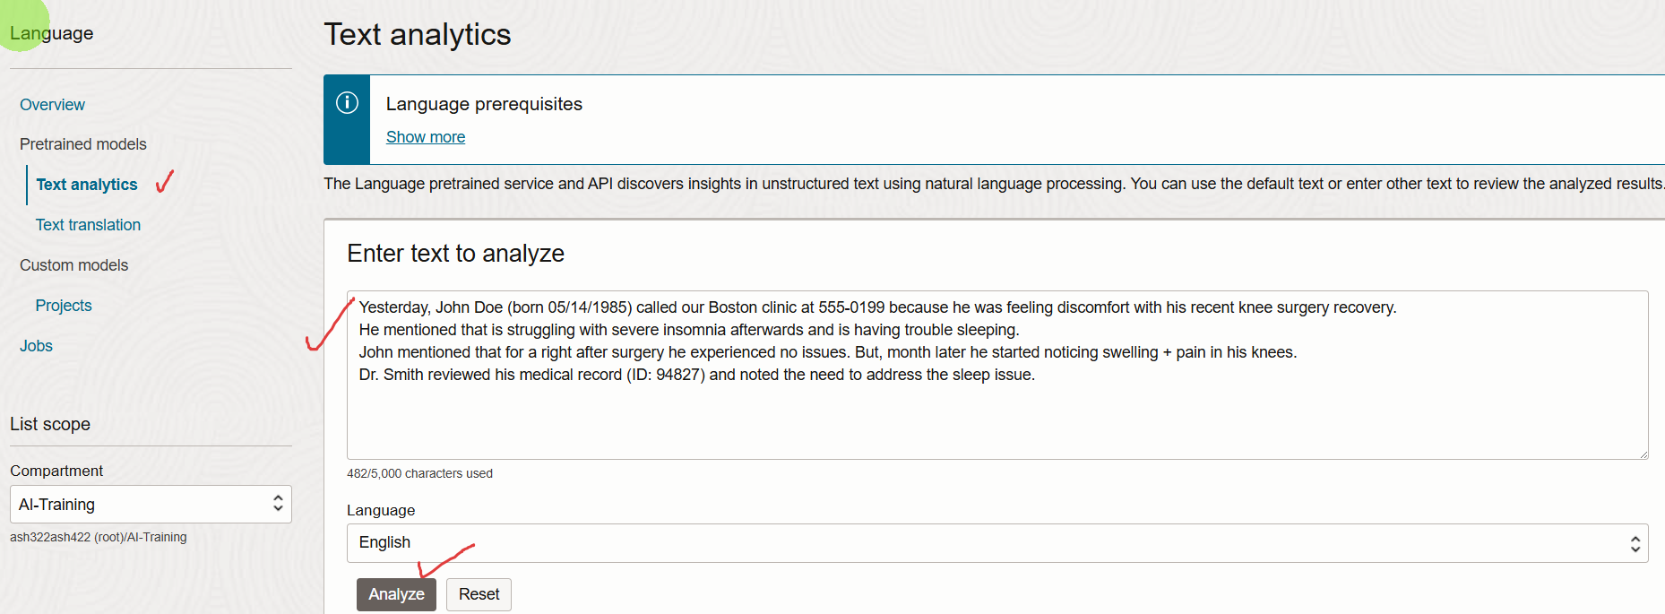
Yesterday, John Doe (born 05/14/1985) called our Boston clinic at 555-0199 because he was feeling discomfort with his recent knee surgery recovery.
He mentioned that is struggling with severe insomnia afterwards and is having trouble sleeping.
John mentioned that for a right after surgery he experienced no issues. But, month later he started noticing swelling + pain in his knees.
Dr. Smith reviewed his medical record (ID: 94827) and noted the need to address the sleep issue.

Slide 7
Output

Slide 8
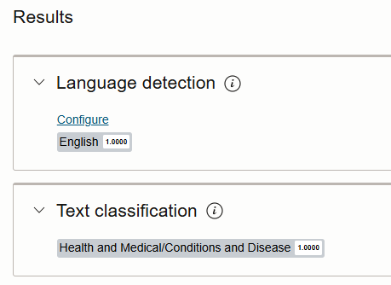




Slide 9
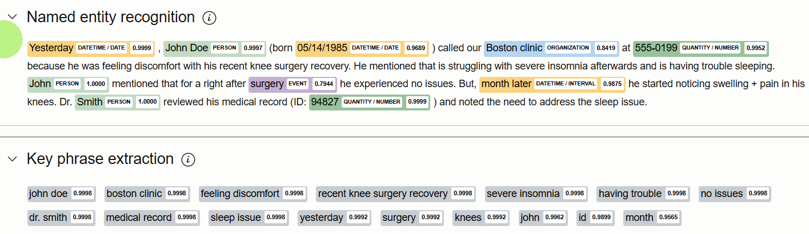



Slide 10
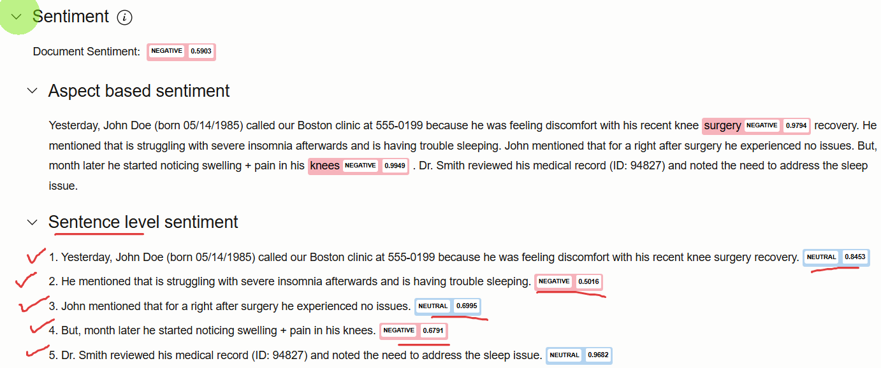

Slide 11
