Slide 1
Creating and Using the API Key

Slide 2
In Oracle Cloud Infrastructure (OCI), you need an API key to securely connect
your external custom code (Python, etc.),
local software development kits (SDKs), or
the OCI Command Line Interface (CLI)
to your cloud account.

Slide 3
Why You Need It
Secure Authentication (No Passwords): When writing code (such as a Python script calling the OCI Language service), passing your human login password over the web is highly insecure. Instead, OCI uses an asymmetric RSA Key Pair (a Private Key kept on your computer and a Public Key uploaded to OCI).
Cryptographic Signing: Your local application code uses your private key to cryptographically "sign" every single API request it sends. When Oracle receives the request, it verifies the signature against the uploaded public key to confirm that the request genuinely came from you.
Identity & Permissions Enforcement: The API key maps the code directly to your OCI User profile. This allows the Identity and Access Management (IAM) framework to confirm that you have the approved permissions to access resources, like extracting text or saving files to a bucket.

Slide 4
General Steps
1) Navigate to Profile → User Settings → API Keys
2) Generate -> API RSA Key Pair
3) Download the private key:
Create a config file as described in the OCI instruction
Your private.pem would get added here
4) Put above files in a special directory
5) Test the API key through the python code

Slide 5
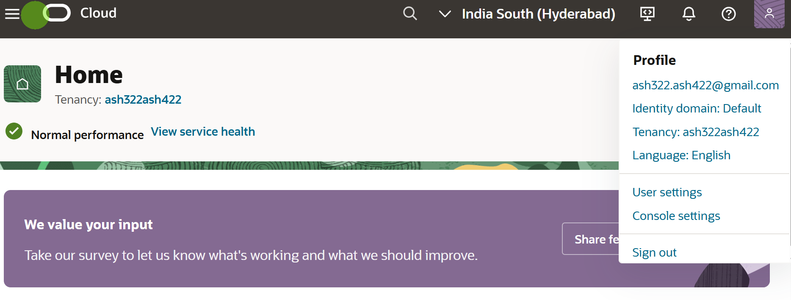


Slide 6
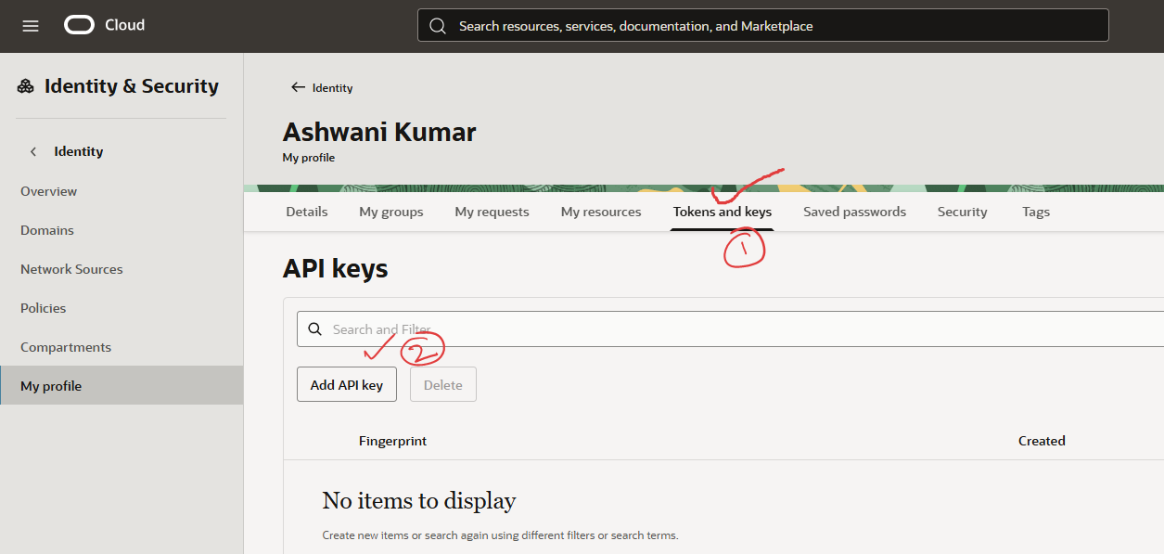

Slide 7
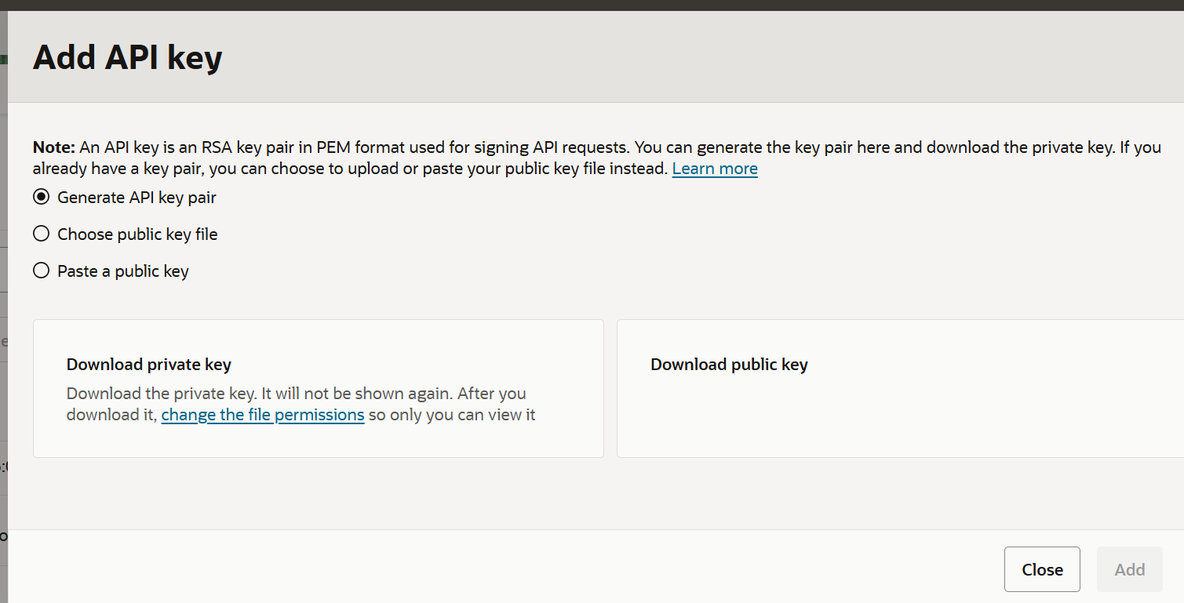



















Slide 8
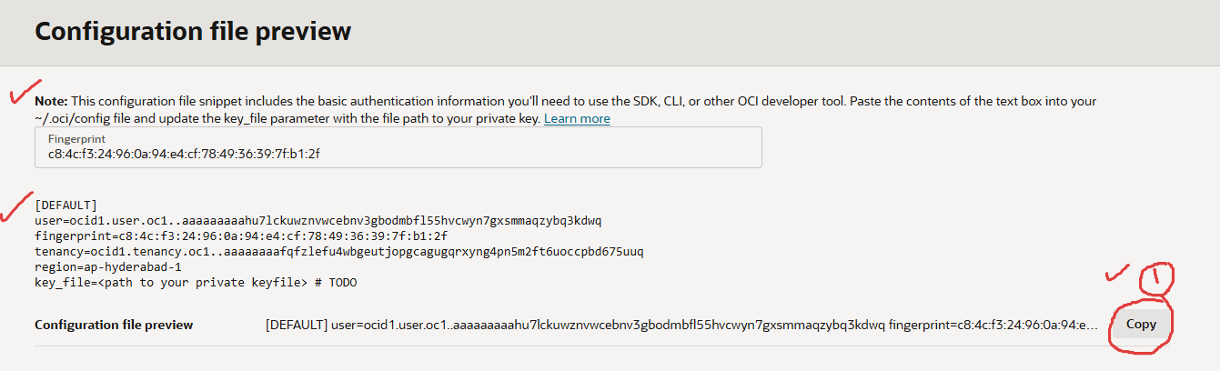

Slide 9
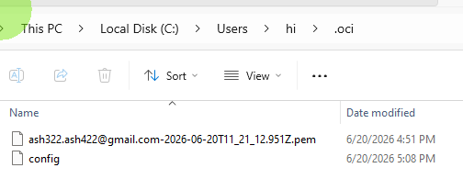
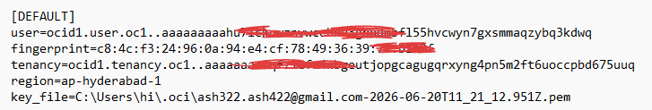
On Windows:
Create a directory named .oci inside your user profile folder
(e.g., C:\Users\YourName\.oci).
2. Move the your_key.pem in this .oci directory
3. Save your copied configuration block into a text file named config inside that folder.
4. In config file, change the key_file to path of your key file: key_file=C:\Users\YourName\.oci\your_key.pem

Slide 10
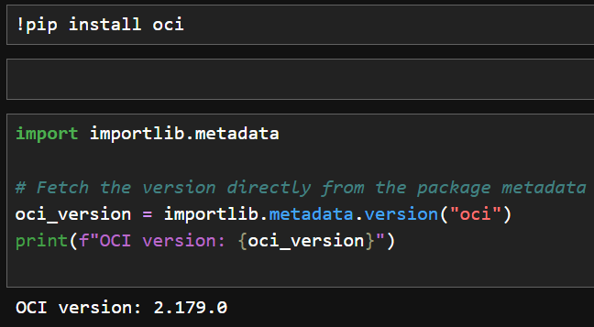

Slide 11
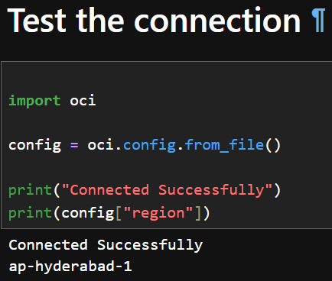

Slide 12
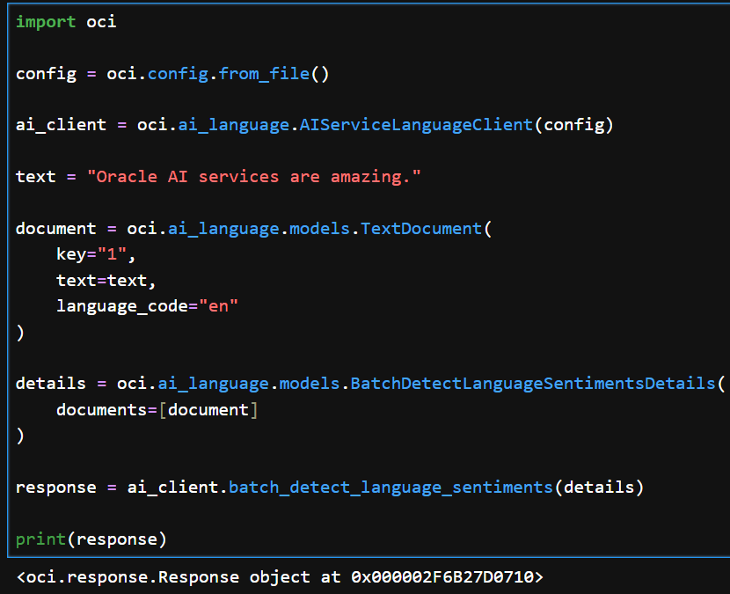







Slide 13
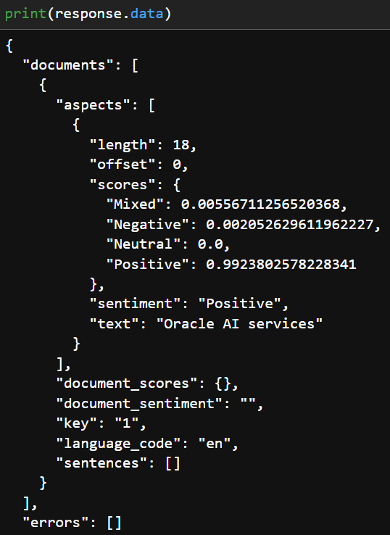



Slide 14
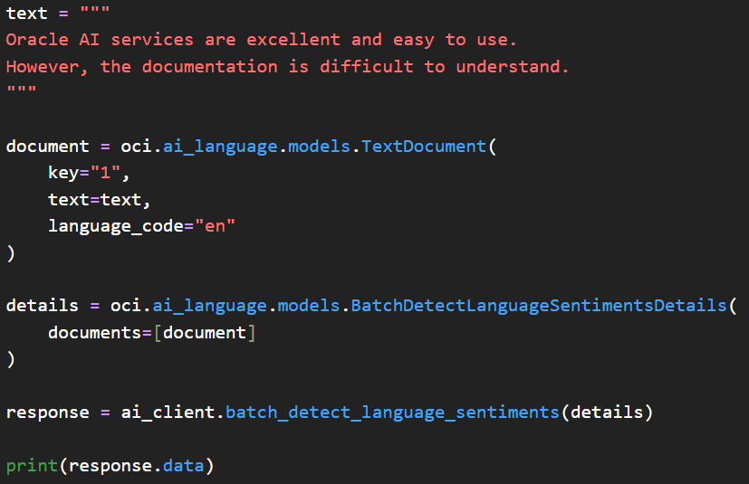





Slide 15
