Slide 1
AI Agents

Slide 3
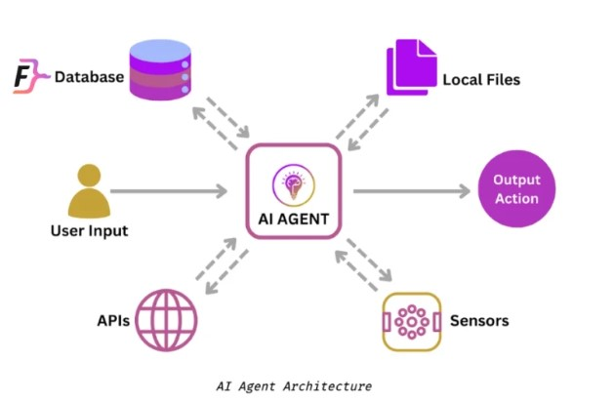
AI Agents are AI systems that can autonomously execute tasks by making decisions about tool usage and process flow. Unlike traditional automation that follows predefined paths, agents can dynamically adapt their approach based on context and intermediate results.
Agents can collaborate to achieve the goal.
AI agent are capable of executing a given task without ongoing direct human intervention. When assigned an objective, an AI agent will perceive its environment, assess the tools at its disposal, and formulate a plan to achieve its given goal.
Agents → non-linear, non-deterministic (can change from run to run)
Workflows → linear, deterministic execution paths

Slide 4
Example: booking vacations(p1)
Lets illustrate how an agent works within a context like booking a vacation.
Imagine you're trying to book a vacation. You need to research flights, find hotels, check restaurant reviews, and keep track of your budget.
Traditional workflow automation
A traditional automation system follows a predetermined sequence: it can take inputs such as dates, location, and budget, and make calls to predefined APIs in a fixed order. However, if any unexpected situations arise, such as flights being sold out, or the specified hotels being unavailable, it cannot adapt.
Input
step1
step2
step3
Output

Slide 5
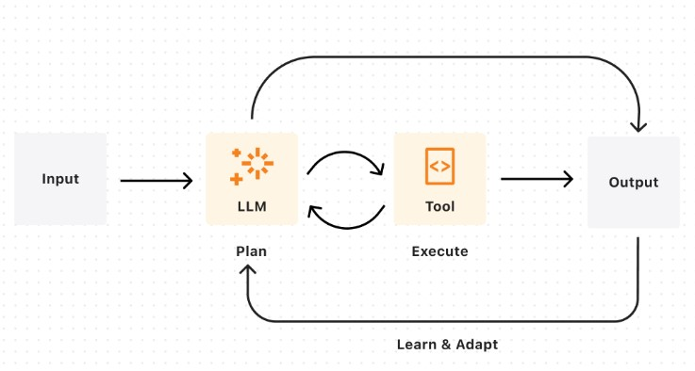
Example: booking vacations(p3)
Agent
An agent combines AI's ability to make judgements and call the relevant tools to execute the task. An agent's output will be nondeterministic given: real-time availability and pricing changes, dynamic prioritization of constraints, ability to recover from failures, and adaptive decision-making based on intermediate results. In other words, if flights or hotels are unavailable, an agent can reassess and suggest a new itinerary with altered dates or locations, and continue executing your travel booking.

Slide 6
Some examples of AI Agent(p1)
simple tasks:
agent that could help me review my emails and create tasks on a digital to-do list based on the highest priority emails coming in.
agent that uses weather data and other information to decide when to water my garden and how long to water it for.
an agent that could respond to people reporting bugs and automatically gather missing information and seek clarification on confusing parts of a bug report and then route the bug to the appropriate team to resolve.
agent could use a camera to look at a Rubik's cube and then use robotic manipulators to solve it.

Slide 7
Some examples of AI Agent(p1)
Complicated tasks:
agent also to build a travel planning agent that takes my preferences and needs into account, researches things like destinations and hotels and even activities, and then suggests an itinerary for me and use a collaborating agent to book everything all in one shot.
agent to find a list of suppliers, email them for quotes, and sort replies according to the best price.
agent to create a shopping list based on a recipe, purchase the ingredients online, and have them delivered to you.
agents that monitor patients vitals, and suggest treatment plans and even support surgical procedures by providing realtime data to surgeons

Slide 8
How Does an AI Agent Work?(p1)
In essence, an AI agent works through the process of assigning, creating, or inferring an objective, which it will then break down into a series of tasks and attempt to complete. This process can be divided into three stages:
Task definition and planning,
Decision-making, and
Feedback and adaptation.
1. Task Definition and Planning
Define and assign an objective: giving an agent a predefined goal you want it to accomplish.
Assign Resources: select the tools and sources of information the agent will be permitted to use to achieve its goal.
Environmental assessment: the agent uses sensors and any other available data sources to collect information about its environment; this helps it understand its given task in greater context, as well as potential obstacles.
Plan generation: taking the tools at its disposal into account, the agent devises strategies for achieving its goal, which typically involves breaking down its tasks into subtasks, and potentially also breaking the goal down into subgoals.

Slide 9
How Does an AI Agent Work?(p2)
2. Decision-Making
Data analysis: analyzing available data – such as environmental sensor readings, past experiences, and the model that powers it, to predict the outcomes of prospective actions it could take.
Action execution: the agent sequentially selects and executes the action it has determined will maximize the likelihood of success.
3. Feedback and Adaptation
Performance Monitoring: the agent monitors the outcome of its actions and evaluates if they brought it closer to accomplishing the given objective.
Feedback loop: The agent uses the feedback to adjust its strategy and potential actions to take. If permitted, i.e., if programmed to do so, it can ask for human intervention if it is stuck on a task.
Adaptation and learning: The agent continuously learns from its experiences. It monitors the results of its actions and updates its knowledge base and decision-making processes based on the new information.

Slide 10
The Components of an AI agent
AI Model: recent advances such as an LLM, VLM (vision-language model), or, more recently, LMM (large multi-modal model) could be used as the core of an AI agent, acting as its decision-making mechanism. The model will process data collected by sensors, make decisions based on said data, and take actions to achieve the agent’s goals.
Sensors: components responsible for collecting data from the agent’s environment so it can “perceive” it accurately and act accordingly. Sensors are an agent’s input devices, enabling it to learn about the world. In software agents, a sensor would be digital interfaces to websites or databases, while in a robotic agent, these include cameras and microphones.
Actuators: these are an agent’s means of output – enabling it to take actions based on its given objective and data collected from its sensors. In software agents, these are components that can control other applications or devices, while for a robotic agent, these could be appendages, i.e., limbs, display screens, or speakers.

Slide 11
EXTRA
Ffnbksdfd
Fdslj;f
Fl;ds

Slide 12
An AI Agent is a system that can perceive its environment, make decisions, and take actions to achieve a goal—often with some level of autonomy.
Core Idea (1-line definition)
An AI agent = Observe → Think → Act → Learn (optional)

Slide 13
An AI agent continuously follows this loop:
Perception (Observe)
Takes input from environment
Example: text, images, sensors, user queries
Decision (Think / Reason)
Uses logic, rules, or ML models
Example: LLM deciding next step
Action (Act)
Performs a task
Example: sending email, calling API, generating response
Learning (Optional)
Improves over time
Example: reinforcement learning, memory updates

Slide 14
Modern AI Agents
Today’s Agentic AI systems often use:
Large Language Models (LLMs) as the “brain”
Tools (APIs, search, calculators)
Memory (vector DB / RAG)
Planning (multi-step reasoning)
👉 Example: “Book me the cheapest flight”
Agent searches flights
Compares prices
Decides best option
Books ticket

Slide 15
EXTRA
Ffnbksdfd
Fdslj;f
Fl;ds

