Slide 1
Fine Tuning
Techniques

Slide 2
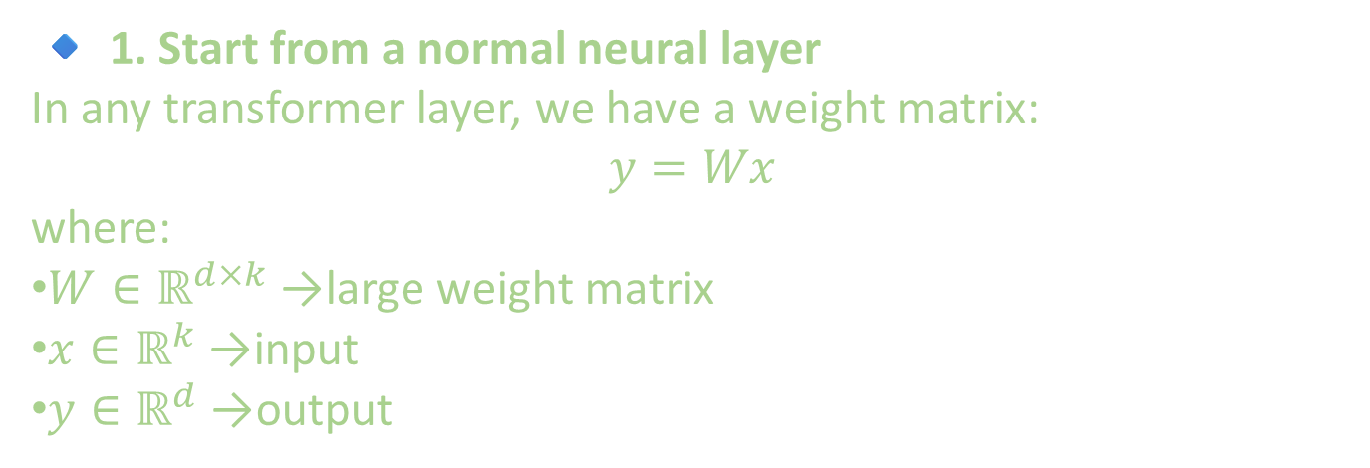
🔹 1. Start from a normal neural layer
In any transformer layer, we have a weight matrix:
$$y=Wx$$
where:
$W∈ℝ^{d×k}$→ large weight matrix
$x∈ℝ^{k}$→ input
$y∈ℝ^{d}$→ output

Slide 3
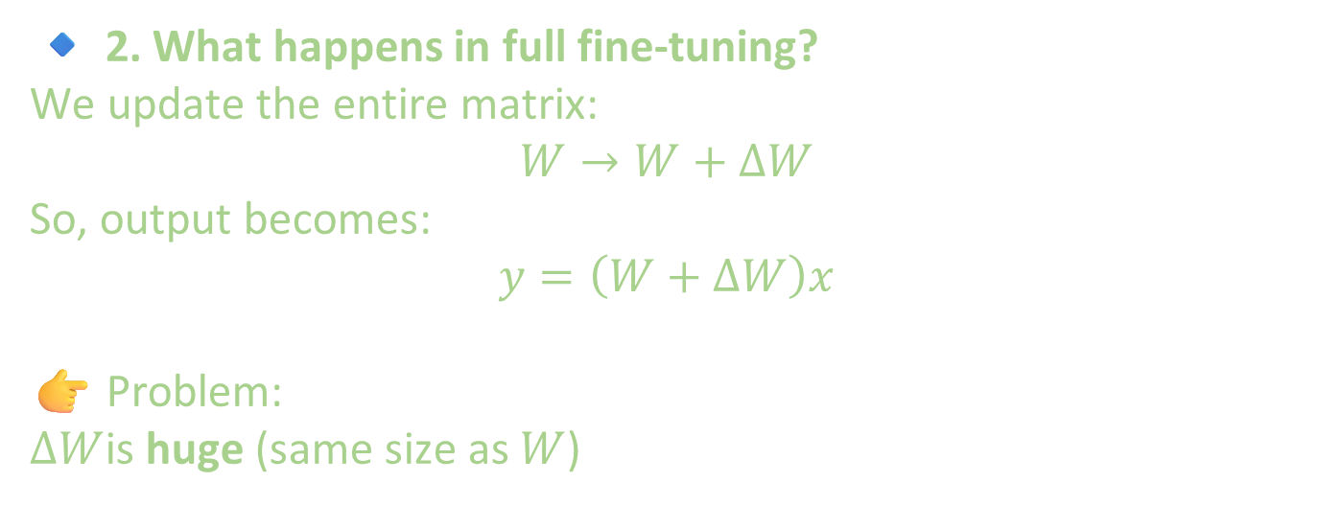
🔹 2. What happens in full fine-tuning?
We update the entire matrix:
$$W→W+ΔW$$
So, output becomes:
$$y=\left(W+ΔW\right)x$$
👉 Problem: $ΔW$is huge (same size as $W$)

Slide 4
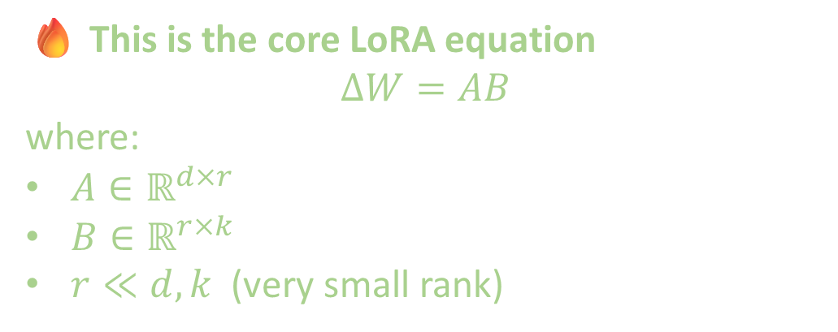
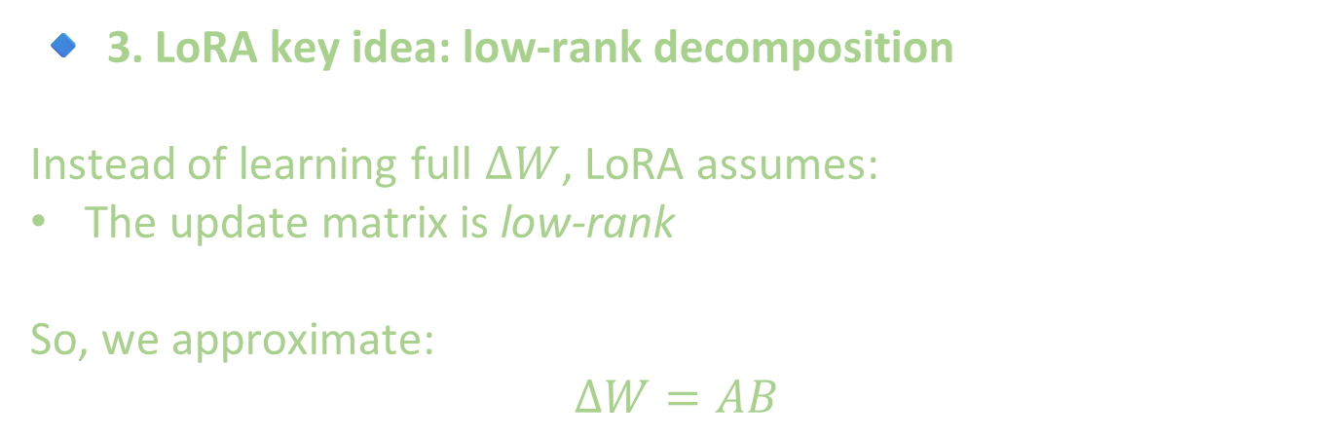
🔹 3. LoRA key idea: low-rank decomposition
Instead of learning full $ΔW$, LoRA assumes:
The update matrix is low-rank
So, we approximate:
$$ΔW=AB$$
🔥 This is the core LoRA equation
$$ΔW=AB$$
where:
$A∈ℝ^{d×r}$
$B∈ℝ^{r×k}$
$r≪d,k$ (very small rank)

Slide 5
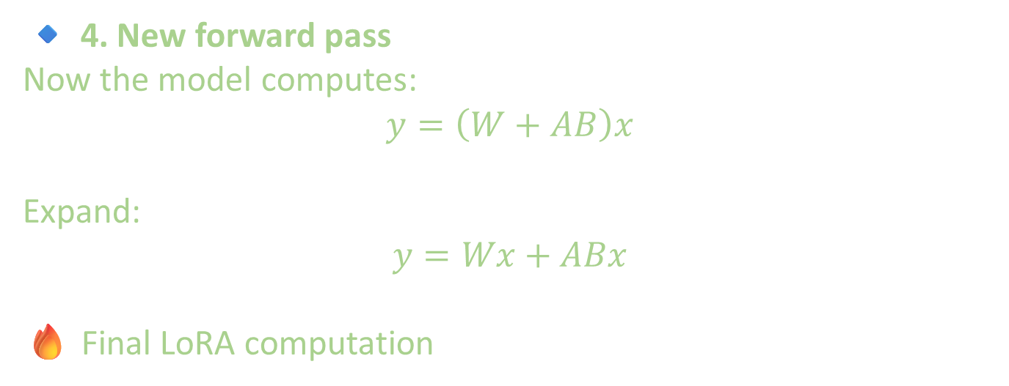
🔹 4. New forward pass
Now the model computes:
$$y=\left(W+AB\right)x$$
Expand:
$$y=Wx+ABx$$
🔥 Final LoRA computation

Slide 6
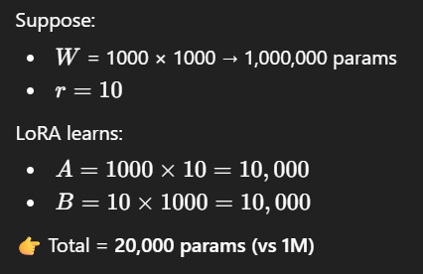
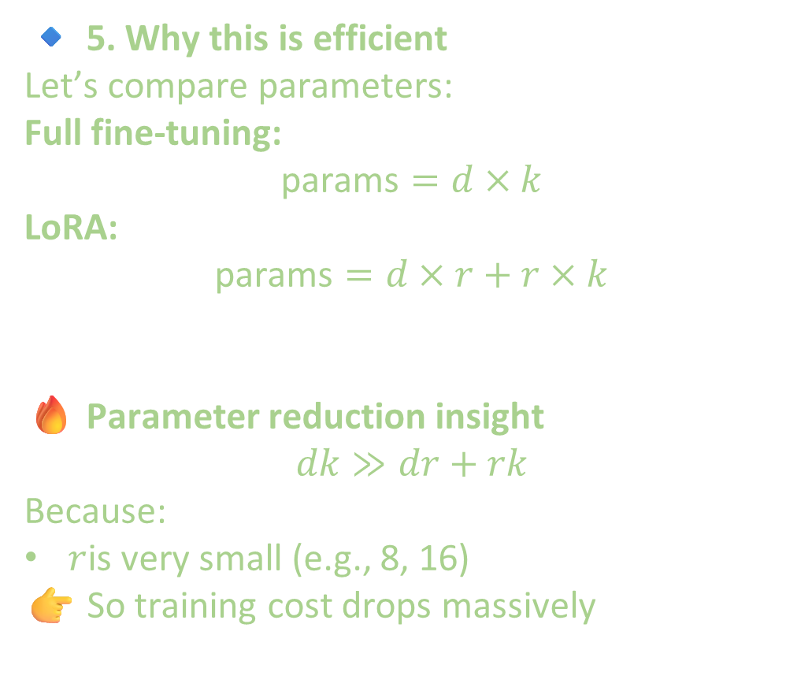
🔹 5. Why this is efficient
Let’s compare parameters:
Full fine-tuning:
$$\text{params}=d×k$$
LoRA:
$$\text{params}=d×r+r×k$$
🔥 Parameter reduction insight
$$dk≫dr+rk$$
Because:
$r$is very small (e.g., 8, 16)
👉 So training cost drops massively

Slide 7
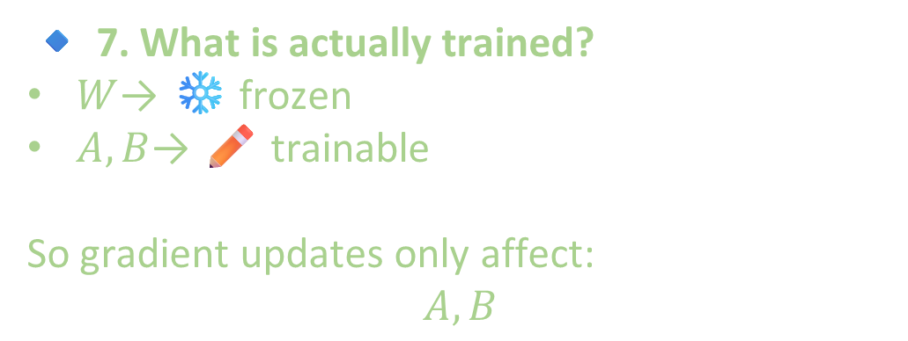
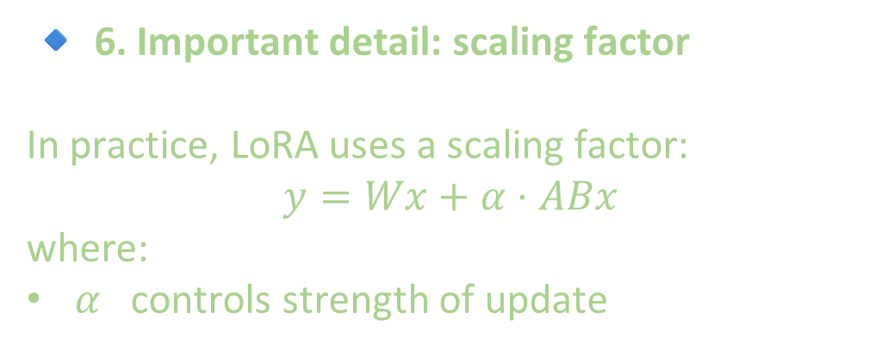
🔹 6. Important detail: scaling factor
In practice, LoRA uses a scaling factor:
$$y=Wx+α⋅ABx$$
where:
$α$ controls strength of update
🔹 7. What is actually trained?
$W$→ ❄️ frozen
$A,B$→ ✏️ trainable
So gradient updates only affect:
$$A,B$$

Slide 8
EXTRA
Ffnbksdfd
Fdslj;f
Fl;ds

