Slide 1
Fine Tune an Open AI Model

Slide 2
Task:
Your task is to design a fine-tuned model that would take input hospital unstructured data and give output as structured data in the form of JSON
Victoria Gupta, a 27-year-old female, presents with chronic fatigue, muscle pain, and tender points throughout body. Reports unrefreshing sleep and cognitive difficulties. Started on Duloxetine 30mg daily with gradual increase to 60mg.
{
"patient name": "Victoria Gupta",
"age": 27,
"diagnosis": "fibromyalgia",
"prescribed medication": "Duloxetine“
}
Fine Tuned
Model

Slide 3


Work flow
Upload training file
+
validation file
Get API Key
Prepare dataset
Create Fine Tuning job
Monitor Fine Tuning Job
Test the model

Slide 4
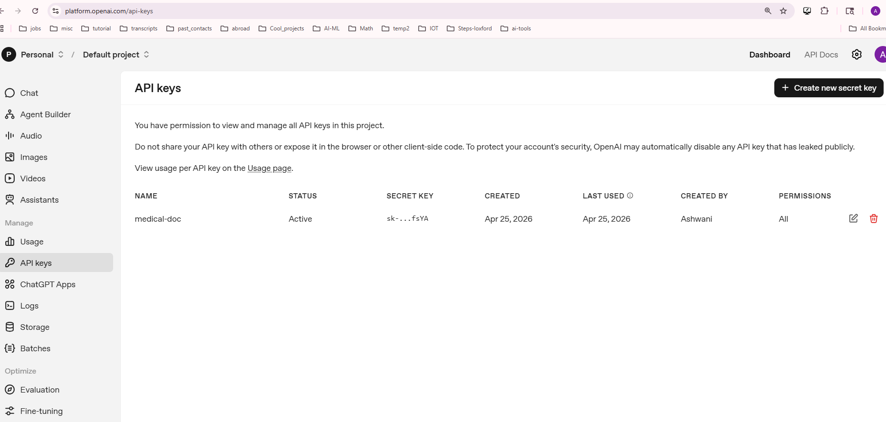
Get API Key

Slide 5
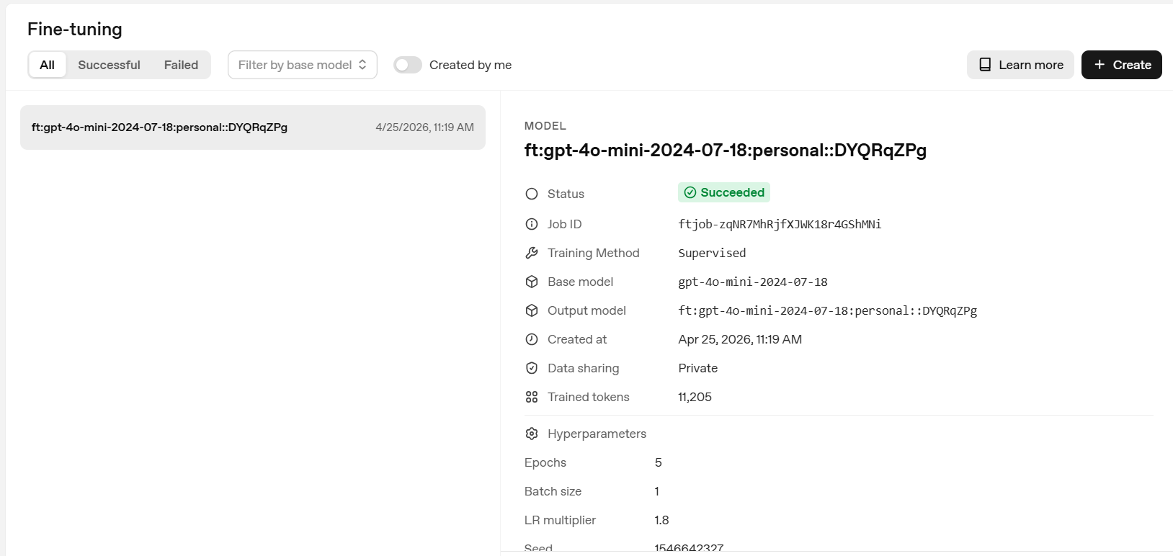
Fine tuning on Open AI Dashboard

Slide 6
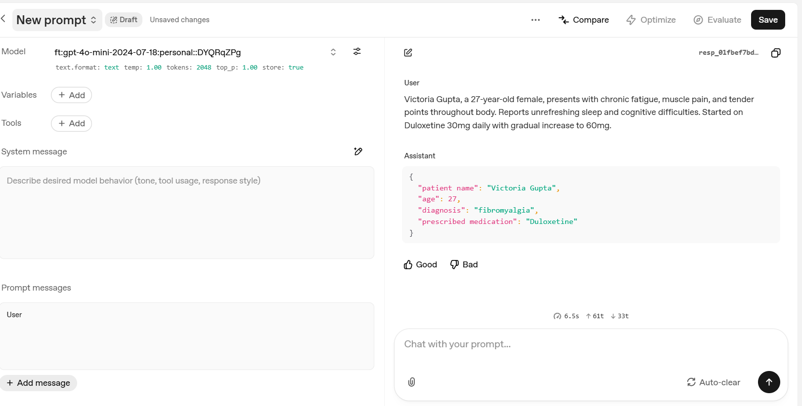
Playground -> Chat with your fine-tuned model

