Slide 2
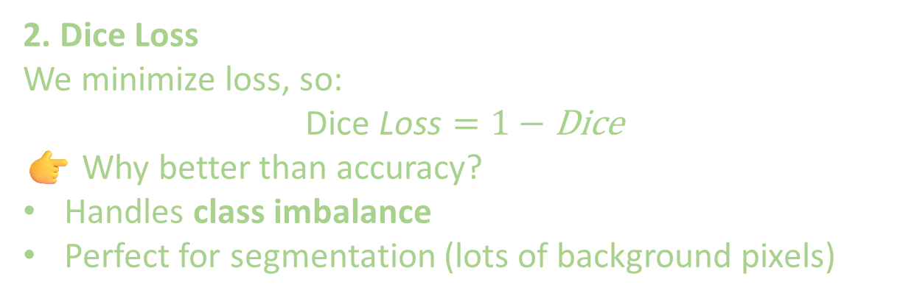
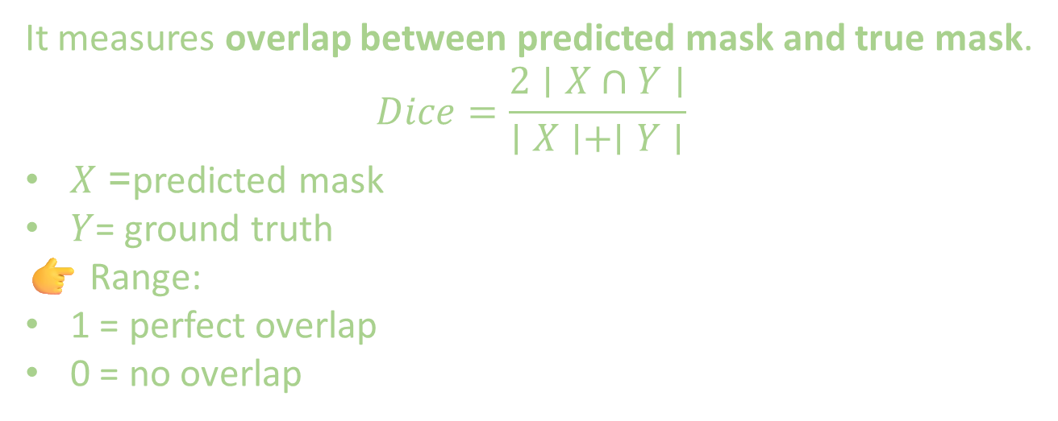
1. What is Dice Coefficient
It measures overlap between predicted mask and true mask.
$$Dice=\frac{2∣X∩Y∣}{∣X∣+∣Y∣}$$
$X$= predicted mask
$Y$= ground truth
👉 Range:
1 = perfect overlap
0 = no overlap
2. Dice Loss
We minimize loss, so:
$$\text{Dice} \text{Loss}=1−\text{Dice}$$
👉 Why better than accuracy?
Handles class imbalance
Perfect for segmentation (lots of background pixels)

Slide 3
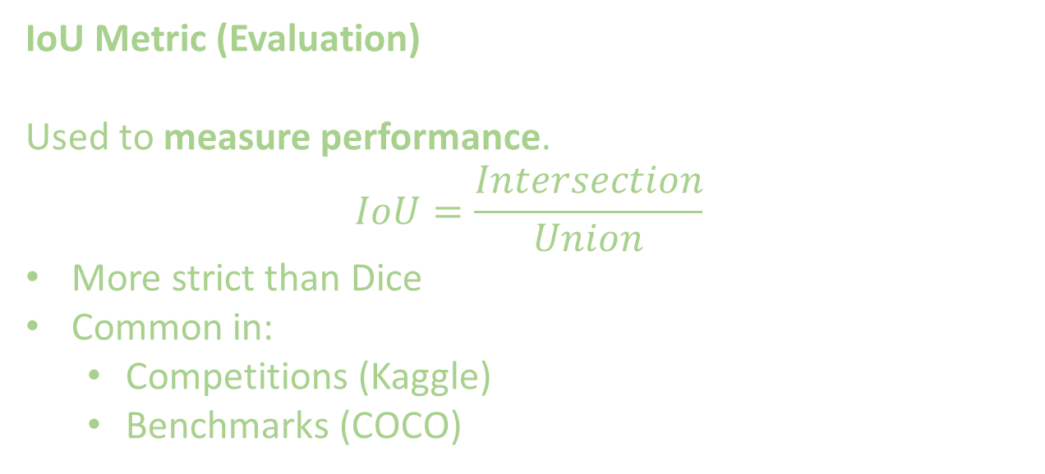
IoU Metric (Evaluation)
Used to measure performance.
$$IoU=\frac{Intersection}{Union}$$
More strict than Dice
Common in:
Competitions (Kaggle)
Benchmarks (COCO)

Slide 4
Dice Loss is used for training because it’s differentiable and handles imbalance well
IoU is used for evaluation because it is stricter and better reflects segmentation quality.

