Slide 2
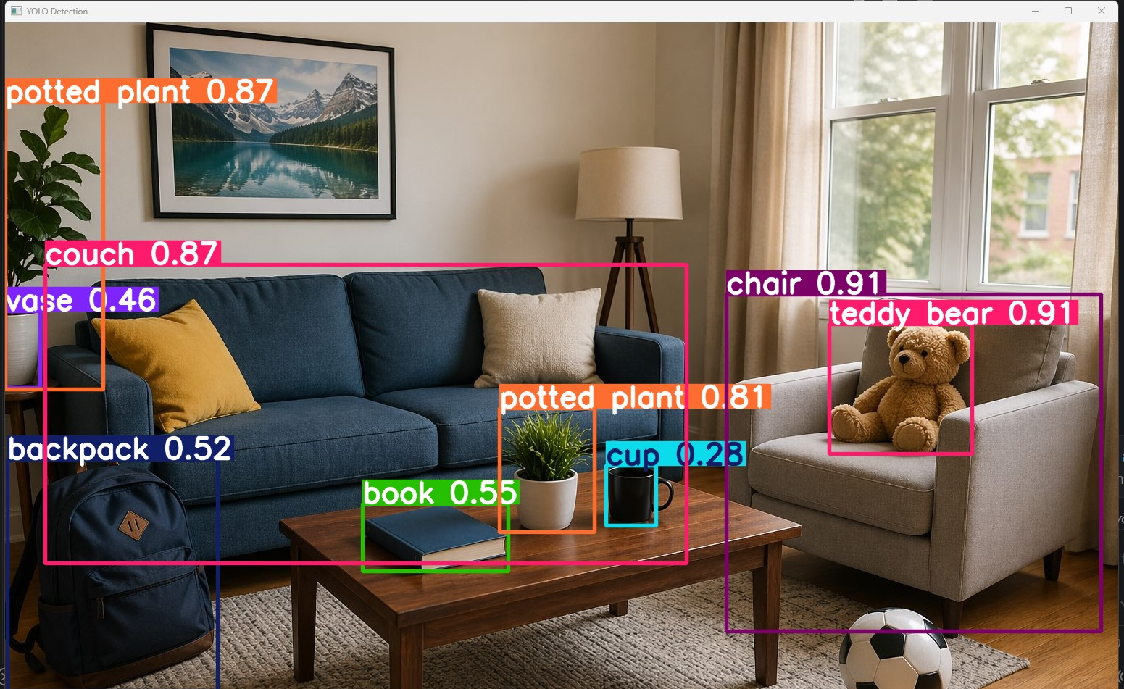
Object detection is a computer vision technology that allows systems to identify and locate specific objects within an image or video.
It answers two fundamental questions:
"What is it?" (classification) and
"Where is it?" (localization)

Slide 3
Object detection model evolution
R-CNN – (Explained here)
Fast R-CNN (optimization idea)
Faster R-CNN (modern region proposal)
SSD
YOLO (industry - today )

Slide 4
1. R-CNN
General Idea:
Step 1: Generate region proposals (possible object areas)
Step 2: Run CNN on each region
Step 3: Classify + bounding box
Easy analogy: “crop image → classify each crop”

Slide 5
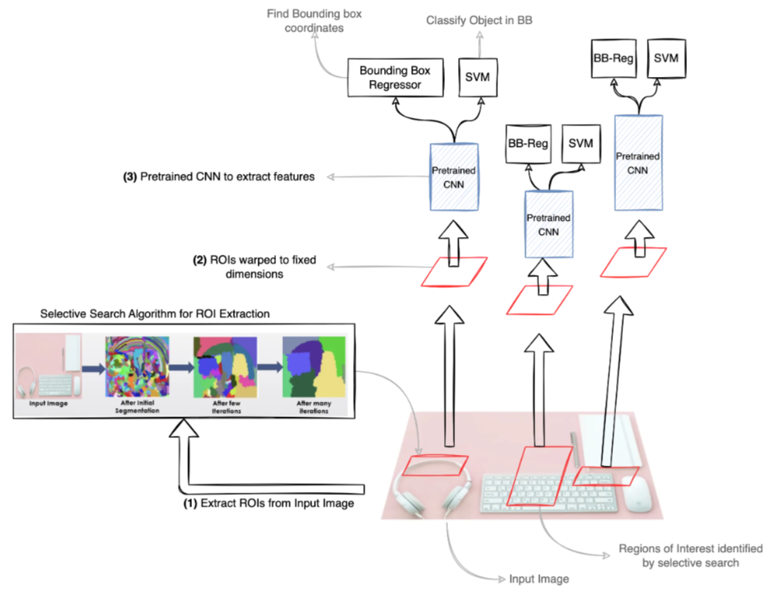
1. R-CNN (In detail)
Region Proposal:
It generates ~2000 class-independent region proposals using Selective Search (i.e., it doesn’t know what the object is yet).
2. Feature Extraction
Each region is warped (resized) to a fixed size and passed through a pre-trained CNN (like AlexNet / VGG) to extract features.
3. Classification
A separate SVM classifier is trained per class, using CNN features.
Source: Medium

Slide 6
1. R-CNN (In detail)
4. Bounding Box Regression
A class-specific bounding box regressor refines the coordinates.
5. Non-Maximum Suppression
Keeps the box with highest confidence and removes overlapping ones.
Source: Medium

Slide 7
1. R-CNN (In detail)
Big drawback of R-CNN:
CNN is run 2000 times per image
Very slow (not practical for real-time)
This motivates :
Fast R-CNN
Faster R-CNN

Slide 8
2. Fast R-CNN
Improves R-CNN (no repeated CNN per region)
3. Faster R-CNN
Adds Region Proposal Network (RPN)
Slightly more complex but logical extension

Slide 9
4. YOLO (You Only Look Once)
Entire image → single pass → predicts everything
Think: “one shot detection”
👉 Harder conceptually (grid system, anchor boxes)

