Slide 1
RAG (Retrieval-Augmented Generation)

Slide 2
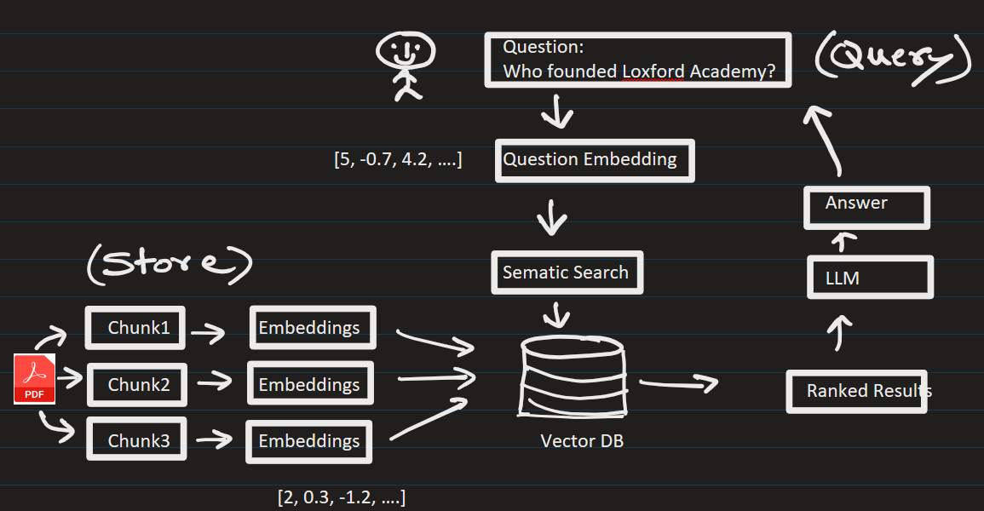
RAG (Retrieval-Augmented Generation)

