Slide 1
AI-ML: Overview of AI/ML in Biomedical Signal Processing

Slide 2
Right now, as you sit listening to me, your body is composing the most complex symphony ever written. Your heart is drumming a steady rhythm at roughly 70 beats per minute. Your brain is firing electrical impulses faster than lightning – about 100 billion neurons communicating through trillions of connections. Your muscles are making micro-adjustments to keep you upright, alert, engaged, look right or left.
And here's the fascinating part: every single one of these actions is generating numbers. Mathematical equations. Electrical signatures that are as unique to you as your fingerprint.
When you smiled or laughed at something or someone – that created a specific electrical pattern. When your heart skipped slightly because you realized you forgot to do something that u were supposed to do – that generated a distinct mathematical waveform. Even the tiny movement of your eyes as they track my words is producing measurable electrical signals.
Your body is the ultimate sophisticated data generator on Earth? Every breath, every heartbeat, every thought, every emotion – they're all being translated into electrical signals that tell the story of who you are and how you're feeling at this very moment.
This is biomedical signal processing.
Your body speaks in the language of electricity:
- Your heart broadcasts its health status through ECG signals – ElectroCardioGrams that reveal not just rhythm, but the story of your cardiovascular wellness
- Your brain transmits its thoughts through EEG waves – ElectroEncephaloGrams that can detect everything from sleep patterns to the onset of seizures
- Your muscles communicate their strength and coordination through EMG signals – ElectroMyoGrams that reveal movement, fatigue, and neurological health
- Your blood vessels pulse with PPG signals – PhotoPlethysmoGrams that monitor circulation and oxygen levels with every heartbeat
- Your eyes generates EOG signals every time it moves - ElectroOculoGraphy monitors eye movement that helps in controlling external devices, detect micro sleep patterns, etc
But here's where it gets truly extraordinary: buried within these electrical whispers are patterns / secrets that even the experienced doctors might miss with the naked eye. Subtle irregularities that could predict a heart attack weeks before symptoms appear. Brain wave anomalies that might signal Alzheimer's in its earliest stages. Muscle activation patterns that could prevent athletic injuries before they happen.
This is where artificial intelligence enters the story. Machine learning algorithms can now listen to your body's electricity and hear things we never could before – like having superhuman hearing that can understand the faintest irregular/discordant note.
Signal processing techniques are transforming these raw electrical signals from your body into precise, actionable insights. We're not just treating diseases anymore – we're predicting them, preventing them, and personalizing treatments with accuracy.
This is where mathematics meets medicine. Where algorithms can read your body's secrets, and where the future of healthcare is being written in the language of electrical signals.
Welcome to the fascinating world of biomedical signal processing – where your body's electrical whispers are becoming medicine's most powerful tool.

Slide 3
ECG: See slides

Slide 4
EEG (see slides)

Slide 5
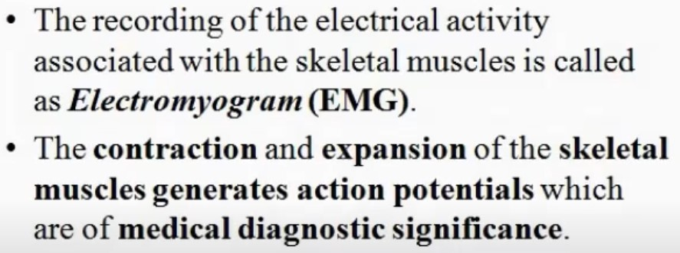
What is EMG
https://www.youtube.com/watch?v=tn0DQzMeqXk

Slide 6
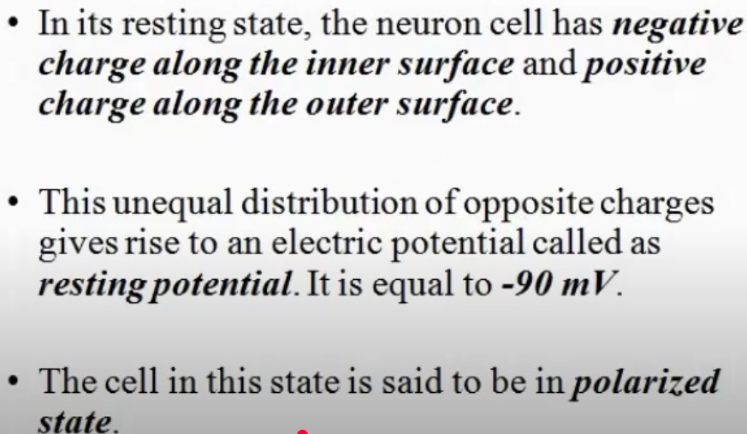
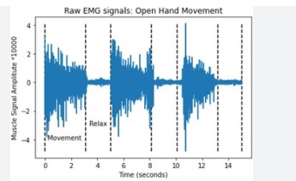
What is EMG
https://www.youtube.com/watch?v=tn0DQzMeqXk
1. Amplitude (in µV or mV) indicates muscle contraction strength
Higher amplitude → stronger contraction
2. Muscle Fatigue Indicators
As muscle fatigues:
Amplitude may increase (more effort)
Median frequency decreases (signal shifts to lower frequencies)

Slide 7
Type of EMG
1. Surface EMG (sEMG)
Non-invasive; electrodes are placed on the skin.
Used for large, superficial muscles.
2. Intramuscular (Needle) EMG
Invasive; fine needle inserted into the muscle.
Used for deep or small muscles and clinical diagnosis.

Slide 8
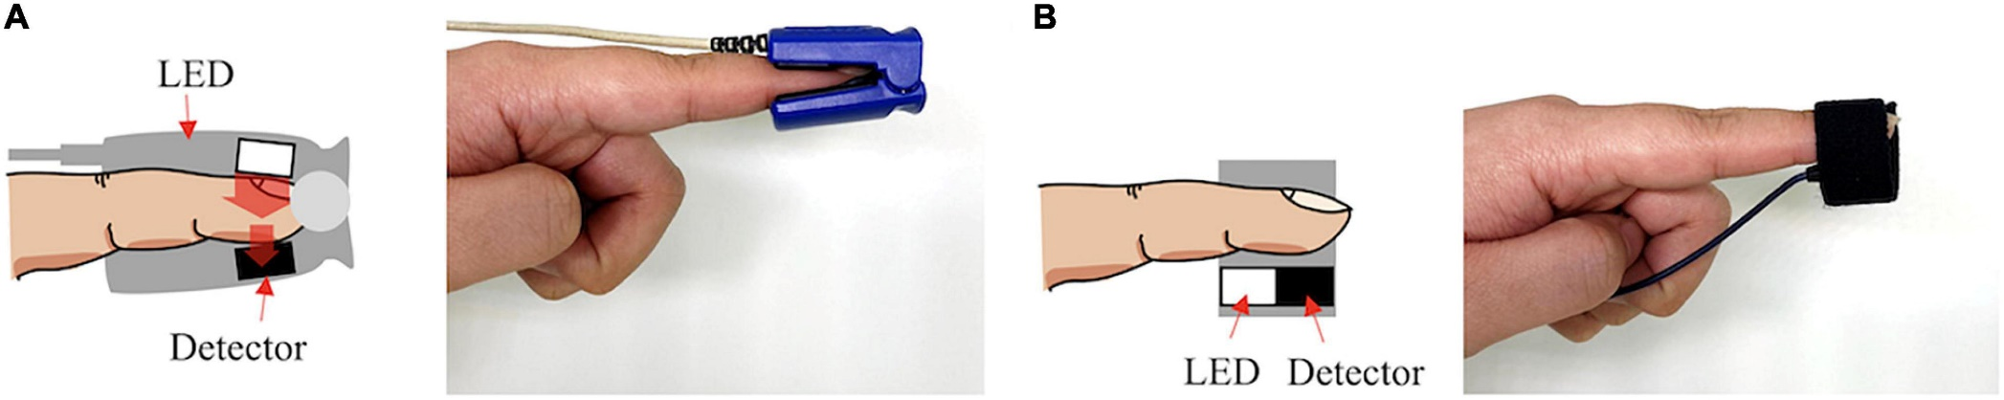
What is PPG?
https://www.frontiersin.org/files/Articles/808451/fphys-12-808451-HTML/image_m/fphys-12-808451-g002.jpg
Photoplethysmography (PPG) is a non-invasive method for measuring blood volume changes in a microvascular bed of the skin based on optical properties, such as absorption, scattering, and transmission properties of human body composition under a specific light wavelength (Challoner, 1979). PPG is a compound word that consists of “photo,” meaning light; “plethysmo,” meaning volume; and “graphy,” meaning recording (Alnaeb et al., 2007). In 1937, Hertzman found that the amount of light detected by back scattering after irradiating light to the skin was significantly changed according to cardiac activity. He suggested that PPG was a technique for measuring blood volume changes in a specific area irradiated with light (Hertzman, 1937, 1938). PPG records the amount of light transmitted or reflected by the change in concentration of substances in the blood and the optical path.
Source: https://www.frontiersin.org/journals/physiology/articles/10.3389/fphys.2021.808451/full

Slide 9
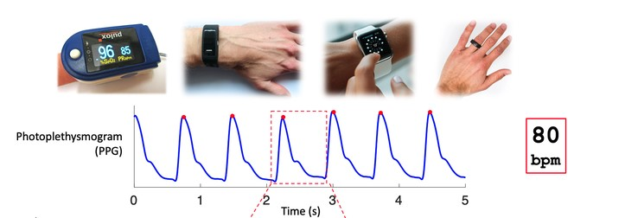
Devices that measures PPG ?
https://www.researchgate.net/figure/Components-of-PPG-signal-waveform-for-healthy-young-subjects_fig5_277027133

Slide 10
Role of AI/ML in Biomedical Signal Processing
Machine Learning (ML) and Artificial Intelligence (AI) are used to:
Identify patterns in complex signals
Detect anomalies
Predict disease onset earlier than traditional methods
Reduce reliance on manual interpretation

Slide 11
Early Disease Detection(p1)
AI/ML algorithms can analyze complex biomedical signals to identify subtle patterns and biomarkers associated with various diseases, enabling early intervention.
EXAMPLES:
A. Cardiovascular Disease – ECG Analysis
Signal Type: ECG ML Task: Classification
Example: Using deep learning (like CNNs) to detect:
Atrial fibrillation
Myocardial infarction (heart attack)
Left ventricular hypertrophy
Impact: Early detection of arrhythmias helps in preventing strokes and sudden cardiac death.

Slide 12
Early Disease Detection(p2)
B. Epilepsy Detection – EEG Analysis (ElectroEncephaloGram) – brain activity
Signal Type: EEG ML Task: Seizure prediction
Example:
Using RNNs or LSTMs to learn temporal patterns in EEG signals.
Preictal (before seizure) phases can be predicted, triggering alerts.
Impact: Helps patients manage epilepsy proactively.

Slide 13
Early Disease Detection(p3)
C. Sleep Disorders – EEG, EOG, EMG(ElectroEncephaloGram, ??, ??)
Signal Type: EEG, EMG ML Task: Sleep stage classification(TODO: Talk about different class)
Example:
Detecting REM Sleep Behavior Disorder (RBD) as an early sign of Parkinson’s Disease.
Using ML to classify sleep stages and flag abnormalities.
Impact: Early neurological disorder diagnosis.

Slide 14
Early Disease Detection(p4)
D. Diabetes & Cardiovascular Risk – PPG & Wearables
Signal Type: PPG(PhotoPlethysmoGram) from smartwatches ML Task: Risk prediction
Example:
PPG signals analyzed using ML to monitor HRV (heart rate variability)
Predict onset of hypertension or diabetes-related complications
Impact: Real-time, non-invasive health monitoring.

Slide 15
Early Disease Detection(p5)
E. Alzheimer’s & Dementia – EEG (ElectroEncephaloGram) or Gait Analysis
Signal Type: EEG / Movement sensors ML Task: Cognitive impairment detection
Example:
EEG signal abnormalities during memory tasks
ML models identifying early biomarkers
Impact: Early intervention before cognitive decline accelerates.

Slide 16
Techniques Used
Signal Denoising: Wavelet transforms, filtering
Feature Extraction: Time-domain, frequency-domain, entropy features
ML Algorithms: SVM, Random Forest, CNNs, RNNs
Deep Learning: Especially useful with raw signal input and large data
Transfer Learning: Adapting pre-trained models to medical signals

Slide 17
Key Aspects of AI/ML in Biomedical Signal Processing(p2)
Improved Accuracy and Efficiency:
By processing large volumes of data and learning from patterns, AI/ML models can enhance the accuracy and efficiency of diagnostic and monitoring processes.
Personalized Treatment Strategies:
AI/ML can help personalize treatment plans by identifying individual patient characteristics and predicting treatment outcomes.
Advanced Signal Processing Techniques:
AI/ML, particularly deep learning, has advanced various signal processing techniques, including imaging, SERS, and EEG analysis.
Diverse Applications:
AI/ML is used in various biomedical applications, including cardiovascular disease diagnosis, neurological disorder detection, and brain-computer interfaces.

Slide 18
Specific Examples:
ECG Analysis:
AI/ML algorithms can be used to analyze ECG signals to identify cardiac arrhythmias, myocardial infarction, and other heart conditions.
EEG Analysis:
AI/ML can be used to analyze EEG signals for detecting seizures, cognitive states, and brain-computer interface (BCI) applications.
MRI Image Reconstruction:
AI/ML can enhance the quality and efficiency of MRI image reconstruction and analysis.
Imaging Data Analysis:
AI/ML can analyze medical images like X-rays and CT scans to identify early-stage diseases and aid in diagnosis.

Slide 19
Challenges and Future Directions
Interpretability:
Understanding how AI/ML models make decisions is crucial for gaining trust and acceptance in the healthcare field.
Data Scarcity:
Obtaining large and diverse datasets for training AI/ML models can be challenging.
Ethical Considerations:
Ensuring fairness, privacy, and accountability in the use of AI/ML in healthcare is important.
Explainable AI (XAI):
Developing AI/ML models that are transparent and explainable is a key research direction.
Personalized Medicine:
Tailoring AI/ML models to individual patients' needs and characteristics is an important area of research.

