Slide 2
Here first load the dataset : data_titanic_Kaggle.csv to colab
Now start giving series prompts: You are asking questions/ giving instructions

Slide 3
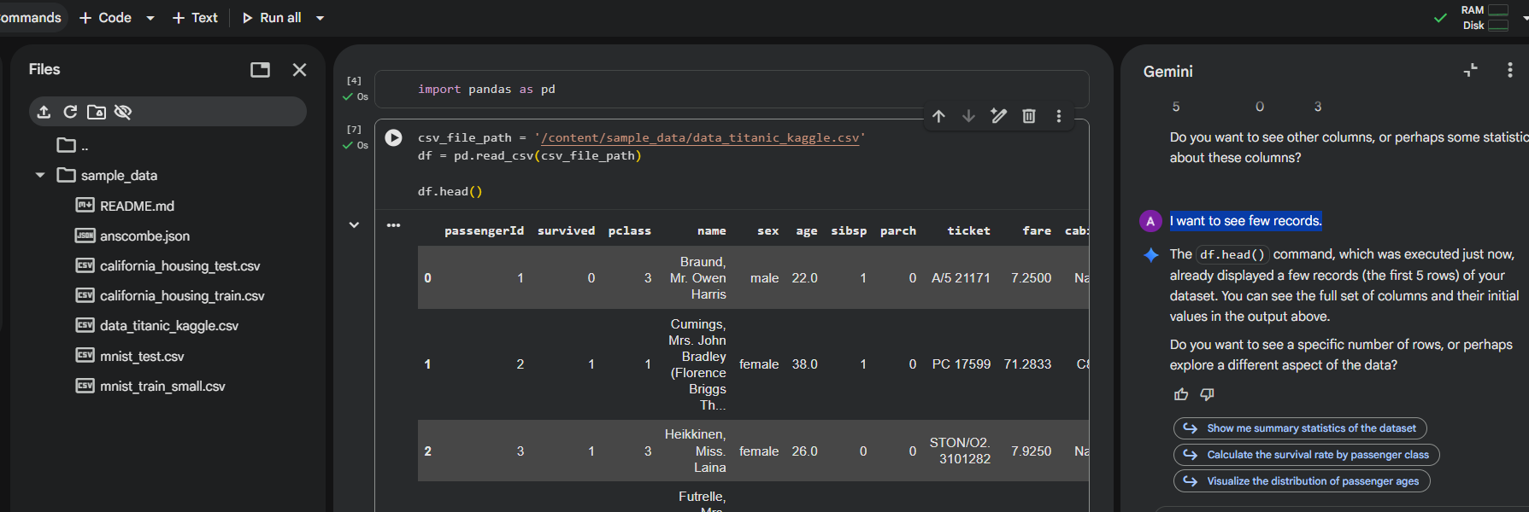

I want to see few records.

Slide 4
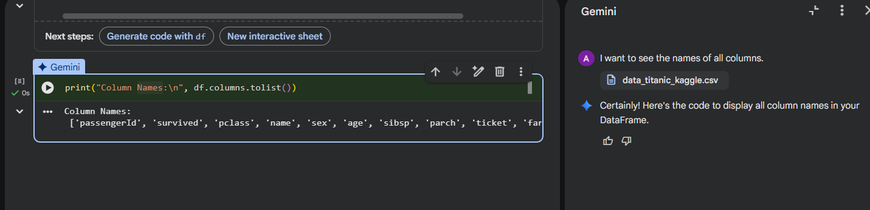
I want to see the names of all columns

Slide 5
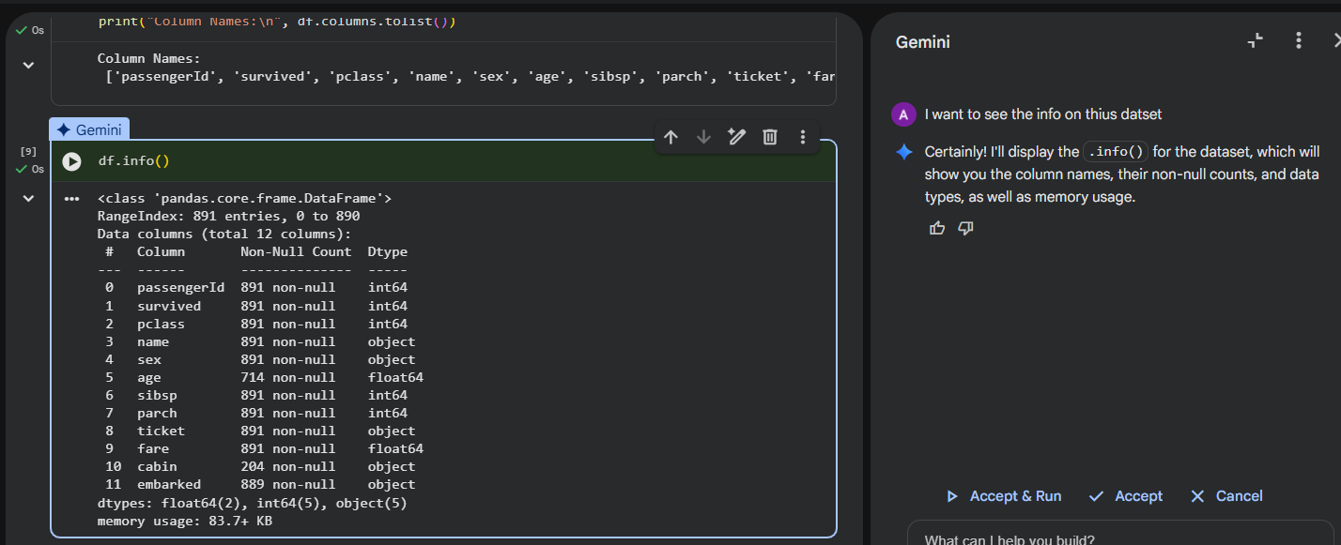
I want to see the info on thius datset

Slide 6
Handling Missing values

Slide 7
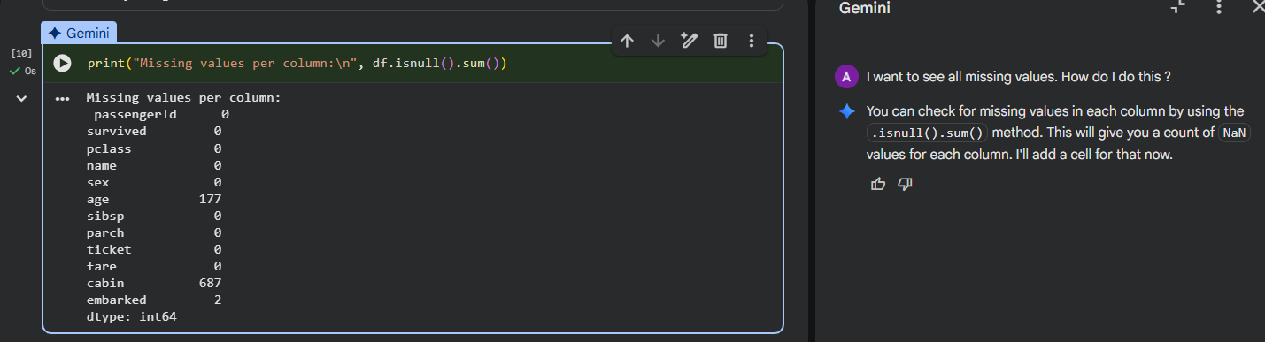
I want to see all missing values. How do I do this ?

Slide 8
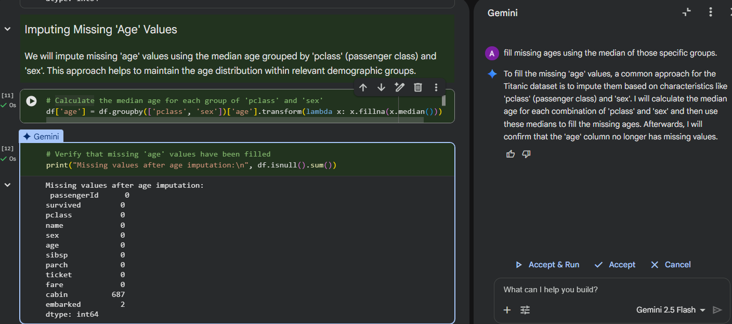

fill missing ages using the median of those specific groups.

Slide 9
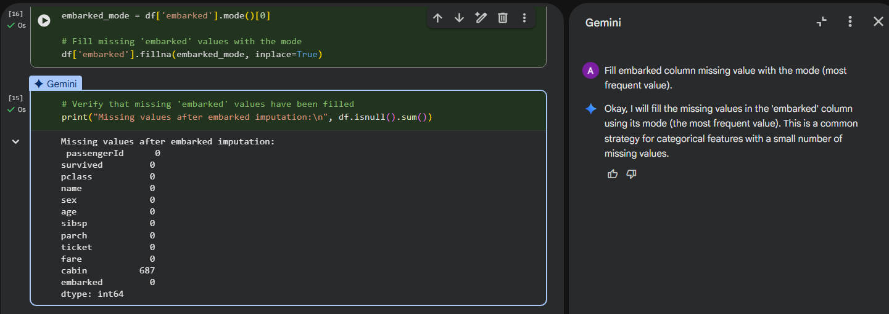

Fill embarked column missing value with the mode (most frequent value).

Slide 10
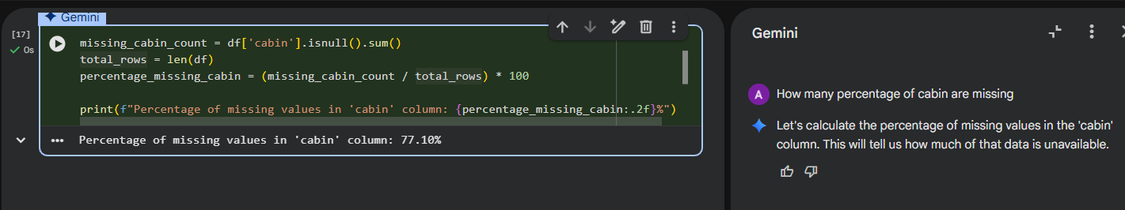
How many percentage of cabin are missing

Slide 11
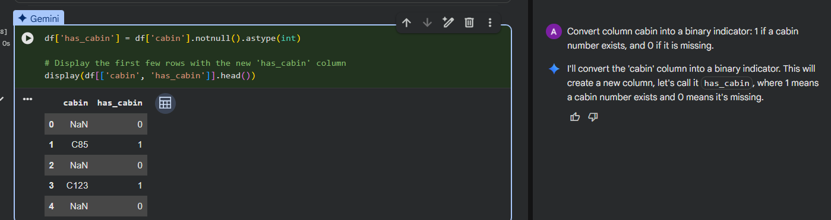

Convert column cabin into a binary indicator: 1 if a cabin number exists, and 0 if it is missing.

Slide 12
Text Parsing and String Manipulation

Slide 13
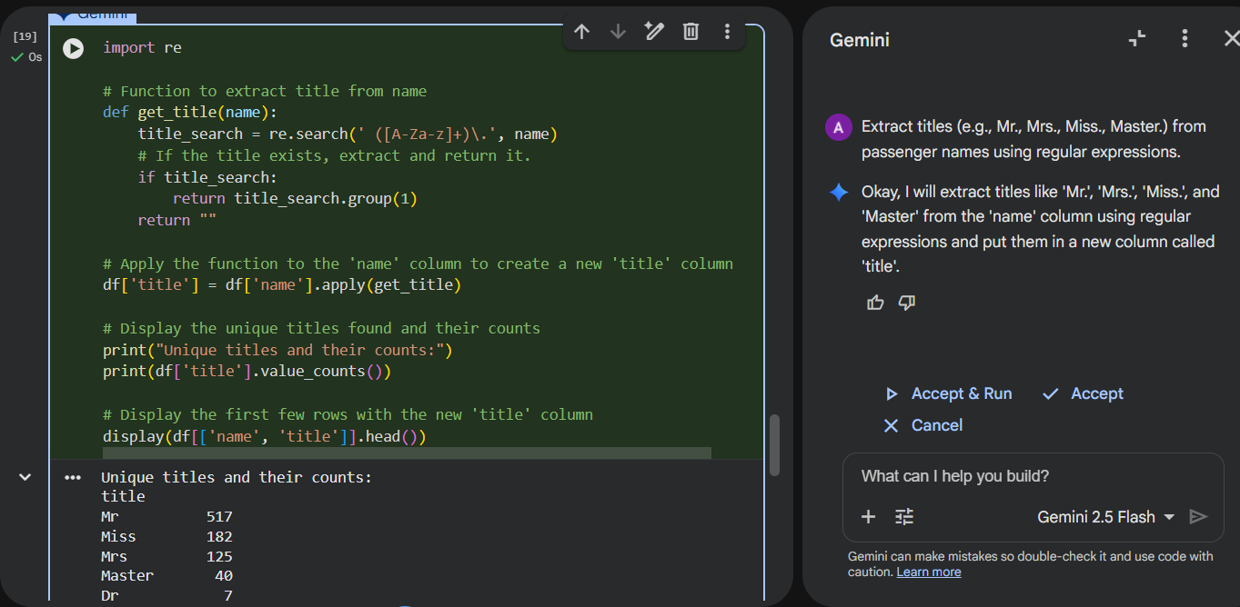




Extract titles (e.g., Mr., Mrs., Miss., Master.) from passenger names using regular expressions.

Slide 14
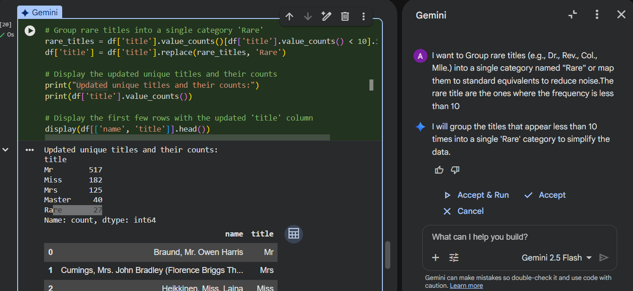
I want to Group rare titles (e.g., Dr., Rev., Col., Mlle.) into a single category named "Rare" or map them to standard equivalents to reduce noise. The rare title are the ones where the frequency is less than 10

Slide 15
Feature Engineering and Transformation

Slide 16
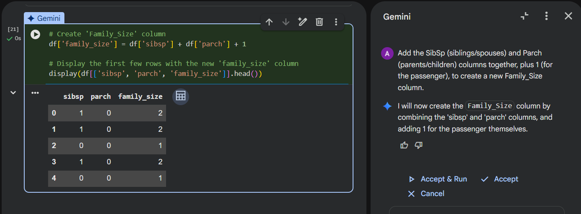
Add the SibSp (siblings/spouses) and Parch (parents/children) columns together, plus 1 (for the passenger), to create a new Family_Size column.

Slide 17
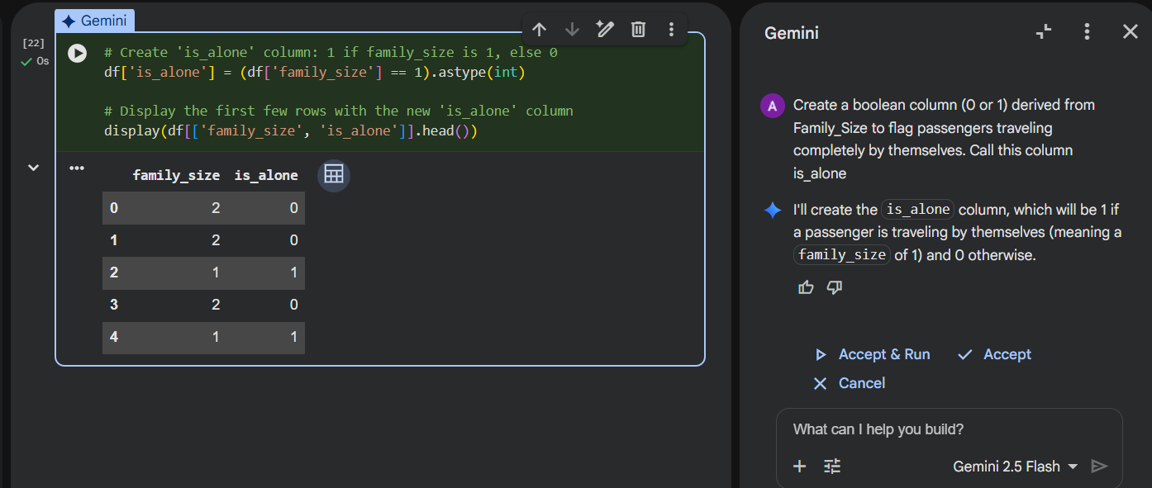


Create a boolean column (0 or 1) derived from Family_Size to flag passengers traveling completely by themselves. Call this column is_alone

Slide 18
Categorical Encoding

Slide 19
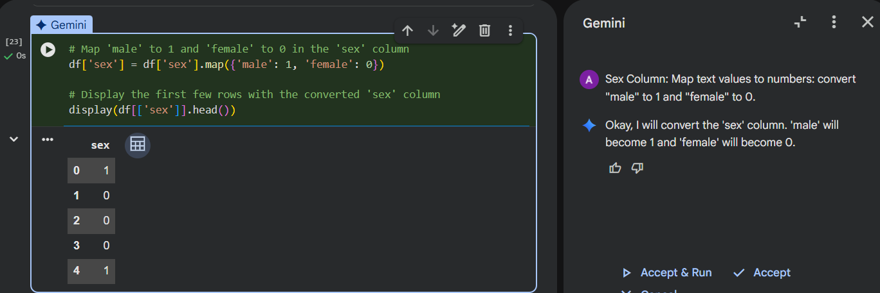

Sex Column: Map text values to numbers: convert "male" to 1 and "female" to 0.

Slide 20
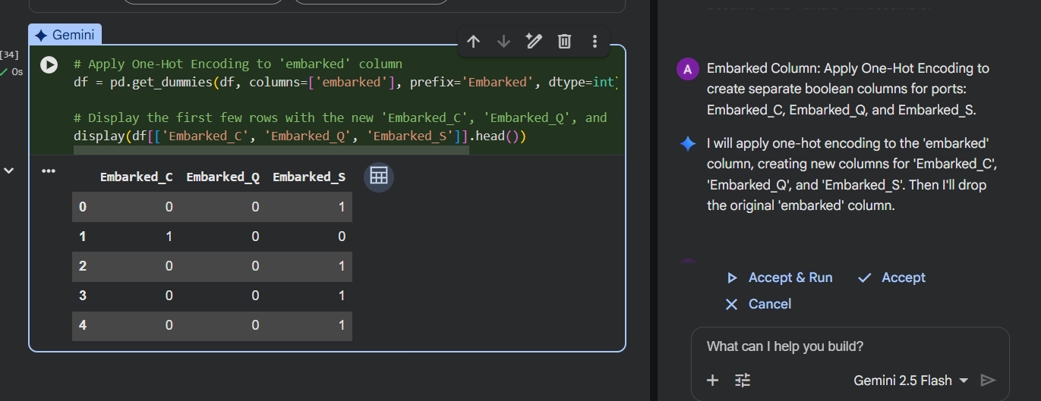
Embarked Column: Apply One-Hot Encoding to create separate boolean columns for ports: Embarked_C, Embarked_Q, and Embarked_S.

Slide 21
Outlier Detection and Binning

Slide 22
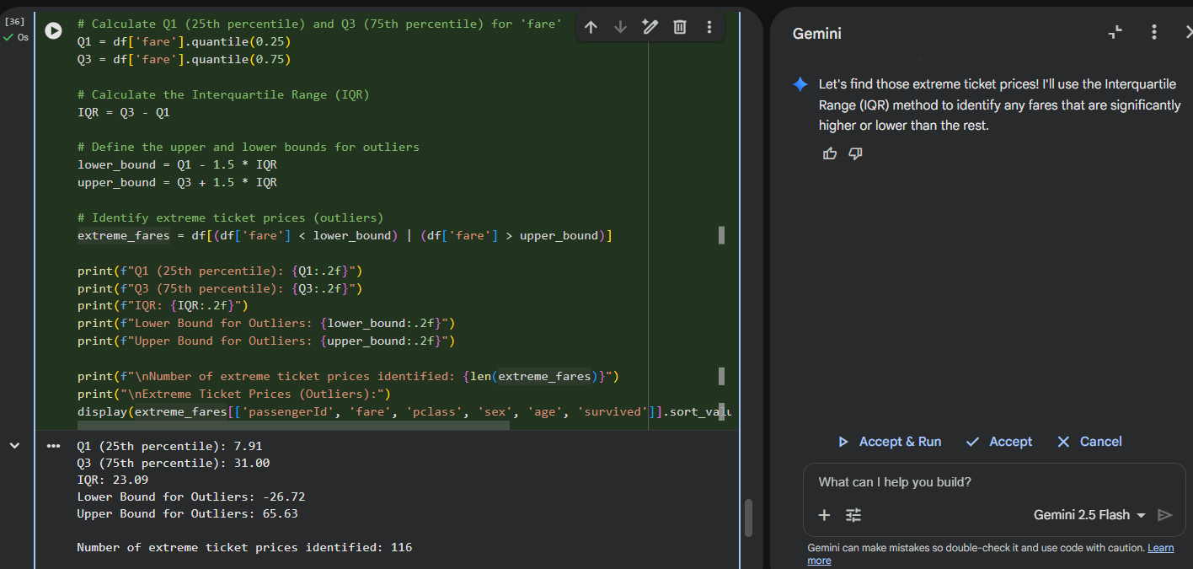

Fare Column: Identify extreme ticket prices using the Interquartile Range (IQR) method,

Slide 23
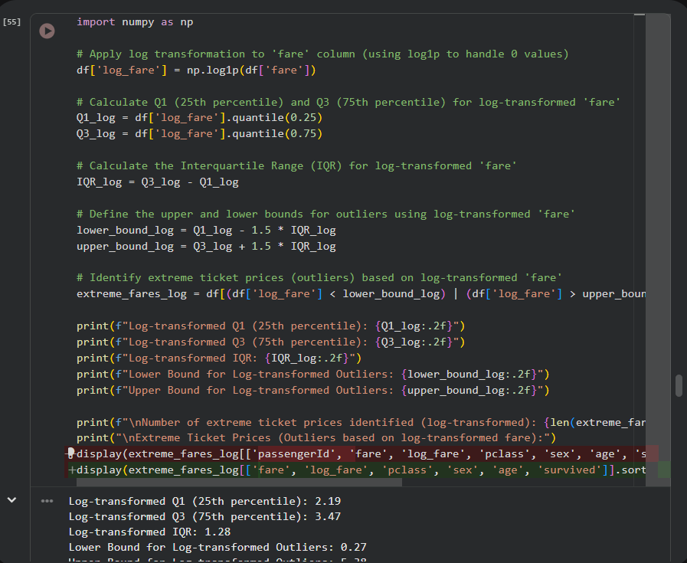
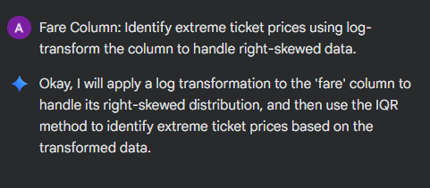

Slide 24
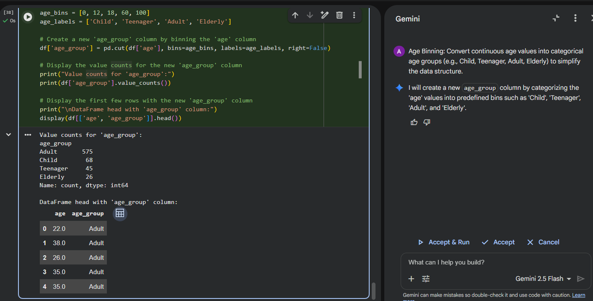
Age Binning: Convert continuous age values into categorical age groups (e.g., Child, Teenager, Adult, Elderly) to simplify the data structure.

Slide 25
Structural Cleaning

Slide 26
