Slide 1
Chi Square Test

Slide 2
What is the Chi-Square Test?
The Chi-Square Test is a statistical test used to examine the relationship between categorical variables.
What type of variables is it used for?
Categorical variables only
These are variables that represent groups or categories, not numbers.
Example:
Gender: Male, Female
Blood Type: A, B, AB, O
Favorite Color: Red, Blue, Green
You cannot use it directly for continuous variables like height, weight, or temperature unless you first convert them into categories (e.g., "short", "tall").

Slide 3
Why do we need it?
We use the Chi-Square test to answer questions like:
Is there an association between gender and voting preference?
Does smoking status affect whether someone gets lung disease?
Are people from different cities equally likely to prefer a particular brand?
In short, it's about checking whether observed differences between groups are statistically significant or could have happened just by chance.

Slide 4
Types of Chi-Square Tests
Chi-Square Test of Independence
Tests if two categorical variables are related.
Example: Is there a relationship between education level and job type?
Chi-Square Goodness-of-Fit Test
Tests if the observed distribution of a single categorical variable matches an expected distribution.
Example: Is a die fair (i.e., all numbers appear equally)?

Slide 5
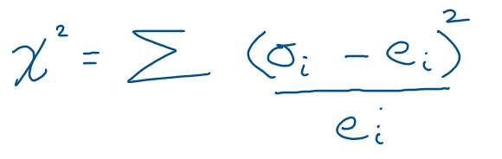
How does the Chi-Square Test work?
Here’s the basic idea:
Observe data (what actually happened).
Calculate expected data (what you would expect if there was no relationship).
Compare observed vs expected.
Compute a statistic called Chi-Square (χ²):
If the chi-square value is large, it suggests there’s a significant difference between observed and expected values — i.e., something is going on.

Slide 6
1) TEST FOR INDEPENDENCE

Slide 7

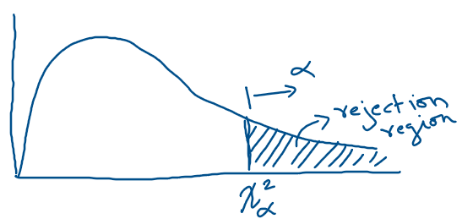
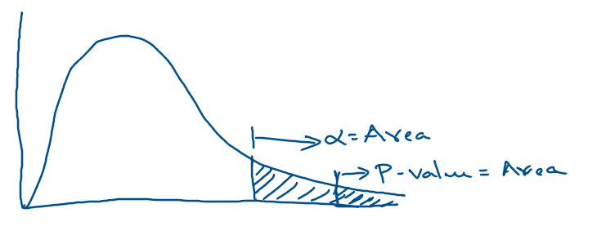
Steps for Chi-Square Test of Independence
4. Calculate the Degrees of Freedom
D.f. = (Number of Rows−1)×(Number of Columns−1)
1) Set Up the Hypotheses
Null Hypothesis (H₀): The variables are independent (no relationship).
Alternative Hypothesis (H₁): The variables are associated (some relationship).
5. Find the Critical Value or P-Value
Use a Chi-Square distribution table or software (Excel, Python, R).
Compare your χ² statistic with the critical value or find the p-value.
2) Calculate the Expected Counts E for each cell
6. Make a Decision
If p-value < 0.05 (common threshold for α), reject the null hypothesis.
Otherwise, fail to reject the null hypothesis.
3) Compute the Chi-Square Statistic
Add up all values for all cells.

Slide 8
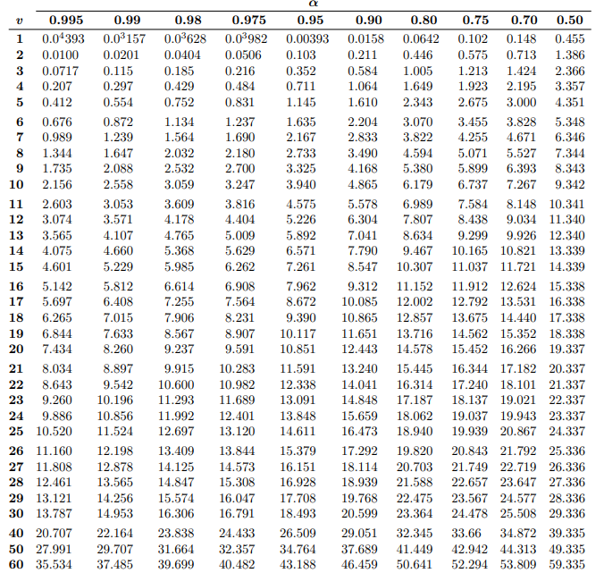
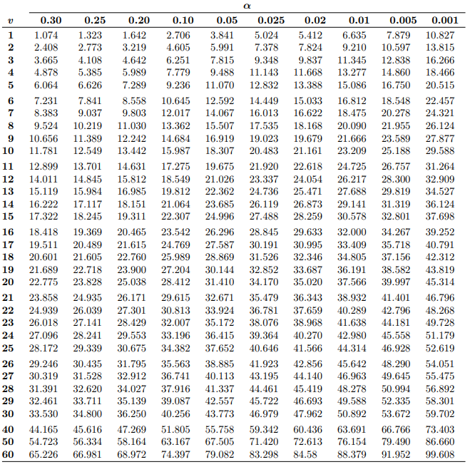
How to find critical value using d.f. , α and Chi square table ?
Given d.f. = 1 , α = 0.05, find critical value. Answer: 3.841
Given d.f. = 4 , α = 0.025, find critical value. Answer: 11.143

Slide 9
Example: Chi-Square Test of Independence(see jupyter n/b and excel sheet)
Question: Following is the result of survey on whether male and female like certain product. At α = 0.05, can it be concluded that the there is a relationship between gender and preference for a product?
For example, expected count for male and like: e = (50*40)/100 = 20
 | Like | Don’t Like
Male | e = 20 | e = 30
Female | e = 20 | e = 30
3. Calculate Chi using the formula:
 | Like Product | Don’t Like Product | Total
Male | 30 | 20 | 50
Female | 10 | 40 | 50
Total | 40 | 60 | 100
Chi square = ${\left(30−20\right)}^{2}/20$ + ${\left(20−30\right)}^{2}/30$ + ${\left(10−20\right)}^{2}/20$ + ${\left(40−30\right)}^{2}/20$
= 16.66
4. d.f = (2-1)(2-1) = 1
Solution: 1) Hypotheses:
Null Hypothesis (H₀): Gender and preference are independent (no relationship).
Alternative Hypothesis (H₁): There is a relationship between gender and preference.
5. At α = 0.05 , with d.f = (2-1)(2-1) = 1, using the table we find the critical value 3.841
2. Calculate Expected Counts
Use the formula:
6. Since 3.841 < 16.66, so we reject the null hypothesis.
There is a statistically significant relationship between gender and product preference.

Slide 10
Now we redo the previous question, but use P-value.
Question: Following is the result of survey on whether male and female like certain product. At α = 0.05, can it be concluded that the there is a relationship between gender and preference for a product?
For example, expected count for male and like: e = (50*40)/100 = 20
 | Like | Don’t Like
Male | e = 20 | e = 30
Female | e = 20 | e = 30
3. Calculate Chi using the formula:
 | Like Product | Don’t Like Product | Total
Male | 30 | 20 | 50
Female | 10 | 40 | 50
Total | 40 | 60 | 100
Chi square = ${\left(30−20\right)}^{2}/20$ + ${\left(20−30\right)}^{2}/30$ + ${\left(10−20\right)}^{2}/20$ + ${\left(40−30\right)}^{2}/20$
= 16.66
4. d.f = (2-1)(2-1) = 1
Solution: 1) Hypotheses:
Null Hypothesis (H₀): Gender and preference are independent (no relationship).
Alternative Hypothesis (H₁): There is a relationship between gender and preference.
5. At chi square=16.66, with d.f = (2-1)(2-1) = 1, using table we find P-value = .000045
2. Calculate Expected Counts
Use the formula:
6. Since 0.000045 < 0.05 , so we reject the null hypothesis.
There is a statistically significant relationship between gender and product preference.

Slide 11
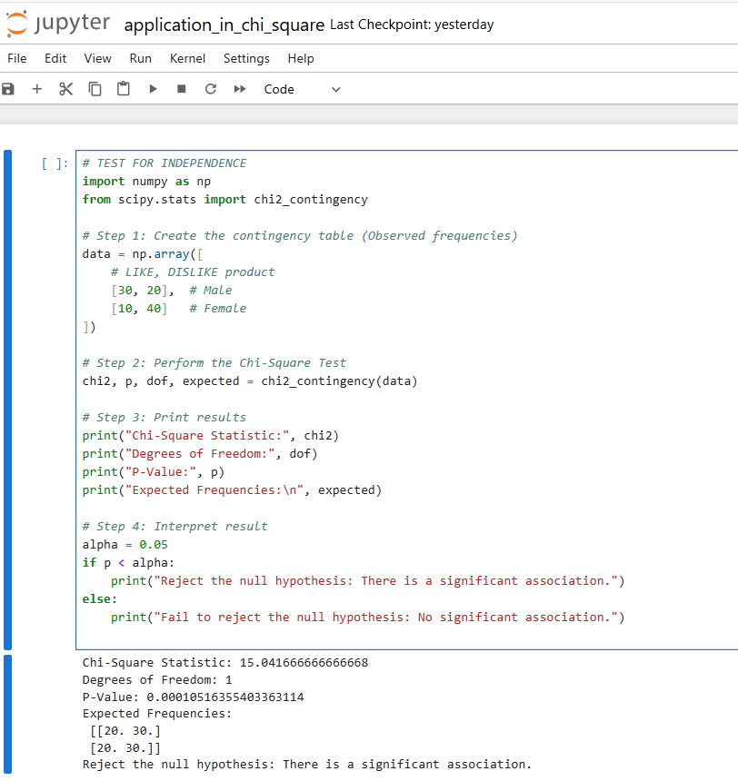

Slide 12
2) Goodness-of-Fit Test

Slide 13
Goal of Goodness-of-Fit Test
You want to check whether the distribution of a single categorical variable matches some expected distribution.
Solution:
Step 1: Hypotheses
Null Hypothesis (H₀): The die is fair (each face has equal probability: 1/6)
Alternative Hypothesis (H₁): The die is not fair (some faces are more/less likely)
Example (see jupyter n/b): You perform an experiment to check if the dice is fair. You roll the dice total of 60 times and record its observed face.
Step 2: Calculate Expected Frequencies
If the die is fair, then for 60 rolls, each face should appear:
E=1/6×60=10
So expected frequency for each face is 10.
Face | Observed
1 | 8
2 | 10
3 | 9
4 | 12
5 | 11
6 | 10
Total | 60
Face | Observed | Expected
1 | 8 | 10
2 | 10 | 10
3 | 9 | 10
4 | 12 | 10
5 | 11 | 10
6 | 10 | 10
Total | 60
Question:
At α = 0.05 , can we conclude that the die is fair, i.e., does each face have an equal probability?

Slide 14
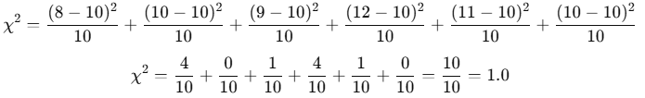
Step 3: Compute Chi-Square Statistic
Step 5: OPTION2: Using critical value
Using a Chi-Square table, at α = 0.05 , with d.f = 5, we find the critical value 11.07
Since 1 < 11.07, we fail to reject the null hypothesis.
The die appears fair.
Step 4: Degrees of Freedom
D.f. = Number of categories − 1 = 6−1 = 5
Step 5: OPTION1: Using P-value
Look Up p-value
Using a Chi-Square table or software we find using χ2 = 1 and d.f. = 5, the p-value ≈ 0.96.
Since p-value > 0.05, we fail to reject the null hypothesis.
The die appears fair.
See next slide for code….

Slide 15
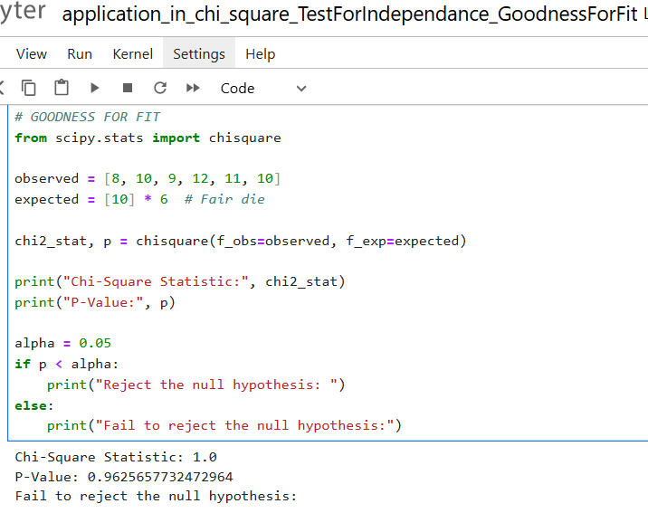

Slide 16
Dggfdfgf
gdfgfd

